Slide 1
Big projects
Git, Project Management, Software Development Processes

Slide 2
Software Estimation is Hard
But not impossible
Estimation is an iterative process
Think in terms of time ranges
Combine with confidence measure
Any guess is better than none

Slide 3
How can I tell if Software is Good?
People use it.

Slide 4
How can I tell if Code is Good?
It is cheap to develop.

Slide 5
Good Software will Evolve
There are always bugs.
There is always room for improvement.
There will always be requests for new features and functionality.

Slide 6
Waterfall Process
Analyze
Code
Test
Design
Deploy

Slide 7
Agile Programming Manifesto
Individuals and interactions over processes and tools
Working software over comprehensive documentation
Customer collaboration over contract negotiation
Responding to change over following a plan

Slide 8
Extreme Programming (XP)
An agile software development methodology intended to improve software quality and responsiveness to changing customer requirements.
Advocates frequent releases in short development cycles, intended to improve productivity and introduce checkpoints at which new customer requirements can be adopted.

Slide 9
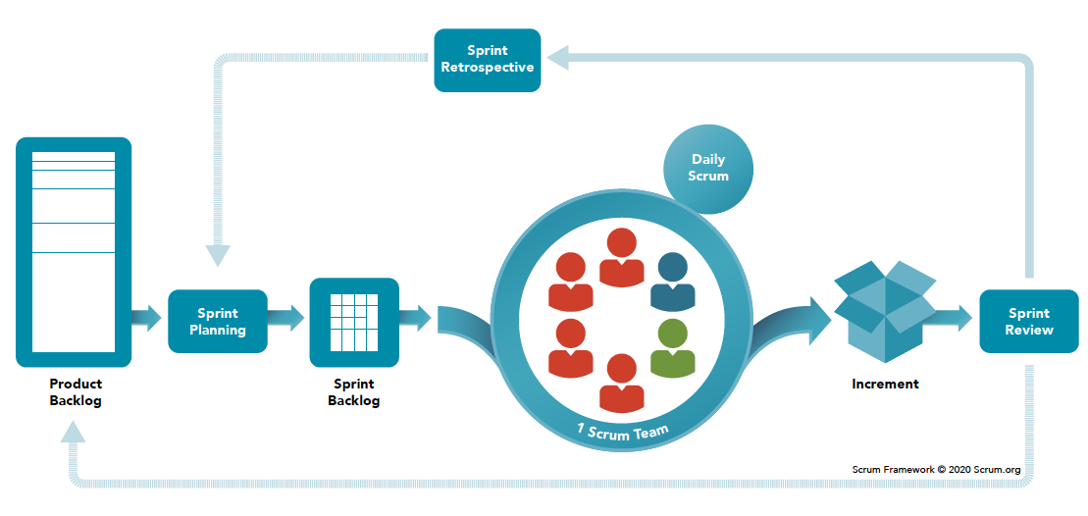
What About Scrum?

Slide 10
Scrum Teams
Consist of one Scrum Master, one Product Owner, and Developers. Within a Scrum Team, there are no sub-teams or hierarchies. It is a cohesive unit of professionals focused on one objective at a time, the Product Goal.
Cross-functional, meaning the members have all the skills necessary to create value each Sprint. They are also self-managing, meaning they internally decide who does what, when, and how.
Small enough to remain nimble and large enough to complete significant work within a Sprint, typically 10 or fewer people.

Slide 11
Scrum Challenges
Very process heavy
Over-emphasizes big items
Doesn’t consider ROI, or customer satisfaction
Many meetings
Loses track of big picture
Assumes skills are transferable within a team.
Scrum-masters and product owners have too much influence.

Slide 12
Misconception Sharing of Skills
Assumption is: “scrum engages groups of people who collectively have all the skills and expertise to do the work and share or acquire such skills as needed"
Most scrum-masters and product-owners are not developers.
Scrum teams include product designers and quality assurance engineers, and maybe documentation.
Makes estimation and sharing of work inconsistent.
Transfer of skills not always possible

Slide 13
Scrum is a Business
The scrum alliance is in the business of selling scrum-master certification

Slide 14
In a nutshell you should be prepared to
Embrace change
Iterate frequently

Slide 15
Continuous Integration (CI)
Code
Build
Test
Integrate

Slide 16
Continuous Deployment (CD)
Code
Integrate
Test
Release
Build

Slide 17
Git Primer
Git is a popular source code management software (aka version control software)
Git was first authored by Linus Torvalds in 2005 for development of Linux

Slide 18
A gross oversimplification of Git
You have a copy of a repository on a server
Individuals can have copies on their machine
You can pull the most recent version from the server to your client
If there is a difference the changes are merged (automatic or manual)
You can push changes from your client to the server
On the server changes may happen automatically or they may need to be reviewed

Slide 19
Git and Commits
Commits are snapshots of a project
This is how you save work to a project
They are associated with a unique hash code and commit message
Commits are created with the git commit –m “Message”
Commits consist of the contents of the staging area
If the staging area is empty, no commit can be created

Slide 20
Staging Area
The command “git add .” adds changed files to a staging area
This is required before making a commit
The staging are is the list of tracked files that will be added to the next commit
Clearing staging area (“git reset”) doe not lose your work

Slide 21
Branches
Different versions of the source code can exist simultaneously
These are called branches
Branches have their own history
Branches can be merged
A branch is a time-line of commits

Slide 22
Pull Request (An unfortunate name)
A notification of intent to merge two branches
It is done on the server
Provides an opportunity for a code review
May trigger automated validity checks (CI)
May trigger automated deployment steps (CD)

Slide 23
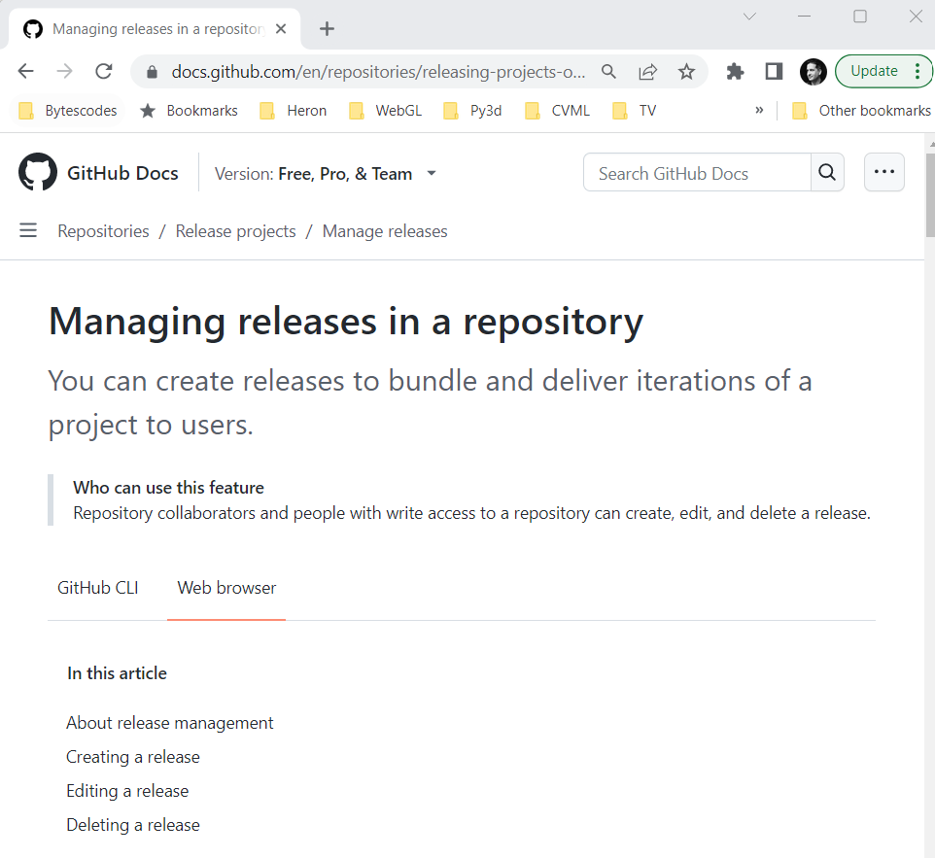
Making a Release

Slide 24
What is “Integration”
We integrate new features into a working project
Involves merging code and resolving conflict (when multiple team works on it)
Testing all features to make sure they don’t break (integration testing)

Slide 25

Not just for teams
Adding new functionality, or refactoring

Slide 26

Alternating Approach
Multi-tasking is hard but it is important to make progress on different things

Slide 27
Alternate Between
Small and big.
Front end and back end.
Hard and easy.
Testing and implementing.
Refactoring and writing new code.
Improving and adding.
Coding and documenting.
Researching and doing.
Known and unknown.
Safe and risky.

Slide 28
Two Parallel Streams
Looks like finished product
Faked implementations
Fill out bit by bit
Come up with a plan
Find common systems
Tackle hard problems

Slide 29
Expect to
Make changes
Uncover things as we go
Discover incorrect assumptions
Discover missing requirements
Find tasks that are harder than we thought
Find features that are easier to implement
Find repetition

Slide 30
Software Development is Iterative
You don’t know what you don’t know until you try to build and elaborate

Slide 31
Project Management Tips
Start from the time you have and work backwards
Give yourself padding for unpleasant surprises’
Aim to be done in advance
Identify the risks
Identify any dependencies

Slide 32

You Have Four Weeks
April 4 – General outline of code. Spikes completed.
April 11 (last day of classes) – All major features implemented.
April 18 – Everything works, maybe a few bugs.
April 25 – Finished Reports

Slide 33

Time Management
There is a clock ticking.
Software is notoriously hard to estimate.
Even professionals are terrible at it.
Can’t avoid it, because it is business!

Slide 34
“Best is Enemy of Good” - Voltaire
« Dans ses écrits, un sage Italien Dit que le mieux est l'ennemi du bien. »
“In their writing a wise Italian said that best is the enemy of good.”

Slide 35
Risk Management
What are the biggest unknowns?
These are the things that are hardest to estimate in terms of time.

Slide 36
MIT/Stanford Approach
Simplicity - The design must be simple, both in implementation and interface. It is more important for the interface to be simple than the implementation.
Correctness - The design must be correct in all observable aspects. Incorrectness is simply not allowed.
Consistency - The design must be consistent. A design is allowed to be slightly less simple and less complete to avoid inconsistency. Consistency is as important as correctness.
Completeness - The design must cover as many important situations as is practical. All reasonably expected cases must be covered. Simplicity is not allowed to overly reduce completeness.

Slide 37
Worse is Better Approach
Simplicity - The design must be simple, both in implementation and interface. It is more important for the implementation to be simple than the interface. Simplicity is the most important consideration in a design.
Correctness - The design should be correct in all observable aspects. It is slightly better to be simple than correct.
Consistency - The design must not be overly inconsistent. Consistency can be sacrificed for simplicity in some cases, but it is better to drop those parts of the design that deal with less common circumstances than to introduce either complexity or inconsistency in the implementation.
Completeness - The design must cover as many important situations as is practical. All reasonably expected cases should be covered. Completeness can be sacrificed in favor of any other quality. In fact, completeness must be sacrificed whenever implementation simplicity is jeopardized. Consistency can be sacrificed to achieve completeness if simplicity is retained; especially worthless is consistency of interface.

Slide 38
For the class project
Implementation matter more than interface
Simplicity in implementation first, interface second
Consistency is a key component of simplicity
Completeness does not matter
Correctness matters in implementation

Slide 39

Trade-Offs
Time is fixed
Functionality is variable
Quality is desired

Slide 40
What is Functionality?
How many features there are
The range of possible interactions
The capabilities of each one

Slide 41
What is Quality
Easy to use
Discoverable
Accessible
Internationalized
Robust
Reliable
Consistent
Appealing
Fun
Performant

Slide 42
Typical Scale of Issues/Bugs
Trivial
Minor
Major
Critical
Showstopper

Slide 43
Spikes
“I would often ask Kent [Beck], ‘What is the simplest thing we can program that will convince us we are on the right track?’ Such stepping outside the difficulties at hand often led us to simpler and more compelling solutions. Kent dubbed this a Spike. I found the practice particularly useful while maintaining large frameworks.”
https://wiki.c2.com/?SpikeSolution - Ward Cunningham

Slide 44
Technical Spikes / Investigations
This is part of risk management and time management
Implementing all features in context of full program can make it harder
Consider working on a separate project
Maybe it is just a series of unit tests
Sometimes we put in back-doors to an application
Involves some reading and writing
Start with a hypothesis
Find out what you can about the problem and solutions

Slide 45
Application Back-door
Like game cheat codes.
Allow game developers to test features, without having to play whole level
Usually disabled in production, but maybe leave it in as an easter-egg.

Slide 46
Ask yourself
What is the simplest thing that could possibly work.

Slide 47
Ask others
Do you have any suggestions or ideas?

Slide 48
Menus, Accelerator and Shortcut Keys
https://learn.microsoft.com/en-us/dotnet/desktop/winforms/controls/how-to-provide-standard-menu-items-to-a-form

