Slide 1
Creating Software
Building non-trivial Windows Applications

Slide 2
Today
How to describe features
How to group and arrange functionality
Finding and downloading packages (libraries)
Taking a look at a Windows application

Slide 3
How do we make non-trivial software?
1. Understand the requirements
2. Plan what we are going to do
3. Implement the code
4. Validate the functionality

Slide 4
Three Questions
What is the functionality we want to implement?
How are we going to arrange that functionality?
What pre-existing technology can we leverage?

Slide 5
Describing Requirement
This is hard!
Not an exact science
A complete specification would be source code!
Some ambiguity is unavoidable
Different ways to do it

Slide 6
Example
MSPaint program:
What happens when I click and move

Slide 7
Grouping Functionality
We can arrange functionality in:
Namespaces
Classes
Projects
Executables
Packages
Libraries

Slide 8
Referencing Code
There are several ways to reference code:
Create a project reference
Install and reference a Nuget package
Reference a managed assembly (DLL or EXE)

Slide 9
The only rule is …
Don’t copy code!

Slide 10
Complexity Management
Writing software is all about complexity management

Slide 11
Using Libraries
When we talk about how to arrange software we talk use many different words.
Libraries
Packages
Modules
Components
Units

Slide 12
Some definitions
Class library – a managed assembly (usually in .DLL form) that contains a set of exported types that can be used in other class
Package – a set of class libraries, tools (executables), visual studio extensions, in an easy to install form called a “.nuget” package
Dependency – a project, DLL, or package

Slide 13
Choose Libraries

Slide 14
They all mean the same thing
Some arbitrary grouping of reusable code
In C# implies a set of types (classes, structs, interfaces, delegates and enums)
For simplicity we call them all “classes”
Remember, in C#, all code exists in classes
Classes have: static data, static method, instance data, instance method

Slide 15
There is a lot we don’t think about
We take a lot for granted when we use software
Luckily there are libraries to help us out
A library (or package) is a set of types

Slide 16
Why Object-Oriented Programming is Helpful
It used to be that we had types and functions separate and it was hard to find what functions went with what types

Slide 17
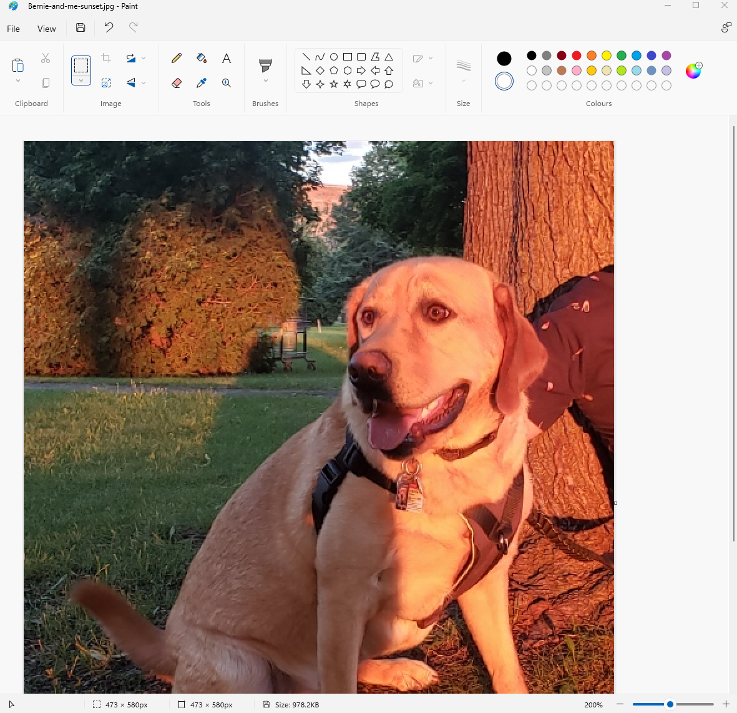
Consider MS Paint

Slide 18
Basics
Read and write image data from file
Display image data in a window
Allow some editing

Slide 19
What can it do?
Draw lines, shapes (outlined or filled), images on a canvas
Open and save files, import images
Select a region and cut/copy/paste
Update the canvas
Flip, rotate, resize, crop regions
Zoom in / out
Undo / redo
Move/Resize/Minimize/Maximize/Close window

Slide 20
What are the UI components?
Window
Title
Menu
Toolbar
Status bar
Border
Shadow
Minimize/Maximize/Close

Slide 21
Drawing Tools
Write text
Draw brush
Make shape (filled or not)
Select and edit region

Slide 22
Standardized Stuff
Color picker
Font chooser
Open file dialog
Save file dialog
Page set-up
Print

Slide 23
Major Areas
Files - open, save, check if modified, recent files
Keyboard and mouse
Window and UI – title, menu, toolbar, context, and shortcuts
Image Edits Selection - skew, crop, flip, rotate, resize
Clipboard - cut, copy, paste, import
Drawing Tools – shapes, lines, fill, erase,
Properties of Drawing Tools – color, fill, brush

Slide 24
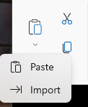
Clipboard
Cut
Copy
Paste
Import

Slide 25
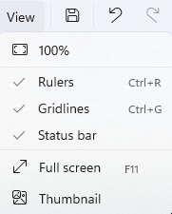
View Options

Slide 26
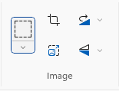
Image and Selection Tools
Select
Crop
Resize
Rotate
Flip

Slide 27
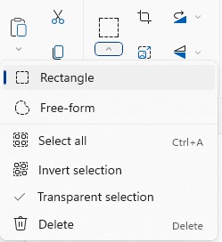
Selection is Complicated
Two types
Selection can be inverted
Transparent

Slide 28
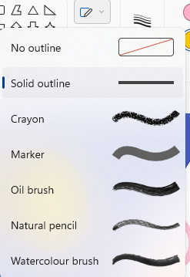
Brush Types
Shape Fill Brush
Outline Fill Brush

Slide 29
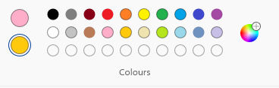
Colours – Pen / Brush (Foreground) and Eraser (Background)

Slide 30
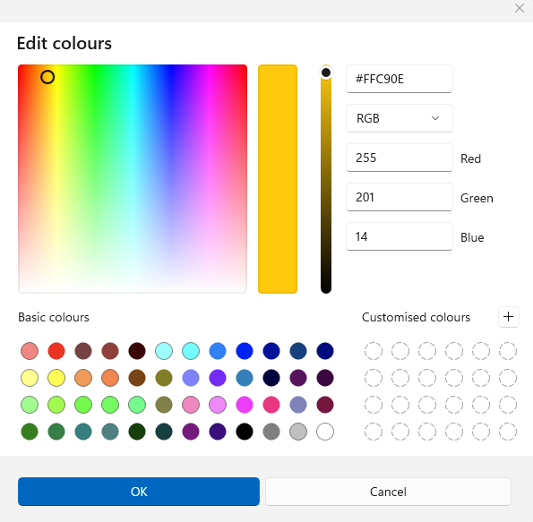
Just the Colour Chooser is a lot of work!

Slide 31
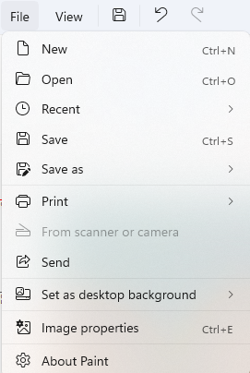
FilE Menu

Slide 32
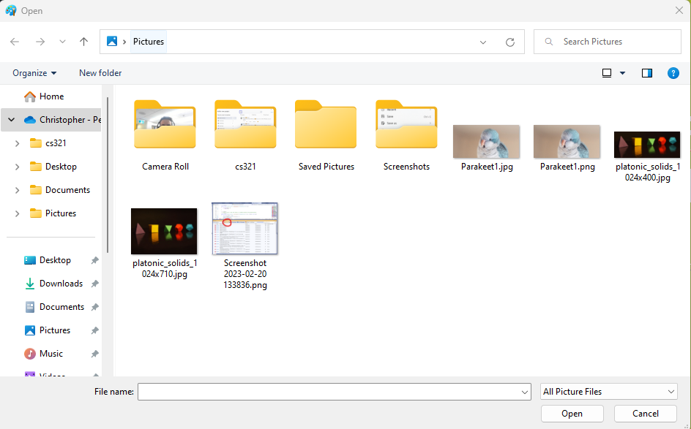
Open File Dialog

Slide 33
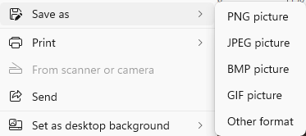
Save As Options

Slide 34
Status Bar

Slide 35
Title Bar

Slide 36
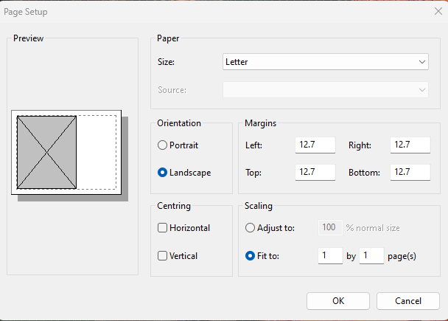
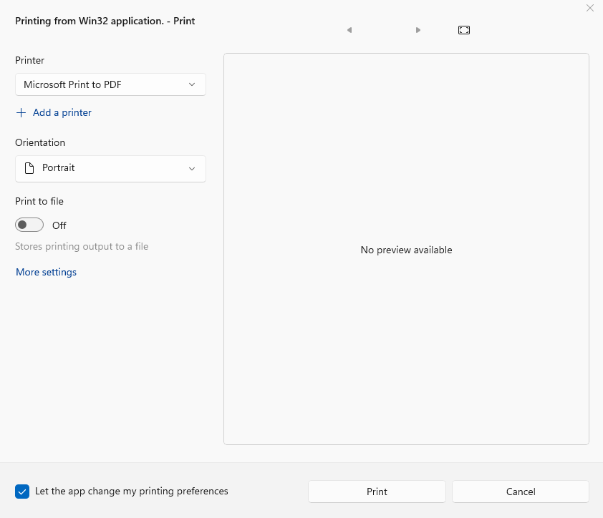
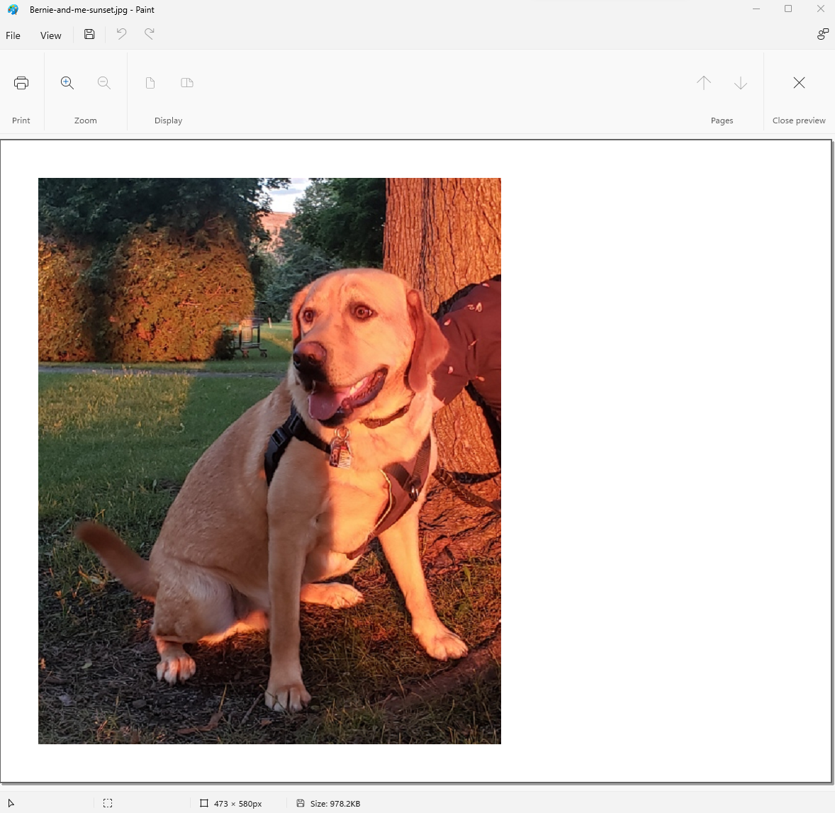
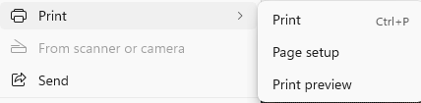
Print Dialog

Slide 37
Describing a Feature
How is it enabled?
Is it modal?
Does it change how keyboard or mouse input is handled?
Are there multiple stages?
Can it be cancelled?
Can it be undone?
What is the impact on the data?

Slide 38
What do we not know how to do?
Read and write image files
Create window application with a GUI
Respond to mouse movement and mouse clicks

Slide 39
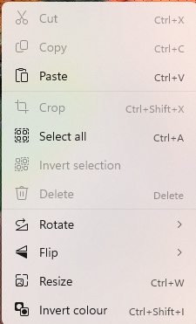
Context Menu

Slide 40
Object Oriented Design
What are the nouns?
These are our classes
What are the verbs?
These are our methods

Slide 41
Libraries
UI
Window management
Standard dialogs
Menu
Shortcut keys
Mouse events
Keyboard events
Bitmap
Reading
Displaying

Slide 42
What’s Left for you
Application data management
Event handling
Designing commands

Slide 43
What’s a “Command”
A user can trigger an action such as “select all” in multiple ways
Main menu
Toolbar
Context menu
Shortcut key

Slide 44
Basic Parts of a Windows UI Application
Menu
Toolbar
Context menu
Status bar
Window

Slide 45
Windows Applications

Slide 46
Examples of Libraries
Manipulating, reading, and writing image data – e.g., ImageSharp
Managing Windows – e.g., WinForms
Parsing the command-line - e.g., CommandLine
Saving arbitrary data to Json – e.g., NewtonSoft

Slide 47
A Basic Winforms Application
Adding some features

Slide 48
How to download and Install Nuget

Slide 49
About Windows UI Applications
The Windows operating system provides a built-in API for creating and managing libraries
What is an API, do you know?
These APIS are written in a cross

Slide 50
How to Create a Simple Winform Application

Slide 51
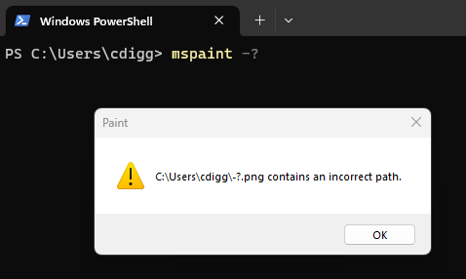
Even GUI Applications take command-line arguments

Slide 52
GUI Applications
Basically a big “while loop”
Waits for Windows message (data packet)
When it arrives does something (or ignores it)

Slide 53
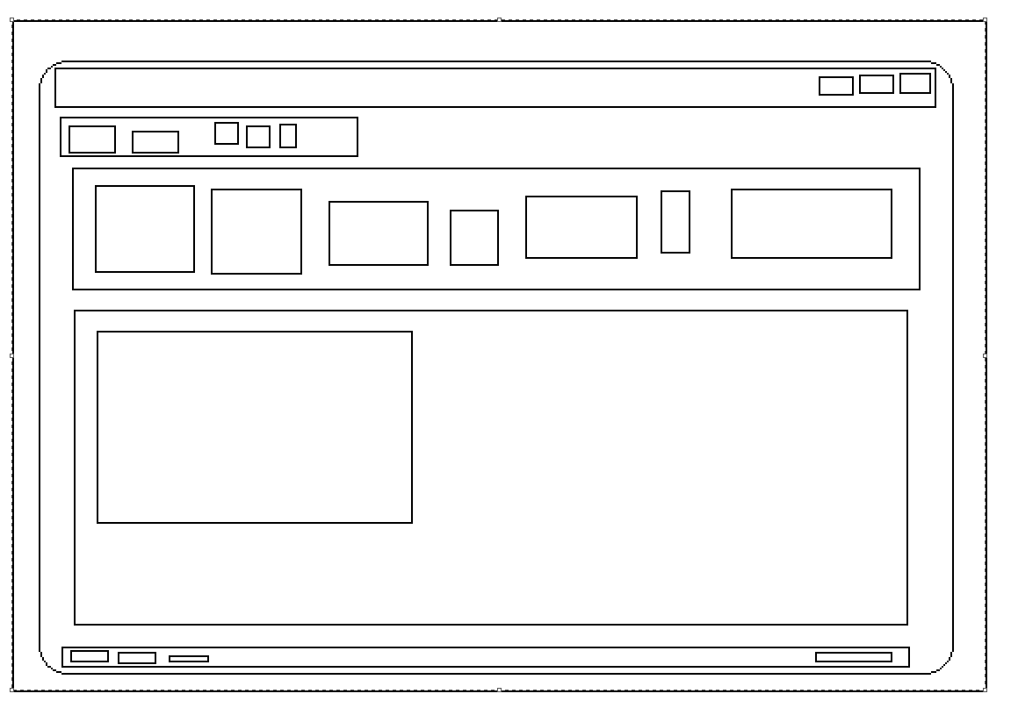
The UI – Lots of Rectangles (Controls)

Slide 54
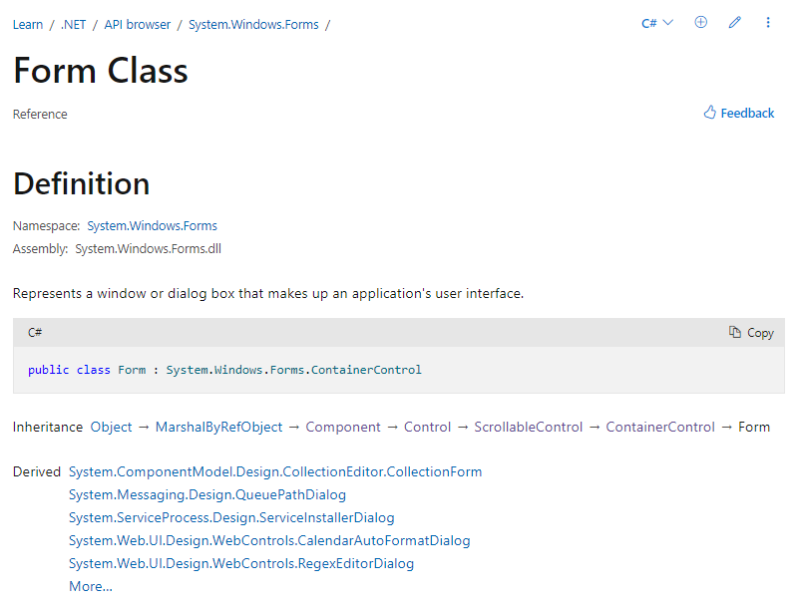
Windows Controls
GUI Applications are good examples of using Object-Oriented Programming

Slide 55
C# Made Windows Applications Easier

