Slide 1
Today’s Goal
Deepen our understanding of C# by diving into strings and characters

Slide 2
Goal Breakdown
Become more familiar with C# syntax and semantics
Understand the concepts introduced using real examples
String manipulation is a microcosm of computing in general
How using Unit tests can help your understanding

Slide 3
Advice
Consider each line of code
What is it doing?
Why is each symbol or element there?
What parts are confusing?
Why does the program do what it is doing?

Slide 4
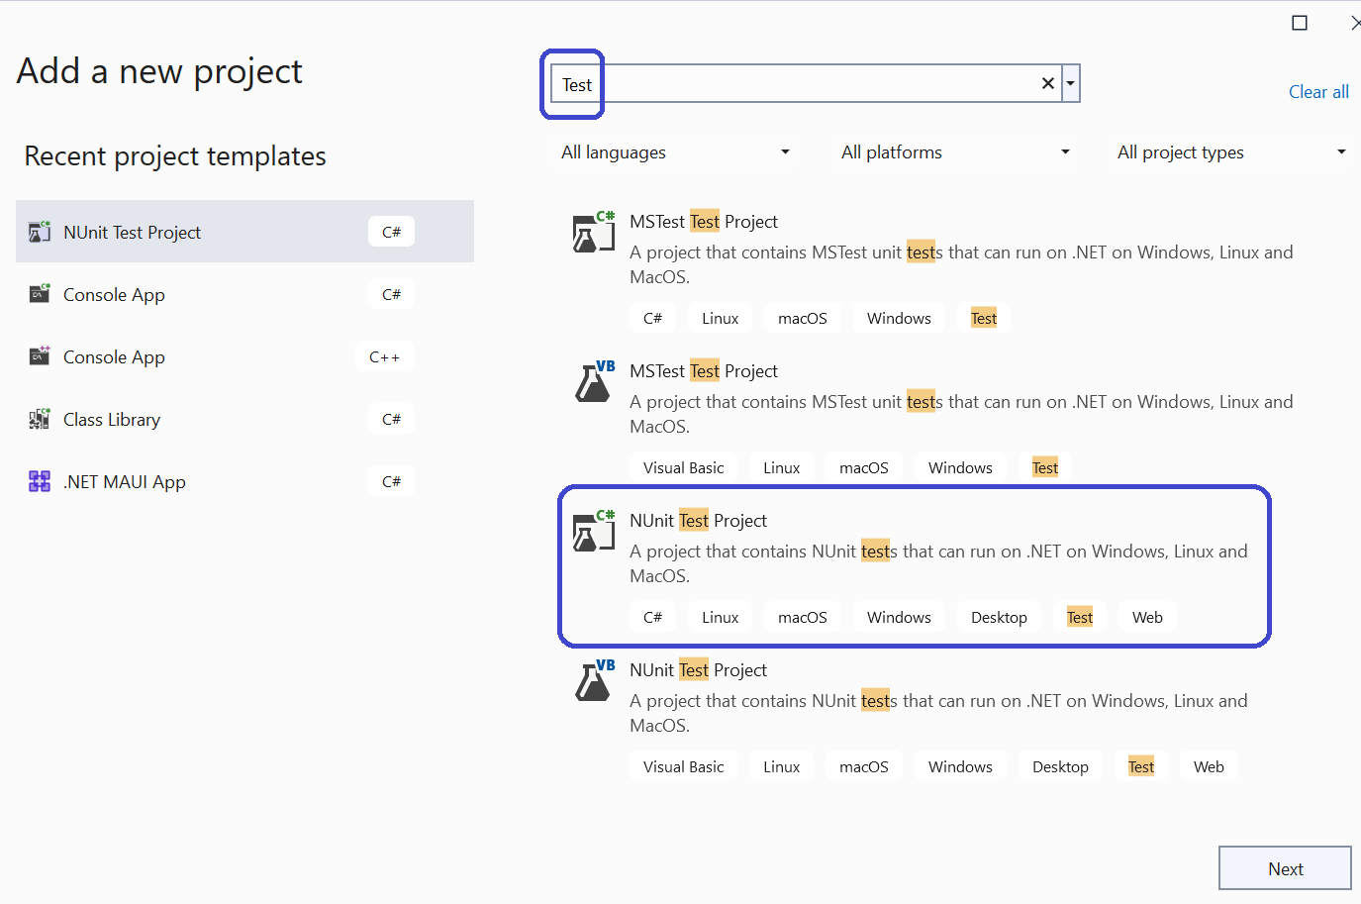
Test Projects: A special kind of library

Slide 5
Test Projects
They provide by default a link to tool support for running tests in the browser
We will be creating test projects in the lab

Slide 6
What is a String?
A representation of text values as sequences of characters

Slide 7
Consider the Following
Are strings value types (“structs”) and allocated on the stack?
Or are they reference types (“classes”) and allocated on the heap?
What about chars?
Why?

Slide 8
Strings
https://learn.microsoft.com/en-us/dotnet/csharp/programming-guide/strings/
A string is an object of type System.String whose value represents text.
Internally, the text is stored as a sequential read-only collection of char objects
The keyword “string” is an alias for the type “System.String”

Slide 9
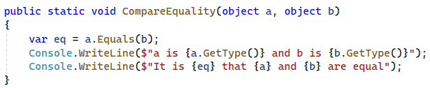
A Helper Function for Today

Slide 10
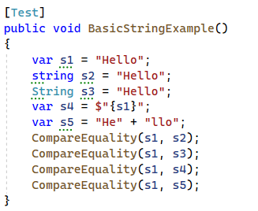
String VARiable DECLARATION

Slide 11
The Take-away
No observable difference between “string” and “System.String”
Local variable declarations can (and should) use var
Use the “string” alias in your code
See the Microsoft coding guidelines

Slide 12
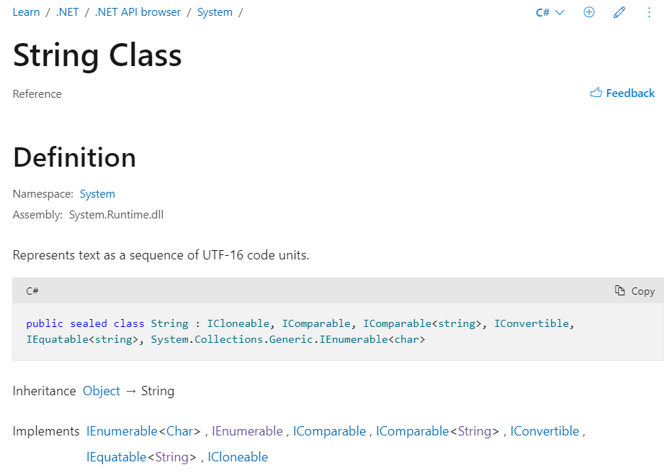
System.String Documentation

Slide 13
Reading the documentation
It said that it was a “class” (so it is a reference type)
It said that it derives from “System.Object”
This means that it shares the methods (functions) of System.Object
We already know that everything derives from System.Object
What is a UTF-16 Code Unit?
What does it mean that it “implements interfaces”?

Slide 14

Why is string a class?

Slide 15
So What’s a Char
A Char is primitive value type that has two bytes, and represents a Unicode UTF-16 character
https://learn.microsoft.com/en-us/dotnet/csharp/language-reference/builtin-types/char
It is classified as an integral type by the specification:
https://learn.microsoft.com/en-us/dotnet/csharp/language-reference/language-specification/types#836-integral-types

Slide 16
Chars are Numbers
Characters are numbers
Each one corresponds to a

Slide 17
A Char is a Code Point not a Characters
A

Slide 18
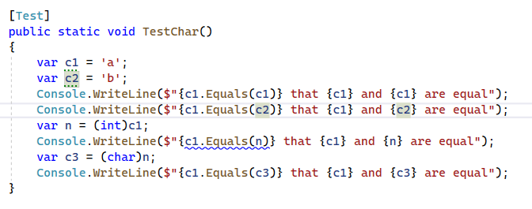

Slide 19
Comparing Characters

Slide 20
Converting to Strings

Slide 21
W

Slide 22
Glyph
A graphic symbol that represents a character
An element of a typeface (aka font fontamily)
Letters (e.g., ‘e’) and diacritics (e.g., accents) are separate glyphys

Slide 23
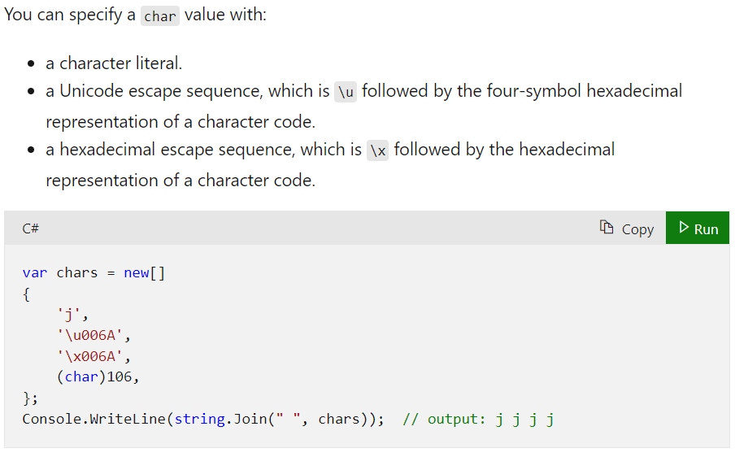
Char Literals

Slide 24
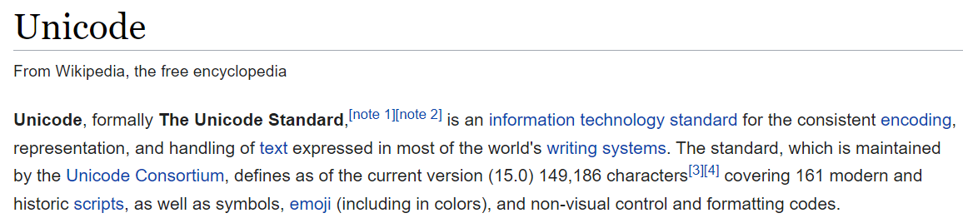
What’s Unicode?

Slide 25
What’s Utf-16
One of multiple Unicode encodings (e.g., Utf-8, Utf-16, Utf-32, GB18030)
It is variable length: Characters use either one or two 16-bit code units
Not as widely used on the web as Utf-8

Slide 26
What’s an Encoding
An assignment of numbers to characters

Slide 27
Did you see that!
Two “Chars” in a row are sometimes needed to properly display characters
This is why we disambiguate code units and code points
Code points are made up of code units
In C# a char instance is a code unit in the Utf-16 encoding

Slide 28
ASCII
ASCII is a character encoding first published as a standard in 1963
Only 128 Characters
95 are printable
33 are control codes
One byte per code point

Slide 29
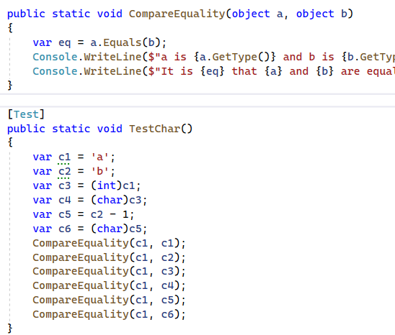
Comparing Character Equality

Slide 30
Let’s Convert it to Bytes
Use “BitConverter.ToBytes”
https://learn.microsoft.com/en-us/dotnet/api/system.bitconverter.getbytes?view=net-7.0

Slide 31
Escape Sequences
How do you write the character used to delimit char literals?
Or the character that represents a newline or tab?
Or an unprintable control code like the bell
Answer: use an escape sequence (backslash followed by code).

Slide 32
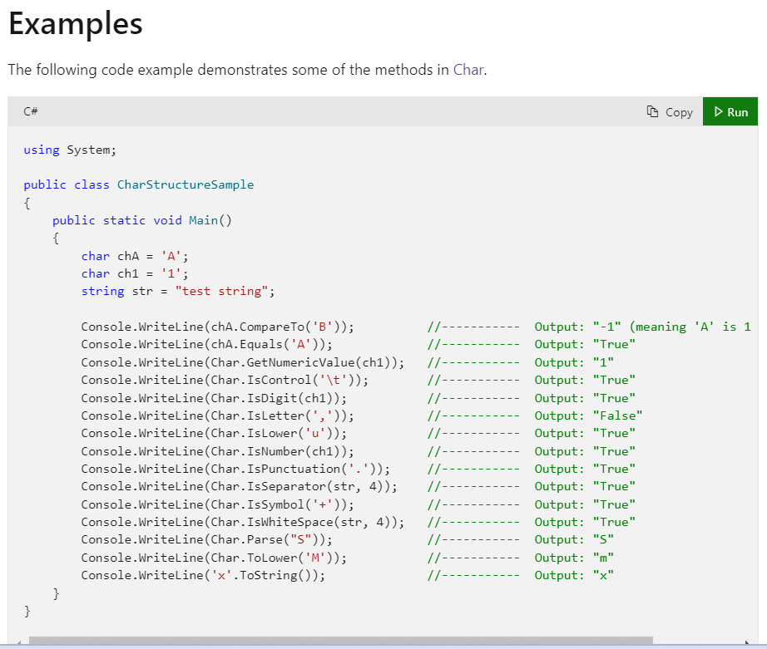
Some Char Methods

Slide 33
Invoking Instance versus Static Methods
Some methods have the form “expression.FunctionName(<args>)”
While others have the form “typename.FunctionName(<args>)”

Slide 34

Char is not an expression
The word “Char” is the name of a type
More specifically a class within the namespace
You cannot use it where you would an expression:

Slide 35
But you can use it to call static methods

Slide 36
Back to Strings

Slide 37
When working with text
We usually

Slide 38
String Literals

Slide 39
string vs. System.String
In C#, the string keyword is an alias for System.String
It's recommended to use the string alias
The string alias works even without including the System namespace

Slide 40
Null Characters
A C# string can contain any number of embedded null characters ('\0').

Slide 41
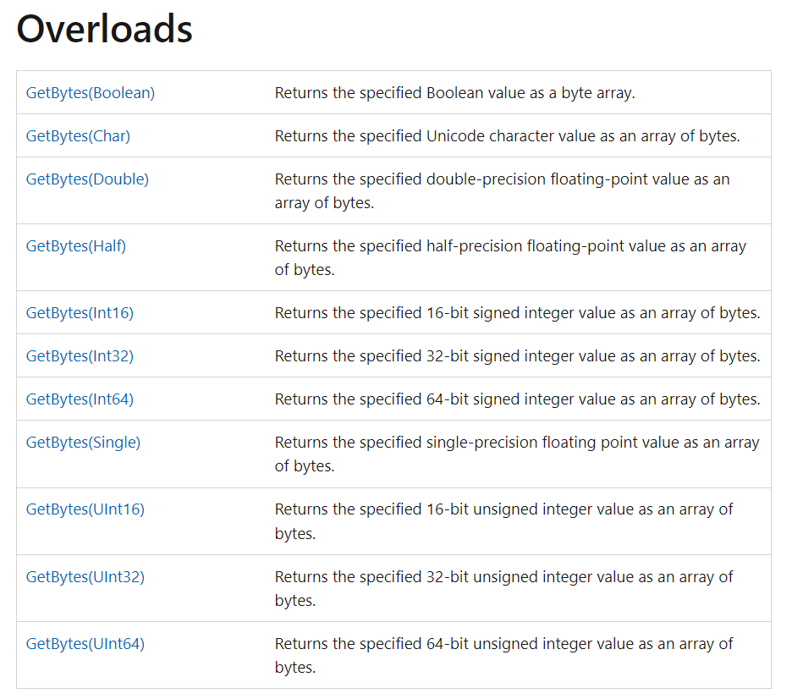
Bit Converter does not work on Strings?!

Slide 42
Remember Encodings?
We have to use one of those

Slide 43
Converting a String to Bytes

Slide 44
Converting Bytes to Strings

Slide 45
String Immutability
String objects are immutable: they can't be changed after they've been created
Methods and C# operators that either query a string or create a new string object

Slide 46
String Interning

