Slide 1
Classes And LIBRARIES

Slide 2
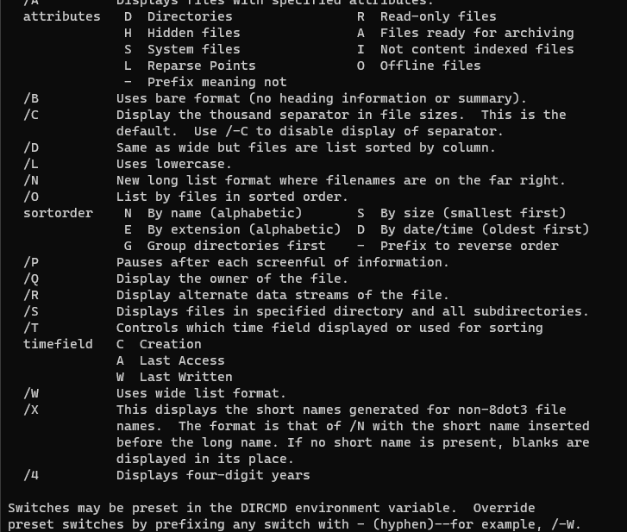
Let’s Review Dir

Slide 3
Hypothetical Functions
GetFilesInDir()
GetSubDirsInDir()
GetFileLastModifiedDate()
GetFileCreateDate()
GetFileOwner()
GetFileSize()
GetFileAttributes()
GetCommandLineArguments()
GetCurrentWorkingDirectory()
IsFile()
IsDirectory()

Slide 4
Pseudo-code
Parse command line arguments
If none use the current working directory
Check if it is a directory
If not exit and tell user
Get all files from the directory
Get all directories from the directory
For each file and directory:
output date modified, size, and name if file
output date modified, and name if a directory

Slide 5
What to put in a Shared Project
Things that could be easily reused
Not specific to a particular program
Notice that console programs have much similarity
Command line parsing
Standard input reading
File reading

Slide 6
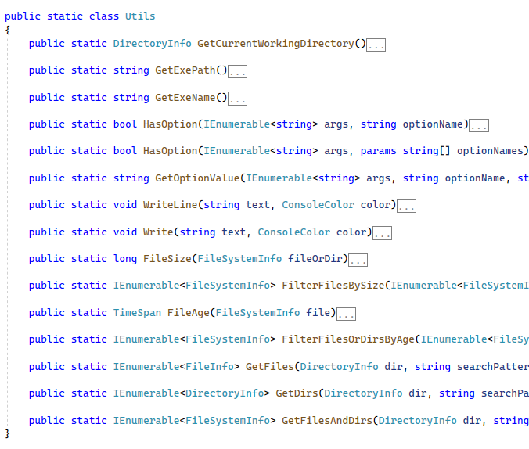
Shared Code

Slide 7
How to decide what is shared
Imagine writing another similar application, would the function or class be useful?
Would I be able to reuse it as-is, or would I have to change it if I reused it?
Is there some hidden dependency on code in the main program?

Slide 8
Good Practice
Makes you think about the division of logic in your program
This is what an AI will take a long time to get good at
Helps you identify and reduce code coupling
Overall reduces hidden complexity and decrease duplication

Slide 9
Code Coupling
“One of the earliest indicators of design quality was coupling. There are several ways to describe coupling, but it boils down to this: If changing one module in a program requires changing another module, then coupling exists.”
https://www.martinfowler.com/ieeeSoftware/coupling.pdf

Slide 10
What can we test?
Does our find application work with a file?
Does our find application work with standard input?
Does our find algorithm find?
Does our sort application sort?
Does our sort application work with a file?
Does our sort application work with standard input?
Does our sort algorithm sort?
Do our applications output help?

Slide 11
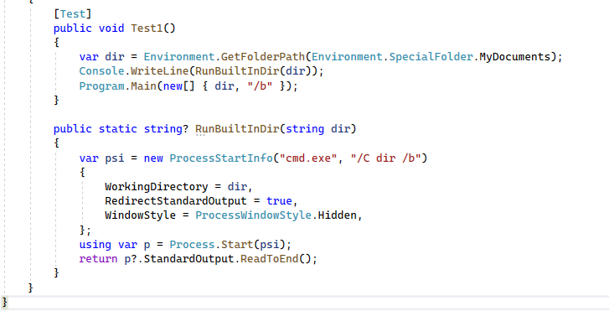

Slide 12
Representing Files and Directories
We could use strings (for paths)
However, how do we remember if looking at a file or directory
One option is to use FileInfo and DirectoryInfo
Both derive from FileSystemInfo
A lot of the functionality we need is on these classes

Slide 13
Class Hierarchy
FileSystemInfo
FileInfo
DirectoryInfo

Slide 14
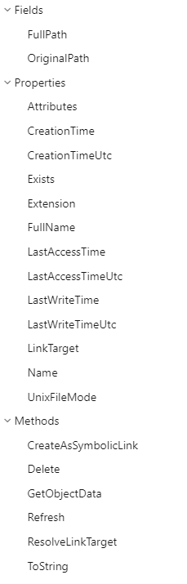
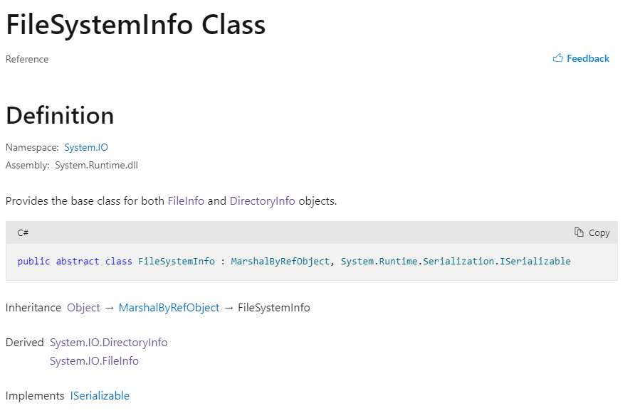
File System Info

Slide 15
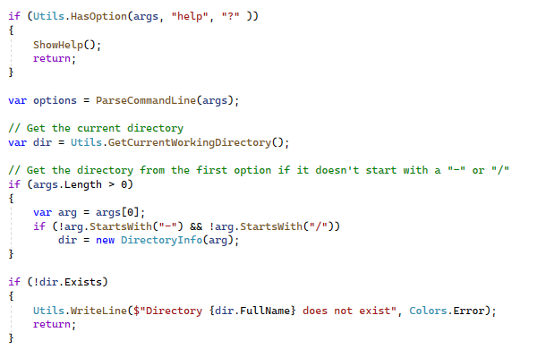
Parse Command Lines Arguments

Slide 16

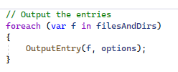
Classes are Useful for Grouping Data
Consider the set of all options
Rather than creating a variable for each option we can group it in one class
We can then return it from a function and pass it as an argument

Slide 17
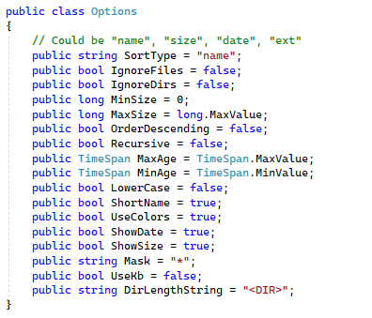
Creating an options class

Slide 18
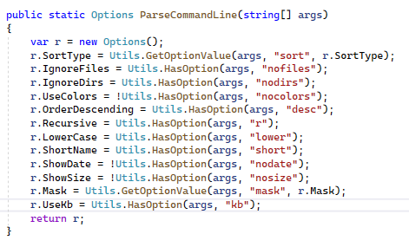
Creating an Instance of the Options Class

