Slide 1
Coding STYLE

Slide 2
Read the Microsoft C# Coding
Your homework is to read: https://learn.microsoft.com/en-us/dotnet/csharp/fundamentals/coding-style/coding-conventions
I expect you to now to adhere to what is outlined in today’s class notes in the next assignment, and will be grading you for it

Slide 3
Be consistent with spacing

Slide 4
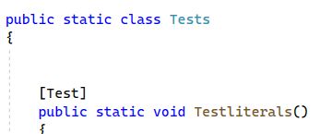
Don’t use Superfluous Blank Lines

Slide 5


Don’t use explicit variable types if not needed

Slide 6
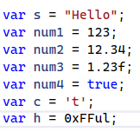
Do use “var” declarations

Slide 7
Don’t use Formatted Console WriteLine Instead use String Interpolation

Slide 8
Use nameof operator for identifier names

Slide 9
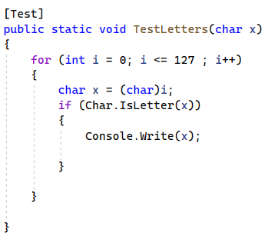
Test: what could be improved?

Slide 10
Be consistent in formatting

Slide 11

Use string Interpolation instead of Concatenation

Slide 12
Don’t compare Boolean values to true (and put space after the if)

Slide 13

Is this executed 127 or 128 times? (don’t forget to use “var”)

Slide 14
Loop using “<“ rather than “<=“ (it becomes more explicit, less error prone)

Slide 15

Empty SetUp() not needed (harmless)

Slide 16
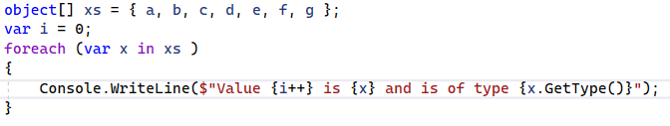
Using a loop is excellent

Slide 17
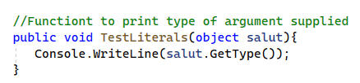
Function name could be replace comment (also put a space after ‘//’)

Slide 18
Use keyword char not Char

Slide 19
Comment doesn’t add anything here

Slide 20

Adding ‘\0’ not necessary (only because we know it is zero by definition)

Slide 21

Using var is better (because you don’t lose the type info)

Slide 22
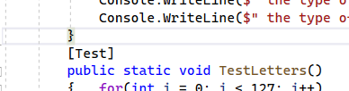
Put one empty line between functions

Slide 23

Put a space after for (and a newline after {)

Slide 24

Indent line after “if” statement (and be careful of superfluous cast or comparison)

Slide 25
Foreach almost always uses a var (unless the enumerable is not typed)

Slide 26
Consistent Spacing (and use var)

Slide 27
Nice: Clear and Concise (prefer the space after { and before })

Slide 28
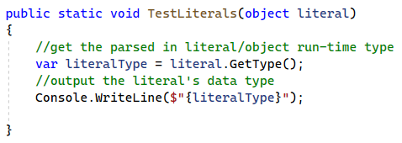
I like the function (but the comments take away from it)

Slide 29
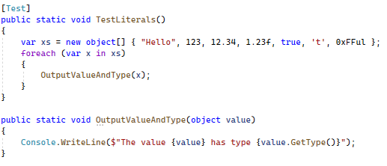
What I am looking for: Part 1

Slide 30
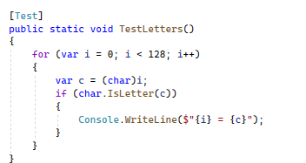
What I am looking for: Part 2

Slide 31
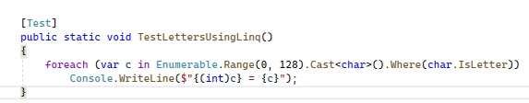
Preview of Using LINQ
There is no logic, so less room for mistakes
Transforming a collection into another collection using cast
Filtering the collection using a predicate
Enumerate the items and output them

