Slide 1
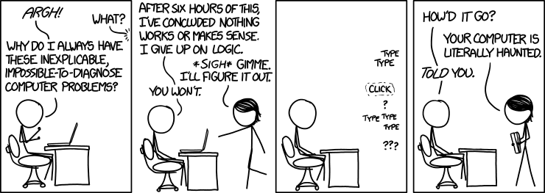
Debugging
https://xkcd.com/1316/
By Randall Munroe

Slide 2
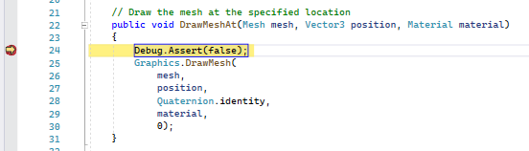
Debugging
Bugs are errors, or unexpected behaviors within code. Debugging is the process of trying to figure out how a computer program working and why it is doing what it is doing.
Some basic tools for debugging are:
Trace Statements
Assertion
Breakpoints
Watches

Slide 3
Debugger
A debugger is a computer program that can attach itself to a running process, pause it, step through it line by line, and allow you to view the values associated with variables.
Debuggers often provide a console window which displays the result from trace statements.
When running a computer program from within the development environment usually the debugger is already attached.

Slide 4
Debug and Release Mode
Computer programs are often compiled in one of two modes: debug and release.
In debug mode a symbol file (.pdb) is generated which contains information that allow the binary executable to be linked to source files.
Release mode builds are usually optimized, certain instructions (like assertions and trace statements) are removed from the executable, and a PDB is not generated.
Another name for a “debug” build is a “development” build.

Slide 5
Tracing
A function call, which outputs information to a console window, is called a trace statement.
One example is the Debug.WriteLine() function which is part of the System library.
Debug.WriteLine() outputs text to the Visual Studio output window.
When using Unity you can use Debug.Log() which outputs to the Unity console.

Slide 6
Assertions
An assertion statement is a function call to which takes a conditional expression that is expected to be true.
If the condition evaluates to false, and a debugger is attached the program will be paused.
All assert calls will be conditionally included only in a development/debug builds
Assert statements are great ways to document and test your assumptions about code.

Slide 7
Breakpoints
A breakpoint is a marker assigned to an instruction within a computer program that triggers the debugger to pause.
In C# you can also use the Debugger.Break() to programmatically pause any attached debugger.
If no debugger is attached, you can also use the Debugger.Launch() function to launch and attach a debugger.
Once you hit a breakpoint, you can step through code one line at a time.

Slide 8
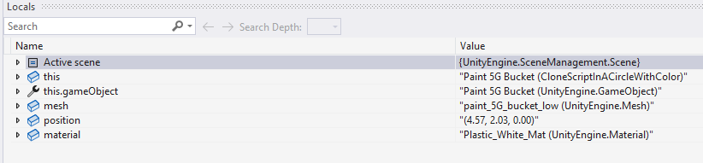
Watches
A watch is a window that shows the value associated with a variable or expression.
We can view all local variables, or specific expressions.
For more information on using watches see this article.

Slide 9
Debugging Advice
Computers and compilers almost never make mistakes.
Virtually of the time, problems arise from an incomplete understanding of what we have asked the computer to do.
When you are stuck, the problem often boils down to unidentified and incorrect assumptions.
You have assumed something about how either the compiler or program works, and you are not aware of what assumptions you have made.
Write out your assumptions as assertion statements or comments

