Slide 1
First Program
In C#

Slide 2
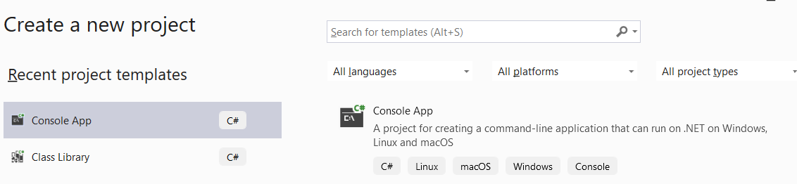
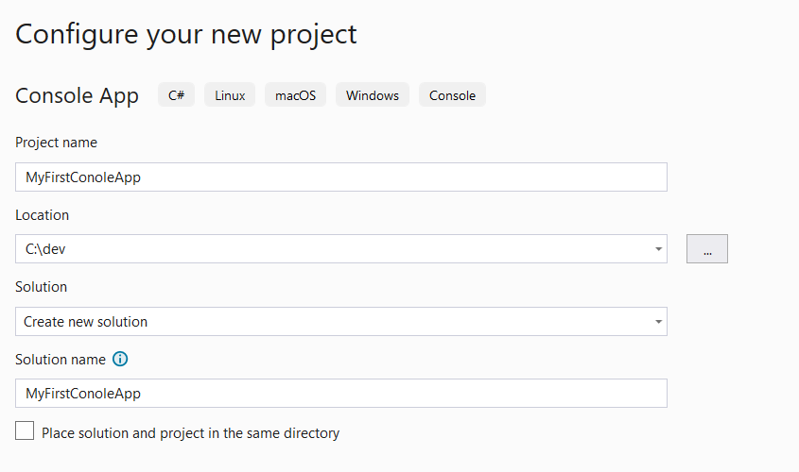
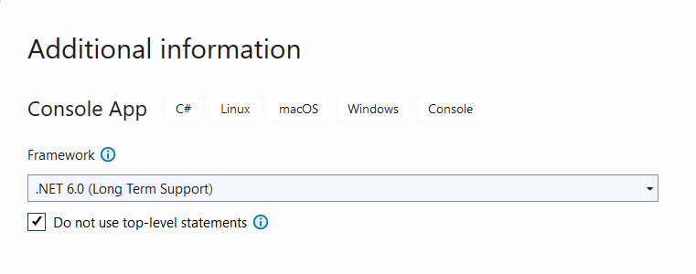
Let’s Make a Console Application
2
1
3

Slide 3
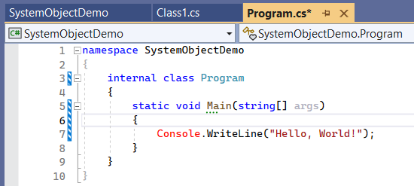
Here’s what it generates

Slide 4
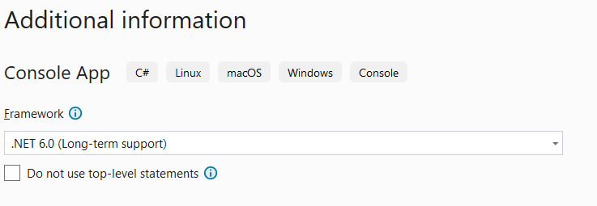
Try Again With Top Level Statements

Slide 5
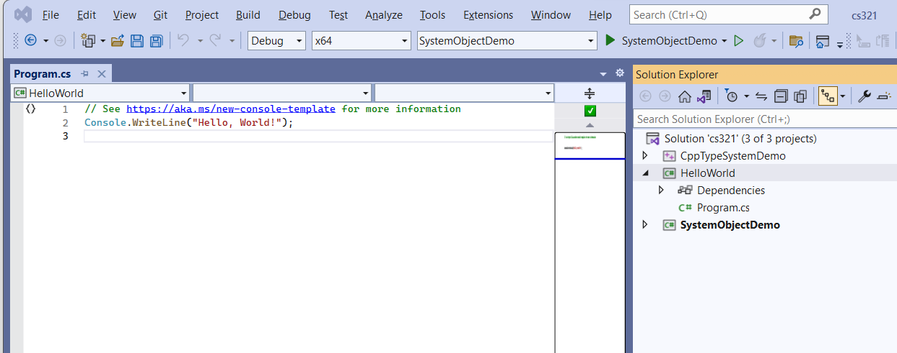
A Shorter Form (don’t use it)

Slide 6
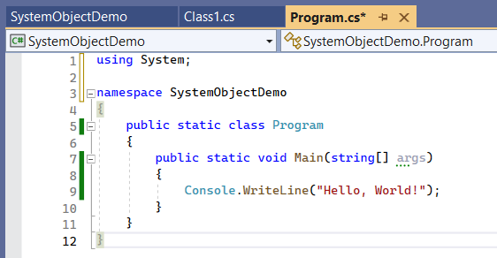
However, this is what I want

Slide 7
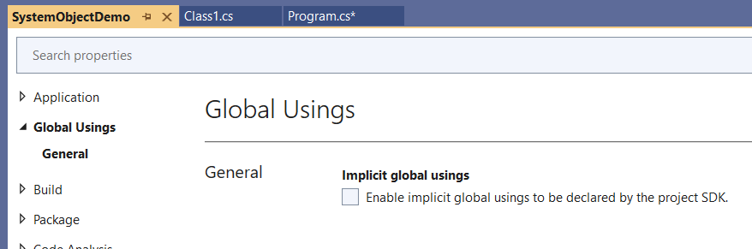
Turned off “Implicit Global Usings”

Slide 8
Style Guide
Do not use top-level statements
Use explicit using statements
Classes with only static members are static
All types public
All members public

