Slide 1
C# Scripts
Within Unity

Slide 2
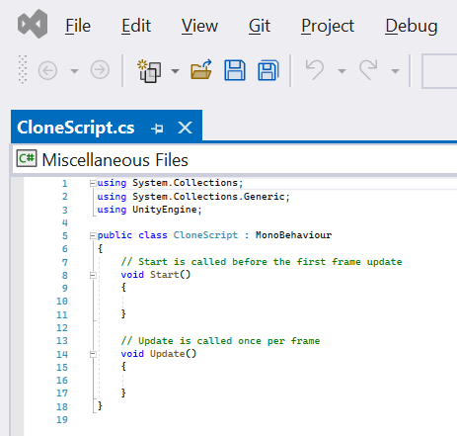
Script Source Code
This is the “source code” of a script.
A script is a small program, or part of a program, that is executed by a host program.
Scripts are often interpreted, but not always (e.g., Unity compiles them).
Coding, programming, and scripting are all the same.

Slide 3
Using Declarations
The “using” declaration says what library parts are used in the current file.
Extra functionality is provided by libraries.
Libraries are organized using “namespaces”.
For example: two things called “List” might exist in different libraries.
Namespaces disambiguate: “MyLibrary.List” and “System.Collections.List”.
Delete them and see what happens.

Slide 4
Don’t Panic!
This is a very common type of error, often because of misspelling, or a missing “using directive”.
Try double-clicking it.
Now fix the mistake.

Slide 5
Class
A class describes a particular type of object.
Objects contain data and provide operations for accessing or transforming that data.
This is part of object-oriented programming (OOP) and will be covered in depth on later classes.
In Unity, all scripts are classes.

Slide 6
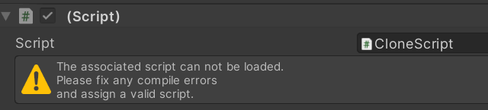
Class Name
The name of the script class must match the file name.
Try changing the name.
You should see this in the inspector:

Slide 7
Inheritance
In Unity all scripts are classes that inherit from a Unity class called “MonoBehavior”.
This means that the things that a MonoBehavior can do, and the values that it contains, are accessible to the new class.
This is called inheritance and is a feature of object-oriented programming (OOP).

Slide 8
Comments
Comments are for humans and have no impact on programs.
The compiler ignores everything from the “//” until the end of the line.
C# supports multi-line block comments using “/*” and “*/”
The C# compiler can generated help documents if you use XMLDoc format.

Slide 9
Functions
The start function is called by Unity once when the game starts.
The update function is called by Unity every frame of the game.
They are not called when the game object is deactivated.

Slide 10
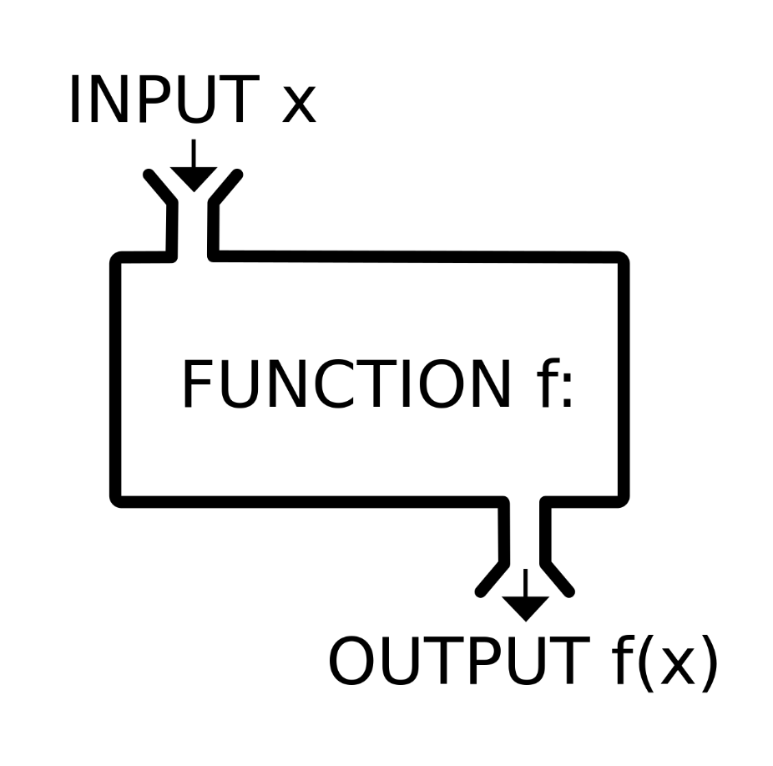
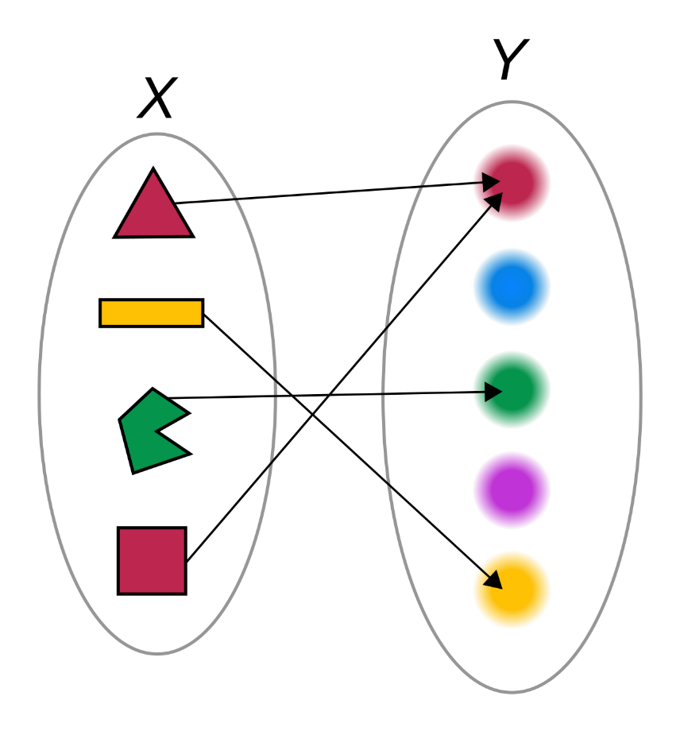
Functions in Code versus Mathematics
In Mathematics, a function from a set X to a set Y assigns to each element of X exactly one element of Y.
In computer languages what are called “functions” are actually “subroutines”.
Unlike mathematical functions:
They might not return a value (“void”).
They might have zero, one, or more inputs.
They might have side-effects
Calling them with the same input might yield different results.

Slide 11
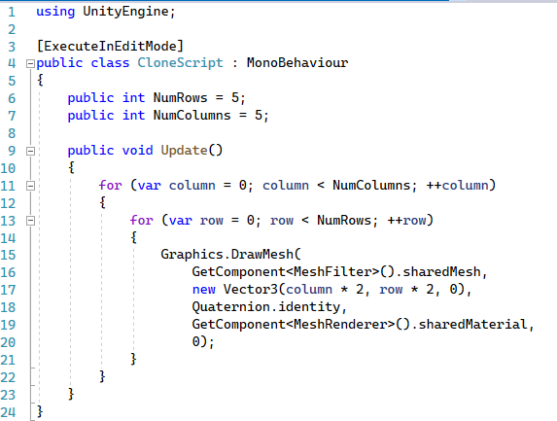
Type in your First Script

Slide 12
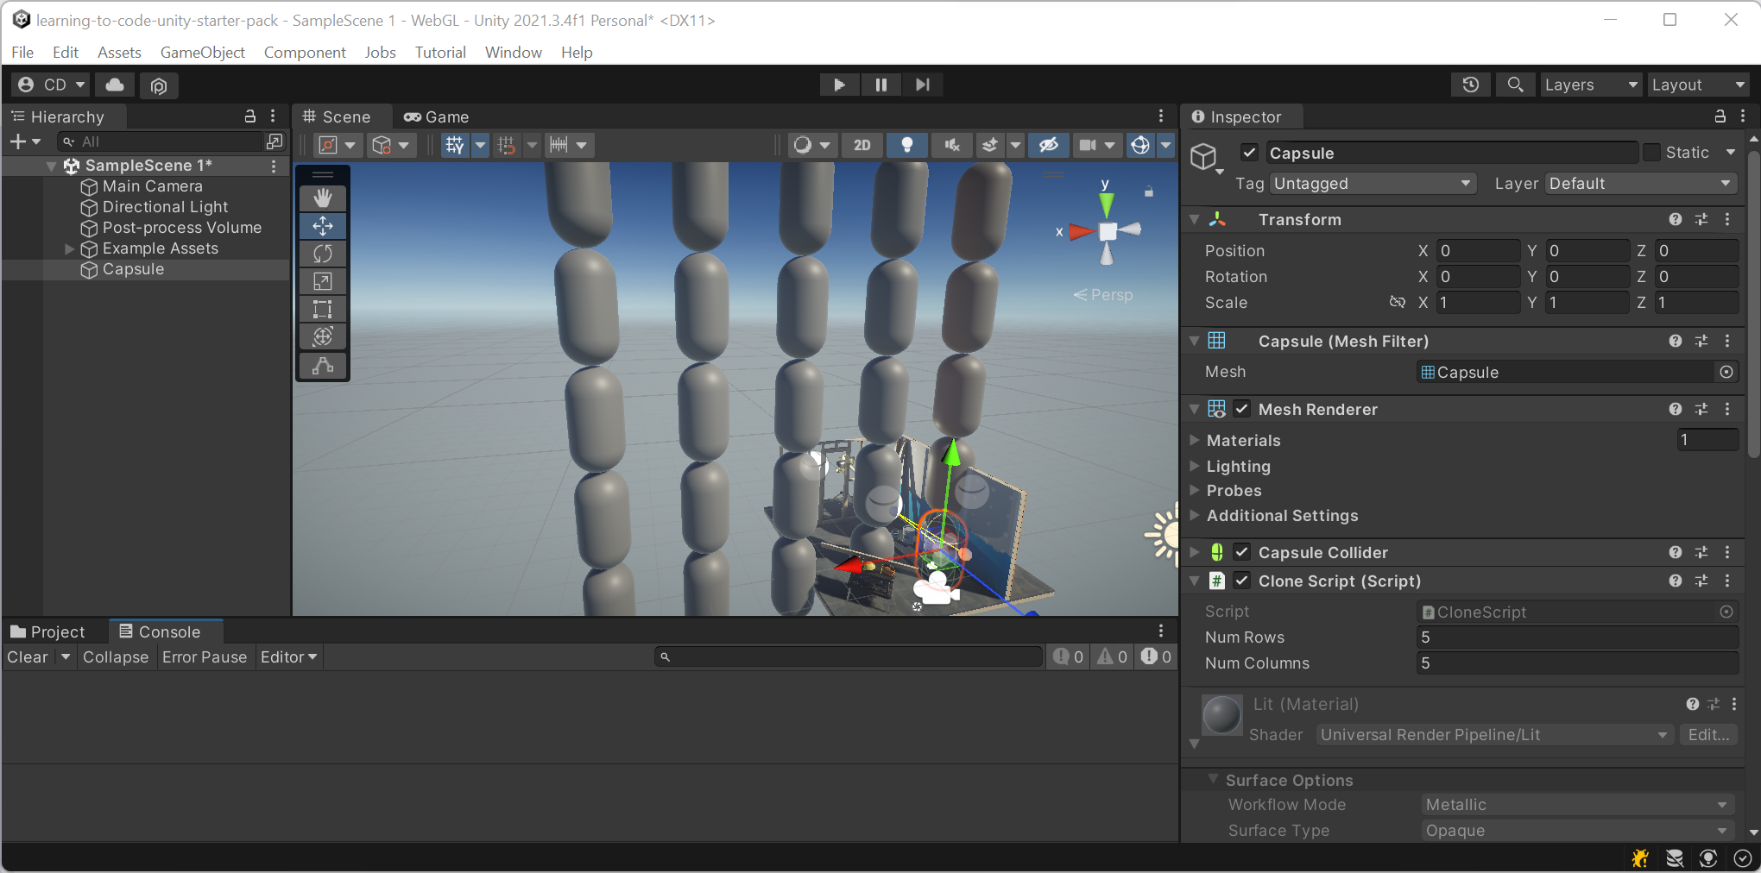

Slide 13
Attribute
Meta-information for the compiler or host environment.
Available through Reflection.
Tells the script to run in editor even when the game is not playing.

Slide 14
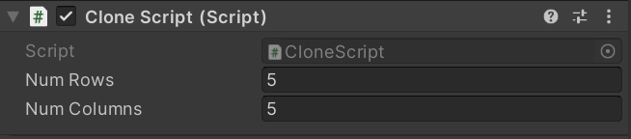
Fields
A field is named data associated with an object. Also known as a “member variable”.
When declared as “public” exposed in the editor as a property.

Slide 15
Variable Declaration
A variable is a name associated with a value.
The value associated with the name can change.
However, the type of data (number, text, vector) associated can’t be changed.
You can use the variable name instead of expression.

Slide 16
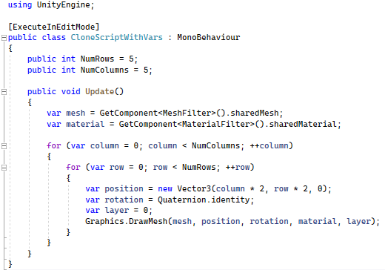
Variables are your friend This is equivalent to the other script – which do you prefer?

Slide 17
Expressions
A sequence of symbols (operators, numbers, variables) that represent computations. They are transformed into values (evaluated) when the program is executed.
Some examples include:
Numbers: 42, 3.15
Booleans: true, false
Variables: x, MyVector, this_is_a_variable
An operation with operands: x + 1, y >= 12, -z
Parenthesized expression: 3 * (y – 2)
A function call: Math.Sqrt(16)
A member variable: this.NumRows

Slide 18

Expression Use Cases
Common uses of expressions are:
operation input (operand)
function input (argument)
assigned to a variable
return value of a function
conditions for loop or branch statements

Slide 19
Practice: Find the Expressions

Slide 20
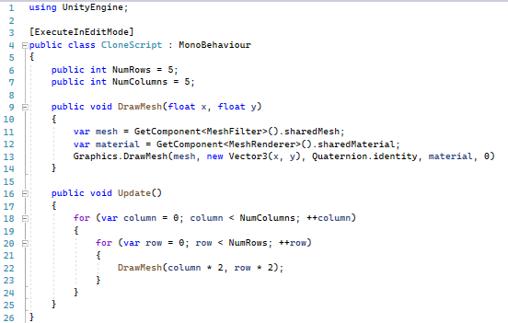
Statements
Statements are sequences of instructions. They might declare something, execute a subroutine, or affect control flow.

Slide 21
For Loop Statement
Calls the next statement (the loop body) multiple times.
Executes an initialization statement before starting.
Only executes while the invariant is true.
After each loop iteration, calls an iteration statement.

Slide 22
Condition
An expression (operation / function call / constant) with a value of type Boolean (true or false).
In the context of a for loop is called the invariant.
Loop is executed while condition is true.

Slide 23
Increment Statement
Adds one to a variable.
Returns the value of a variable after adding one to the variable.
The same as “x = x + 1”.
In the context of a for loop, it is called after each loop iteration.

Slide 24
Block Statements
Also called a compound statement.
Allows any number of statements (0 or more) to be treated like one statement.

Slide 25
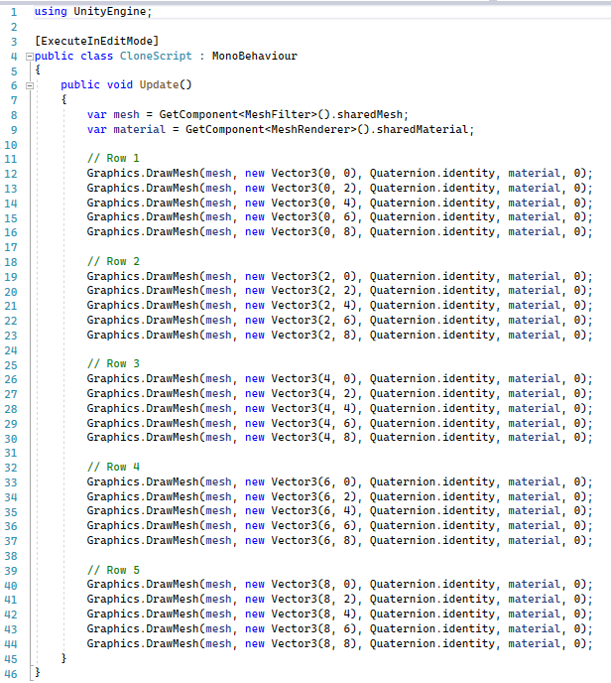
Why are Loops Important?
The computer doesn’t care … you could write out a statement 25 times.
What could possibly go wrong with this approach?
An important thing to ask yourself frequently when programming.

Slide 26
Function Calls
An expression or statement that executes a function.
If it returns a value, can be used as an expression.
Accepts types and/or expressions as inputs.

Slide 27
Functions
Functions are the fundamental building blocks of a computer program.
Also known as procedures, subroutines, or methods.
Let’s write a function that draws the mesh at a specified location
Consider other ways we could have written it

