Slide 1
Lab and ASsiGNMENT

Slide 2
Today’s Lecture
Writing tests
Sharing code
Following instructions
Dealing with ambiguity
Dealing with complexity
Writing functions
Creating a simple class

Slide 3
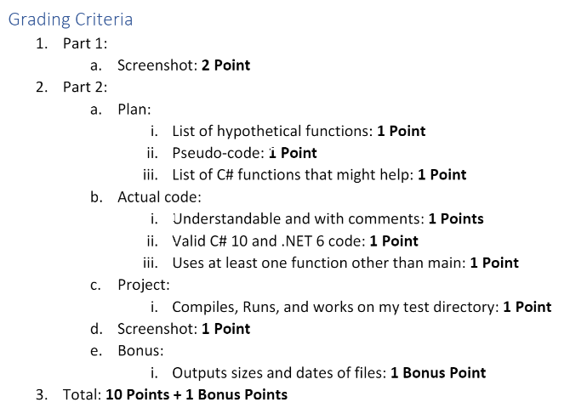
Assignment #1 Review
What were the instructions?
Command-line arguments
I need to run the code without rewriting it

Slide 4
Hypothetical Functions
GetFilesInDir()
GetSubDirsInDir()
GetFileLastModifiedDate()
GetFileCreateDate()
GetFileOwner()
GetFileSize()
GetFileAttributes()
GetCommandLineArguments()
GetCurrentWorkingDirectory()

Slide 5
Pseudo-code
Parse command line arguments
If none use the current working directory
Check if it is a directory
If not exit and tell user
Get all files from the directory
Get all directories from the directory
For each file and directory:
output date modified, size, and name if file
output date modified, and name if a directory

Slide 6
What does “Console.ReadLine()” do?
Reads from the standard input stream

Slide 7
Creating References

Slide 8
How to create a Debug Profile
This is how I run the programs

Slide 9
How I would tackle the dir assignment
Lots of small functions
Use an options class
A project for testing
A project for shared code

Slide 10
What to put in a Shared Project
Things that could be easily reused
Not specific to a particular program

Slide 11
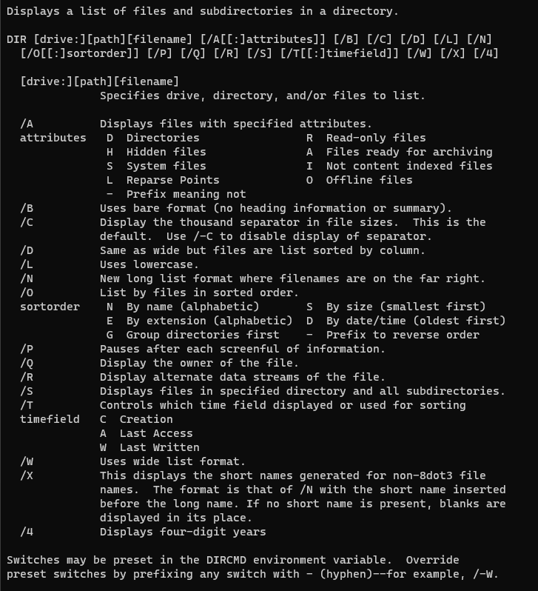

Slide 12
Dir Extension
Filter by date, time, attributes, name
Order by date, time, attributes, name
Reverse order
Pattern matching (glob)
Control output: color, size, dates, tab, lowercase, long/short, pause, date format, attributes,

Slide 13
Taking Dir to the Next Level
What could we do next?
Add support for coloring
Additional command-line options
Options
Make it recursive
Show different data

Slide 14
Different Options
Hard-coded string
Command line argument
Environment variable
Standard input
Written in a file
Request it from a URL
Graphical Users Interface (GUI)

Slide 15
How to test my projects
How to create a debug profile
How to write and run an integration test
How to write a unit test
How to write a test plan
How to launch a process

Slide 16
Manual Test without Debugger
Running the programs from the command line
Where are the programs?
Difference between Mac and Windows
Windows you just write the command-line
Mac you write “mono command.exe”

Slide 17
Manual Test from IDE with Debugger
Marking a Unit test with the [Explicit] attribute causes it to not run automatically

Slide 18
Automated Unit Test
Test a function or class

Slide 19
Automated Integration Test
Create a process start info
Set up command-line arguments
Set up environment variables
Redirect the standard input
Redirect the standard output
Launch the process

Slide 20
What can we test?
Does our find application work with a file?
Does our find application work with standard input?
Does our find algorithm find?
Does our sort application sort?
Does our sort application work with a file?
Does our sort application work with standard input?
Does our sort algorithm sort?
Do our applications output help?

Slide 21
Redirecting Standard Input
https://learn.microsoft.com/en-us/dotnet/api/system.console.setin?view=net-7.0
Console.SetIn

Slide 22
A Program to Test the Standard Output
Column display program

Slide 23
Command Line Arguments and Standard Input Stream

Slide 24
Sharing Code
Putting a function in one library and using it across

Slide 25
Representing Files and Directories

Slide 26
Creating an options class

Slide 27
What could we share?
Read a file into lines
Read standard input into lines
Output lines to standard
Look at command line arguments

Slide 28
What is expected
Shared code:
Parse command line arguments
Sort strings
Filter strings
Unit test

Slide 29
Writing Functions

Slide 30
Namespaces

Slide 31
Invoking Static Functions

Slide 32
Isn’t there extra allocations happening
Yes, but there doesn’t have to be.

Slide 33
Switching Between

Slide 34
Using Declarations

Slide 35
My version

