Slide 1
Console App
A walkthrough

Slide 2
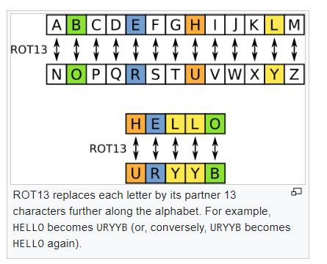
Rot13 Example

Slide 3
Program Requirements
Convert letters in every line of text using the Rot13 Cipher
Support different offsets that are set on the command-line
Check an environment variable for the offset

Slide 4
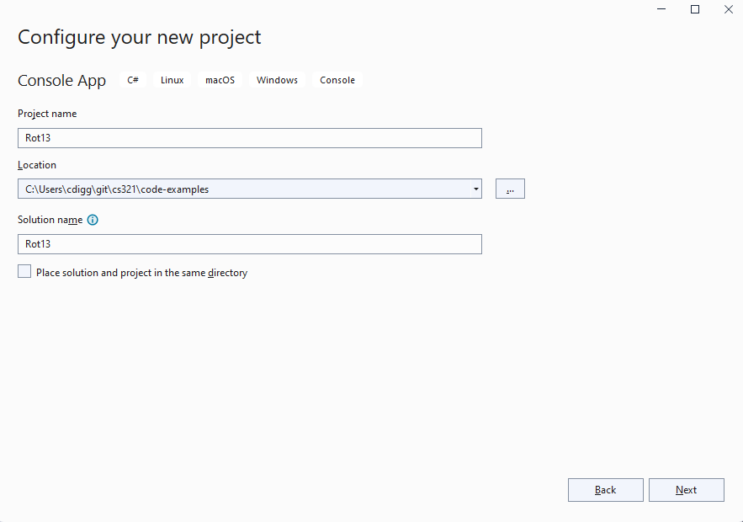
Create a Console Project

Slide 5
One Folder per Project
Solution in the upper level
Starting with the console project
We will add unit tests and shared code after

Slide 6
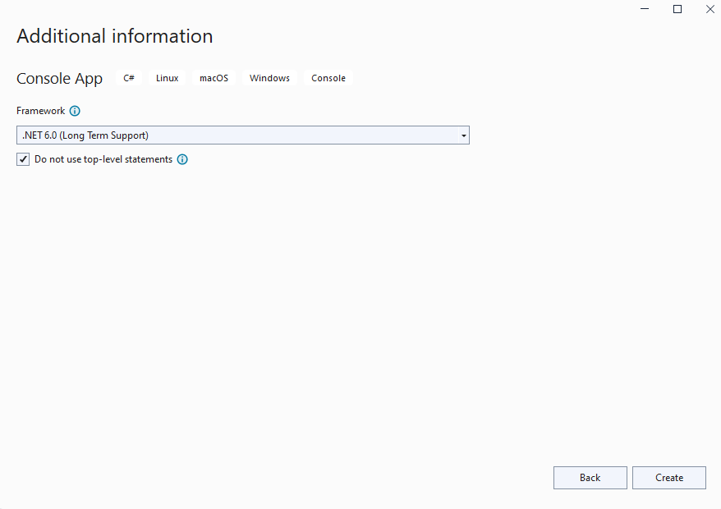
Choose the .NET Framework

Slide 7
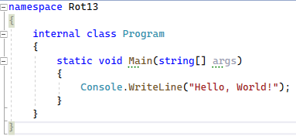
Generated Code

Slide 8
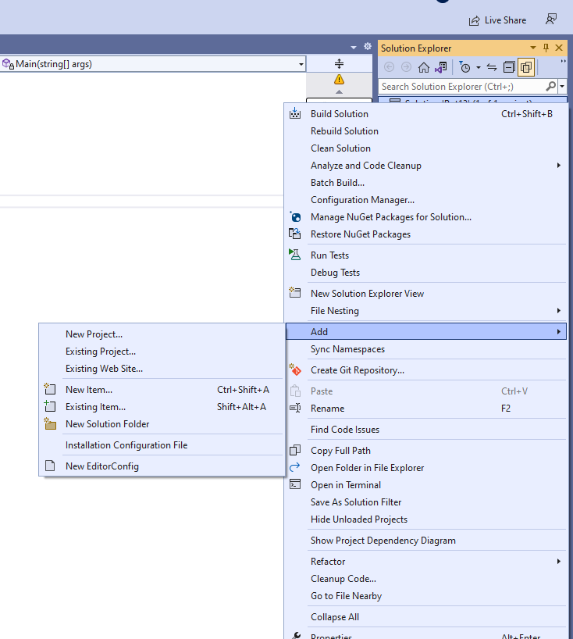
Right Click on Solution – Add New Project

Slide 9
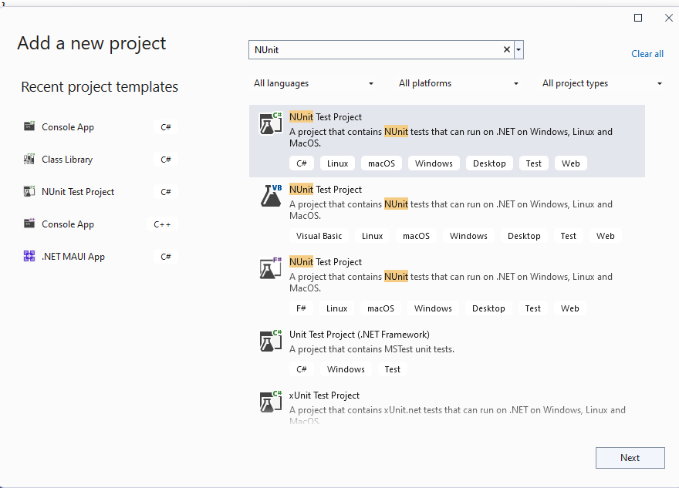
Create a new NUnit Test Project

Slide 10
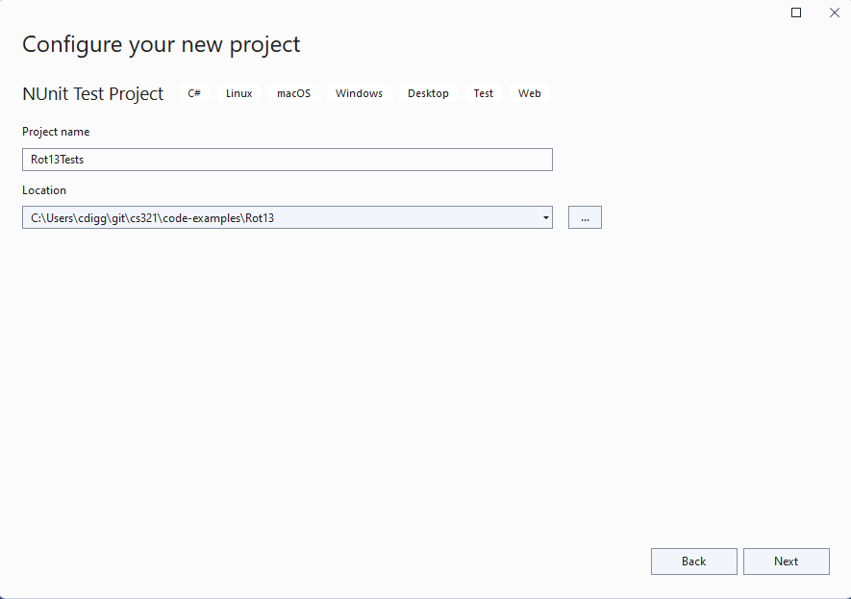
Name the Project

Slide 11
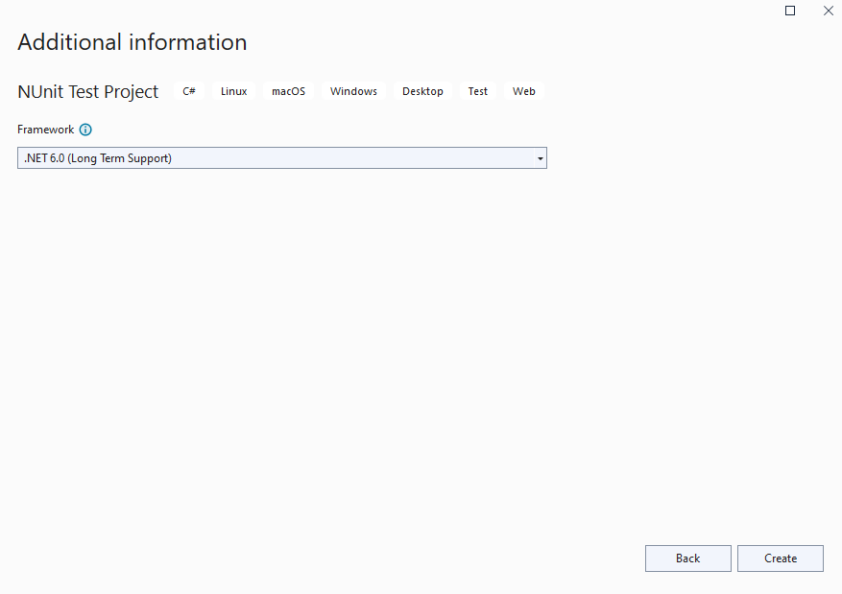
Set the .NET Framework

Slide 12
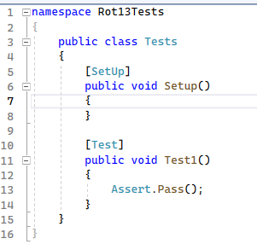
Generated Code

Slide 13
We want to write a smoke test
Just make sure we can start the program from the entry point

Slide 14
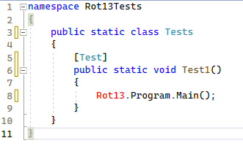
Make unit test class static

Slide 15
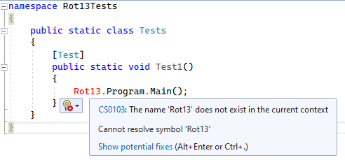
What does the error say?

Slide 16
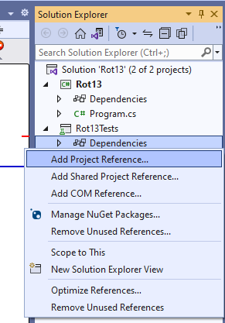
Add Missing Project Reference

Slide 17
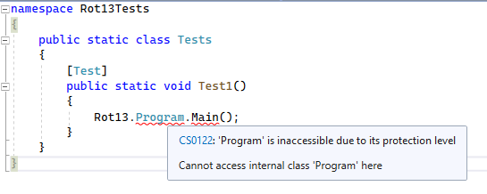
New Problem

Slide 18
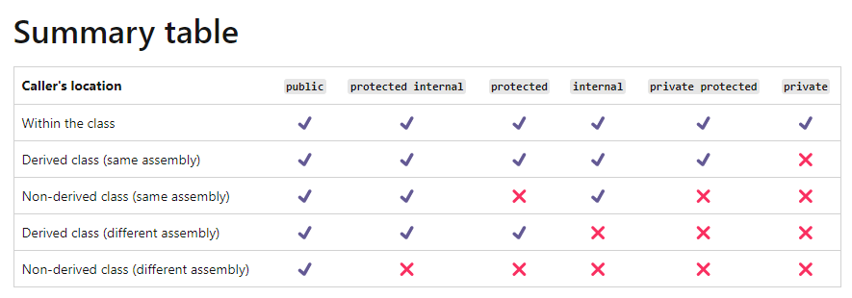
What is Internal
Called an access modifier
Prevents access to functions and types from other libraries and executables

Slide 19
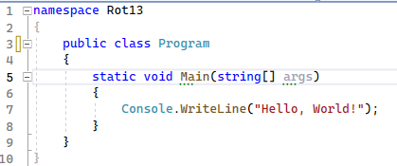
Make the Program class public

Slide 20
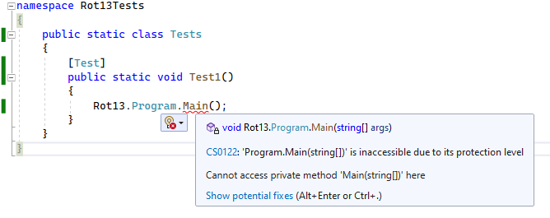
Now Visibility Problem on Main

Slide 21
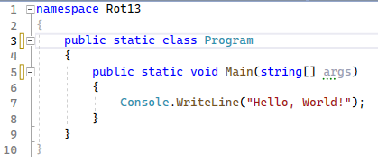
Make class static and add public to main

Slide 22
Why a static class?
We will never create a “Rot13.Program” object
We only use the “Rot13.Program” class
It will only have static methods
If you don’t new to “new” it, make it static

Slide 23
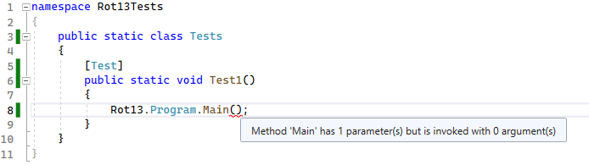
One last problem

Slide 24
Parameters and Arguments
Parameters are variables that are bound to a function’s inputs
Arguments are the values that are passed to a function as inputs

Slide 25
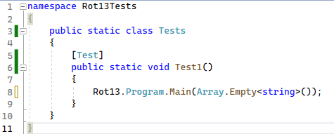
Create an empty array and pass it

Slide 26
What is Array.Empty<T>()?
What can you say about this?

Slide 27
Array.Empty<T>()
It is a function invocation
It is an expression
It is a static method - because Array is a type
It is public - because we can call it from a non-derived type other than array
It is not internal – because we can call it from another assembly
It is generic – it takes a type parameter
The expression has a type of “T[]”
It returns a non-null value of run-time type of “T[]”

Slide 28
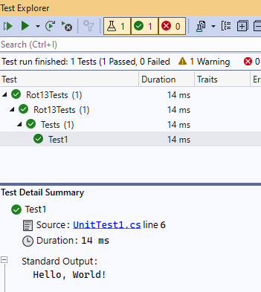
Test Results

Slide 29
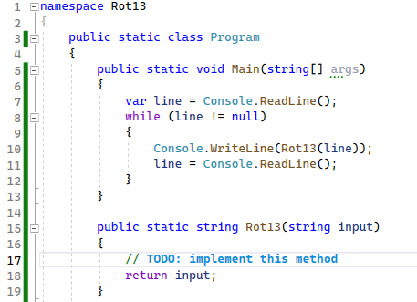
Create a Stub Implementation

Slide 30
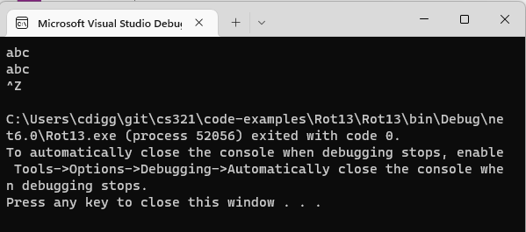
Run the Program from IDE

Slide 31
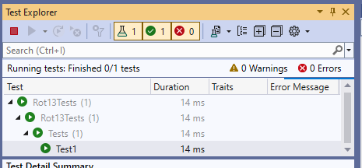
Problem: Test now Hangs!

Slide 32
It is waiting for standard input
Tests provide no console

Slide 33
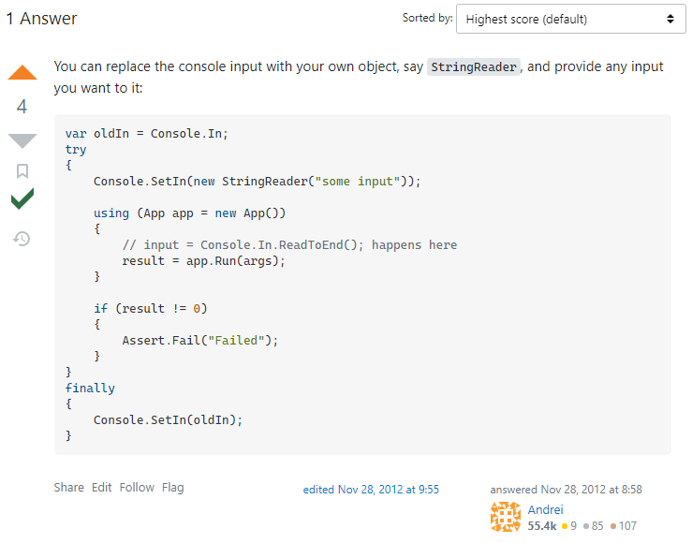
How to test standard input?
https://stackoverflow.com/questions/13601175/imitate-the-standard-input-in-tests

Slide 34
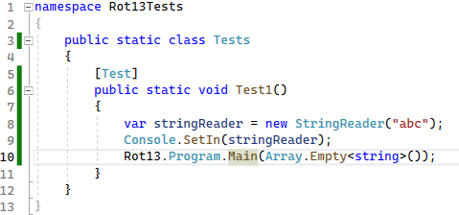
Use Console.SetIn()

Slide 35
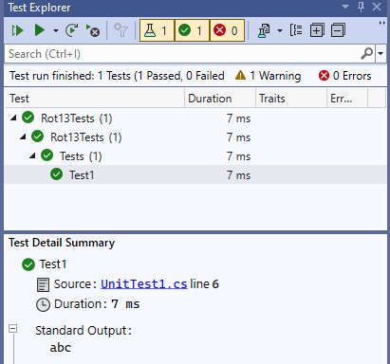
Test now Passes

Slide 36
A very subtle problem
Why did the answer have a “try” and “finally”?

Slide 37
Try / Finally Statement
After we leave the try block always call the finally block
No matter how we leave that block of code
For example could be a return statement or an exception
Useful to make sure a clean-up always happens
We will come back to this later

Slide 38
If not …
Imagine running multiple tests
If you leave a failing test the standard input might not be restored
For our immediate purposes: not important

Slide 39
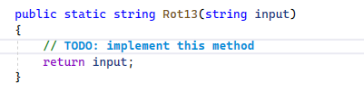
Now let’s implement Rot13

Slide 40
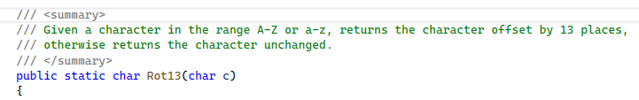
What if we had a Rot13 function for char?

Slide 41
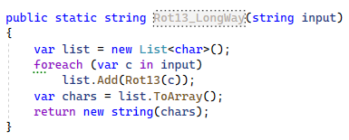
Long Form

Slide 42
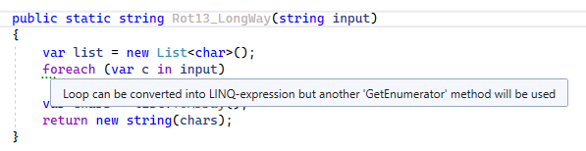
Automated Refactoring Suggestion

Slide 43

First Refactoring Result

Slide 44
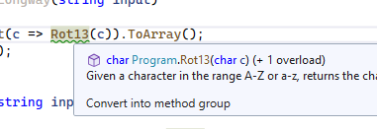
Next Refactoring Suggestion

Slide 45
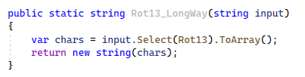
Final Automated Refactoring

Slide 46

Even Shorter Form

Slide 47
Advantages of Short Form (LINQ)
Less change of error
More explicit about desired result
Less explicit about technique

Slide 48

Could go another step

Slide 49
Expression body form: implicit return

Slide 50
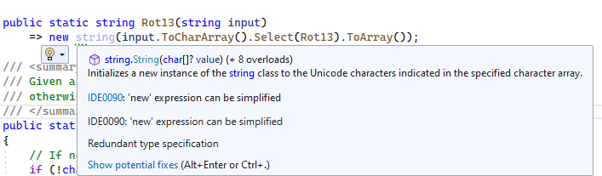
Now a new suggestion appears

Slide 51
Target-Typed New
Types of the new expression can be inferred in some cases
Called a target-typed new
Available in C# 9 and beyond
I find it very convenient

Slide 52
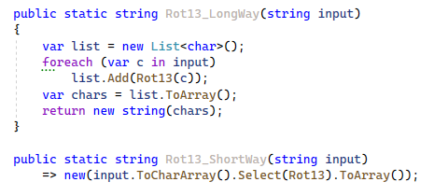
Side by Side: You Decide

Slide 53
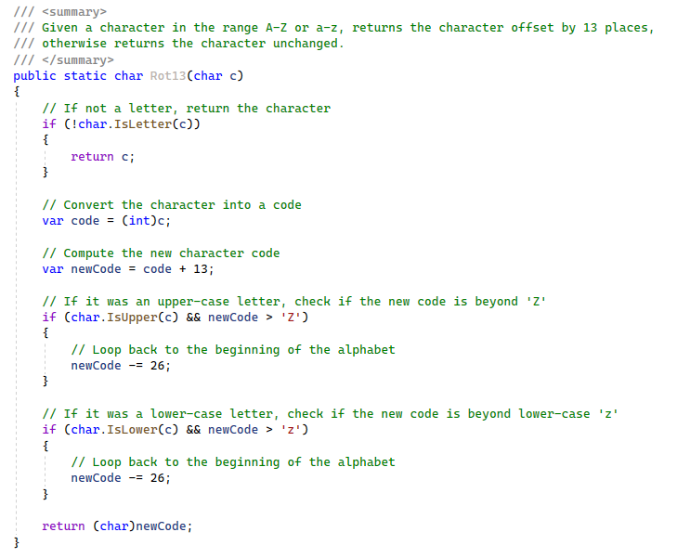
Possible implementation of Rot13

Slide 54
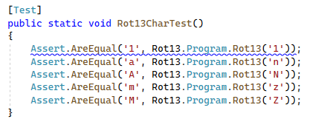
Let’s Test it

Slide 55
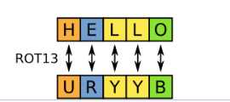
Test Example from Wikipedia

Slide 56
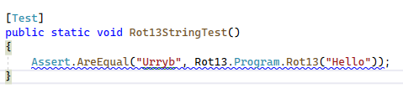
Try in Code

Slide 57
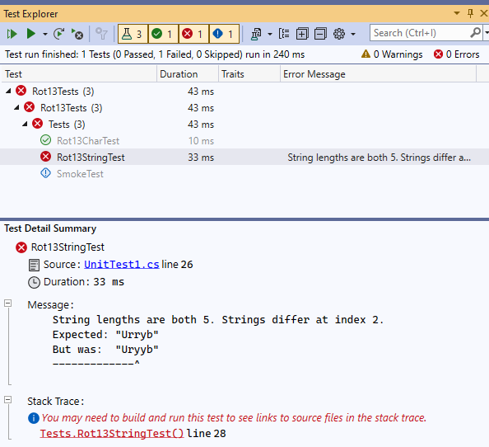
Test Failed

Slide 58
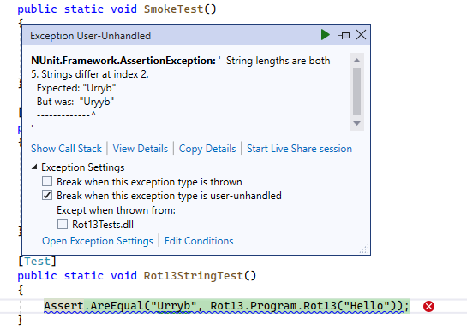
Can try debugging it

Slide 59
Problem can be
Either my test
Or my implementation

Slide 60
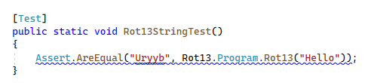
In this case … was my test

Slide 61
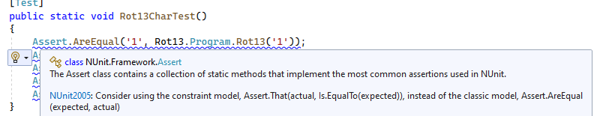
Why all the squiggles?

Slide 62
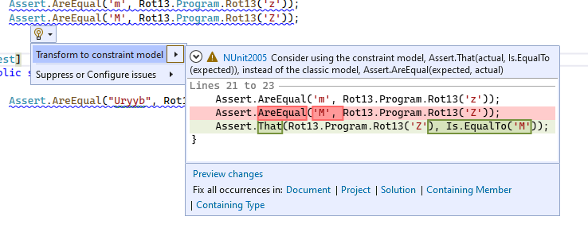
Suggested Refactoring Constraint Model

Slide 63
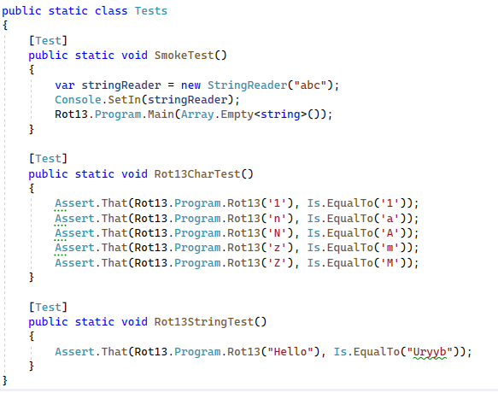
Apply Refactoring to Document

Slide 64
Your choose your preference
Currently I find the “classic model” easier to read
But squiggles are distracting
And the constraint model is now recommended
Lesson: things seem strange until you become accustomed to them

Slide 65
Using Directive
We don’t need to have “Rot13.Program.” everywhere
It is because we haven’t included the namespace
Try adding a using directive (read-up on this)
We can now use “Program.”

Slide 66
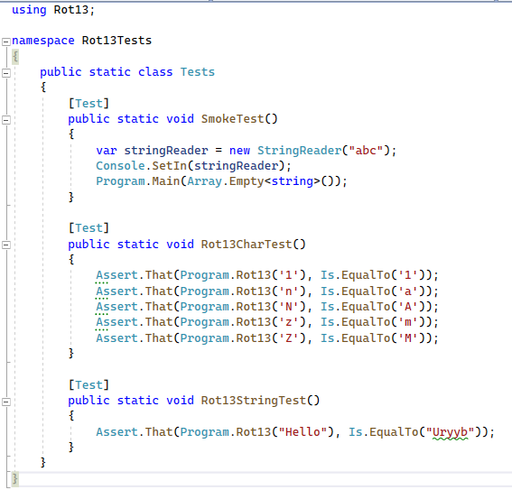
Isn’t this better?

Slide 67

Using static
We can simplify further with the “using static” directive

Slide 68
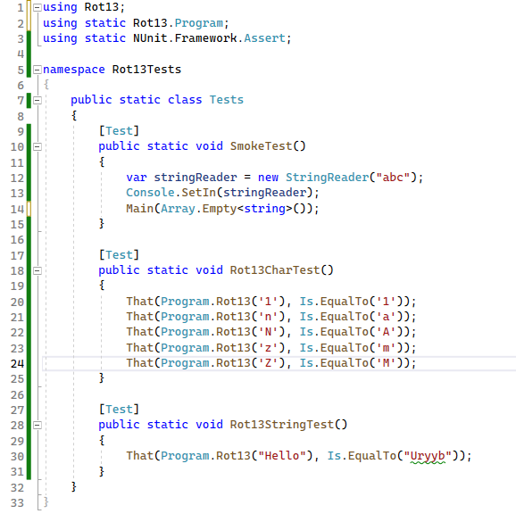
After Automated Refactoring

Slide 69
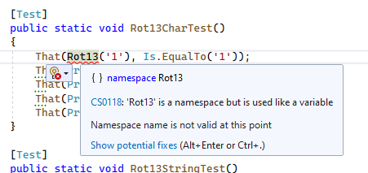
Wait … why still Program.Rot13
Because “Rot13” alone is ambiguous (namespace or function?)

Slide 70
Moral
Simplify as much as you can but there are limits
Compilers cannot guess what you meant if there is ambiguity

Slide 71
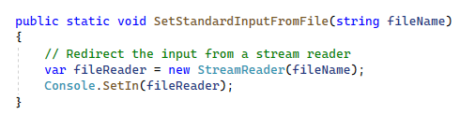
What if we want to read from a file?

Slide 72
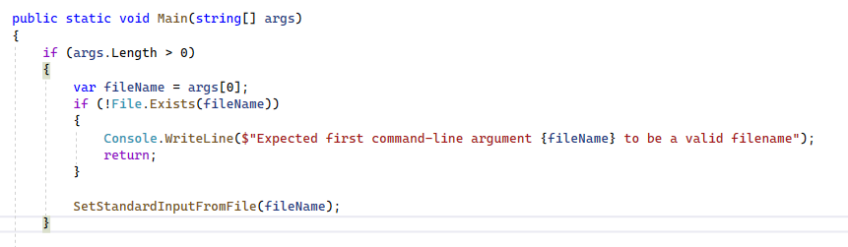
Parsing Command Line Arguments

Slide 73
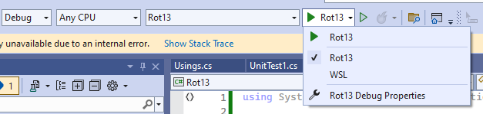
Manual Testing of Command Line

Slide 74

Launches the Debug Profiles Menu

Slide 75

Set the Command Line Argument

Slide 76

Success! Gibberish

Slide 77

Testing from Command Prompt

Slide 78

I wrote a console app for Julius Caesar

