Slide 1
Functional PROGRAMMING
And code reuse

Slide 2
What is it and why do we care
Functional programming reduces the amount of code we have to write

Slide 3
Why is code reduction good?
Less possibility of mistakes
Less tests we have to write
Easier to understand and debug
Easier to maintain and modify

Slide 4
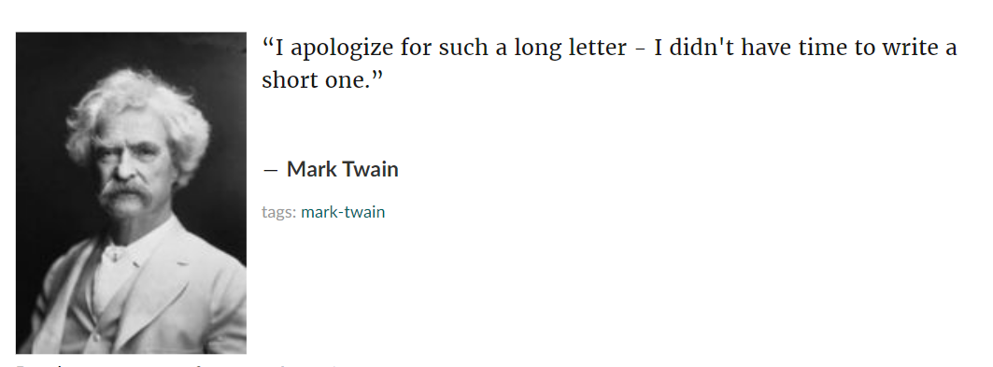

Slide 5
Building Blocks
map / filter / fold
In C# called:
Select / Where / Aggregate

Slide 6
Learning to Read Functional Code

Slide 7
Generics Review
Without generics we have to either:
Write multiple versions of each function

Slide 8
Difference between IEnumerable and Collections

Slide 9
The Universality of Aggregate
Things you can do with the aggregate operation:
Generate a new list

Slide 10
Things you can build
With “map”
With “filter”
With “aggregate”

