Slide 1
Types and VALUES

Slide 2
What does a type do?
Provides a guarantee of safety during compilation
Helps the compiler produce efficient code
Make a program more predictable

Slide 3

C# Specification wording
C# is a strongly typed language. Every variable and constant has a type, as does every expression that evaluates to a value. Every method declaration specifies a name, the type and kind (value, reference, or output) for each input parameter and for the return value.
https://learn.microsoft.com/en-us/dotnet/csharp/fundamentals/types/

Slide 4

Java Specification wording
The Java programming language is a statically typed language, which means that every variable and every expression has a type that is known at compile time.
The Java programming language is also a strongly typed language, because types limit the values that a variable (§4.12) can hold or that an expression can produce, limit the operations supported on those values, and determine the meaning of the operations. Strong static typing helps detect errors at compile time.
https://docs.oracle.com/javase/specs/jls/se8/html/jls-4.html

Slide 5
C++ and C are Weakly Typed
This does not mean bad
There is a static type checker
It is possible to convert a value into an incompatible type
In other words, you can work around the type system

Slide 6
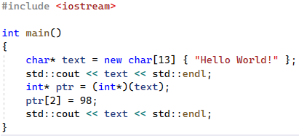

C++ Type System Violation

Slide 7
Difference Between C/C++ and C#/Java
In C/C++ you manipulate bits in a memory location
In C/C++ types are properties of variables and heap-allocated polymorphic objects
In C#/Java you are creating or querying values

Slide 8
C# is a Strongly Typed Language
All variables (including parameters) and expressions have types
Types are checked at compile-time (static-typing)
Values are assigned types at run-time
Those values cannot change types at run-time
By default it is also statically typed
Expressions of type “dynamic” defer all checking until run-time

Slide 9
Run-Time Type vs Type System
In C# values have type information
Theorists call this a “type tag”
It is not part of a “type system”.
This is confusing!

Slide 10
C++ RTTI
It is possible to ask the type of certain values allocated on the heap in C++
You use the typeid operator and get a type_info struct if you are lucky
Gives you a hash code and an implementation specific name

Slide 11
C# Values all have Fixed Types
All run-time values have types
You cannot change the type of a value in C#
You can query the exact type using the GetType method
This is possible because all C# values derive from System.Object

Slide 12
Common System.Object Methods
Equals - Compare two objects
GetHashCode - Generates a number from the value for use in hash tables
ToString - Returns a human-readable string
GetType – Returns a System.Type object describing the object

Slide 13
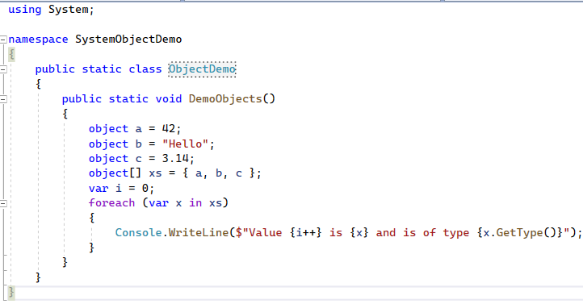
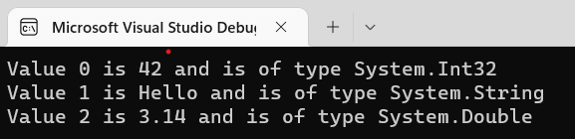
Why is this cool?

