Slide 1
Types and VALUES

Slide 2
What does a type do?
Provides a guarantee of safety during compilation
Helps the compiler produce efficient code
Make a program more predictable

Slide 3
C# Specification wording
C# is a strongly typed language. Every variable and constant has a type, as does every expression that evaluates to a value. Every method declaration specifies a name, the type and kind (value, reference, or output) for each input parameter and for the return value.
https://learn.microsoft.com/en-us/dotnet/csharp/fundamentals/types/

Slide 4
Java Specification wording
The Java programming language is a statically typed language, which means that every variable and every expression has a type that is known at compile time.
The Java programming language is also a strongly typed language, because types limit the values that a variable (§4.12) can hold or that an expression can produce, limit the operations supported on those values, and determine the meaning of the operations. Strong static typing helps detect errors at compile time.
https://docs.oracle.com/javase/specs/jls/se8/html/jls-4.html

Slide 5
C++ and C are Weakly Typed
This does not mean bad
There is a static type checker
It is possible to convert a value into an incompatible type
In other words, you can work around the type system

Slide 6
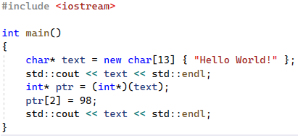

C++ Type System Violation

Slide 7
Difference Between C/C++ and C#/Java
In C/C++ you are manipulating bits in a memory location
In C#/Java you are creating or querying values

Slide 8
C# is a Strongly Typed Language
All variables (including parameters) and expressions have types
Types are checked at compile-time (static-typing)
Values are assigned types at run-time
You cannot convert a value from one type into an incompatible type
Unless you use an unsafe context
The “dynamic” type defers checking until run-time

Slide 9
At Run-Time
In C# and many modern language values have type information
Theorists call this a “type tag”
It is not part of the type system.
I only just figured this out.

Slide 10
C# Values all have Fixed Types
All run-time values have types
You cannot change the type of a value in C#
You can query the exact type using the GetType method
This is possible because all C# values derive from System.Object

Slide 11
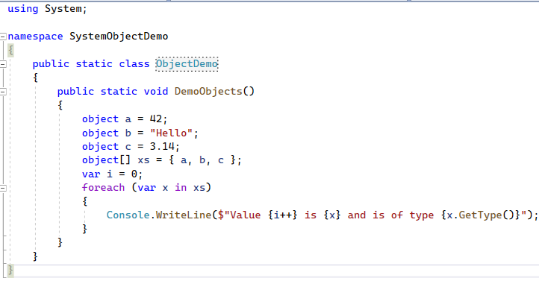
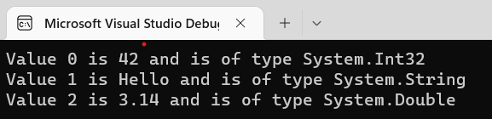
Why is this cool?

Slide 12
Common System.Object Methods
Equals - Compare two objects
GetHashCode - Generates a number from the value for use in hash tables
ToString - Returns a human-readable string
GetType – Returns a System.Type object describing the object

Slide 13
Variables

Slide 14
Casts
https://learn.microsoft.com/en-us/dotnet/csharp/programming-guide/types/casting-and-type-conversions

Slide 15
Case Study: Strings
https://learn.microsoft.com/en-us/dotnet/csharp/programming-guide/strings/
A string is an object of type System.String whose value represents text. Internally, the text is stored as a sequential read-only collection of Char objects.
A C# string can contain any number of embedded null characters ('\0').

Slide 16
string vs. System.String
In C#, the string keyword is an alias for System.String
It's recommended to use the string alias
The string alias works even without including the System namespace

Slide 17
String Immutability
String objects are immutable: they can't be changed after they've been created
Methods and C# operators that either query a string or create a new string object

Slide 18
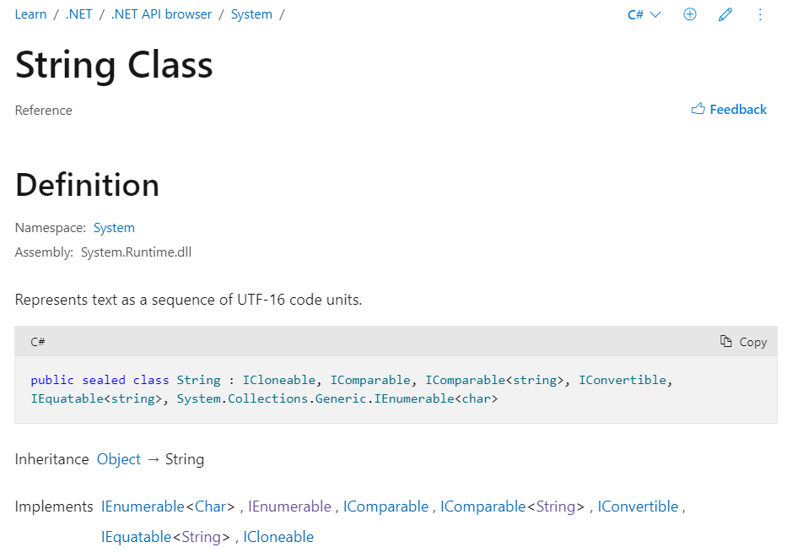
System.String Documentation

Slide 19
Inheritance
Notice that System.String inherits, or derives from, from System.Object
This means that it “inherits” the operations that are present on System.Object

Slide 20
Querying the Type
In C# every object implements a function: “GetType()”.
This returns a “System.Type” object.

Slide 21
Example
Show the debugger
What type is a value
Look at a String
Then look at an Int
Then look at an Array

Slide 22
Boxing and Unboxing

