Slide 1
Coding TIPS

Slide 2
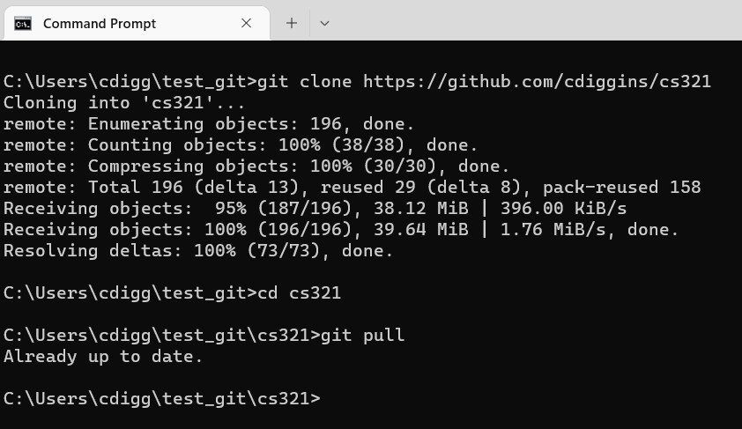

Slide 3
First Pieces of Advice
Practice, practice, practice
You will get much faster
If you are stuck, ask for help

Slide 4
Learning to Program
Recognizing mistakes
Reading code
Problem solving
Writing code

Slide 5
Programming Note
If you are confused
Set a breakpoint see what it does
Step through the code
Ask yourself, is it doing what I expected?
Why or why not?

Slide 6
If you are not sure what you expect
Valid!!
Write out what you want to happen in code
Find the inconsistency in your code and understanding
Ask yourself in a comment
Make the best guess
Mention you are guessing

Slide 7
Tracing and Asserts
Use Debug.WriteLine() in regular code
Use Console.WriteLine() in tests
Use Debug.Assert() in regular code
Use Assert.IsTrue or Assert.AreEqual in tests projects

Slide 8
Reversing the Direction
A problem solving trick is to reverse the direction that we loop over stuff
Look for a “counter example” as opposed to proving something is true

Slide 9
Consider the Test Cases
Make them explicit
Don’t solve every problem right away
Sometimes code is “good enough”
That is where documentation is important

Slide 10
Use Braces
If statements and loops don’t require curly braces
However, it can make code easier to read and avoid errors

Slide 11
Use Variables
While learning, break complex expressions down into smaller ones
Assign sub-expressions to variables
Yes your code is longer, but easier to find mistakes
You can also debug easier

Slide 12
Comments
Don’t put too many
Don’t state the obvious
They are for you and the reader
Tell us something useful
Code should speak for itself

Slide 13
Don’t Leave Unused Code in a File
It can be confusing to yourself and others

Slide 14
For Note:
Don’t monkey with the loop index

Slide 15
What was
0xFFul - hexadecimal number 255, typed as a 64 bit unsigned number (long)
123.45f – single precision floating point number
TIP: When using the “var” declaration hover the mouse over the var

