Slide 1
Collections

Slide 2
Collections of things
A collection is a value that contains other values.
A collection has items of the same type.
Examples include arrays, stacks, set, dictionaries, and lists.
We can get far with just using lists (dynamic arrays).

Slide 3
Arrays
The grandfather of collections
Most languages start with a built-in array
Supports fast indexing
Fast length queries
Can’t insert things
Can’t remove things
Length is fixed upon construction

Slide 4
Changing Items
You can however change the values within an array.
It is the first class that we have seen so far that allows that.
This is useful, but you must be cautious

Slide 5
In C#
You can change elements of an array
You cannot change the length
It is fixed at construction time

Slide 6
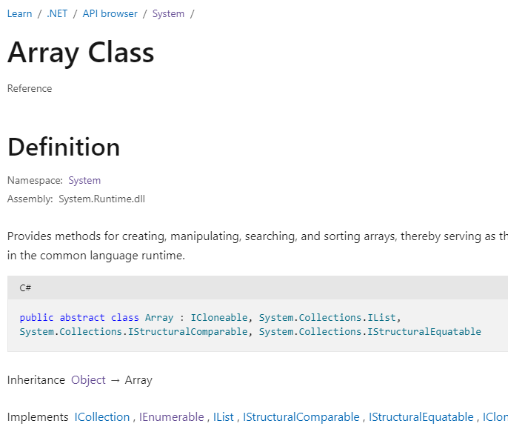
System.Array
https://learn.microsoft.com/en-us/dotnet/api/system.array?view=net-6.0

Slide 7
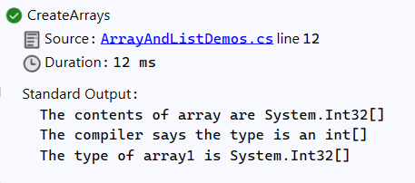
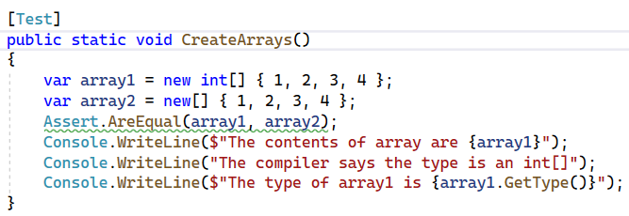
What is the Runtime Type of an Array

Slide 8
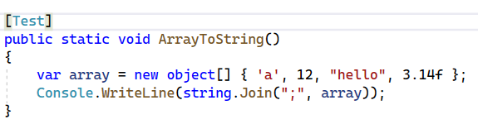
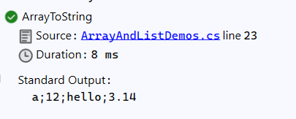
Why don’t I see contents?
Converting arrays to strings can consume a lot of resources
The “Array.ToString()” just returns the type of the array
Manually convert to a string using String.Join

Slide 9
What is the Runtime Type of a List
A list is a generic type
It is parameterized over the type of an element
Arrays are too … but for historical reasons are special

Slide 10
Writing a Function to work on Any List

Slide 11
Common Array Operations
Array.Length() – returns the length of the array
Array.CopyTo() – copies the array, or a part of it, into another array
Array.IndexOf() – find the index of a specific element

Slide 12
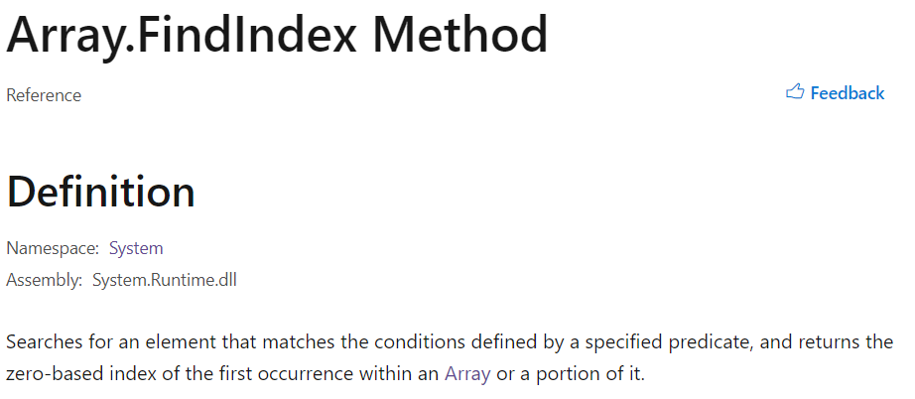
Array.FindIndex()

Slide 13
a Predicate
A function that takes a single value as input and returns a Boolean.

Slide 14
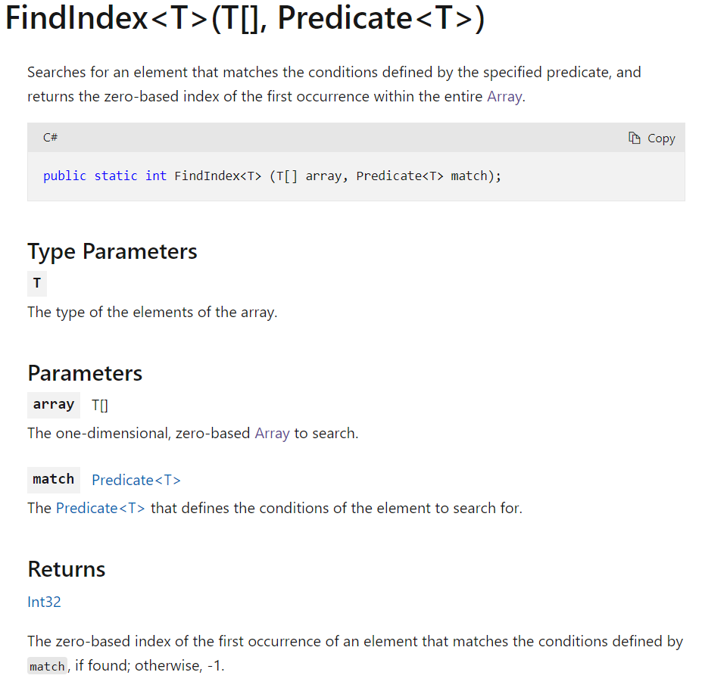

Slide 15
What is the TypeParameter T?
Array.FindIndex() is a Generic Method
This means it has type parameters.
Constraints the type of the elements in the array to match the type of the predicate parameter
Results in compile-time errors if misused

Slide 16
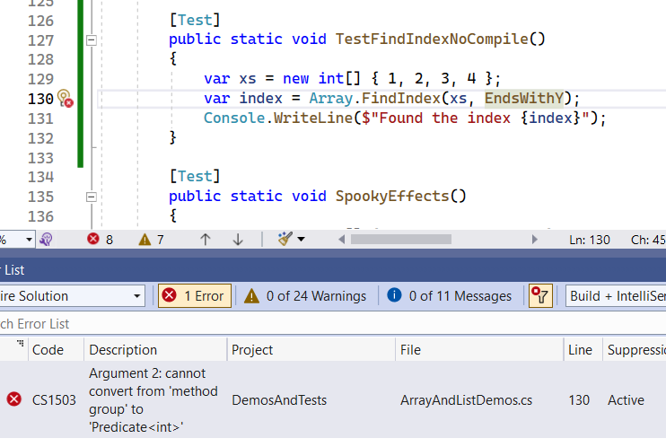

Slide 17
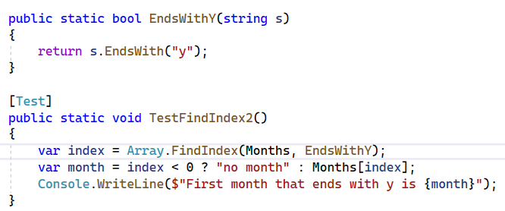
Array.FindIndex() Demo

Slide 18
The ternary conditional operator - ?:
Takes a Boolean value (Cond) and two other argument (X and Y)
Returns X if Cond is True
Returns Y is Cond is False
Short circuit evaluation
https://learn.microsoft.com/en-us/dotnet/csharp/language-reference/operators/conditional-operator

Slide 19
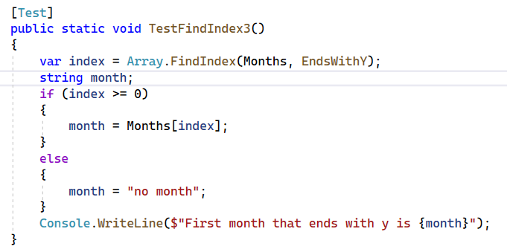
Without the Ternary Operator

Slide 20
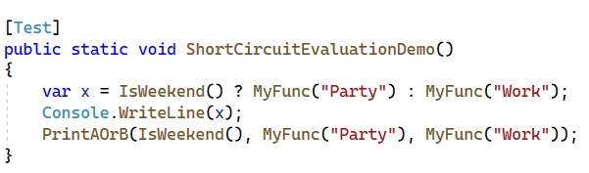
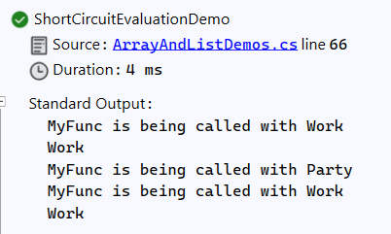
Short Circuit Evaluation

Slide 21
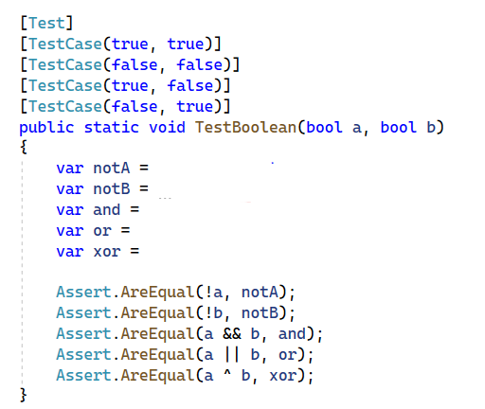
Implementing Boolean Operators
It is possible to implement the Boolean operations with only the ternary operator. Try it!

Slide 22
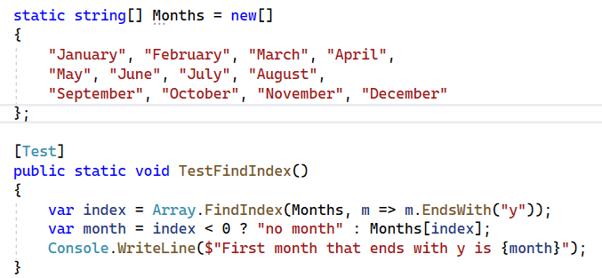
Array.FindIndex() Demo 2

Slide 23
My First Lambda

Slide 24
A function without a name
Lambdas are also called anonymous function
We are just defining a small inline local function
Notice that the types of the parameter and return type are inferred
The function we pass it to tells the compiler the type
More convenient than defining named functions for single-use

Slide 26
Mutating Array Operations
Array.Reverse – reverses order of elements in a section of array, or the whole array
Array.Sort – sorts orders of elements in ascending order
Array.Fill -
Convert

Slide 27
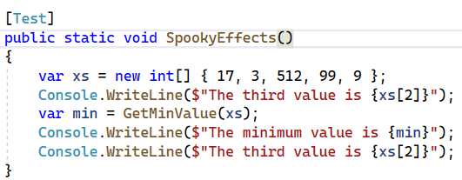
What Happens?

Slide 28
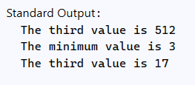
Did you predict this?

Slide 29
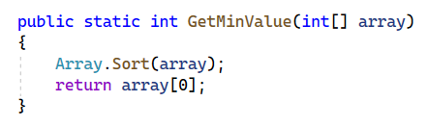
GetMinValue() implementation

Slide 30

That was bad … Don’t do THat

Slide 31
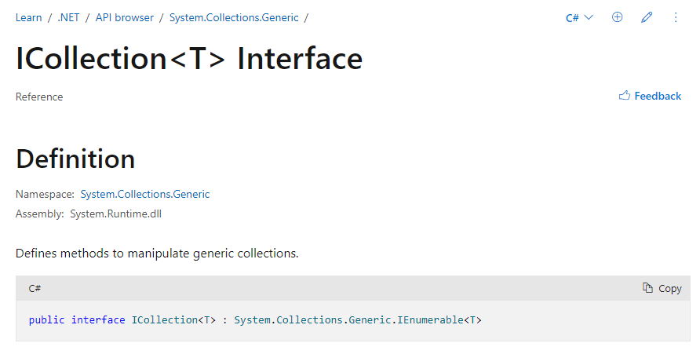
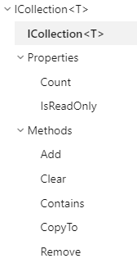

Slide 32
Collections are IEnumerable
Just like strings are enumerable over characters
Arrays are enumerable over the element type (whatever that is)

Slide 33
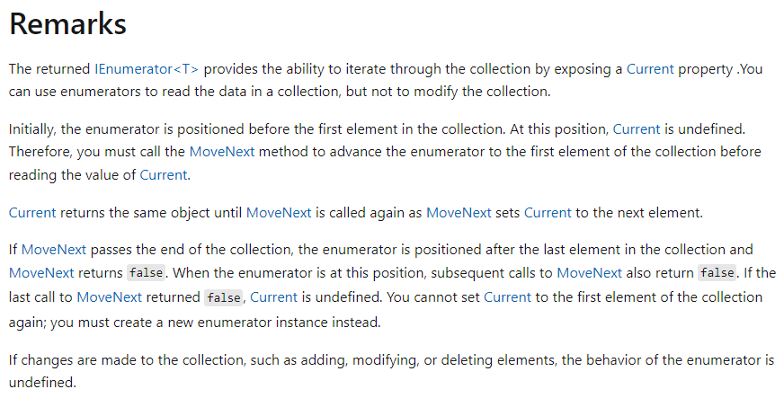
Don’t Change a Collection During Foreach
https://learn.microsoft.com/en-us/dotnet/api/system.collections.generic.ienumerable-1.getenumerator?view=net-6.0

Slide 34
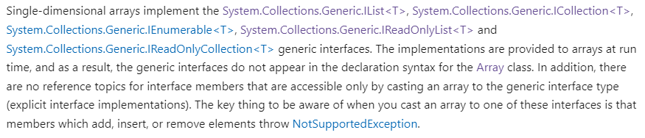
Arrays also implement IReadOnlyList

Slide 35
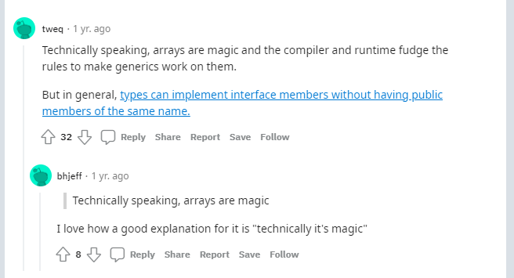
Or as Reddit user tweq says
https://www.reddit.com/r/csharp/comments/q2s9sa/how_can_string_implement_ireadonlycollectiont/

Slide 36
Conceptually this is the model:
IEnumerable
IReadOnlyList
IList
Array
List

Slide 37
When are interfaces useful?
We use usually “var” for variable declarations
As function parameters and return types.

Slide 38
Robustness Principle
"be conservative in what you send, be liberal in what you accept".
Allows you to write functions that are reusable in more scenarios

Slide 39
Interfaces and Upcasts
Interfaces that a class implements are higher up on the hierarchy tree
So casting from a class to an interface it implement is an upcast

Slide 40
This is interesting
I want to write a function that only enumerates a collection: use Ienumerable as the parameter type
I want to write a function that uses the count or indexes a collection: use IReadOnlyList as the parameter type

Slide 41
Concrete Examples
Find the middle item of a collection?

Slide 42
For Note:
Don’t monkey with the loop index

Slide 43
How to Build an Array
Use a list
Add items
Call IEnumerable.ToArray()

Slide 44
How to Create a List
Create an array of capacity X
Track how many items are in the array (N)
When N is equal to X, allocate a new array that is twice as big

Slide 45
Implicit Array Typing
You might see this:
Var xs = new[] { “a”, “b”, “c” };
The compile guess that it is an array of strings, because

Slide 46
The Runtime Type of An Array

Slide 47
List<T>
Items of the same type.
xs = new List<Vector3>();
Add, remove, and insert items:
xs.Add(), xs.Remove(), xs.Insert()
Query the count:
xs.Count
Retrieve specific elements:
var v = xs[3];
Change specific items:
xs[i] = new Vector3(0, 2, 0);

Slide 48
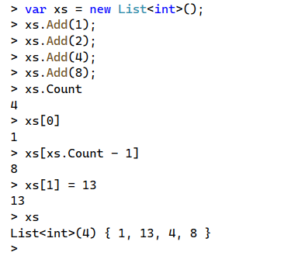

List<T> Example

Slide 49
Indexing
Lists and Arrays use an integer index for each item
Indices start at 0
You can retrieve an item: myList[index]
You can modify an item at a position: myList[index] = 12
The last item in a list is: myList[myList.Count – 1]

Slide 50
What if I don’t need mutation?
Preventing changes should be your default
If you need efficient indexing and count: use IReadOnlyList<T>
Otherwise: use IEnumerable<T>

Slide 51
IEnumerable<T>
An IEnumerable<T> is a generalization of collections
Enumerating means visiting each item in order one by one
To access an element, you must walk through items one by one
To get the count, you must visit each item until the end
Be careful: can sneakily increase computational complexity.

Slide 52
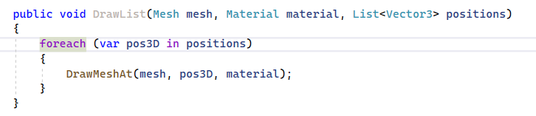
Using “Foreach”
A foreach is a loop statement designed for IEnumerable<T>.
Easier to type and read
Visits each element in sequence

Slide 53
Basic IEnumerable<T> Operations
Select - Transform each item into a new one using a function
Where - Filter a collection by checking against a conditional function (predicate)
Aggregate - Combine elements using a function (generalization of sum)

Slide 54
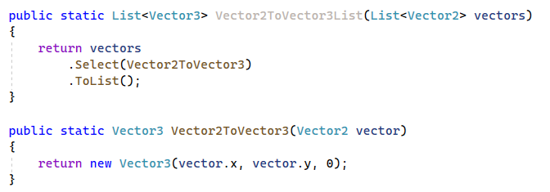
Converting a List of X into a List of Y
A select statement takes a function as an argument
Transforms collection, by applying function to each element

Slide 55
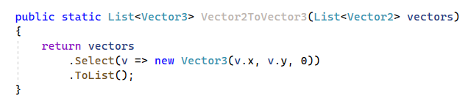
Using Anonymous Functions (Lambdas)
Anonymous functions (lambdas) simplify syntax
Types of parameters are inferred

