Slide 1
Saving and READING DATA

Slide 2
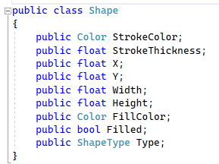
Some Classes are Just Data
In general classes should be immutable
Sometimes it doesn’t make sense
Consider the shape class

Slide 3
How do you save data to disk?
There exist libraries to write bytes or characters to disk
So you need to convert your classes into bytes or characters
A process known as serialization

Slide 4
How do you read data from disk?
You need to convert from a stream of characters or a binary representation
Doing this in a robust manner is very hard

Slide 5
Serialization / Deserialization
Serialization is the process of converting objects into bytes (or characters) so that they can save to disk or transmitted over a network.
Deserialization is the process of reconstituting byte or character streams back into the original objects

Slide 6
How Serializers work
By querying at runtime the fields of the different types using “GetType()”

Slide 7
Common Types of Serializers
XmlSerializer
JsonSerializer
BinarySerializer

Slide 8
Reflection
Reflection allow objects to query information about objects
For example: what are the names and types of the fields?
What values does each field hold?
In C# we can query this kind of information about any object

Slide 9
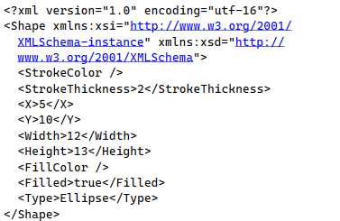
Example XML

Slide 10
How does it work under the hood?
Let’s take a look!

