Slide 1
Streams and ITERATORS

Slide 2
Streams are sequential data
A sequence of data made available over time
Represents a data source or data sink
The next value might not be ready for a while
Streams are potentially infinite (codata)

Slide 3
When do we usually use streams?
To read from the keyboard
To read or write to a file
To write to the screen

Slide 4
What kind of data is in a stream?
Could be any type, but is often characters, bytes, and strings (lines of text)

Slide 5
You already used streams
Console.WriteLine() outputs data to output stream
That stream by default is connected to the standard output (defined by OS)
The standard output is connected to screen by the terminal (a program)
Console.ReadLine() reads data from input stream
That stream by default is connected to the standard input (defined by OS)
The standard input is connected to keyboard by the terminal (a program)

Slide 6
Why do we use streams?
When data can’t fit into memory all at once
Avoids the overhead of copying data into an intermediate collection
When we aren’t sure we will use the data
When we want to read or write values on-demand
When accessing elements is potentially expensive

Slide 7
Containers/Collections are not Streams
Containers (collections) are finite
Data is always available
Data can be queried multiple times

Slide 8
Wikipedia is contradicting itself
https://en.wikipedia.org/wiki/Stream_(computing)
I/O devices can be interpreted as streams, as they produce or consume potentially unlimited data over time
In object-oriented programming, input streams are generally implemented as iterators
https://en.wikipedia.org/wiki/Iterator:
In computer programming, an iterator is an object that enables a programmer to traverse a container, particularly lists
So: iterators can be used for streams and containers / collections
Don’t even read the bit about containers / collections. It is a mess.

Slide 9
Let’s call this a sequence
Less awkward than saying IEnumerable
We are including standard containers and streams
If I was rewriting the library from scratch I’d call it ISequence

Slide 10
Streams are Like Collections
You can iterate over them
Difference is you can’t go back to the beginning unless buffered
Buffering means data is stored in memory
A collection can be treated like a stream
IEnumerable can be used on both streams and collections

Slide 11
Refresher: IEnumerable<T>
Exposes an enumerator, which supports iteration over collections (and codata)
The base interface for all collections that can be enumerated.
Contains a single method, GetEnumerator(), which returns an Ienumerator<T>
IEnumerator<T> exposes a Current property and MoveNext() and Reset() methods

Slide 12
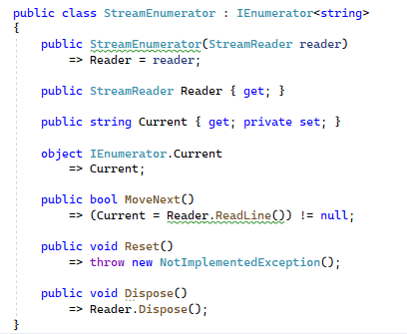
StreamReader as Iterator
Has a “ReadLine()” method
Returns a string or null
If null then no more data
This is effectively an enumerator
We will learn how to create this later

Slide 13
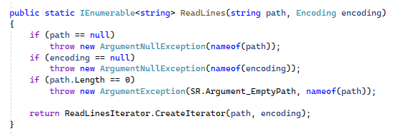
The File.ReadLines() function does this

Slide 14

This implies
Algorithms and functions written for streams can work on collections
We can write a single library that accepts IEnumerable and save a lot of code
This is what the “LINQ” library does

Slide 15
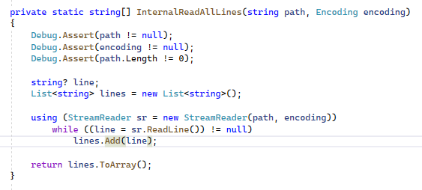
Here is an example of reading a file (From reference source: notice they are using a stream reader)

Slide 16

This function returns an IEnumerable
You can “foreach” over it
Data is only loaded if/when requested
Can read only part of data if requested
No 2GB limit

Slide 17

They could also have written

Slide 18
ToList() versus ToArray()
If I return a “IReadOnlyList()” my function can return a list or array
A ToList() function is usually better than a “ToArray()”
Why? Exercise for the reader.
Hint: think about how you would implement both functions
Note: a restriction of IEnumerable is that you can only iterate over it once

Slide 19
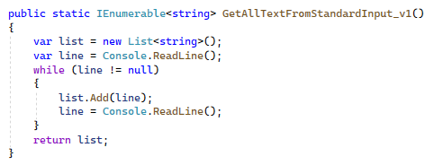
An example of a streaming into a buffer

Slide 20
Why return IEnumerable and not List?
Remember IEnumerable is an interface and List is a class
We want flexibility to change the implementation
We should prefer to return an interface over classes
The reduces “coupling” and hides implementation details
We should choose the interface that best describes the result

Slide 21
Could IList<T> makes sense?
Yes it could, however it adds requirements
Forces the data to be buffered
In other words copied into an intermediate collection
Requires that the intermediate collection is mutable (can be changed)
We can only handle up to 2 billion items (e.g. 2GB binary data)

Slide 22
So is IReadOnlyList<T> better?
Yes it is a bit however it still requires “indexing”
Indexing a stream means it must be in memory
Or if it is a file we must perform a seek operation
Seeking in a file is slow, hogs resources, and is best avoided

Slide 23

Choosing the Return Type is Important
It’s like developing your pieces early in chess
Decisions you make early on affect your options later on

Slide 24
Guiding Principle
Return interfaces to minimize dependency on implementation details
Only return interfaces that the client needs or expects
This is related to the “Interface Segregation Principle”

Slide 25
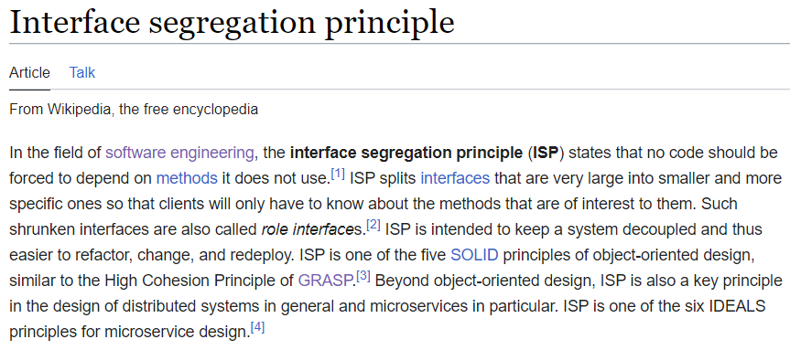

Slide 26
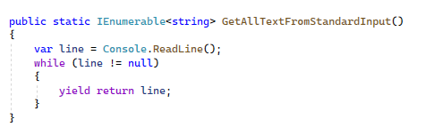
An alternative implementation

Slide 27

Iterator Methods (Coroutines)
An iterator method is a function that generates a stream
See: https://learn.microsoft.com/en-us/dotnet/csharp/iterators
Understanding them fully requires understanding how to implement interfaces
They act like functions which can be paused and resumed
In other words they are a form of coroutine

