Slide 1
C# Tooling

Slide 2
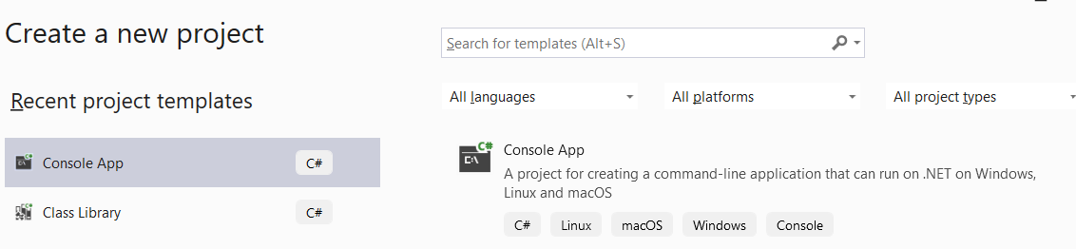
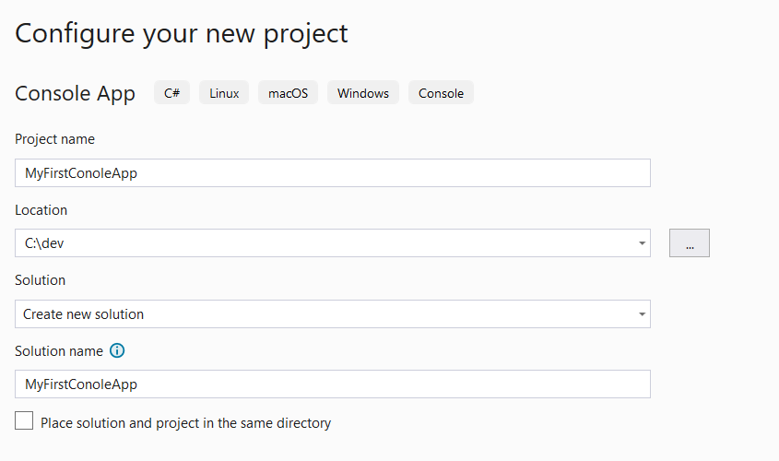
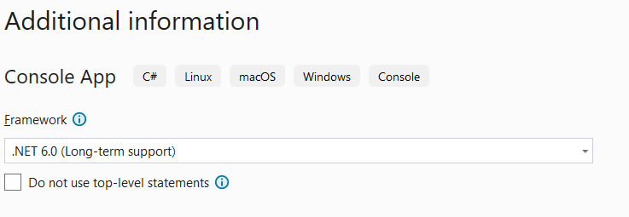
Let’s Make a Console Application
2
1
3

Slide 3
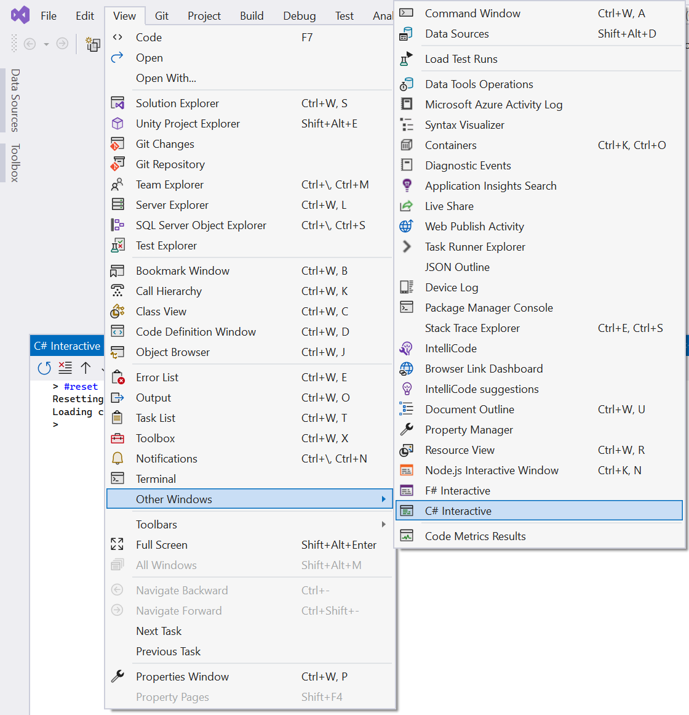
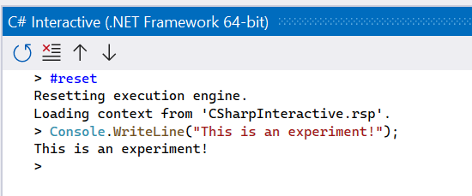
C# Interactive (Windows Only)

Slide 4
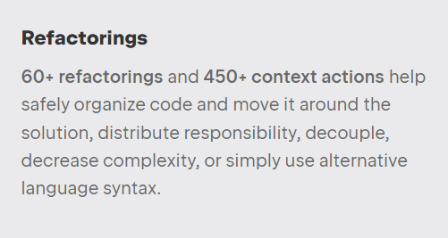
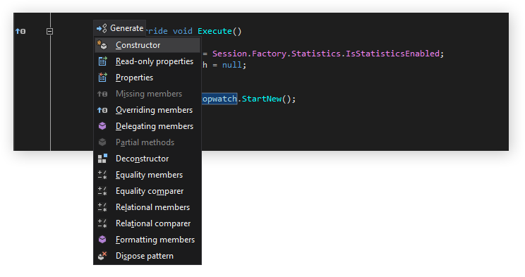
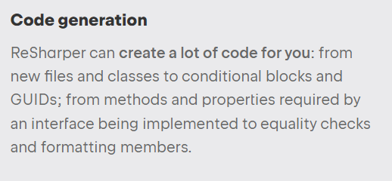
ReSharper
https://www.jetbrains.com/resharper/

Slide 5

GitHub Copilot
https://github.com/features/copilot

Slide 6
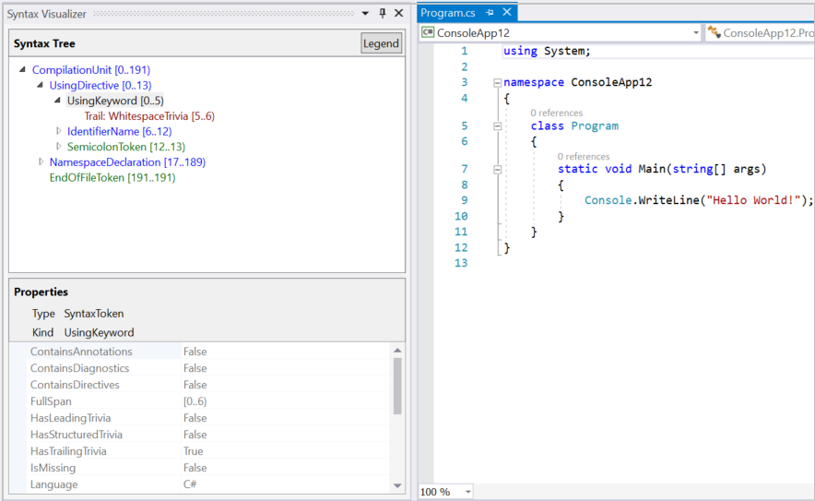
Roslyn Syntax Visualizer
https://learn.microsoft.com/en-us/dotnet/csharp/roslyn-sdk/syntax-visualizer
Notes:
https://learn.microsoft.com/en-us/dotnet/csharp/roslyn-sdk/syntax-visualizer?tabs=csharp

Slide 7
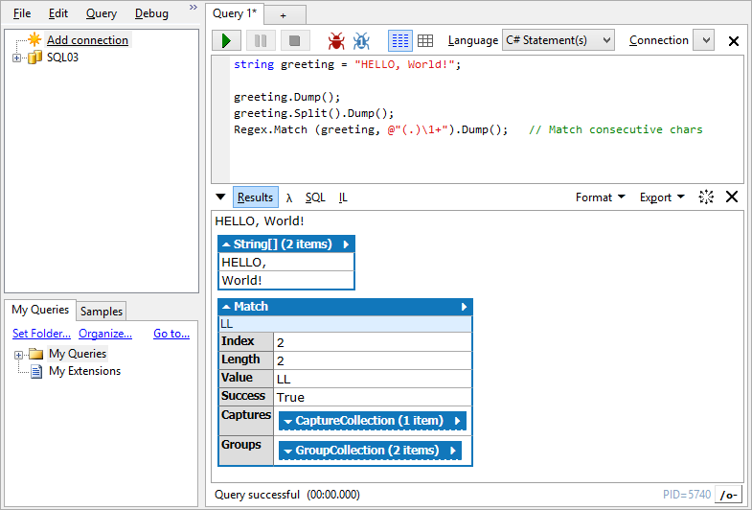
LINQPad
https://www.linqpad.net/

Slide 8
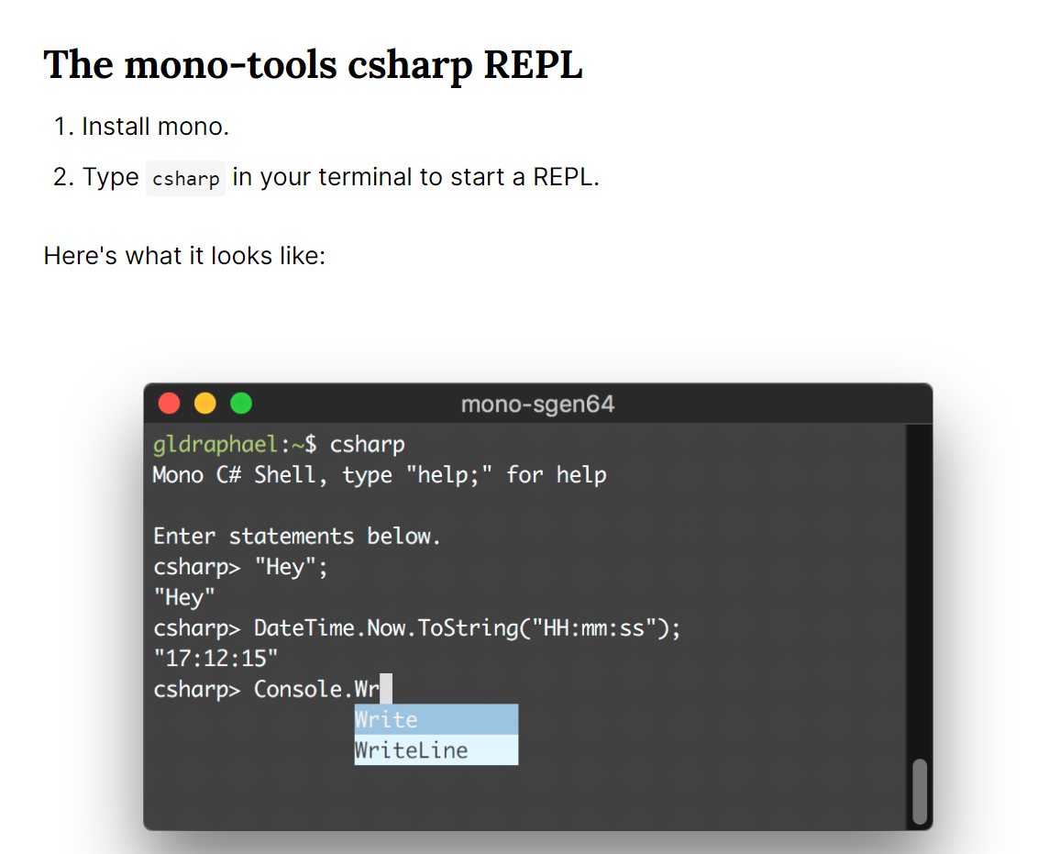
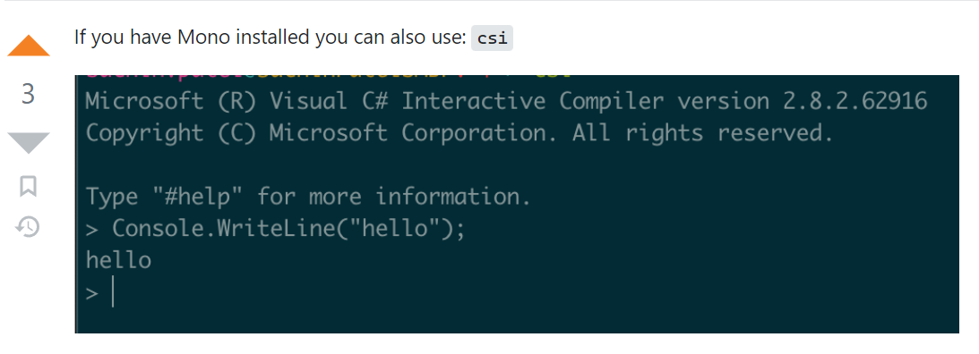
On Mac use Mono tools csharp or csi
https://www.mono-project.com/docs/getting-started/install/mac/

