Slide 1
Collections

Slide 2
Collections of things
A collection is a value that contains other values.
A collection has items of the same type.
Examples include arrays, stacks, set, dictionaries, and lists.
We can get far with just using lists (dynamic arrays).

Slide 3
List<T>
Items of the same type.
xs = new List<Vector3>();
Add, remove, and insert items:
xs.Add(), xs.Remove(), xs.Insert()
Query the count:
xs.Count
Retrieve specific elements:
var v = xs[3];
Change specific items:
xs[i] = new Vector3(0, 2, 0);

Slide 4
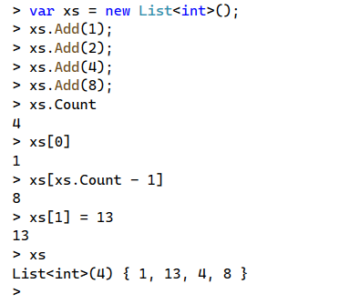

List<T> Example

Slide 5
Indexing
Lists and Arrays use an integer index for each item
Indices start at 0
You can retrieve an item: myList[index]
You can modify an item at a position: myList[index] = 12
The last item in a list is: myList[myList.Count – 1]

Slide 6
What if I don’t need mutation?
Preventing changes should be your default
If you need efficient indexing and count: use IReadOnlyList<T>
Otherwise: use IEnumerable<T>

Slide 7
IEnumerable<T>
An IEnumerable<T> is a generalization of collections
Enumerating means visiting each item in order one by one
To access an element, you must walk through items one by one
To get the count, you must visit each item until the end
Be careful: can sneakily increase computational complexity.

Slide 8
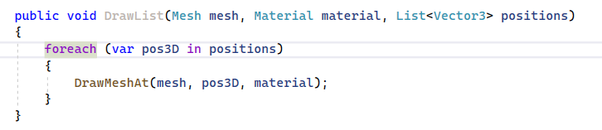
Using “Foreach”
A foreach is a loop statement designed for IEnumerable<T>.
Easier to type and read
Visits each element in sequence

Slide 9
Basic IEnumerable<T> Operations
Select - Transform each item into a new one using a function
Where - Filter a collection by checking against a conditional function (predicate)
Aggregate - Combine elements using a function (generalization of sum)

Slide 10
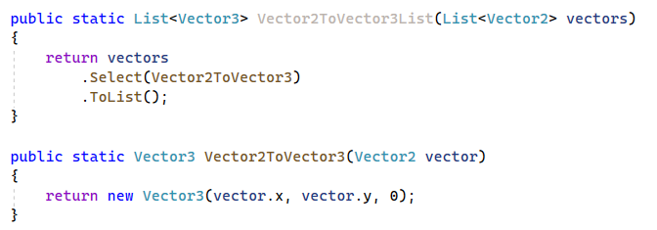
Converting a List of X into a List of Y
A select statement takes a function as an argument
Transforms collection, by applying function to each element

Slide 11
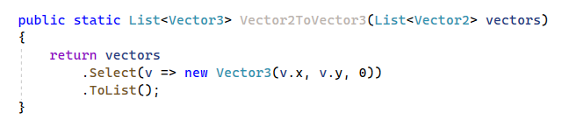
Using Anonymous Functions (Lambdas)
Anonymous functions (lambdas) simplify syntax
Types of parameters are inferred

