Slide 1
Final Project
Events

Slide 2
Final Project
Create a drawing program
Use the C# Windows Forms library
Export SVG files.
User can interact with the program using the mouse and keyboard,
Provide a visual representation of the document being created by the user.
Submit as a link to a Github repository.

Slide 3
Review
Enumerator
Code style …

Slide 4
Skills Required
Learn to create a GUI
Respond to events
Installing 3rd party libraries via Nuget
Design patterns
Respond to mouse and keyboard events

Slide 5
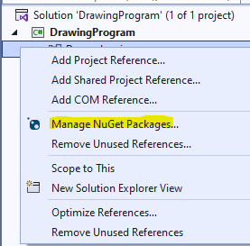
Adding NUGET PACKAGE

Slide 6
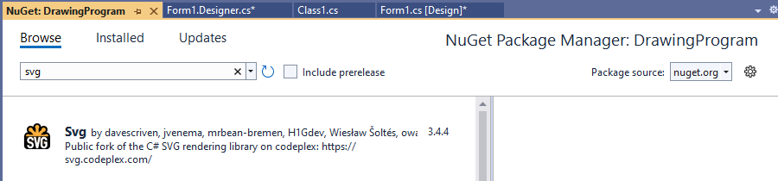
A sample Nuget package

Slide 7
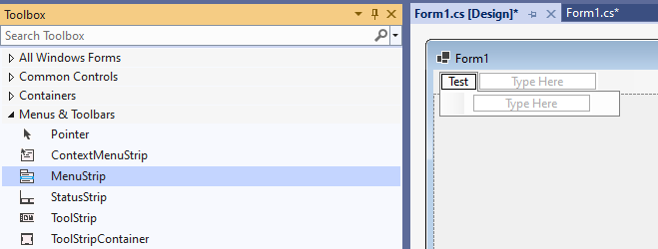
Add a Menu to the Window

Slide 8
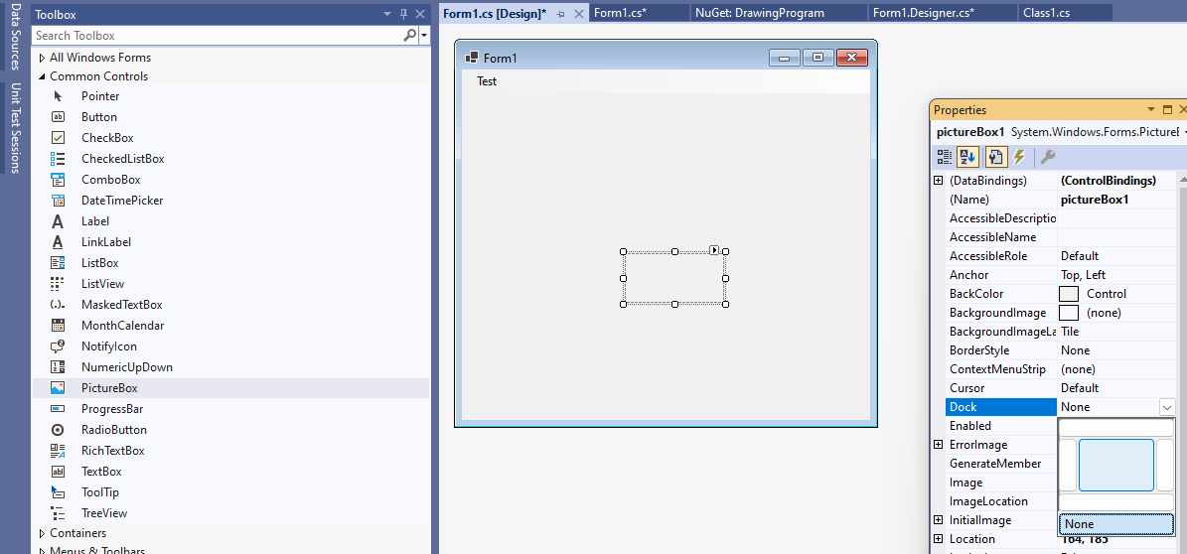
Add a Picture Box (and set the dock property)

Slide 9
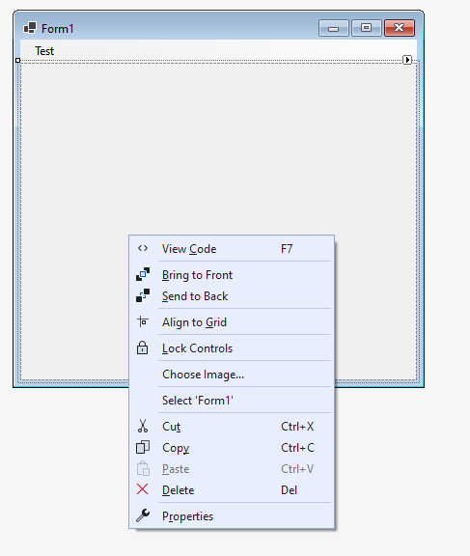
Switch to the Code Behind View

Slide 10
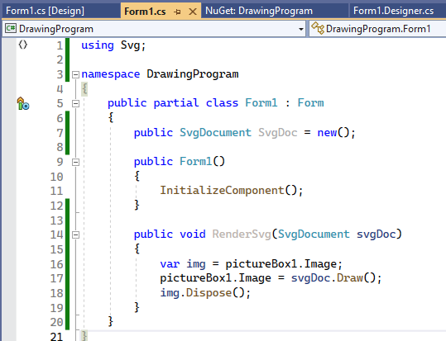
Write Some Code

Slide 11
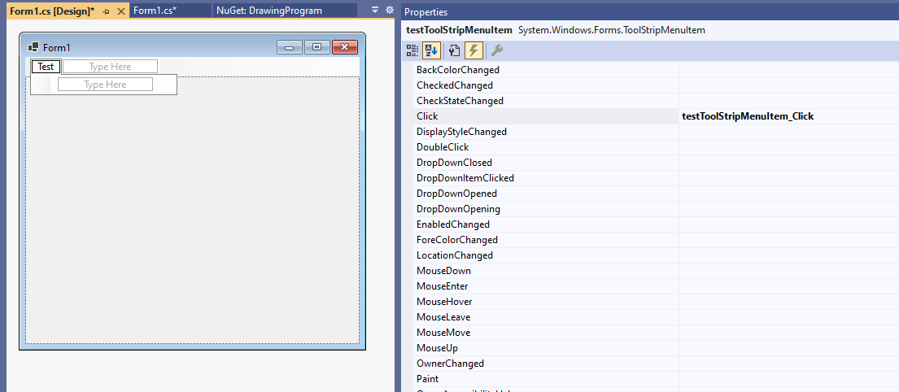
Add an Event for Menu Item

Slide 12

An Event Handler is Generated

Slide 13
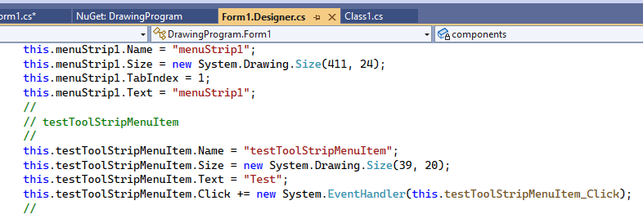
Behind the Scenes Code is add to the “Designer.cs” file

Slide 14
How Events Work:
An event is just a list of functions with the same signature
These functions are called “event handlers”
Event handlers can be added or removed from an event using += or -=
Event handlers can be methods (static or instance) or lambdas
Events are raised using the “Invoke” function
When an event is raised all event handlers are called

Slide 15
What the Heck are Delegates
A delegate is a type that refers to a function as data
Instances of delegates might be methods or lambdas
They are just like Func<…> types

Slide 16
Recommended Reading
https://learn.microsoft.com/en-us/dotnet/standard/events/
https://learn.microsoft.com/en-us/dotnet/csharp/language-reference/keywords/event
https://learn.microsoft.com/en-us/dotnet/csharp/programming-guide/delegates/

Slide 17
Observer Pattern
Events are an example of the observer pattern
In the observer software design pattern – an object, called the subject, maintains a list of its dependents, called observers, and notifies them automatically of any state changes.
https://en.wikipedia.org/wiki/Observer_pattern

Slide 18
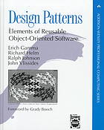
What is a “Software Design Pattern”
In theory it is a general, reusable solution to a commonly occurring problem within a given context in software design.
However, much of the industry uses the term to refer to what remains a largely unchanged set of object-oriented patterns that were first published in 1993

Slide 19
Other approaches are possible
Data Binding (INotifyPropertyChanged)
Use a message queue (aka Publisher Subscriber Pattern)
Model View Update (MVU Pattern)
Reactive Programming

Slide 20
Back to ouR PROGRAM

Slide 21
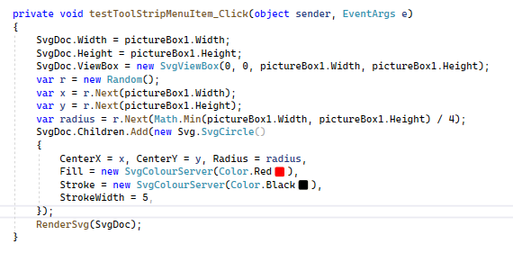
Adding some Code

Slide 22
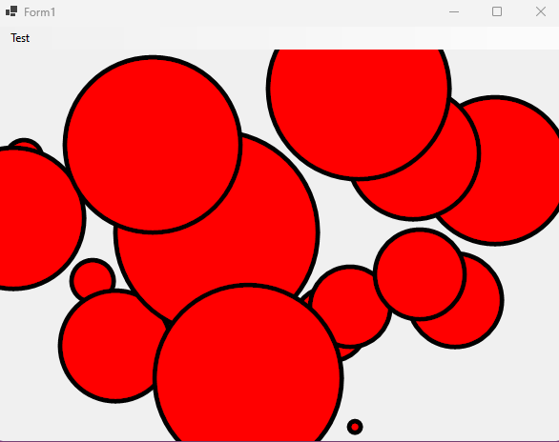
It begins!

Slide 23
How do I …
Select a shape once it is created?
Click and create a shape?

Slide 24
Building Blocks
Functions
Data types

Slide 25
Interfaces first Data Types Second

Slide 26
Serializing Types

