Slide 1
Today’s Goal
Deepen our understanding of C# by diving into strings and characters

Slide 2
Goal Breakdown
Become more familiar with C# syntax and semantics
Understand the concepts introduced using real examples
How using Unit tests can help your understanding
Learn about how text and characters are represented

Slide 3
Advice
Consider each line of code
What is it doing?
Why is each symbol or element there?
What parts are confusing?
Why does the program do what it is doing?

Slide 4
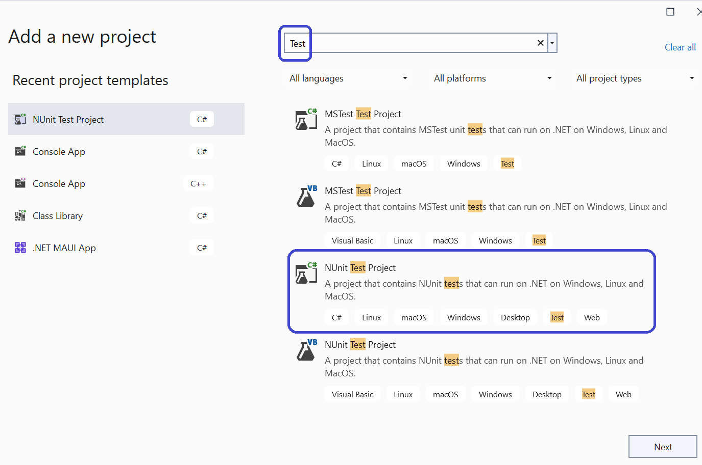
Test Projects: A special kind of library

Slide 5
Test Projects
They provide tool support for running tests in the IDE
We will be creating test projects in the lab
Useful for exploratory coding and … well … testing

Slide 6
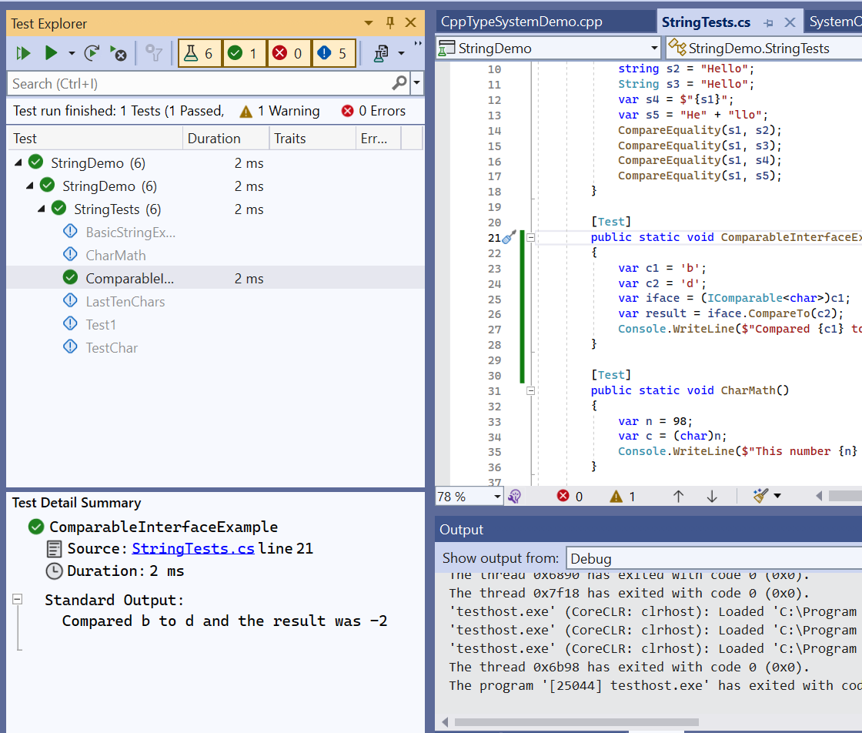
The Test Explorer Window

Slide 7
What is a String?
A representation of text values as sequences of characters

Slide 8
Consider the Following
Are strings value types (“structs”) and allocated on the stack?
Or are they reference types (“classes”) and allocated on the heap?
What about chars?
Why?

Slide 9
Strings
https://learn.microsoft.com/en-us/dotnet/csharp/programming-guide/strings/
A string is an object of type System.String whose value represents text.
Internally, the text is stored as a sequential read-only collection of char objects
The keyword “string” is an alias for the type “System.String”

Slide 10
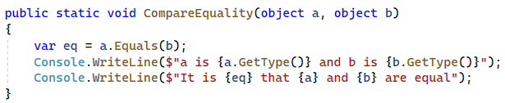
A Helper Function for Today

Slide 11
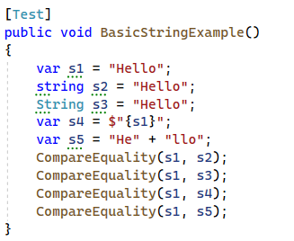
String VARiable DECLARATION

Slide 12
The Take-away
No observable difference between “string” and “System.String”
Local variable declarations can (and should) use var
Use the “string” alias in your code
See the Microsoft coding guidelines

Slide 13
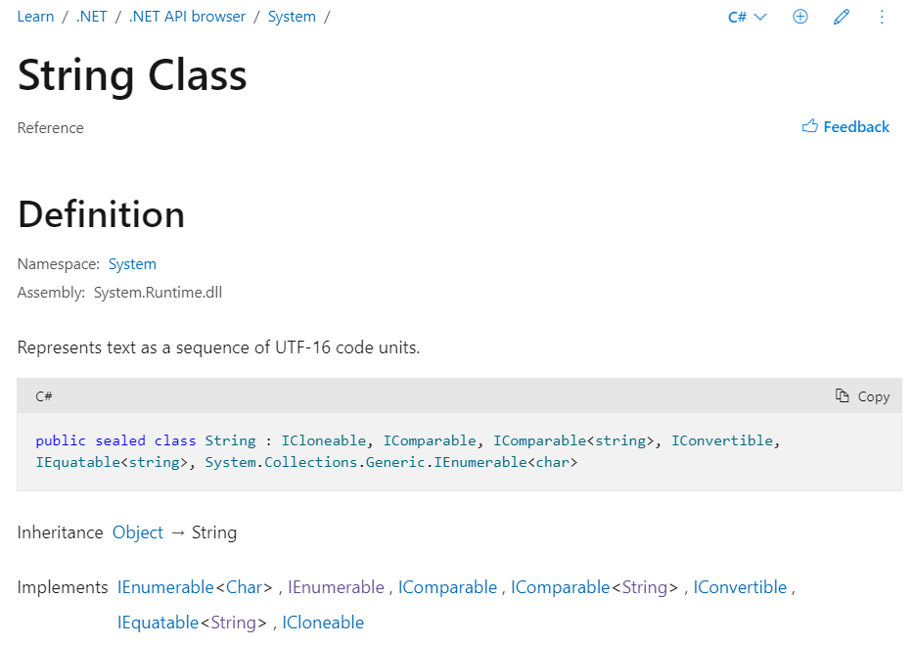
System.String Documentation

Slide 14
Reading the documentation
It said that it was a “class” (so it is a reference type)
It said that it derives from “System.Object”
This means that it shares the methods (functions) of System.Object
We already know that everything derives from System.Object
What is a UTF-16 Code Unit?
What does it mean that it “implements interfaces”?

Slide 15

Why is string a class?

Slide 16
So What’s a Char
A Char is primitive value type
It has two bytes, and represents a Unicode UTF-16 character.
It is classified as an integral type by the specification:
The char keywords is an alias for the type System.Char
See the language reference and the type documentation

Slide 17
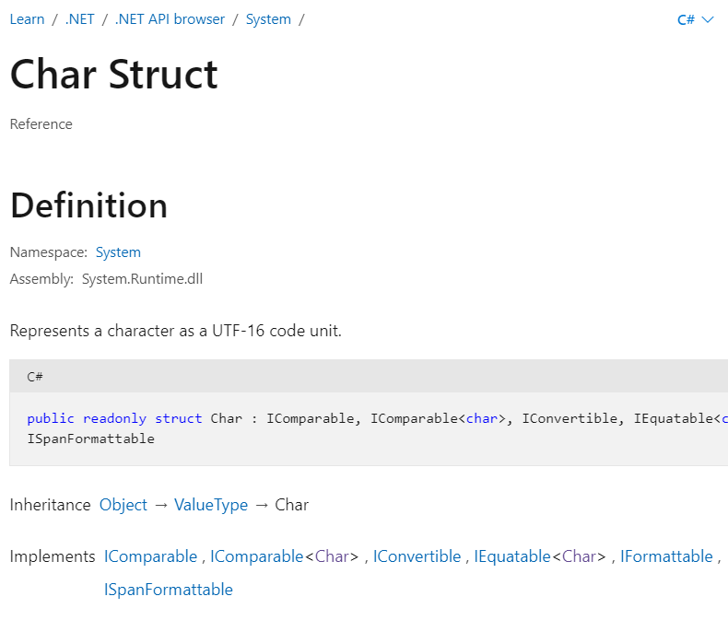
The System.Char Documentation

Slide 18
Salient Points from Documentation
It’s a struct
It derives from ValueType
All structs derive from ValueType automatically
It implements a number of interfaces like IComparable

Slide 19
What “Implementing Interfaces” means
An interface is a kind of contract
It states a set of methods and properties that a class or struct may implement
An interface is also a type

Slide 20
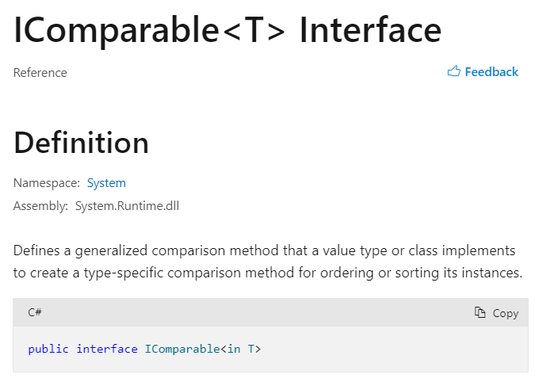
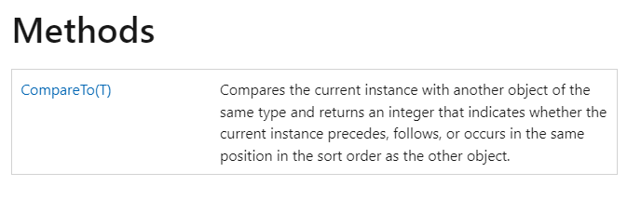
Interface Example

Slide 21
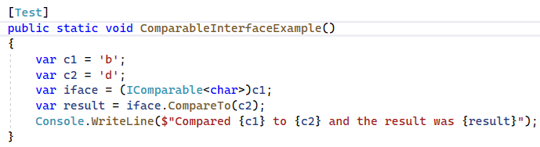
Code Example of IComparable

Slide 22
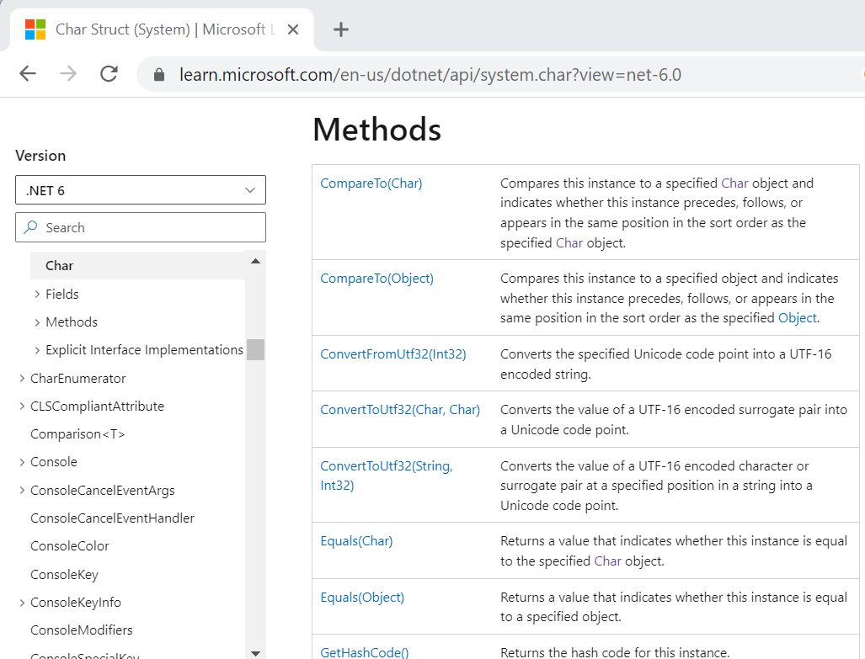
The Interface Methods are on the Type

Slide 23
Glyph
A graphic symbol that represents a character
An element of a typeface (aka font fontamily)
Letters (e.g., ‘e’) and diacritics (e.g., accents) are separate glyphys

Slide 24
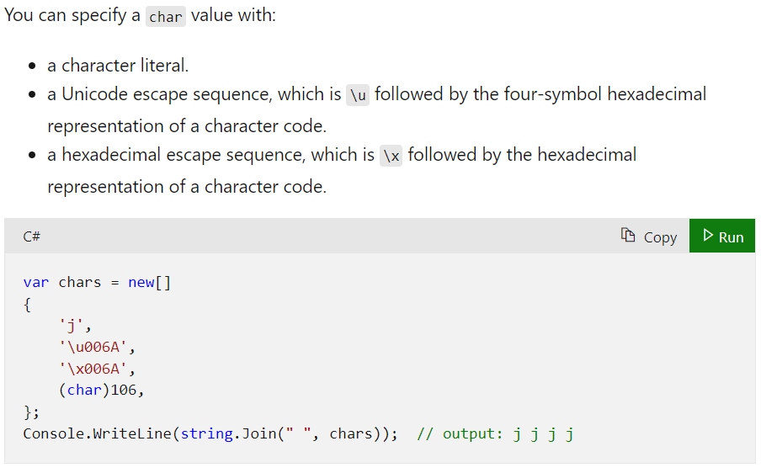
Char Literals

Slide 25
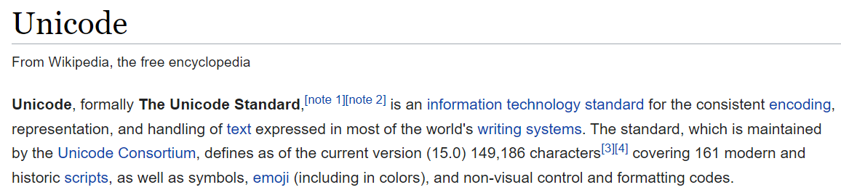
What’s Unicode?

Slide 26
What’s Utf-16
One of multiple Unicode encodings (e.g., Utf-8, Utf-16, Utf-32, GB18030)
It is variable length: Characters use either one or two 16-bit code units
Not as widely used on the web as Utf-8

Slide 27
What’s an Encoding
An assignment of numbers to characters

Slide 28
Did you see that!
Two “Chars” in a row are sometimes needed to properly display characters
This is why we disambiguate code units and code points
Code points are made up of code units
In C# a char instance is a code unit in the Utf-16 encoding

Slide 29
ASCII
ASCII is a character encoding first published as a standard in 1963
Only 128 Characters
95 are printable
33 are control codes
One byte per code point

Slide 30
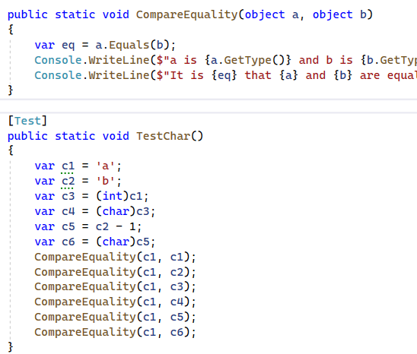
Comparing Character Equality

Slide 31
Escape Sequences
How do you write the character used to delimit char literals?
Or the character that represents a newline or tab?
Or an unprintable control code like the bell
Answer: use an escape sequence (backslash followed by code).

Slide 32
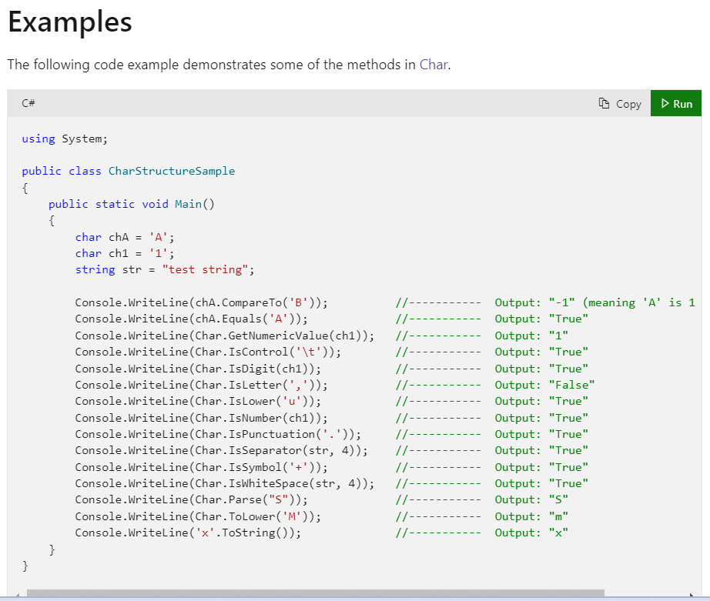
Some Char Methods

Slide 33
From String to Char
A string (s) with one character can be converted to a char in two ways:
One is to use “String.Parse”
The other is to use the indexing property of the string “string[0]”

Slide 34
Invoking Instance versus Static Methods
Some methods have the form “expression.FunctionName(<args>)”
While others have the form “typename.FunctionName(<args>)”

Slide 35

Char is not an expression
The word “Char” is the name of a type
More specifically a class within the namespace
You cannot use it where you would an expression:

Slide 36
But you can use it to call static methods
Char.IsControl
Char.IsLetterOrDigit
Char.IsUpper
Char.IsWhitespace
Etc.

Slide 37
Back to Strings

Slide 38
String Literals
Regular string literals
Verbatim string literals
Interpolated string expressions
Raw string literals (C# 11)

Slide 39
Verbatim String Literals
A verbatim string literal is preceded by the “@” character
See: https://learn.microsoft.com/en-us/dotnet/csharp/language-reference/tokens/verbatim.

Slide 40
Nul Characters
A C# string can contain any number of embedded nul characters ('\0’).
This differs from C/C++ which uses null to indicate termination
Not to be confused with the null keyword, this is a char that encodes zero

Slide 41
Useful String Functions
String.Join
01
String.IndexOf
02
String.LastIndexOf
03
String.Substring
04
String.Split
05
String.Format
06

Slide 42
Useful String Operations not on String
Int32.ParseInt
Double.TryParse()
Object.ToString();
Convertible?

Slide 43
Converting Strings to Bytes and Back

Slide 44
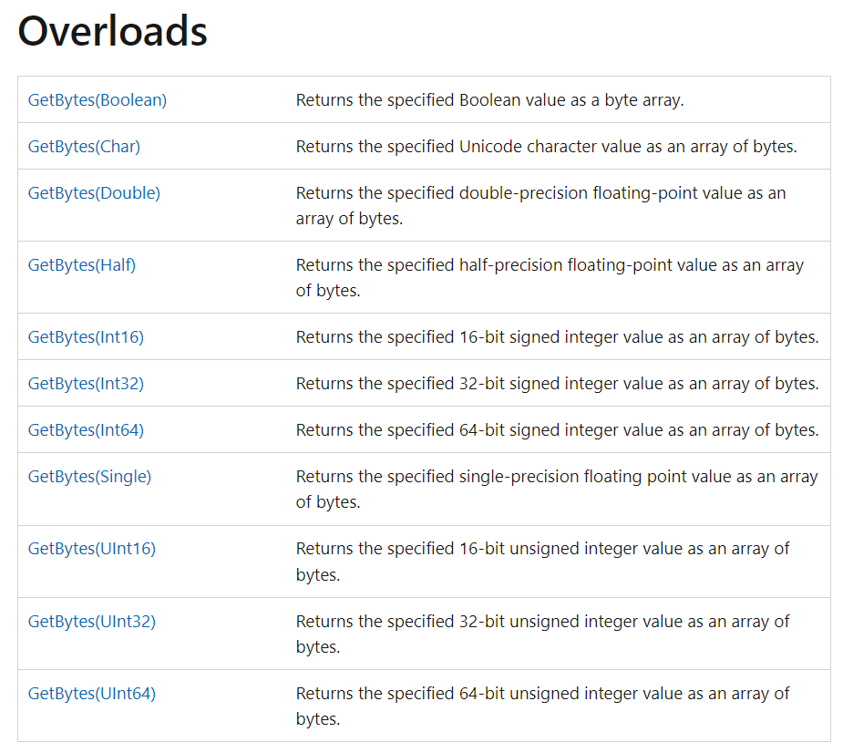
Bit Converter does not work on Strings?!

Slide 45

Remember Encodings?
string value = "\u00C4 \uD802\u0033 \u00AE"; byte[] bytes= System.Text.Encoding.UTF8.GetBytes(value);
System.Text.Encoding.UTF8.GetBytes(value);
We have to use one of those:
System.Text.Encoding.UTF8.GetBytes(value);
System.Text.Encoding.UTF16.GetBytes(value);
System.Text.Encoding.ASCIIEncoding.GetBytes(value);

Slide 46
String Immutability
String objects are immutable: they can't be changed after they've been created
Methods and C# operators either query a string or create a new string object

Slide 47
So how do you build them?
StringBuilder class
String.Format
String interpolation expression
Concatenation
From an array of chars

Slide 48
String Operators
+ String concatenation
+= String concatenation and assignment
== Equality
!= Inequality

Slide 49
Strings are Like Arrays
They have a Length property
They support indexing using an integer index
In other words you can get the nth character using a subscript

Slide 50
Wait, what is a property?
A property is a type member that resembles a field (data member)
It may redirect to a field or to a function under the hood
It may be read-only, read-write, or write-only (rare)
An example is the “Length” property of arrays and strings, or “Count” property of Lists
Like other members it may be static or instance based

Slide 51
Indexers
An indexer allows a type instance to be indexed like an array or dictionary
An indexer can accept any type of parameters (like an int, string, object.)

Slide 52

String Formatting
Before string interpolation we had string formatting routines
Like a safe and powerful version of the C function sprintf().
String.Format()

Slide 53
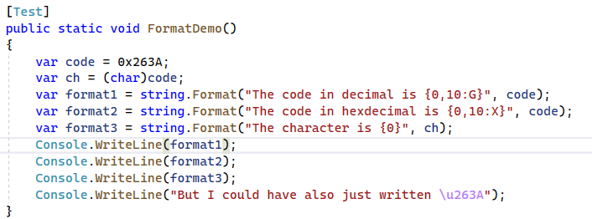
String Formatting

Slide 54
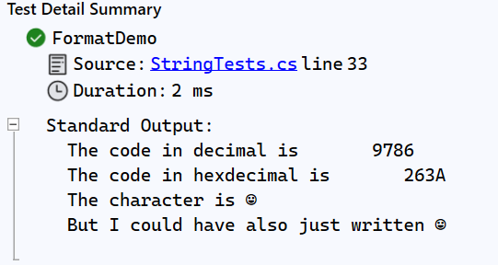

Slide 55
The Null Literal
The null keyword represents a reference that does not refer to an object.
It has a special type (called the null type) but can be cast to any reference type
Reference variables are assigned null by default
In other words it means “no value”

Slide 56
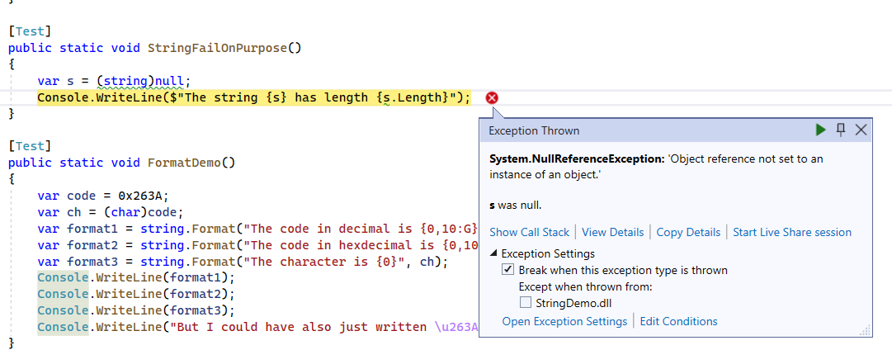
NullReferenceException

Slide 57
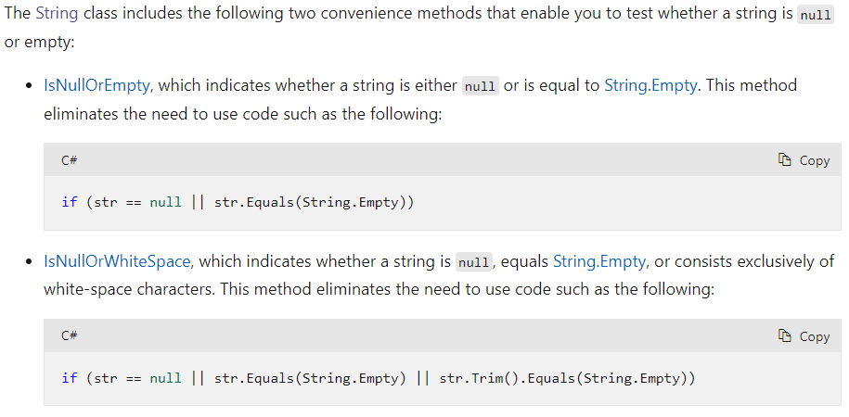
Checking if Strings are Null or Empty

Slide 58
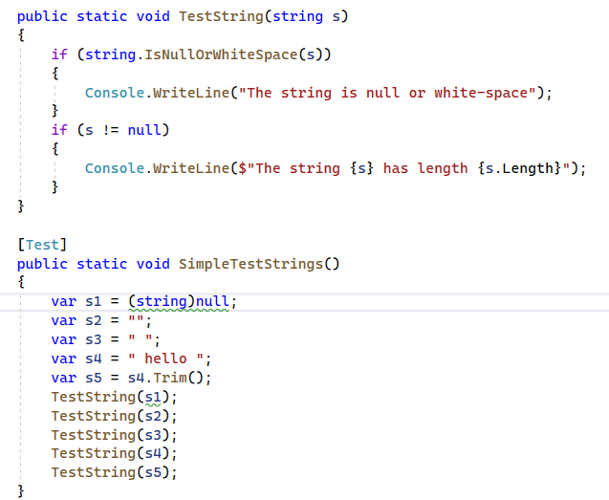
String Queries

Slide 59
Strings are Enumerable
Strings implement “IEnumerable”
This means you can loop through the characters with a foreach

Slide 60

Next Class
Collections
Foreach loops
Interfaces in a more depth
Indexers in more depth
Iterators

