Slide 1
Polymorphism

Slide 2
Inheritance
A class C can derive from another class B
Class B is called the base class (also superclass)
Class C is called the derived class (also subclass)

Slide 3
When Inheriting
Derived class inherits all members of base class
Nothing can be removed
Things can be added
Things can be made more visible not less

Slide 4
Some rules of inheritance for C#
A class can only inherit from one other class
Classes cannot inherit from a struct
Structs cannot inherit from anything
If you don’t specify a base class, it implies System.Object

Slide 5
Inheritance is used in different ways
To reuse code
To describe is-a relationship between entities
To provide a supertype / subtype
To write functions that operate on groups of types

Slide 6

Subtype
An instance of Class C can be used wherever an instance of Class B is requested
This means that C is a “subtype” of B
We can also call C a “specialization” of B
Conversely, B is a “supertype” of C
We can also say B is a “generalization” of B

Slide 7
Multiple Kinds of Polymorphism
Ad-hoc polymorphism – a.k.a. function overloading
Parametric polymorphism – e.g., generic methods
Subtyping – e.g., when implied by inheritance in C# or Java
Discussed quite well on Wikipedia

Slide 8

Subtype Polymorphism
In OOP context, the most common meaning of polymorphism
The ability for a type identifier to represent a set of types
Within the context of a function or interface
In this case the base class is polymorphic
As is any function consuming a base class
Recommend reading about subtype polymorphism on Microsoft Learn.

Slide 9
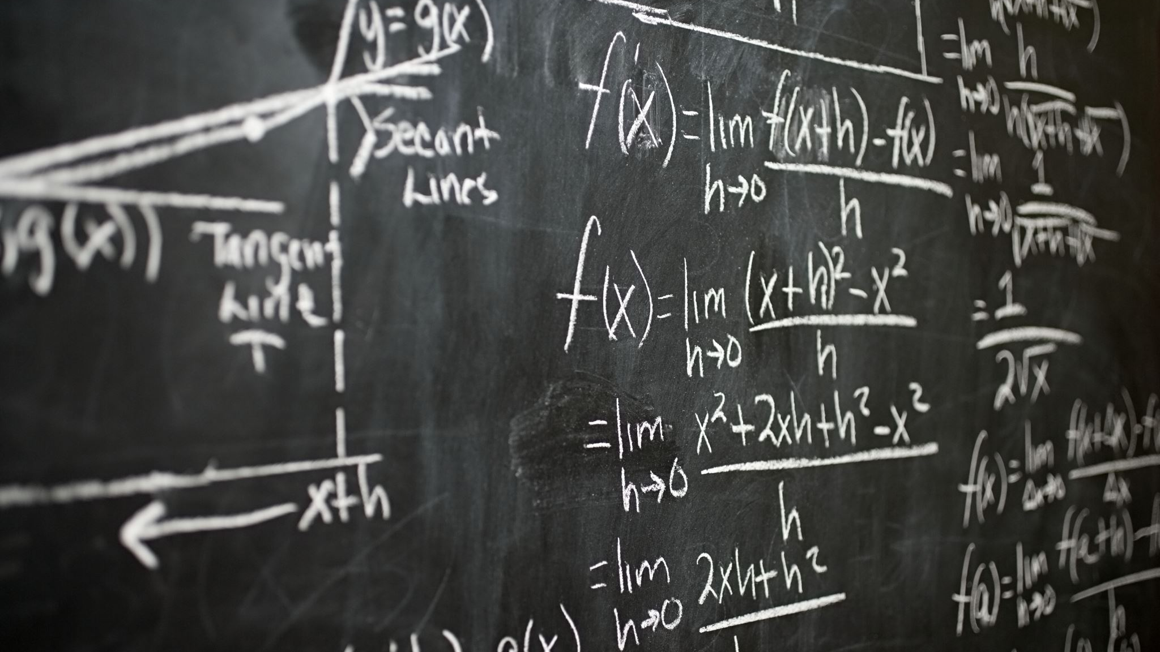
Is Inheritance Equal to Subtyping?
Formally, in C# the answer is yes
Only from the point of view of the type system
Remember type-system validates expressions (not values)
Run-time is a different story

Slide 10
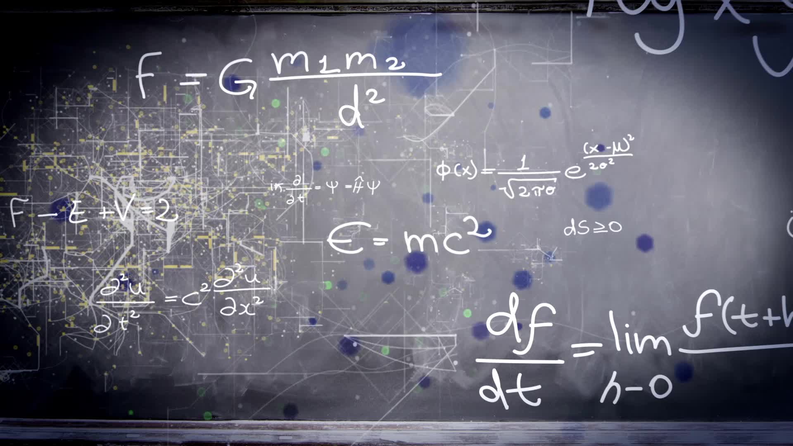
Liskov Substitution Principle
The “L” in the SOLID principles
A principle of substitutability
Any instance of a type should be able to be replaced by instances of subtype
Should not “break” the program (alter desirable characteristics)
Applies both to type system and to run-time behavior

Slide 11
Example: Calendar Application
ScheduledItem
Task
Checklist
Meeting
Out of office
Reminder

Slide 12
Using a Base Class in a Collection
A big advantage of subtyping is that we can have similar items in a collection
01
You define the collection to contain the base class
02
For example: List<ScheduledItem>
03
Operations that are common to the base class can be applied to all elements
04

Slide 13
Don’t use Inheritance to Reuse Code
Prefer composition instead
Inheritance implies a “is-a” relationship between entities
Composition implies a “has-a” relationship between entities
Small amount of extra coding (have to forward functions)
Still better and safer

Slide 14
Composition
The idea that one object may contain another
Any class with any fields is an example of composition
Trivial concept, but used to describe alternative to inheritance

Slide 15
Class Relationships
Is-a relationship – inheritance
Has-a relationship – composition

Slide 16
Upcast and Downcasts
Upcasting from a class to a super type (base class) always works
Conversion happens implicitly
Downcasting from a base class to a derived class may or may not work
Require an explicit conversion

Slide 17
What if Explicit Conversion Fails?
An exception is thrown.
You have to catch the exception or the program halts
There is a safer alternative

Slide 18
The “as” operator
Casting to a derived type can be done safely using the “as” operator.
If the run-time type of the object does not match returns null
If successful returns an expression that has the cast type

Slide 19
The “is” operator
Checks if a value (result of expression) is of a given type
Returns true if the run-time type matches the requested type
Note: in recent C# versions also allows pattern matching

Slide 20
Overview: checking the run-time type
Use the “is” operator: expr is Type
Use the “as” operator and check for null: (expr as Type) == null
Call “GetType()” on the object (tricky)
Use an explicit cast conversion: (Type)expr and catch InvalidCastException
Try catch is a bad idea here
See Microsoft learn documentation

Slide 21
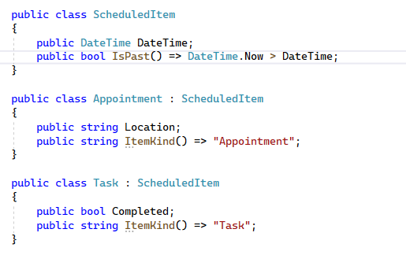
Consider Functions on Every Derived Class

Slide 22
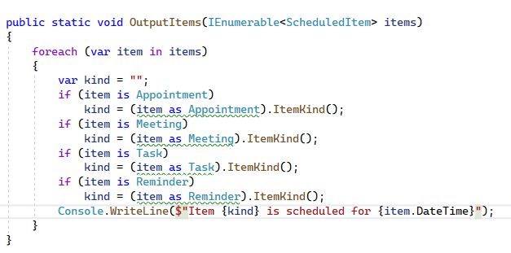

Slide 23
That function can be improved
The “is” operator can also declare a variable name.
It makes an improvement in the code readability

Slide 24
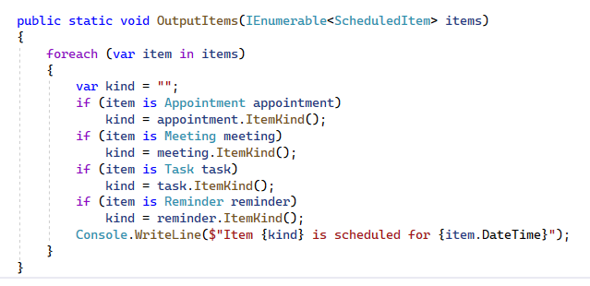

Slide 25

Still not ideal:
Using the function is complex
What if there are a lot of base classes?
What if we want many functions for ScheduledItem?
Ideally we want complexity hidden in the class
This is where “virtual” functions come in useful

Slide 26
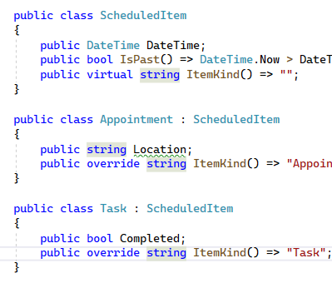
Using a virtual function

Slide 27
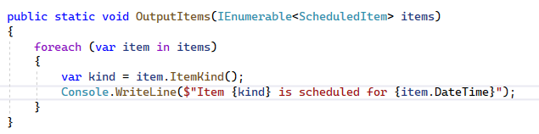
Now the function is Simpler

Slide 28
Understanding Virtual Functions
When a virtual function is called on a base class
If the run-time type of the value is different (a derived class)
If an override of the virtual function exists (on the derived class)
Then the override is called
This is called “dynamic dispatch”
It happens thanks to a “virtual method table”
Please read the Microsoft Learn documentation for the virtual keyword for C#

Slide 29
Examples of Virtual Functions
It is good practice to override virtual functions from System.Object.
virtual string Object.ToString();
virtual bool Object.Equals(object? other);
virtual int Object.GetHashCode();

Slide 30
Should we use ScheduledItem directly?
There are many things that are a ScheduledItem but what use it the class itself?
Its main role is to describe a family of types (it’s subtypes)
So perhaps we should prevent it from being used directly

Slide 31
Abstract Class
The abstract keyword (on a class) prevents it from being instantiated
In other words, you can’t call new.
Allows adding abstract methods

Slide 32
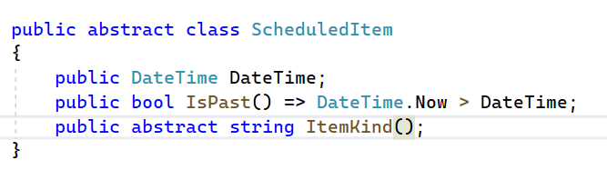
Abstract Class with Abstract Method

Slide 33
Abstract Method
An abstract method is a virtual function with no body
It is only allowed on abstract classes
All classes that derive from the class, must override the abstract method

