Slide 1
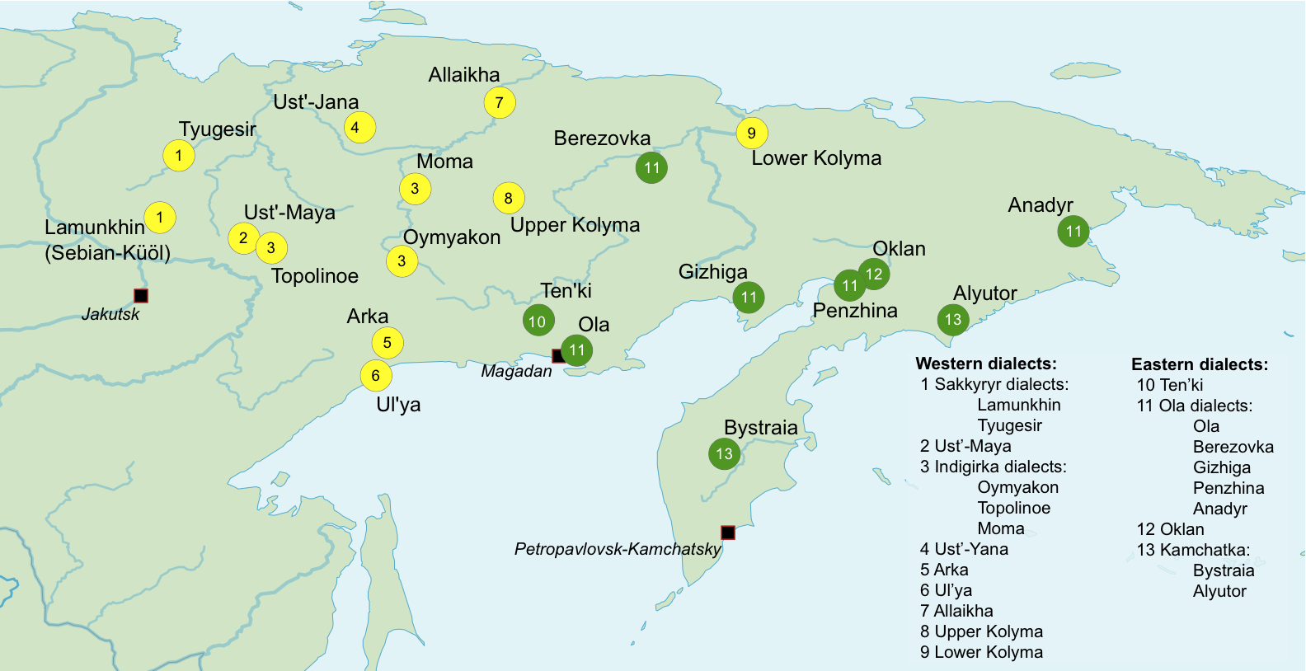
Distribution of Even dialects
yellow = western dialects
green = eastern dialects
Map by Natalia Aralova & Hans-Jörg Bibiko

Slide 2
Fieldwork data from 2 dialects:
1)
2)
Lamunkhin
Bystraja
Map by Natalia Aralova & Hans-Jörg Bibiko

Slide 3
Fieldwork data from 2 dialects:
Lamunkhin (LAM)
Bystraja (BYS)
western dialect
spoken in Sebjan-Küöl (Yakutia)
still viable (passed on to children)
intense contact with Turkic language Sakha (Yakut)
eastern dialect
spoken in central Kamchatka
moribund dialect (speakers ≥ 40 yrs)
rapid language death, shift to Russian

Slide 4
Some more information on Sebjan-Küöl (2009 household data)
863 inhabitants
731 Evens (84.7%)
64 Sakha (7.4%)
18 Russians and Ukrainians
1 Tatar, 1 Buryat, 1 Yukaghir
47 unspecified

Slide 5
Some more information on Lamunkhin Even
dialect still viable: some children are still acquiring Even as their home language
practically all Even speakers are bilingual in Sakha (actually, trilingual in Even, Sakha, and Russian) → Sakha picked up from peers in kindergarten and at school

