Slide 1

Time Series Analysis and Forecasting
08 ^{th} September, 2025
-PRATHIBHA R

Slide 2


Slide 3
Agenda
Time Series – Definition and Example
Applications of Time Series
Time Series Components
Types of Time Series Analysis
Processing Time Series Data
Time Series Analysis and Decomposition
Time Series Forecasting Algorithms
Evaluating Time Series

Slide 4
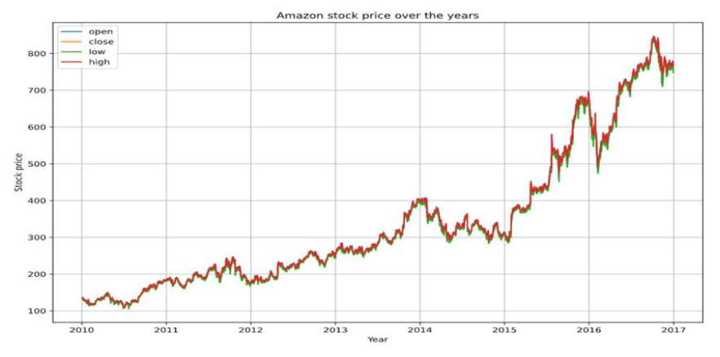
Time Series
A time series is a series of statistical observations that are arranged in chronological order that are collected at successive, regular intervals over time.
Example: Amazon stock price over a time period

Slide 5
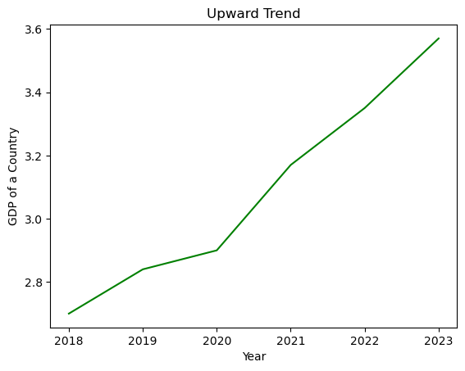
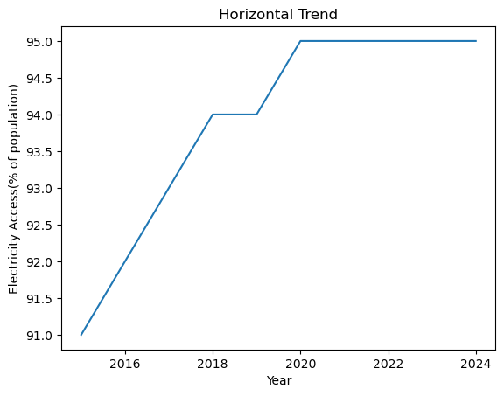
Time Series Components - Trend
Trend → Long-term direction
Upward trend in country’s GDP
Horizontal trend in electricity access in India

Slide 6
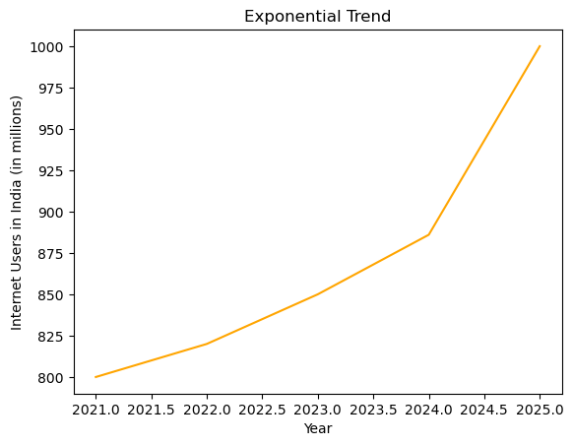
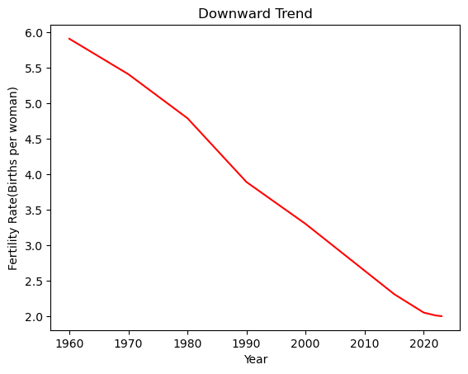
Time Series Components - Trend
Exponential trend in internet users in India
Downward trend in fertility rate of women in India

Slide 7
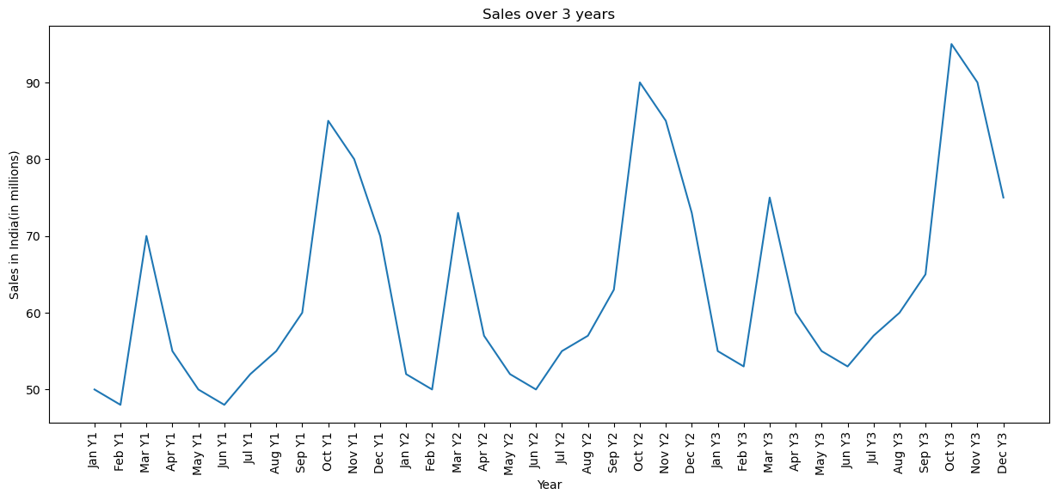
Time Series Components - Seasonality
Seasonality → Regular calendar based repeating patterns
Example : In India, sales peak during
Festive seasons
Holi : Mar Y1 (70), Mar Y2 (73), Mar Y3 (75)
Diwali : Oct Y1 (85), Oct Y2 (90), Oct Y3 (95)

Slide 8
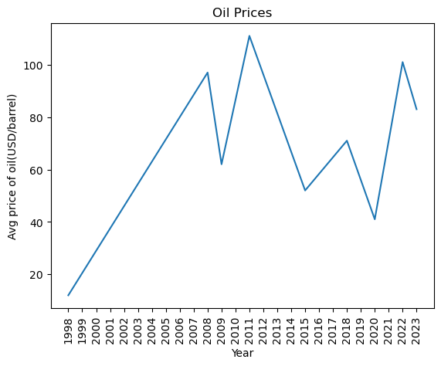
Time Series Components - Cyclicality
Cyclicality → Irregular long-term cycles
Not strictly calendar-based, unlike seasonality.
Example : Oil price boom over the years
(2008, 2011, 2022)

Slide 9
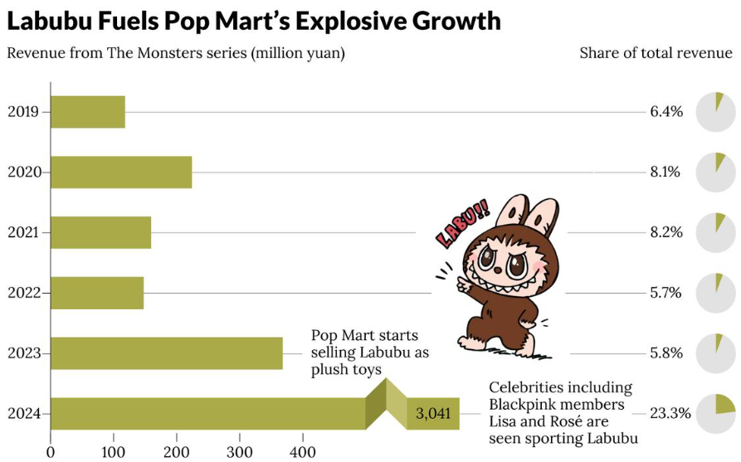
Time Series Components - Noise
Noise/Irregular → Short-term shocks or
unexpected events that disrupt normal patterns.
Example : Viral fashion trends(Labubu doll)
leading to sudden spike in demand.

Slide 10
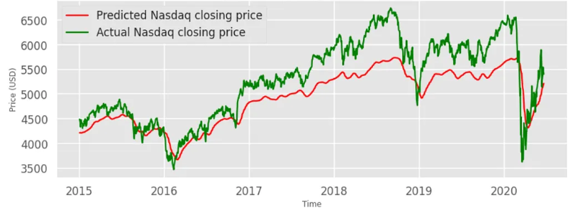
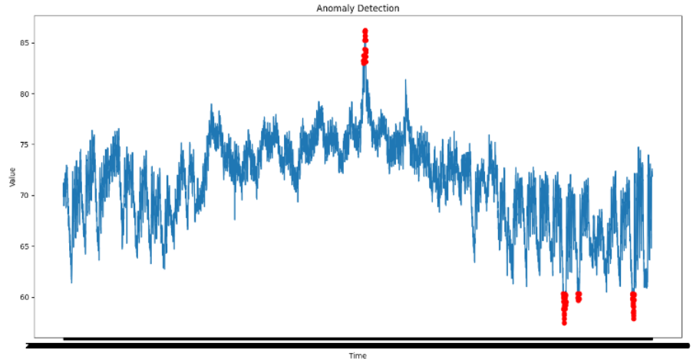
Applications of Time Series
Predict Future Trends Detect Patterns and Anomalies

Slide 11
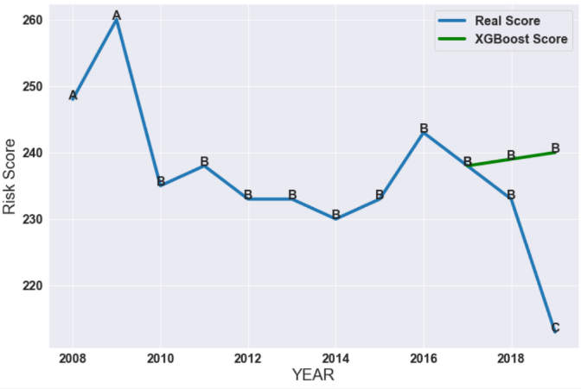
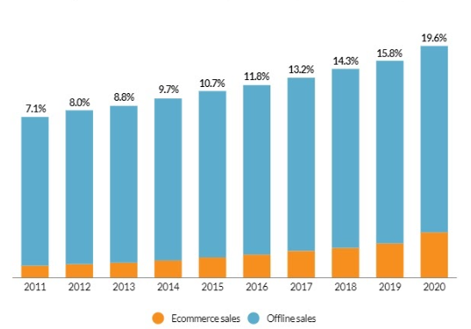
Applications of Time Series
Risk Mitigation Strategic planning & Resource Optimization

Slide 12
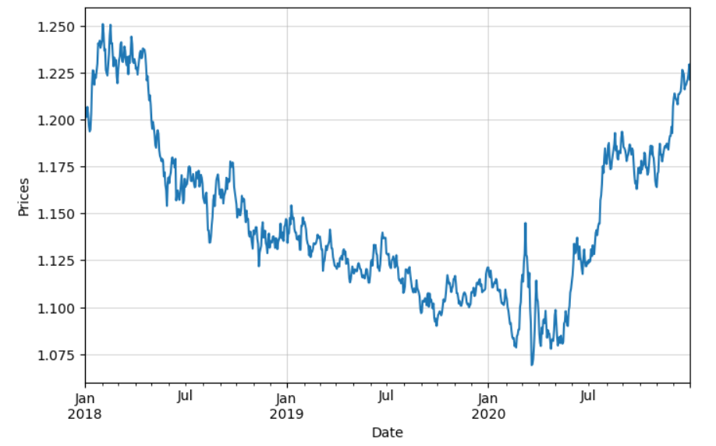
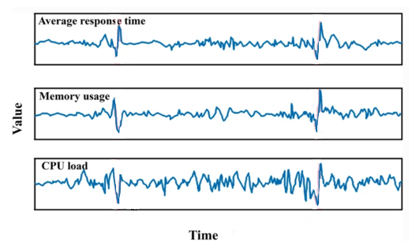
Time Series Types
Univariate Time Series – single time-dependent variable
Multivariate Time Series – more than one time series variable
Univariate
Multivariate

Slide 13
Data Preprocessing for Time Series
Stationarity
Differencing
Moving average
Exponential moving average
Missing value imputation
Log Data transformation
Z – Scaling Normalization
Min-Max Normalization

Slide 14
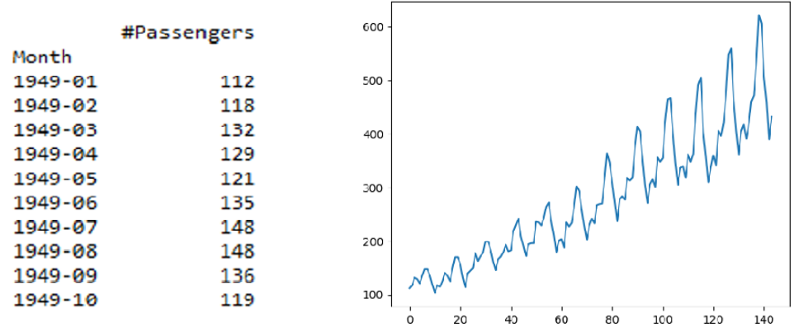
Data Preprocessing - Stationarity
A time series is stationary if its statistical properties (like mean, variance) are constant over time.
Properties do not depend on the time at which the series is observed.
Has no predictable patterns in the long-term.
Example: Airlines passenger count, Stock returns
Mean 1 | Mean 2 | Mean 3
150 | 160 | 155
Variance 1 | Variance 2 | Variance 3
33 | 35 | 37

Slide 15

Data Preprocessing - Differencing
Differencing is subtracting current value from its lagged value to remove trends and seasonality.
Makes series stationary by removing trend/seasonality.
First-order differencing(Y′​): removes linear trends.
$Y^{′}=$Y_{t} – Y_{t-1}
Seasonal differencing(Y′​′​): removes seasonal patterns.
$Y^{′′}=$Y_{t} – Y_{t-12}

Slide 16
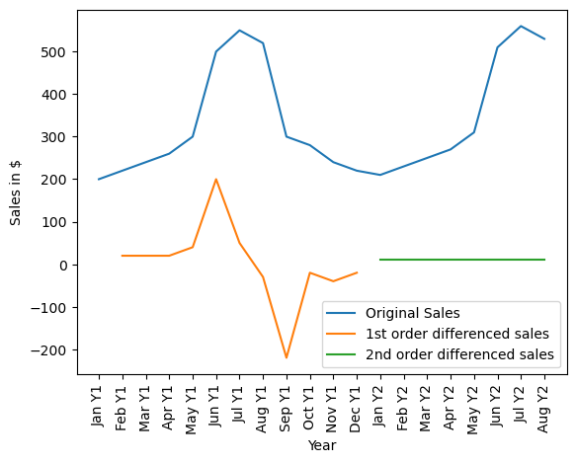
Data Preprocessing - Differencing
Example: Seasonal sales data - Seasonal differencing removes repeating peaks.
Month | Original Sales (Y) | 1st Order Diff (Y′​=Y_{t}​−Y_{t−1}​) | 2nd Order Diff (Y′′​=Y_{t}​−Y_{t−12})
Jan | 200
Feb | 220 | 20
Mar | 240 | 20
Apr | 260 | 20
May | 300 | 40
Jun | 500 | 200
Jul | 550 | 50
Aug | 520 | -30
Sep | 300 | -220
Oct | 280 | -20
Nov | 240 | -40
Dec | 220 | -20
Jan (next yr) | 210 |  | 10
Feb (next yr) | 230 |  | 10
Mar (next yr) | 250 |  | 10
Apr (next yr) | 270 |  | 10
May (next yr) | 310 |  | 10
Jun (next yr) | 510 |  | 10
Jul (next yr) | 560 |  | 10
Aug (next yr) | 530 |  | 10

Slide 17
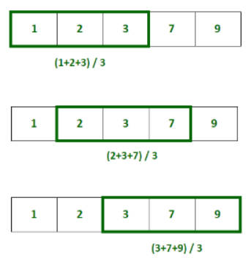
Data Preprocessing – Moving Average
Highlights medium/long-term trends while reducing noise.
Smooths data by averaging values over a fixed window.

Slide 18
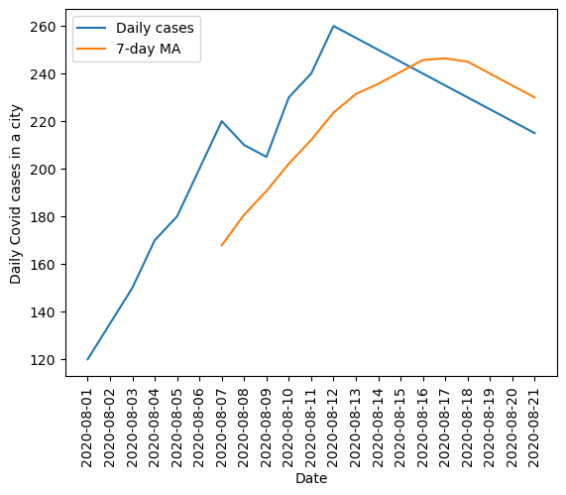
Data Preprocessing – Moving Average
Example: COVID-19 daily cases: 7-day MA smooths weekday-weekend reporting fluctuations.
Date | Daily Cases | 7-day MA
2020-08-01 | 120 | —
2020-08-02 | 135 | —
2020-08-03 | 150 | —
2020-08-04 | 170 | —
2020-08-05 | 180 | —
2020-08-06 | 200 | —
2020-08-07 | 220 | 167.9
2020-08-08 | 210 | 180.7
2020-08-09 | 205 | 190.7
2020-08-10 | 230 | 202.1
2020-08-11 | 240 | 212.1
2020-08-12 | 260 | 223.6
2020-08-13 | 255 | 231.4
2020-08-14 | 250 | 235.7
2020-08-15 | 245 | 240.7
2020-08-16 | 240 | 245.7
2020-08-17 | 235 | 246.4
2020-08-18 | 230 | 245.0
2020-08-19 | 225 | 240.0
2020-08-20 | 220 | 235.0
2020-08-21 | 215 | 230.0

Slide 19
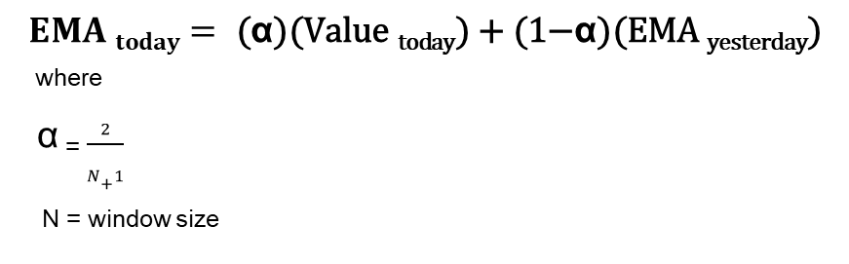
Data Preprocessing – Exponential Moving Average
Weighted average where recent values get more weight.
Better for capturing recent shifts in trend than MA.
Example: Financial trading: (12-day) is used for reacting faster to new price.
The first EMA value is usually initialized as the Simple Moving Average (SMA) of the first N days.
The remaining EMA values are given by the below formula:
$$EMA today=\text{ (}\text{α}\text{)(}\text{Value} \text{today}\text{) + (1−}\text{α}\text{)(}\text{EMA} \text{yesterday}\text{)}$$
where
$\text{α}$ ₌ $\frac{\begin{aligned}2 \\ \end{aligned}}{N+1}$
_{N = window size}

Slide 20
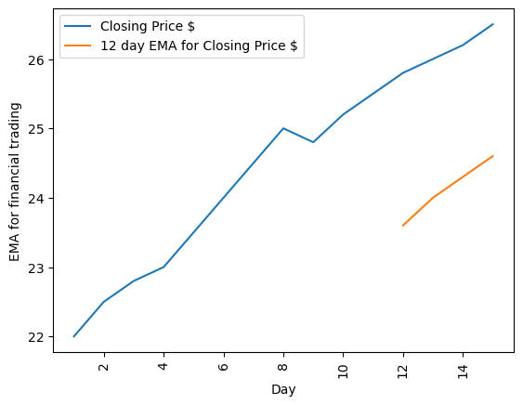

Data Preprocessing – Exponential Moving Average
Example: Financial trading: (12-day) is used for reacting faster to new price.
For 12 day EMA, $α=\frac{2}{13}≈0.1538$
Day | Closing Price ($) | 12-day EMA for Closing Price
1 | 22
2 | 22.5
3 | 22.8
4 | 23
5 | 23.5
6 | 24
7 | 24.5
8 | 25
9 | 24.8
10 | 25.2
11 | 25.5
12 | 25.8 | 23.6 (using SMA)
13 | 26 | 24.0 (using EMA)
14 | 26.2 | 24.3 (using EMA)
15 | 26.5 | 24.6 (using EMA)
$$EMA today=\text{ (0.1538)(}\text{Price} \text{today}\text{) + (0.8462)(}\text{EMA} \text{yesterday}\text{)}$$

Slide 21
Data Preprocessing – Missing Value Imputation
Replace missing values using methods like forward fill, backward fill, interpolation.
Prevents gaps that can break forecasting models or anomaly detectors.
Example: Sensor readings in IoT - If a temperature sensor skips a minute, interpolate values.
Missing value imputation using Forward Fill
Time | Sensor Reading | After Forward Fill
08:00 | 21.5 | 21.5
08:05 | — (missing) | 21.5
08:10 | — (missing) | 21.5
08:15 | 22.0 | 22.0
08:20 | 22.3 | 22.3
08:25 | — (missing) | 22.3
08:30 | 22.8 | 22.8
08:35 | 23.0 | 23.0

Slide 22
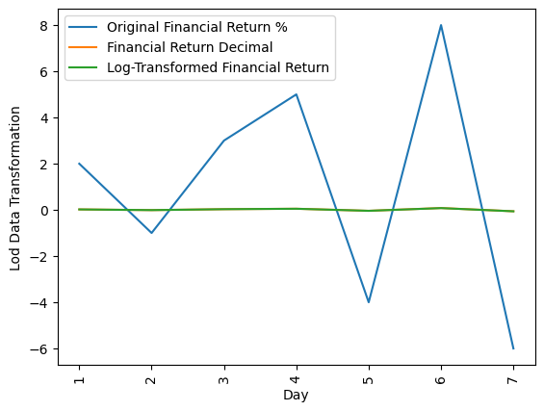
Data Preprocessing – Log Data Transformation
Stabilizes variance and makes series more linear for regression/forecasting by using techniques like log
transformation.
Makes data less sensitive to large values.
Improved Interpretability of Percentage Changes
Example: Financial returns often use log transformation to handle exponential growth of asset prices.
Day | Financial Return (%) | Financial Return (Decimal) | Log-Transformed (ln(1+R))
1 | +2.0% | 0.0200 | 0.0198
2 | -1.0% | -0.0100 | -0.0101
3 | +3.0% | 0.0300 | 0.0296
4 | +5.0% | 0.0500 | 0.0488
5 | -4.0% | -0.0400 | -0.0408
6 | +8.0% | 0.0800 | 0.0769
7 | -6.0% | -0.0600 | -0.0619

Slide 23

Data Preprocessing – Z-Scaling Normalization
Rescale values using $z score={\left(x−\text{μ}\right)}/σ$
Many ML algorithms require comparable scales.
Example: Weather data - Standardizing temperature (°C), rainfall (mm), and wind speed (km/h)
Day | Temp (°C) | Rainfall (mm) | Wind Speed (km/h)
1 | 20 | 5 | 15
2 | 22 | 0 | 10
3 | 25 | 10 | 20
4 | 18 | 2 | 12
5 | 30 | 15 | 25
Day | Temp (Z) | Rainfall (Z) | Wind Speed (Z)
1 | (20−23)/4.18 = -0.72 | (5−6.4)/5.94 = -0.24 | (15−16.4)/5.16 = -0.27
2 | (22−23)/4.18 = -0.24 | (0−6.4)/5.94 = -1.07 | (10−16.4)/5.16 = -1.24
3 | (25−23)/4.18 = +0.48 | (10−6.4)/5.94 = +0.61 | (20−16.4)/5.16 = +0.70
4 | (18−23)/4.18 = -1.20 | (2−6.4)/5.94 = -0.74 | (12−16.4)/5.16 = -0.85
5 | (30−23)/4.18 = +1.68 | (15−6.4)/5.94 = +1.45 | (25−16.4)/5.16 = +1.67

Slide 24

Data Preprocessing – Min-Max Normalization
Adjusts the data into a fixed range (commonly [0,1]) using $X^{′}=(Xmax −Xmin)/(X−Xmin)$ where
X_{min} = 0, X_{max} = 255, X = actual value
Ensures features fit into a bounded range.
Example: Image pixel intensities - Normalize between [0,1]
Time (Frame) | Pixel Row 1 | Pixel Row 2 | Pixel Row 3
1 | 0 | 128 | 255
2 | 64 | 200 | 180
3 | 32 | 90 | 220
Time (Frame) | Pixel Row 1 (Normalized Values) | Pixel Row 2 (Normalized Values) | Pixel Row 3 (Normalized Values)
1 | 0.000 | 0.502 | 1.000
2 | 0.251 | 0.784 | 0.706
3 | 0.125 | 0.353 | 0.863

Slide 25

Problem Statement
Forecast and evaluate performance metrics of
Continental Stock’s ‘Close’ value from
2024 Sep to 2025 Sep(1 year) based on the stock
values for 10 years(2015 Sep to 2025 Sep)

Slide 26
Continental Stocks Data
Extracted data from Yahoo Finance for Continental(CON.DE) stocks:
Date – date and timestamp
Open - price of the stock when the market opens
High - highest price
Low - lowest price
Close - last price of the stock when the market closes for the day
Volume - number of shares traded during the day
Dividends - cash or stock payments a company distributes to shareholders from profits
Stock Splits - reducing the share price but keeping total value the same

Slide 27
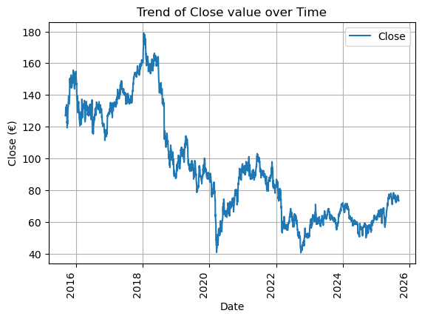
Open Value Trend wrt Date
Mean | Variance
133.90 | 87.11
133.01 | 67.27
154.84 | 130.56
98.81 | 69.42
74.76 | 216.24
89.18 | 60.90
71.00 | 166.18
57.92 | 49.46
61.73 | 29.05
65.82 | 60.11
Overall, there ‘Close’ value has a decreasing trend wrt time.
The data is not stationary as we get different mean and variance values for different groups of ‘Close’ values (Ref slide 13).

Slide 28
Data Pre-Processing
First Order Differencing is applied on ‘Close’ and ‘Open’ column to make the data stationary.
(Ref: Slide 19)
‘Date’ column is modified to have date in YYYY-mm-DD format(removed timestamp).

Slide 29
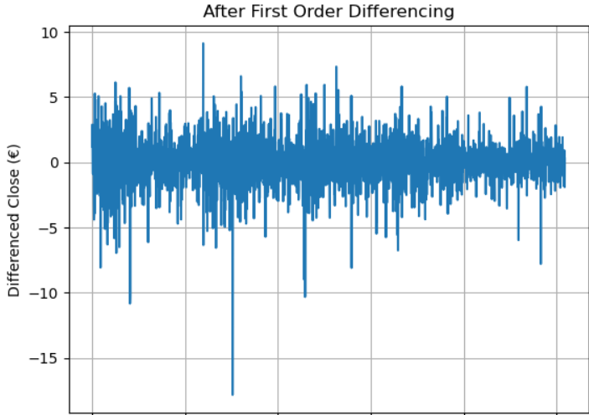

Open Value Trend wrt Date after First Order Differencing
Trends are removed and ‘Close’ values are stationary now.

Slide 30
Lags
Lag is the difference between two observations in a sequence.
Date | Actual | Lag1 | Lag2 | Lag3
2020-01-04 | 0.848963 | 0.759957 | 0.554590 | -1.408663
2020-01-05 | 0.965644 | 0.848963 | 0.759957 | 0.554590
2020-01-06 | 0.669081 | 0.965644 | 0.848963 | 0.759957
2020-01-07 | -1.011657 | 0.669081 | 0.965644 | 0.848963
2020-01-08 | -1.148796 | -1.011657 | 0.669081 | 0.965644

Slide 31
Autoregressive(AR) model
Captures the relationship between an observation and several lagged observations (previous time steps).
$$\text{X}\text{t} \text{​=} \text{μ}\text{+} \text{ϕ}\text{1}\text{​}\text{X}\text{t}\text{−1​} \text{+} \text{ϕ}\text{2}\text{​}\text{X}\text{t}\text{−2​} \text{+} \text{…} \text{+} \text{ϕ}\text{p}\text{​}\text{Xt}\text{−}\text{p}\text{​} \text{+} \text{ε}\text{t}\text{​}$$
Where:
X_{t} is the value at time t.
μ is a constant.
ϕ₁,ϕ₂,…,ϕ_{p}​ are the model parameters.
X_{t−1},X_{t−2},…,X_{t−p}​ are the lagged values.
ε_{t​} represents white noise or random error at time t.
Lag Order - how many past values(lags) are included to predict the current value
2 ways to predict lag order:
Partial Autocorrelation Function (PACF)
Grid Search using log-likelihood and Akaike Information Criterion (AIC)

Slide 32
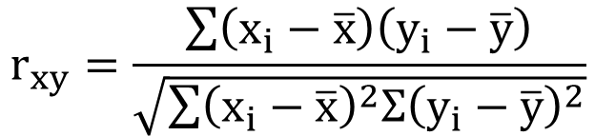
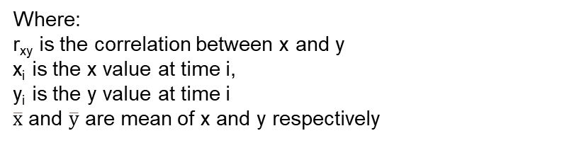
Correlation
Correlation measures the linear relationship between two variables. Its value ranges from -1 to 1
$$r_{xy}=\frac{\sum{\left(x_{i}−\overline{x}\right)\left(y_{i}−\overline{y}\right)}}{\sqrt{\sum{{\left(x_{i}−\overline{x}\right)}^{2}Σ{\left(y_{i}−\overline{y}\right)}^{2}}}}$$
Month | Ad Spend ($1000s) | Sales Revenue ($1000s)
1 | 2 | 10
2 | 3 | 15
3 | 4 | 20
4 | 5 | 25
5 | 6 | 30
Where:
r_{xy} is the correlation between x and y
x_{i} is the x value at time i,
y_{i} is the y value at time i
$\overline{x}$ and $\overline{y}$ are mean of x and y respectively
1: Perfect positive linear relationship
-1: Perfect negative linear relationship
0: No linear relationship
For above example, r = 1 suggests a perfect positive correlation

Slide 33
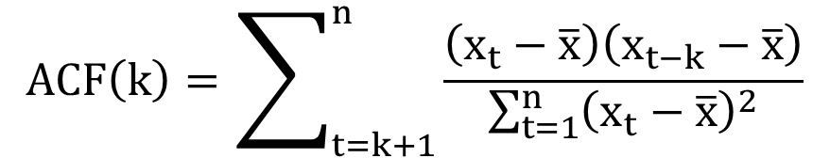
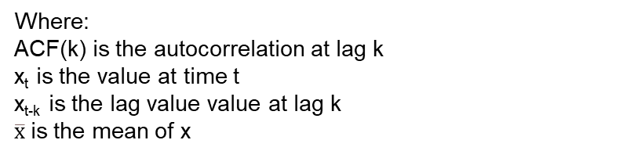
Autocorrelation Function
Measures how a variable is correlated with its own past values at different lags(k).
$$ACF\left(k\right)=\sum_{t=k+1}^{n}{\frac{\left(x_{t}−\overline{x}\right)\left(x_{t−k}−\overline{x}\right)}{\sum_{t=1}^{n}{{\left(x_{t}−\overline{x}\right)}^{2}}}}$$
Day | Temp
1 | 20
2 | 22
3 | 21
4 | 23
5 | 22
Where:
ACF(k) is the autocorrelation at lag k
x_{t} is the value at time t
x_{t-k} is the lag value value at lag k
$\overline{x}$is the mean of x
ACF(1) = 0.3 suggests temp today is somewhat correlated with yesterday’s temp.

Slide 34
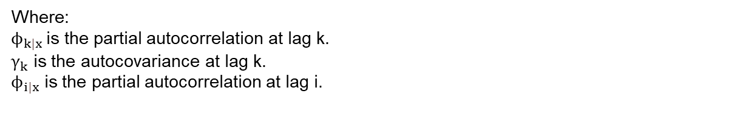
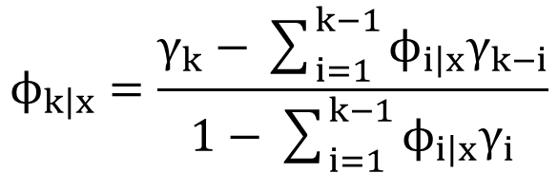
Partial Autocorrelation Function(PACF)
Measures the partial correlation between time series and its own past values (X_{t​} and X_{t−k}​) after removing the effect of all intermediate lags. Helps identify the lag order of an AR(AutoRegressive) model.
$$ϕ_{\left.k\right|x}=\frac{γ_{k}−\sum_{i=1}^{k−1}{ϕ_{\left.i\right|x}γ_{k−i}}}{1−\sum_{i=1}^{k−1}{ϕ_{\left.i\right|x}γ_{i}}}$$
Where:
$ϕ_{\left.k\right|x}$ is the partial autocorrelation at lag k.
$γ_{k}$ is the autocovariance at lag k.
$ϕ_{\left.i\right|x}$ is the partial autocorrelation at lag i.

Slide 35
Partial Autocorrelation Function(PACF)
Day | Price ($)
1 | 100
2 | 102
3 | 101
4 | 103
5 | 102
Lag 1 PACF = correlation between Day 2 & Day 1 ≈ 0.5
Lag 2 PACF = correlation between Day 3 & Day 1 after removing influence of Day 2 ≈ 0.1
Stock price today depends moderately on yesterday, very little on the day before yesterday.

Slide 36
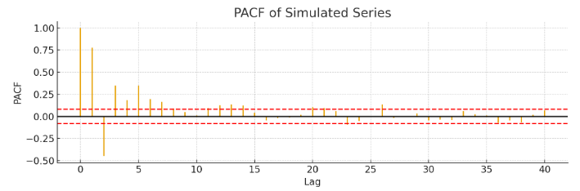
PACF Plot Interpretation
Lag order = lag where the significant yellow spikes crossing the red-dotted lines are found.
P = lag order = 2

Slide 37

AIC(Akaike Information Criterion)
AIC balances goodness of fit (via the likelihood) against model complexity (number of lags and other parameters).
$$AIC=−2∗\log\left(L\right)+2K$$
where
L is the maximized log-likelihood for the model.
K is the number of parameters in the AR(p) model = (μ, ϕ₁​,…,ϕ_{p}​,, σ², ϵ_{t}​)
To find the optimal lag order :
Fit the models with different lag orders (e.g., 1 lag, 2 lags, 3 lags, etc.).
Calculate the AIC value for each model.
Select the lag order that yields the lowest AIC value.

Slide 38
PACF or AIC?
PACF can be subjective and may require human interpretation.
AIC offers a quantitative, model-agnostic approach by selecting the model with the lowest AIC value.
Go for AIC 👍

Slide 39
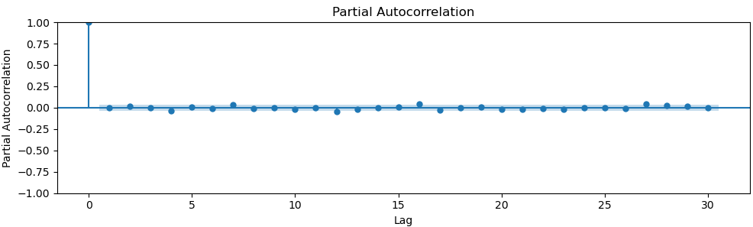
PACF for Open Value (Continental Stocks)
Lag order = 1 based on Akaike Information Criterion ($AIC=−2∗\log\left(L\right)+2K)$

Slide 40
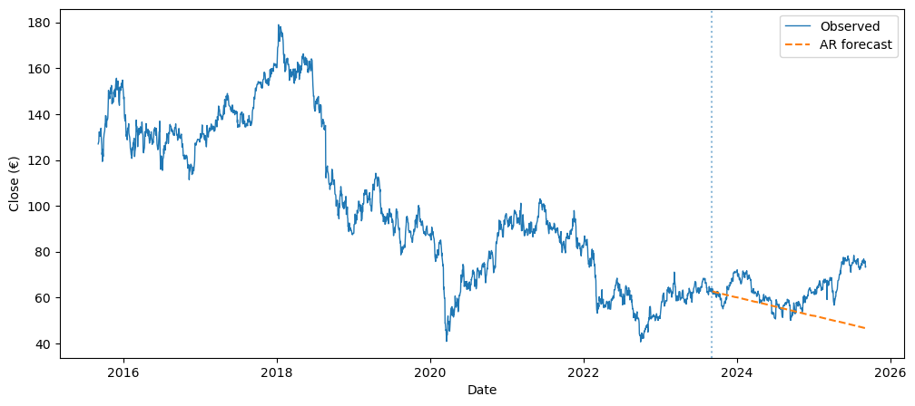
Forecasting using AR Model
Orange dotted line is the forecasted ‘Close’ value of wrt Date
MAE = 0.928(splitting data into training - 80% and testing - 20%)
Prediction timeline = Sep 2023 to Sep 2025

Slide 41

ARIMA
AutoRegressive Integrated Moving Average captures the relationship between an observation and several lagged observations by combining three components:
Autoregression (AR) - dependence of the current observation on its previous values(Ref: Slide 31)
Integration through Differencing (I) – transforming a time series into a stationary one by differencing consecutive observations(Ref: Slide 15)
$y_{t}^{′}=y_{t}−y_{t−1}$
Moving Averages (MA) - dependence of the current observation on the previous forecast errors (Ref: Slide 17)
$y_{t}\text{ = }\text{μ}+ε_{t}+θ_{1}ε_{t−1}+θ_{2}ε_{t−2}+⋯+θ_{q}ε_{t−q}$
$$\text{X}\text{t} \text{​=} \text{c} \text{+} \text{ϕ}\text{1}\text{​}\text{X}\text{t}\text{−1​} \text{+} \text{ϕ}\text{2}\text{​}\text{X}\text{t}\text{−2​} \text{+} \text{…} \text{+} \text{ϕ}\text{p}\text{​}\text{Xt}\text{−}\text{p}\text{​} \text{+} \text{ε}\text{t}\text{​}$$
$$\text{y}\text{t} \text{′} \text{​=} \text{c} \text{+} \text{ϕ}\text{1}\text{​}\text{y}\text{′}\text{t}\text{−1​} \text{+} \text{…} \text{+} \text{ϕ}\text{p}\text{​}\text{y}\text{′}\text{t}\text{−}\text{p}\text{​} \text{+} θ_{1}ε_{t−1}+⋯+θ_{q}ε_{t−q }+ \text{ε}\text{t}\text{​}$$

Slide 42
ARIMA model parameters
The ARIMA model is defined by three main parameters: p, d and q.
p (AR order): number of autoregressive terms (past observations) that directly influence the current value.
d (Differencing order): number of differences needed to make the time series stationary.
q (MA order): represents the number of lagged forecast errors in the prediction equation.
The optimal value for the above parameters are computed using grid search.

Slide 43
Grid Search
Define search space(p∈[0,3], d∈[0,1], q∈[0,3], P∈[0,2], D∈[0,1], Q∈[0,2], s∈{5,7,12}
Fit each candidate model, estimate μ,ϕ,θ,σ²,β,Φ,Θ by MLE and compute maximum log likelihood
Compute AIC using maximum log likelihood
Compare models and pick the model with the lowest AIC
μ - Constant
ϕ₁​,…,ϕ_{p}​ - Autoregressive coefficients
θ₁​,…,θ_{q}​ - Moving Average coefficients
Φ₁,…,Φ_{P} – Seasonal autoregressive coefficients
Θ₁,…,Θ_{Q} – Seasonal Moving Average coefficients
β₁​,…,β_{k}​ - Exogenous variable coefficients(used in ARIMAX and SARIMAX)
σ² - Variance of error term(ϵ_{t}​)
ϵ_{t}​ - Residuals(errors)

Slide 44

Likelihood
Likelihood says "Given a set of data, how likely is it that these parameters are the correct ones for the model?“ Likelihood is the product of probability densities.
Probability density function represents the density of probability for a continuous random variable over the specified ranges.
Where
L - likelihood
μ – mean of the data
σ² - Variance of the data

Slide 45

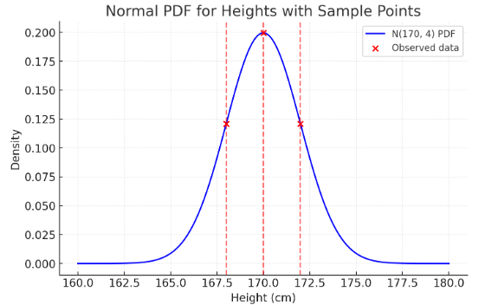
Probability Density
Probability density function represents the density of probability for a continuous random variable over the specified ranges.
Height(x) in cm | PDF(x)
170 | 0.199
172 | 0.121
168 | 0.121
Where
μ – mean of the data
σ² - Variance of the data
f(x_{t} | μ, σ²) – probability density function
Likelihood = L(μ=170, σ²=4) = 0.199 × 0.121 × 0.121
L≈0.00291

Slide 46

Log-likelihood
Log of likelihood is taken to make the mathematical computations easier.
Log likelihood estimation provides a robust method for estimating the parameters that best describe that distribution.
Where
l – log-likelihood
μ - Constant
ϕ₁​,…,ϕ_{p}​ - Autoregressive coefficients
θ₁​,…,θ_{q}​ - Moving Average coefficients
β₁​,…,β_{k}​ - Exogenous variable coefficients(used in ARIMAX)
σ² - Variance of error term(ϵ_{t}​)
ϵ_{t}​ - Residuals(errors)
T_{c}​ = T − t₀ ​+ 1 is the number of terms used
t₀​ = max(p,q) + 1

Slide 47
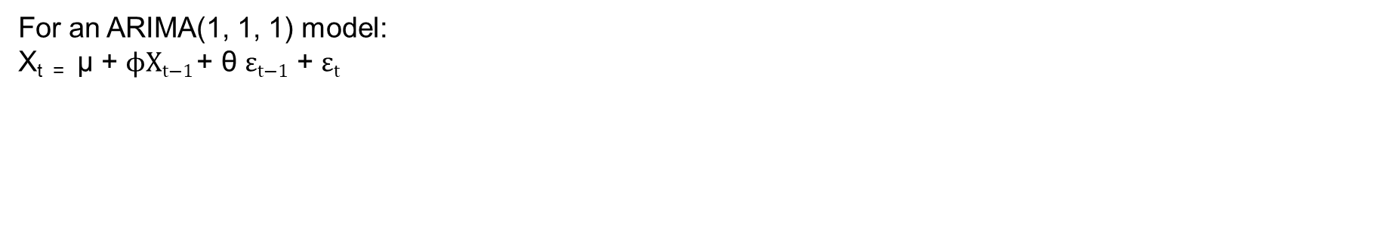
Log-likelihood computation
For an ARIMA(1, 1, 1) model:
X_{t =} μ + $\text{ϕ}\text{​}\text{X}\text{t}\text{−1}$+ θ $\text{ε}\text{t}\text{−1}\text{​}$ + $\text{ε}\text{t}\text{​}$
Choose trial values for parameters(μ,ϕ,θ,σ²,β,Φ,Θ)
Compute residuals ($\text{ε}\text{t}$ = x_{t} – ${\hat{x}}_{t}$ )
Compute residuals ("ε_{t"} = x_{t} – x ̂_t )
Plug into log-likelihood formula
Iterate to maximize log-likelihood

Slide 48

AIC computation
$$AIC=−2l_{max}+2k$$
Where
l_{max} = maximum log likelihood
k = number of parameters in that ARIMA(p, d, q) = (μ, ϕ₁​,…,ϕ_{p}​, θ₁​,…,θ_{q}​, β₁​,…,β_{k,} Φ₁,…,Φ_{k}, Θ₁,…, Θ_{k,} σ², ϵ_{t}​)

Slide 49
Example
Practical search range in ARIMA p∈[0,5], d∈[0,2], q∈[0,5]
p∈{0,1,2}
d∈{0,1}
q∈{0,1,2}
That gives 3×2×3 = 18 candidate models.
For ARIMA(1, 1, 1)
Model | AIC
ARIMA(0,1,0) | 52
ARIMA(1,1,0) | 48
ARIMA(0,1,1) | 47
ARIMA(1,1,1) | 45 ✅
ARIMA(2,1,0) | 49
ARIMA(2,1,1) | 46
ARIMA(1,0,0) | 60
ARIMA(1,0,1) | 58
… | …
Fitted log-likelihood: −19.5
Number of parameters (k): 3
List of parameters computed by MLE:
Φ1 = 0.60 (AR coefficient)
Θ1 = 0.40 (MA coefficient)
σ² = 4.0 (error variance)
AIC value: 45
ARIMA(1, 1, 1) model gives the best fit.

Slide 50
Example
Month | Sales (X_{t}) | Differenced (Y_{t})
1 | 120
2 | 135 | 15
3 | 150 | 15
4 | 160 | 10
5 | 170 | 10
6 | 180 | 10
7 | 195 | 15
8 | 210 | 15
9 | 230 | 20
10 | 240 | 10
11 | (X₁₁)?
Firstly, on differencing, data becomes stationary(Y_{t})

Slide 51

Example
For an ARIMA(1, 1, 1) model:
Y_{t =} $\text{ϕ}\text{​}\text{Y}\text{t}\text{−1}$+ θ $\text{ε}\text{t}\text{−1}\text{​}$ + $\text{ε}\text{t}\text{​}$
Now, from MLE, if ϕ≈0.6, θ≈0.4, the model becomes
Y_{t =} $\text{0}\text{.6 }\text{​}\text{Y}\text{t}\text{−1}$+ 0.4 $\text{ε}\text{t}\text{−1}\text{​}$+ $\text{ε}\text{t}\text{​}$
In order to forecast the sales for the 11th month:
If error($\text{ε}$) terms are ignored,
Forecast differenced value(Y₁₁):
Y₁₁ = 0.6⋅Y₁₀
Y₁₁ = 0.6⋅10 = 6
Convert back to sales:
X₁₁ = X₁₀ + Y₁₁ = 240 + 6 = 246 units

Slide 52
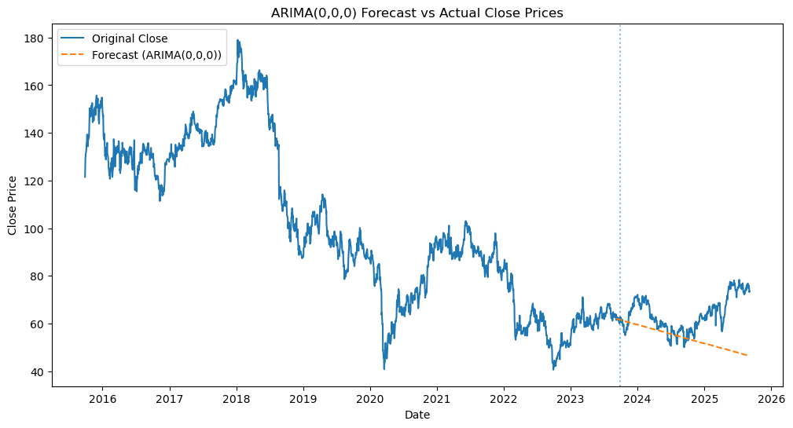
Forecasting using ARIMA(Sep 2023 to Sep 2025)
Orange dotted line is the forecasted ‘Close’ value of wrt Date
MAE = 10.309(splitting data into training - 80% and testing - 20%)

Slide 53

ARIMAX
AutoRegressive Integrated Moving Average with eXogenous inputs captures the relationship between an observation and several lagged observations by combining the below components:
Autoregression (AR) - dependence of the current observation on its previous values
Integration through Differencing (I) – transforming a time series into a stationary one by differencing consecutive observations
$y_{t}^{′}=y_{t}−y_{t−1}$
Moving Averages (MA) - dependence of the current observation on the previous forecast errors
$y_{t}=c+ε_{t}+θ_{1}ε_{t−1}+θ_{2}ε_{t−2}+⋯+θ_{q}ε_{t−q}$
Exogenous Variables (X) - external not part of the time series but may have a significant impact on it
$$\text{X}\text{t} \text{​=} \text{c} \text{+} \text{ϕ}\text{1}\text{​}\text{X}\text{t}\text{−1​} \text{+} \text{ϕ}\text{2}\text{​}\text{X}\text{t}\text{−2​} \text{+} \text{…} \text{+} \text{ϕ}\text{p}\text{​}\text{Xt}\text{−}\text{p}\text{​} \text{+} \text{ε}\text{t}\text{​}$$
$$\text{y}\text{t} \text{′} \text{​=} \text{c} \text{+} \text{ϕ}\text{1}\text{​}\text{y}\text{′}\text{t}\text{−1​} \text{+} \text{…} \text{+} \text{ϕ}\text{p}\text{​}\text{y}\text{′}\text{t}\text{−}\text{p}\text{​} \text{+} θ_{1}ε_{t−1}+⋯+θ_{q}ε_{t−q }+\text{β}\text{1}\text{​}\text{Z}\text{1,}\text{t}\text{​} \text{+} \text{⋯} \text{+} \text{β}\text{k}\text{​}\text{Zk}\text{,}\text{t} \text{+ }\text{ε}\text{t}\text{​}$$

Slide 54
Example
Month | Sales (X_{t}) | Ad Spend (Z_{t}) | Differenced (Y_{t})
1 | 120 | 5
2 | 135 | 7 | 15
3 | 150 | 8 | 15
4 | 160 | 9 | 10
5 | 170 | 9 | 10
6 | 180 | 10 | 10
7 | 195 | 11 | 15
8 | 210 | 13 | 15
9 | 230 | 14 | 20
10 | 240 | 15 | 10
11 | (X₁₁)? | 16
Firstly, on differencing, data becomes stationary(Y_{t})

Slide 55

Example
For an ARIMAX(1, 1, 1) model:
Y_{t =} $\text{ϕ}\text{​}\text{Y}\text{t}\text{−1}$+ θ $\text{ε}\text{t}\text{−1}\text{​}$ + βZ_{t} + $\text{ε}\text{t}\text{​}$
Now, from MLE, if ϕ≈0.6, θ≈0.4, β=0.8, the model becomes
Y_{t =} $\text{0}\text{.6 }\text{​}\text{Y}\text{t}\text{−1}$+ 0.4 $\text{ε}\text{t}\text{−1}\text{​}$ + 0.8 Z_{t} + $\text{ε}\text{t}\text{​}$
In order to forecast the sales for the 11th month:
If error($\text{ε}$) terms are ignored,
Forecast differenced value(Y₁₁):
Y₁₁ = 0.6⋅Y₁₀ + 0.8⋅Z₁₁
Y₁₁ = 0.6⋅10 + 0.8⋅16 = 6 + 12.8 = 18.8
Convert back to sales:
X₁₁ = X₁₀ + Y₁₁ = 240 + 18.8 = 259 units

Slide 56
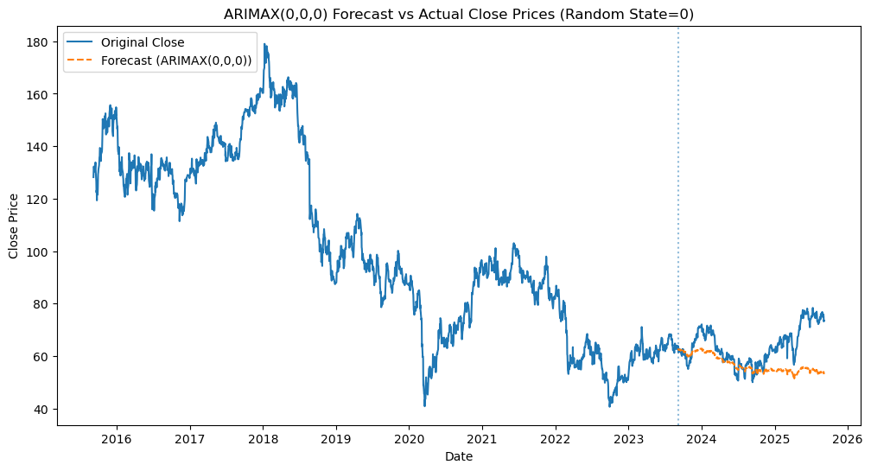
Forecasting using ARIMAX(Sep 2023 to Sep 2025)
Orange dotted line is the forecasted ‘Close’ value of wrt Date considering influence of external variable ‘Open’
MAE = 7.605(splitting data into training - 80% and testing - 20%)

Slide 57

SARIMA
Seasonal AutoRegressive Integrated Moving Average captures the relationship between an observation and several lagged observations by combining the below components:
Autoregression and Seasonal Autoregression - dependence of the current observation on its previous values
Integration through Differencing and Seasonal Differencing(I) – transforming a time series into a stationary one by differencing consecutive observations
${ y}_{t}^{′}=y_{t}−y_{t−1}$
Moving Averages and seasonal moving average(MA) - dependence of the current observation on the previous forecast errors
${ y}_{t}=c+ε_{t}+θ_{1}ε_{t−1}+θ_{2}ε_{t−2}+⋯+θ_{q}ε_{t−q}$
Seasonal Component(Ref: Slide 7) - periodic patterns in the data, such as weekly, monthly, or yearly cycles(Ref: Slide 7)
$$\text{X}\text{t} \text{​=} \text{c} \text{+} \text{ϕ}\text{1}\text{​}\text{X}\text{t}\text{−1​} \text{+} \text{ϕ}\text{2}\text{​}\text{X}\text{t}\text{−2​} \text{+} \text{…} \text{+} \text{ϕ}\text{p}\text{​}\text{Xt}\text{−}\text{p}\text{​} \text{+} \text{ε}\text{t}\text{​}$$

Slide 58
SARIMA
Where:
X_{t}​: observed series
L: lag operator (LX_{t}=X_{t−1}​)
ϕ_{p}(L) = 1 − ϕ₁L − ⋯ − ϕ_{p}​L_{p} → non-seasonal AR part
θ_{q}(L) = 1 + θ₁L + ⋯ + θ_{q}​L_{q} → non-seasonal MA part
Φ_{P}(L^{s}) = 1 − Φ₁L^{s} − ⋯ − Φ_{P}​L^{s} → seasonal AR part
Θ_{Q}(L^{s}) = 1 + Θ₁L^{s} + ⋯ + Θ_{Q}​L^{s} → seasonal MA part
d: order of regular differencing
D: order of seasonal differencing
s: seasonal period (e.g., 12 for monthly data with yearly seasonality)
ε_{t}∼N(0,σ²): white noise

Slide 59
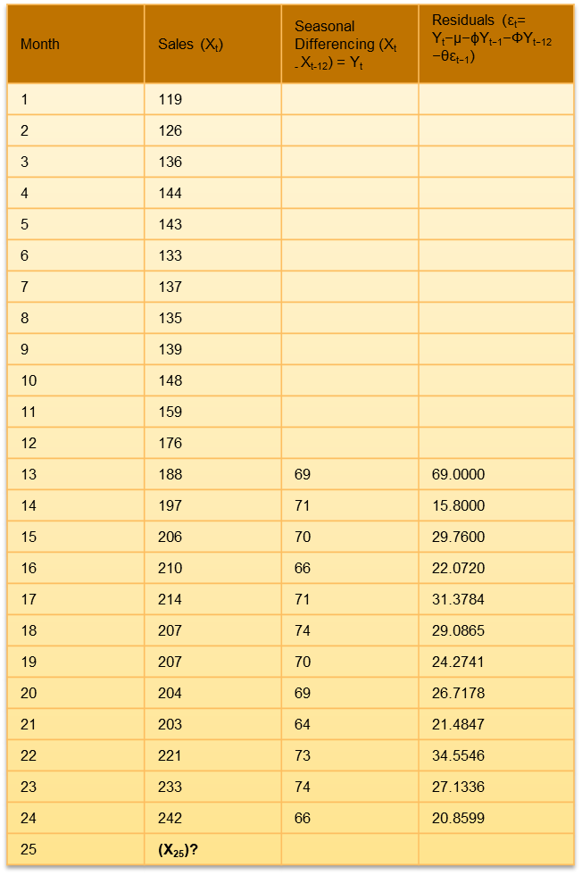
Example
Month | Sales (X_{t}) | Seasonal Differencing (X_{t -} X_{t-12}) = Y_{t} | Residuals ($\text{ε}\text{t}$= Y_{t}​−μ−ϕY_{t−1}​−ΦY_{t−12}​−θε_{t−1}​)
1 | 119
2 | 126
3 | 136
4 | 144
5 | 143
6 | 133
7 | 137
8 | 135
9 | 139
10 | 148
11 | 159
12 | 176
13 | 188 | 69 | 69.0000
14 | 197 | 71 | 15.8000
15 | 206 | 70 | 29.7600
16 | 210 | 66 | 22.0720
17 | 214 | 71 | 31.3784
18 | 207 | 74 | 29.0865
19 | 207 | 70 | 24.2741
20 | 204 | 69 | 26.7178
21 | 203 | 64 | 21.4847
22 | 221 | 73 | 34.5546
23 | 233 | 74 | 27.1336
24 | 242 | 66 | 20.8599
25 | (X₂₅)?

Slide 60


Example
For an SARIMA(1, 0, 1)(1, 1, 0)(12) model(non-seasonal orders (p=1,d=0,q=1), seasonal orders (P=1,D=1,Q=0) with s=12):
In order to forecast the sales for the 25th month:
Y_{t =} μ + ϕY_{t-1}​ + ΦY_{t-12}​ + θε_{t-1}​ + $\text{ε}\text{t}\text{​}$
Now, from MLE, if ϕ=0.5, Φ=0.6, θ=0.3, μ=0 the model becomes
Y_{t =} $0+ \text{0}\text{.5 }\text{​}\text{Y}\text{t}\text{−1} \text{+}\text{ 0.6}\text{Y}\text{t}\text{−1}\text{2}$+ 0.3 $\text{ε}\text{t}\text{−1}\text{​}$+ $\text{ε}\text{t}\text{​}$
If error($\text{ε}$₂₅) terms are ignored,
Forecast differenced value(Y₂₅):
Y₂₅ = 0 + 0.5⋅66 + 0.6⋅69 + 0.3⋅20.8599 = 80.6580
Convert back to sales:s
X₂₅ = X₁₃ + Y₂₅ = 188 + 80.6580 = 268.66 units

Slide 61
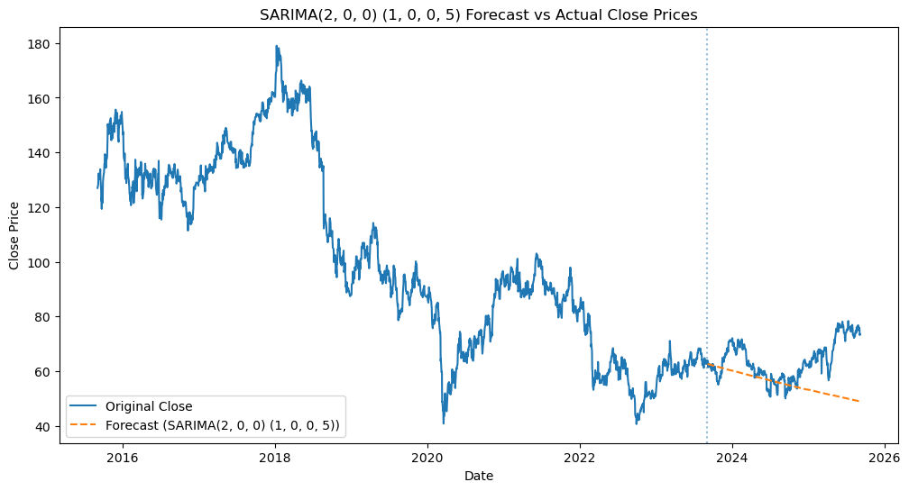
Forecasting using SARIMA(Sep 2023 to Sep 2025)
Orange dotted line is the forecasted ‘Close’ value of wrt Date

Slide 62

SARIMAX
Seasonal AutoRegressive Integrated Moving Average captures the relationship between an observation and several lagged observations by combining the below components:
Autoregression and Seasonal Autoregression - dependence of the current observation on its previous values
Integration through Differencing and Seasonal Differencing(I) – transforming a time series into a stationary one by differencing consecutive observations
${ y}_{t}^{′}=y_{t}−y_{t−1}$
Moving Averages and seasonal moving average(MA) - dependence of the current observation on the previous forecast errors
${ y}_{t}=c+ε_{t}+θ_{1}ε_{t−1}+θ_{2}ε_{t−2}+⋯+θ_{q}ε_{t−q}$
Exogenous Variables (X) - external not part of the time series but may have a significant impact on it
Seasonal Component(Ref: Slide 7) - periodic patterns in the data, such as weekly, monthly, or yearly cycles.
$$\text{X}\text{t} \text{​=} \text{c} \text{+} \text{ϕ}\text{1}\text{​}\text{X}\text{t}\text{−1​} \text{+} \text{ϕ}\text{2}\text{​}\text{X}\text{t}\text{−2​} \text{+} \text{…} \text{+} \text{ϕ}\text{p}\text{​}\text{Xt}\text{−}\text{p}\text{​} \text{+} \text{ε}\text{t}\text{​}$$

Slide 63
SARIMAX
Where:
X_{t}​: observed series
L: lag operator (LX_{t}=X_{t−1}​)
ϕ_{p}(L) = 1 − ϕ₁L − ⋯ − ϕ_{p}​L_{p} → non-seasonal AR part
θ_{q}(L) = 1 + θ₁L + ⋯ + θ_{q}​L_{q} → non-seasonal MA part
Φ_{P}(L^{s}) = 1 − Φ₁L^{s} − ⋯ − Φ_{P}​L_{P}^{s} → seasonal AR part
Θ_{Q}(L^{s}) = 1 + Θ₁L^{s} + ⋯ + Θ_{Q}​L_{Q}^{s} → seasonal MA part
d: order of regular differencing
D: order of seasonal differencing
β^{T}Z_{t} → exogenous variables part
s: seasonal period (e.g., 12 for monthly data with yearly seasonality)
ε_{t}∼N(0,σ²): white noise

Slide 64
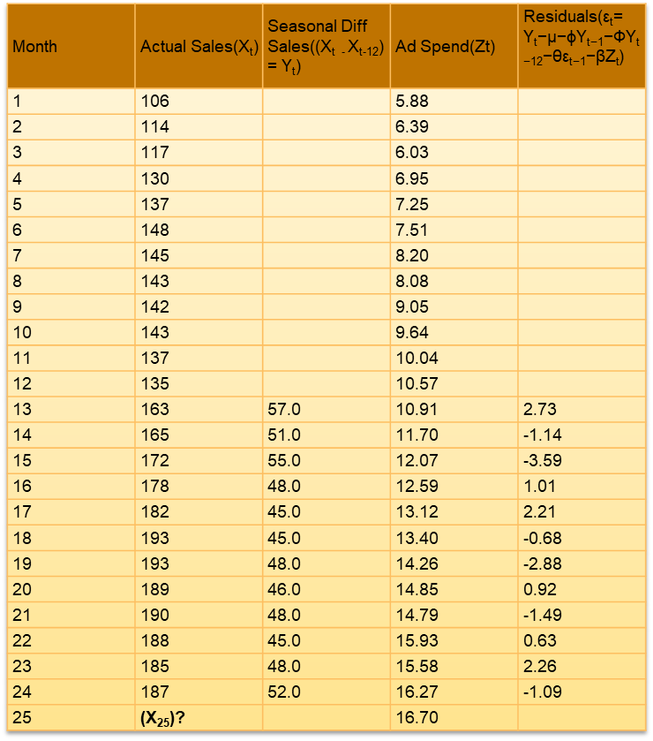
Example
Month | Actual Sales(X_{t}) | Seasonal Diff Sales((X_{t -} X_{t-12}) = Y_{t}) | Ad Spend(Zt) | Residuals($\text{ε}\text{t}$= Y_{t}​−μ−ϕY_{t−1}​−ΦY_{t−12}​−θε_{t−1}​​−βZ_{t}​)
1 | 106 |  | 5.88
2 | 114 |  | 6.39
3 | 117 |  | 6.03
4 | 130 |  | 6.95
5 | 137 |  | 7.25
6 | 148 |  | 7.51
7 | 145 |  | 8.20
8 | 143 |  | 8.08
9 | 142 |  | 9.05
10 | 143 |  | 9.64
11 | 137 |  | 10.04
12 | 135 |  | 10.57
13 | 163 | 57.0 | 10.91 | 2.73
14 | 165 | 51.0 | 11.70 | -1.14
15 | 172 | 55.0 | 12.07 | -3.59
16 | 178 | 48.0 | 12.59 | 1.01
17 | 182 | 45.0 | 13.12 | 2.21
18 | 193 | 45.0 | 13.40 | -0.68
19 | 193 | 48.0 | 14.26 | -2.88
20 | 189 | 46.0 | 14.85 | 0.92
21 | 190 | 48.0 | 14.79 | -1.49
22 | 188 | 45.0 | 15.93 | 0.63
23 | 185 | 48.0 | 15.58 | 2.26
24 | 187 | 52.0 | 16.27 | -1.09
25 | (X₂₅)? |  | 16.70

Slide 65

Example
For an SARIMAX(1, 0, 1)(1, 1, 0)(12) model(non-seasonal orders p=1,d=0,q=1 and seasonal orders P=1,D=1,Q=0 with s=12):
In order to forecast the sales for the 25th month:
Y_{t =} μ + ϕY_{t-1}​ + Φy_{t-12}​ + θε_{t-1}​ + β Z_{t-1} +$\text{ε}\text{t}$
Now, from MLE, if ϕ=0.5, Φ=0.6, θ=0.3, μ=0, β=0.8 the model becomes
Y_{t =} $0+ \text{0}\text{.5 }\text{​}\text{Y}\text{t}\text{−1} \text{+}\text{ 0.6}\text{Y}\text{t}\text{−1}\text{2}$+ 0.3 $\text{ε}\text{t}\text{−1}\text{​}$+ 0.8 Z_{t-1}+$\text{ε}\text{t}\text{​}$
If error($\text{ε}$₂₅) terms are ignored,
Forecast differenced value(Y₂₅):
Y₂₅ = 0 + 0.5⋅52 + 0.6⋅57 + 0.3⋅(-1.09) + 0.8⋅16.70 = 73.233
Convert back to sales:
X₂₅ = X₁₃ + Y₂₅ = 163 + 73.233 = 236.2 units

Slide 66

Forecasting using SARIMAX(Sep 2023 to Sep 2025)
Orange dotted line is the forecasted ‘Close’ value of wrt Date considering the
influence of external variable ‘Open’

Slide 67

Time Series Performance Metrics Comparison
Metric | Formula | Suitability for timeseries forecasting
MAE (Mean Absolute Error) | $$MAE=\frac{1}{n}\sum_{i=1}^{n}{\left|yi−\hat{y}i\right|}$$ | Good for interpretability
RMSE (Root Mean Squared Error) | $$RMSE=\sqrt{\frac{1}{n}\sum_{i=1}^{n}{{\left(yi−\hat{y}i\right)}^{2}}}$$ | Risk-sensitive domains
MAPE (Mean Absolute Percentage Error) | $$MAPE≡\frac{100}{n}\sum_{i=1}^{n}{\left|\frac{y_{i}−{\hat{y}}_{i}}{y_{i}}\right|}$$ | Relative error(comparison)
sMAPE (Symmetric Mean Absolute Percentage Error) | $$sMAPE=\frac{100}{n}\sum_{i=1}^{n}{\frac{{\left|y_{i}−{\hat{y}}_{i}\right|}_{}}{{\left(\left|y_{i}\right|+\left|\hat{y}i\right|\right)}/2}}$$ | Good for percentage-based error
MASE (Mean Absolute Scaled Error) | $$MASE=\frac{\frac{1}{n}\sum_{i=1}^{n}{\left|y_{i}−{\hat{y}}_{i}\right|}}{\frac{1}{n−1}\sum_{i=2}^{n}{\left|yi−y_{i−1}\right|}}$$ | Benchmarking models across different time series

Slide 68
Thank You

Slide 69
Comparison of algorithms
Model | Uses past errors (MA) | Handles trend (I) | Allows external predictors | Best Use Cases | Performance
AR | ❌ | ❌ | ❌ | Short-term, stationary series | Low performance
ARIMA | ✅ | ✅ | ❌ | Univariate forecasts with trend | ARIMA > AR
ARIMAX | ✅ | ✅ | ✅ | Series influenced by external drivers | ARIMAX > ARIMA > AR (if ext factor is involved)

Slide 70
Time Series Performance Metrics Comparison
Metric | Best Use-Cases | Suitable for timeseries forecasting
MAE (Mean Absolute Error) | When interpretability matters; robust to outliers (e.g., housing price prediction, demand forecasting). | Good for interpretability
RMSE (Root Mean Squared Error) | When you want to penalize large errors but keep results interpretable (e.g., weather, energy forecasts). | Risk-sensitive domains
MAPE (Mean Absolute Percentage Error) | When relative error matters (e.g., sales/revenue forecasting). | Relative error(comparison)
sMAPE (Symmetric Mean Absolute Percentage Error) |  | Good for percentage-based error
MASE (Mean Absolute Scaled Error)

Slide 71

Partial Autocorrelation
Measures how strongly two variables are related while considering and adjusting for the influence of one or more additional variables.
Month | Sales (Y)
1 | 100
2 | 110
3 | 125
4 | 150
5 | 160
6 | 180
$$ρ_{xy,z}=\frac{ρ_{xy}−ρ_{xz}ρ_{yz}}{\sqrt{\left(1−ρ_{xz}^{2}\right)\left(1−ρ_{yz}^{2}\right)}}$$
Where:
ρ_{XY} is the correlation coefficient between X and Y.
ρ_{XZ}​ is the correlation coefficient between X and Z.
ρ_{YZ} is the correlation coefficient between Y and Z.
PAC(1) = 0.99
PAC(2) = -1.0
PAC(3) = 0
Last month’s sales almost fully explain current sales

Slide 72

Example
For an SARIMA(1, 0, 1)(1, 1, 0)(12) model(non-seasonal orders (p=1,d=0,q=1), seasonal orders (P=1,D=1,Q=0) with s=12):
In order to forecast the sales for the 25th month:
Y_{t =} μ + ϕY_{t-1}​ + ΦY_{t-12}​ + θε_{t-1}​ + $\text{ε}\text{t}\text{​}$
Now, from MLE, if ϕ=0.5, Φ=0.6, θ=0.3, μ=0 the model becomes
Y_{t =} $0+ \text{0}\text{.5 }\text{​}\text{Y}\text{t}\text{−1} \text{+}\text{ 0.6}\text{Y}\text{t}\text{−1}\text{2}$+ 0.3 $\text{ε}\text{t}\text{−1}\text{​}$+ $\text{ε}\text{t}\text{​}$
If error($\text{ε}$₂₅) terms are ignored,
Forecast differenced value(Y₂₅):
Y₂₅ = 0 + 0.5⋅66 + 0.6⋅69 + 0.3⋅20.8599 = 80.6580
Convert back to sales:s
X₂₅ = X₁₃ + Y₂₅ = 188 + 80.6580 = 268.66 units

