Slide 1
CS4743 MACHINE LEARNING PROJECT
Credit Card Fraud Detection
Using Machine Learning Classification
Basil Mohad
Texas State University • November 25, 2025

Slide 2
Introduction & Problem Statement
THE PROBLEM
150K+
Credit card fraud causes billions in losses annually. Financial institutions need automated systems to detect fraudulent transactions in real-time.
Total Transactions
THE CHALLENGE
~0.2%
Extreme class imbalance: Fraud is only ~0.2% of transactions. Traditional accuracy metrics are misleading.
Fraud Rate
THE GOAL
30
Build a model to accurately identify fraudulent transactions while minimizing false positives.
Features (PCA)

Slide 3
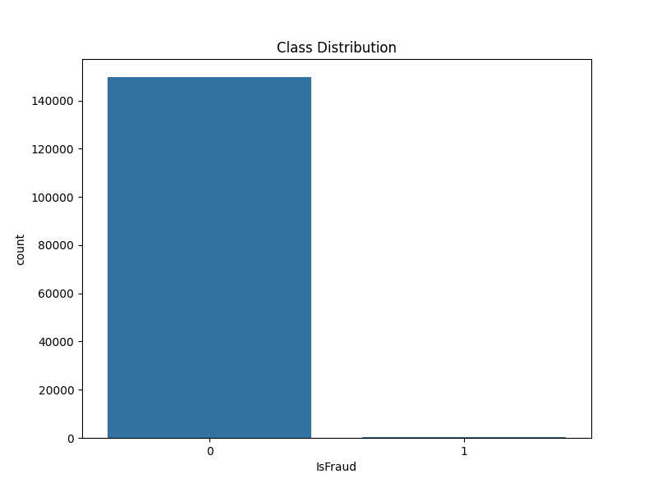
Data Overview: Class Imbalance
WHAT THIS SHOWS
The bar chart shows the extreme imbalance between legitimate (0) and fraudulent (1) transactions.
KEY INSIGHT
~150,000 legitimate vs only ~300 fraud cases. A naive model predicting "not fraud" would be 99.8% accurate but useless!
IMPLICATION
Must use ROC-AUC, not accuracy. Need class weights or resampling techniques.

Slide 4
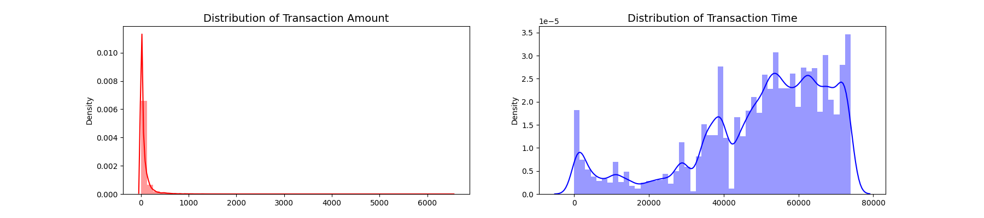
Feature Distributions
TRANSACTION AMOUNT
TRANSACTION TIME
PREPROCESSING
Highly right-skewed distribution. Most transactions are small ($0-500). Outliers up to $7000. Requires scaling.
Bimodal pattern showing daily cycles (day/night activity). Spans ~48 hours of data. May contain temporal fraud patterns.
Used RobustScaler on Time & Amount. Robust to outliers - uses median/IQR instead of mean/std.

Slide 5
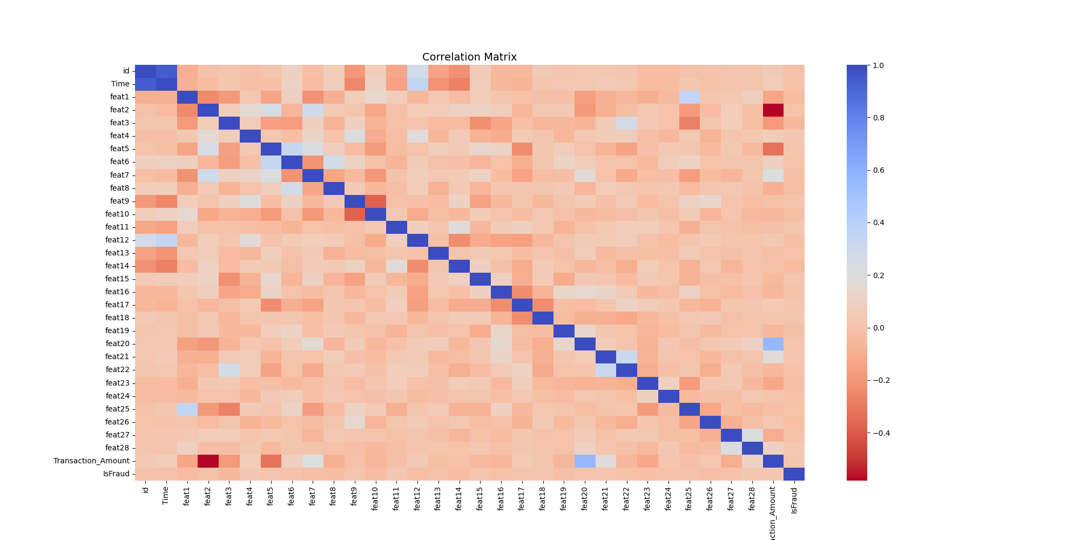
Feature Correlation Analysis
WHAT THIS SHOWS
Heatmap of correlations between all features. Blue = positive, Red = negative. Diagonal is always 1 (self-correlation).
IMPLICATION
Low multicollinearity is good for model stability. PCA preprocessing already handled feature independence.

Slide 6
Methodology
1
2
3
4
5
Preprocessing
Split
Model
Threshold
Evaluate
RobustScaler on Time & Amount
80/20 stratified train-test
ProbaBoost Ensemble
F1-Score Optimization
ROC-AUC Score
PROBA BOOST (Main Model)
THRESHOLD OPTIMIZATION
WHY ROC-AUC?
Ensemble of conditional probability classifiers
Default 0.5 threshold caught 0 fraud
Works well with imbalanced classes
30 boosters with 20 buckets each
Searched across probability range
Measures ranking ability, not threshold
Bootstrapped samples for diversity
Optimized for best F1 score
Competition evaluation metric

Slide 7

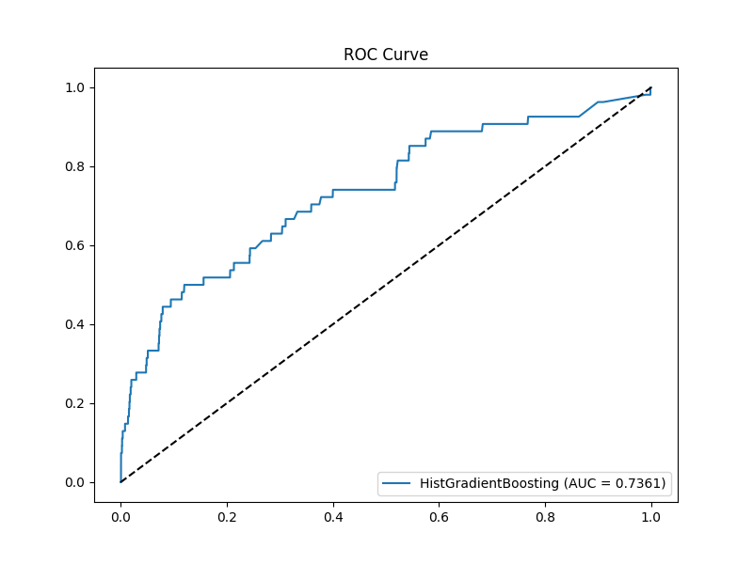
Results: ROC Curve Performance
AUC SCORE
0.7361
HOW TO READ THIS
X-axis: False Positive Rate (incorrectly flagged as fraud)
Y-axis: True Positive Rate (correctly caught fraud)
Dashed line = random guessing (0.5)
INTERPRETATION
AUC = 0.7361 means the model correctly ranks a random fraud above a random non-fraud 73.6% of the time. Well above random (50%).

Slide 8
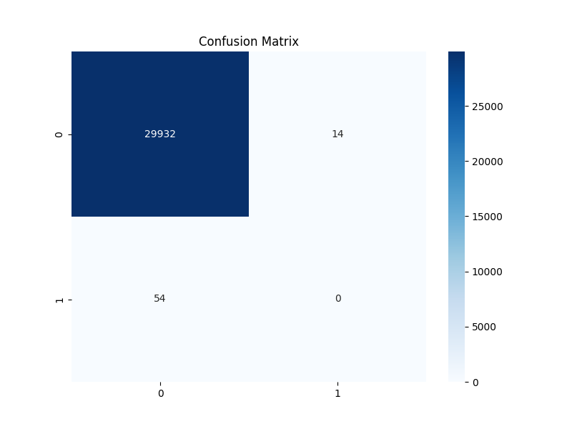
The Problem: Zero Fraud Detected
WHAT WENT WRONG
The model predicted 0 fraud cases! All 54 actual frauds were missed (bottom-left). It only predicted "not fraud" for everything.
WHY THIS HAPPENED
With 99.8% legitimate transactions, the model learned fraud is extremely rare. It outputs very low probabilities like 0.001 - 0.05 for everything. At the default 0.5 threshold, nothing crosses it.
Fraud Caught
Recall
0 / 54
0%
THE LESSON
Good AUC (0.74) but useless predictions! The model CAN rank fraud higher - we just need to find the right threshold.

Slide 9

The Solution: Threshold Optimization
WHAT WE FIXED
Switched to ProbaBoost ensemble and optimized threshold using F1-score. Searched across the full probability range.
THE RESULTS
TN (29,819): Correct non-fraud | FP (127): False alarms
FN (43): Missed fraud | TP (11): Caught fraud!
Fraud Caught
Recall
11 / 54
20%
THE TRADEOFF
127 false alarms is acceptable - investigating false alarms is cheaper than missing real fraud! Note: This had AUC-ROC 0.8001

Slide 10
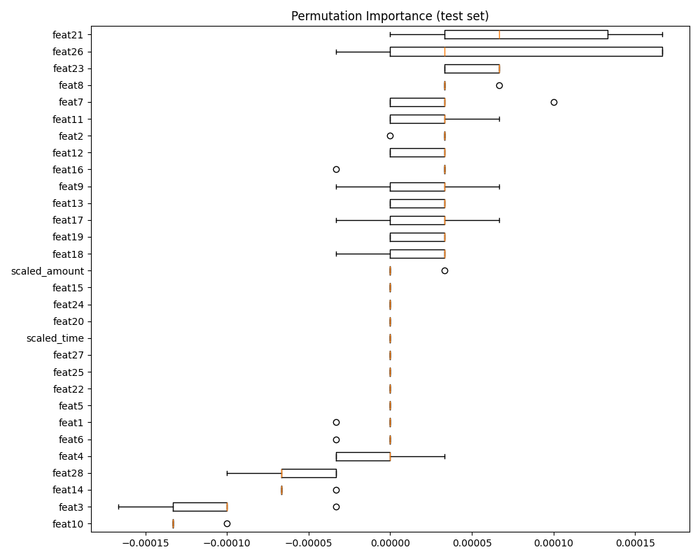
Feature Importance Analysis
PERMUTATION IMPORTANCE
Measures how much performance drops when each feature is randomly shuffled. Higher = more important.
TOP FEATURES
1. feat21 - Highest importance
2. feat26 - High with variance
3. feat23, feat8, feat7 - Moderate
4. scaled_amount - Transaction size matters
NEGATIVE IMPORTANCE
feat3, feat10 show negative importance - shuffling them improves performance, suggesting noise or overfitting.

Slide 11






Future Work & Improvements
Resampling Techniques
Hyperparameter Tuning
Ensemble Methods
Apply SMOTE (Synthetic Minority Oversampling) or ADASYN to generate synthetic fraud samples and balance classes.
Use GridSearchCV or Optuna to find optimal learning rate, max depth, and iterations for better performance.
Combine XGBoost, LightGBM, and CatBoost via stacking or voting for improved robustness.
Threshold Optimization
Feature Engineering
Anomaly Detection
Find optimal classification threshold using precision-recall curve to balance fraud detection vs false alarms.
Create time-based features (hour of day, weekend), transaction frequency features, and amount ratios.
Try Isolation Forest or Autoencoders to treat fraud as anomalies rather than classification problem.

Slide 12



Conclusion
FINAL AUC
SUMMARY
0.8001
Built a credit card fraud detection model using XGboost achieving an ROC-AUC of 0.8001
Successfully addressed the extreme class imbalance challenge through appropriate evaluation metrics and preprocessing.
IMPROVEMENT OVER RANDOM
+50%
Identified key predictive features through permutation importance analysis.
Thank You! Questions?
GitHub Repository: github.com/basilmohad/fraud-detection

