Slide 1



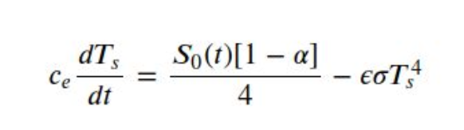
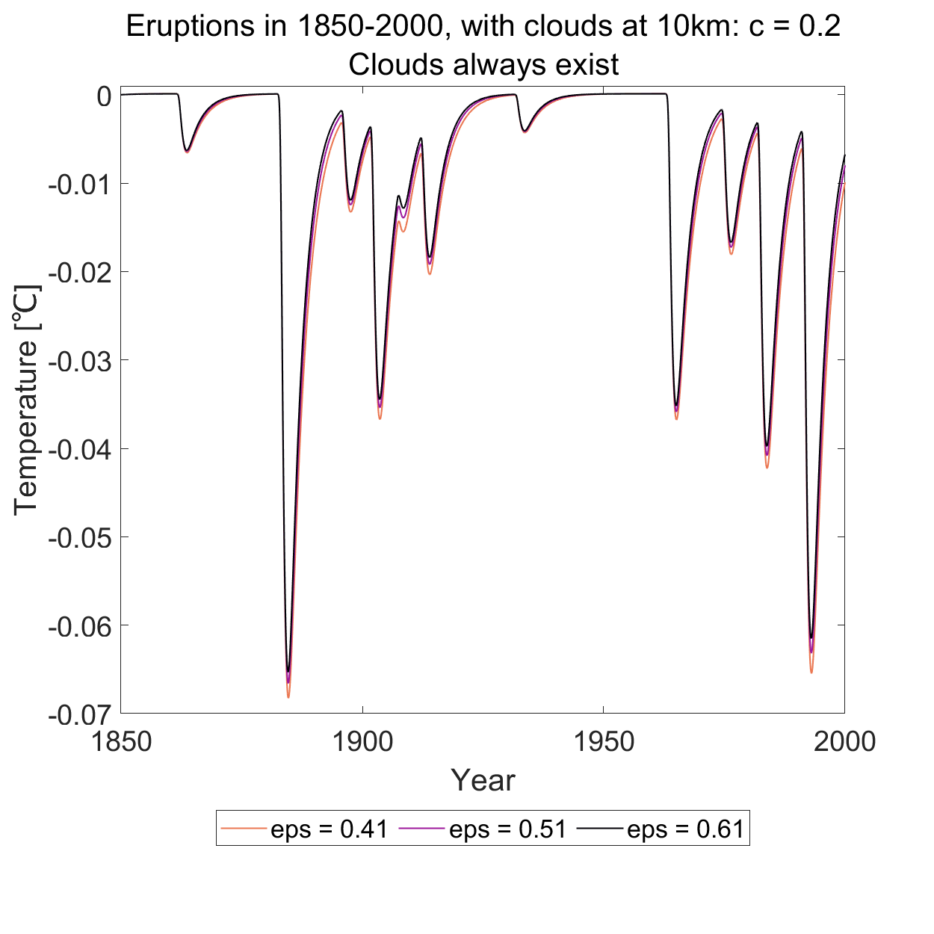
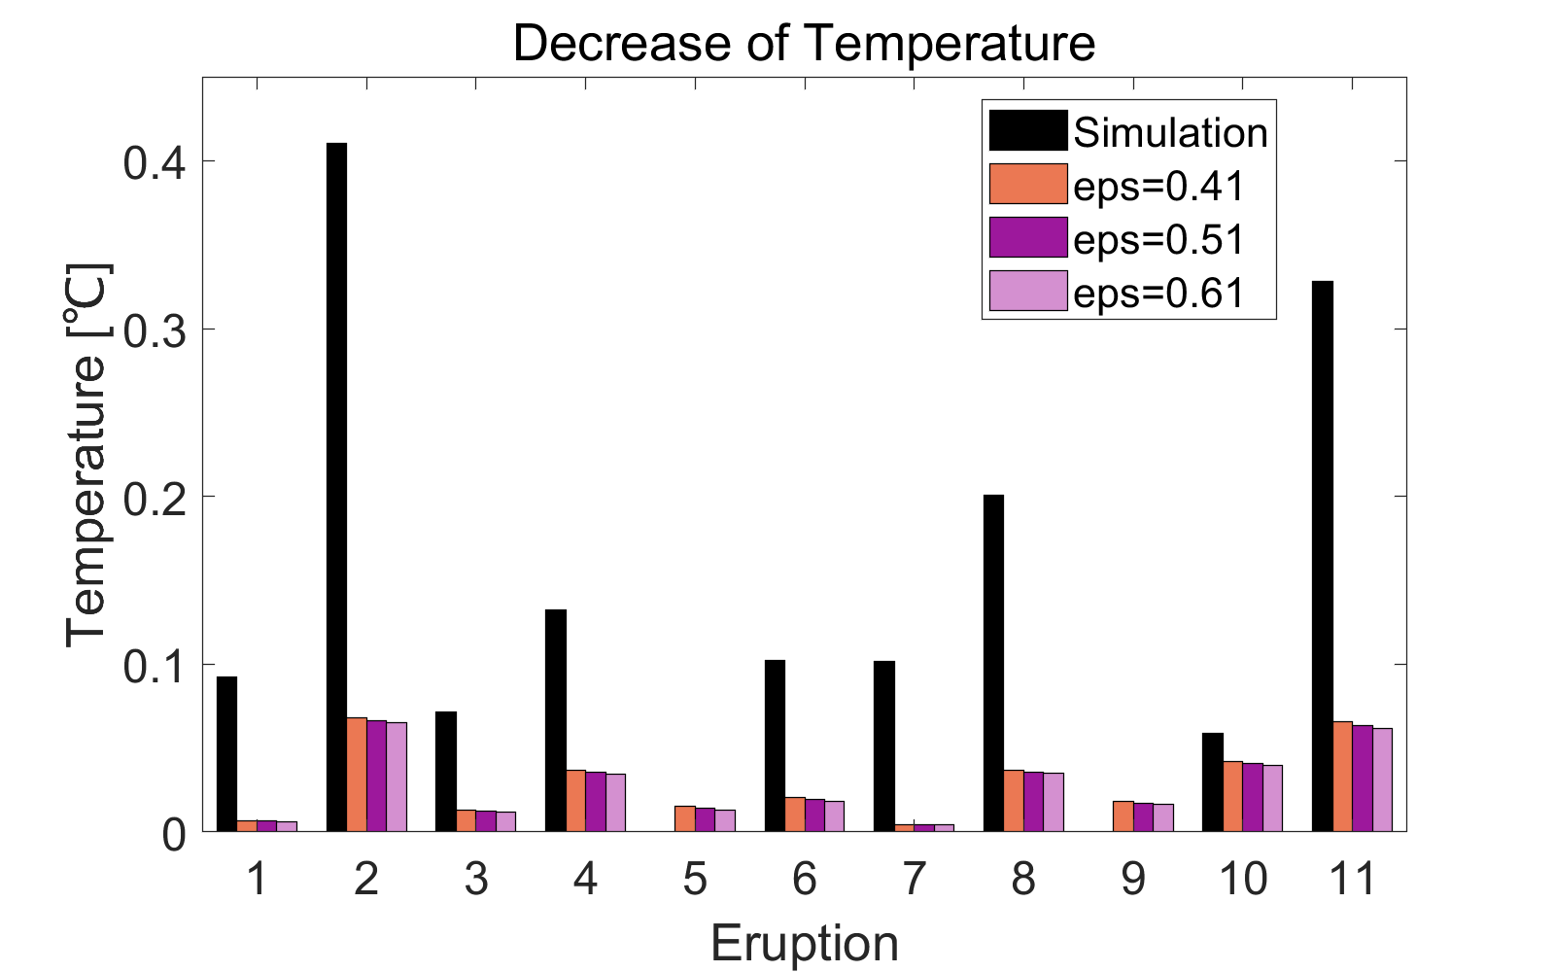
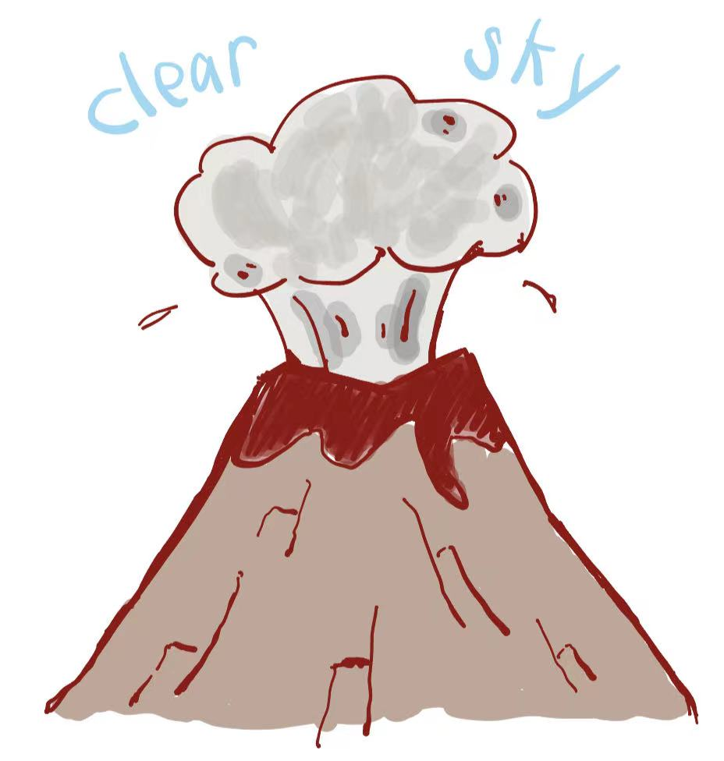
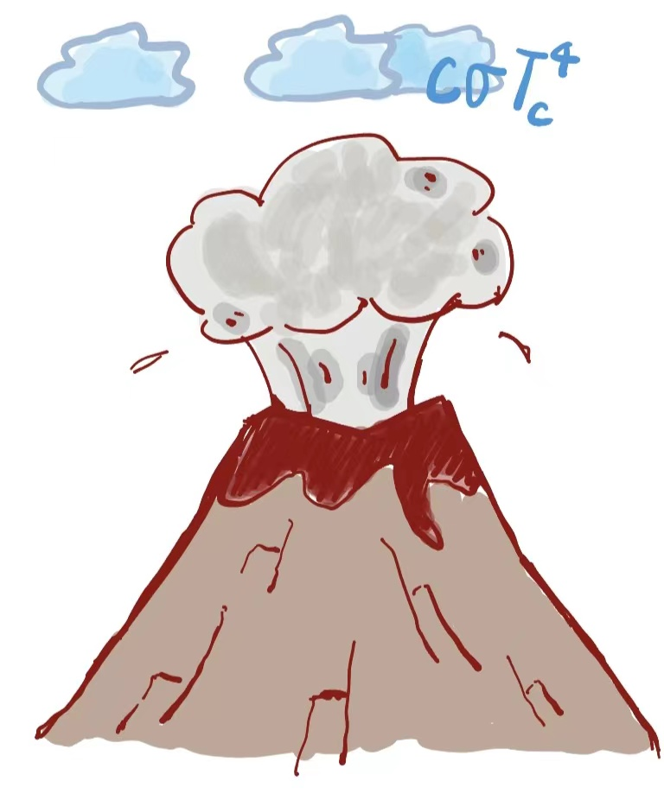
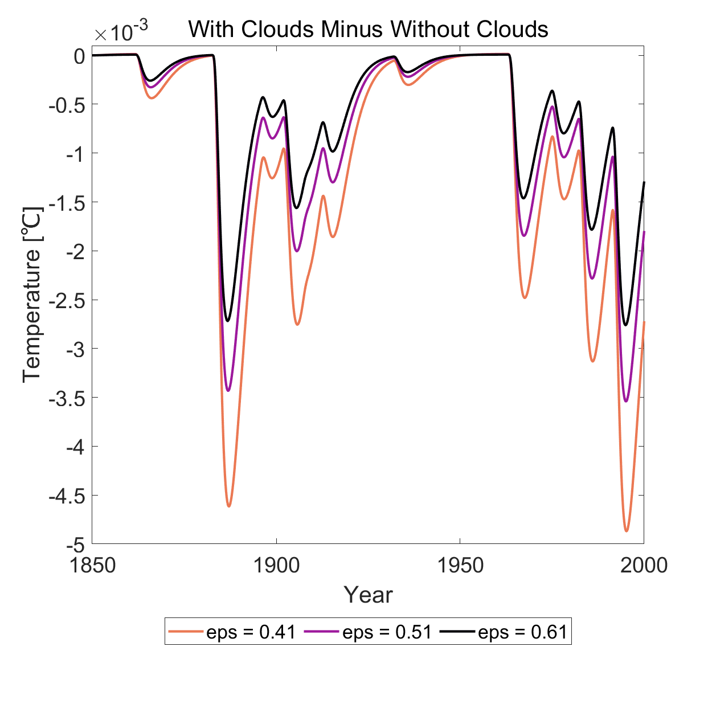


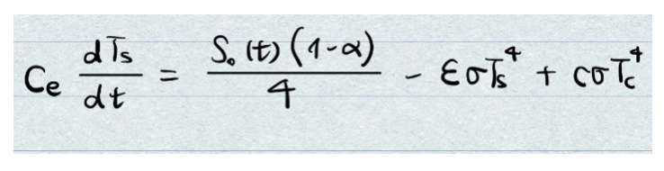
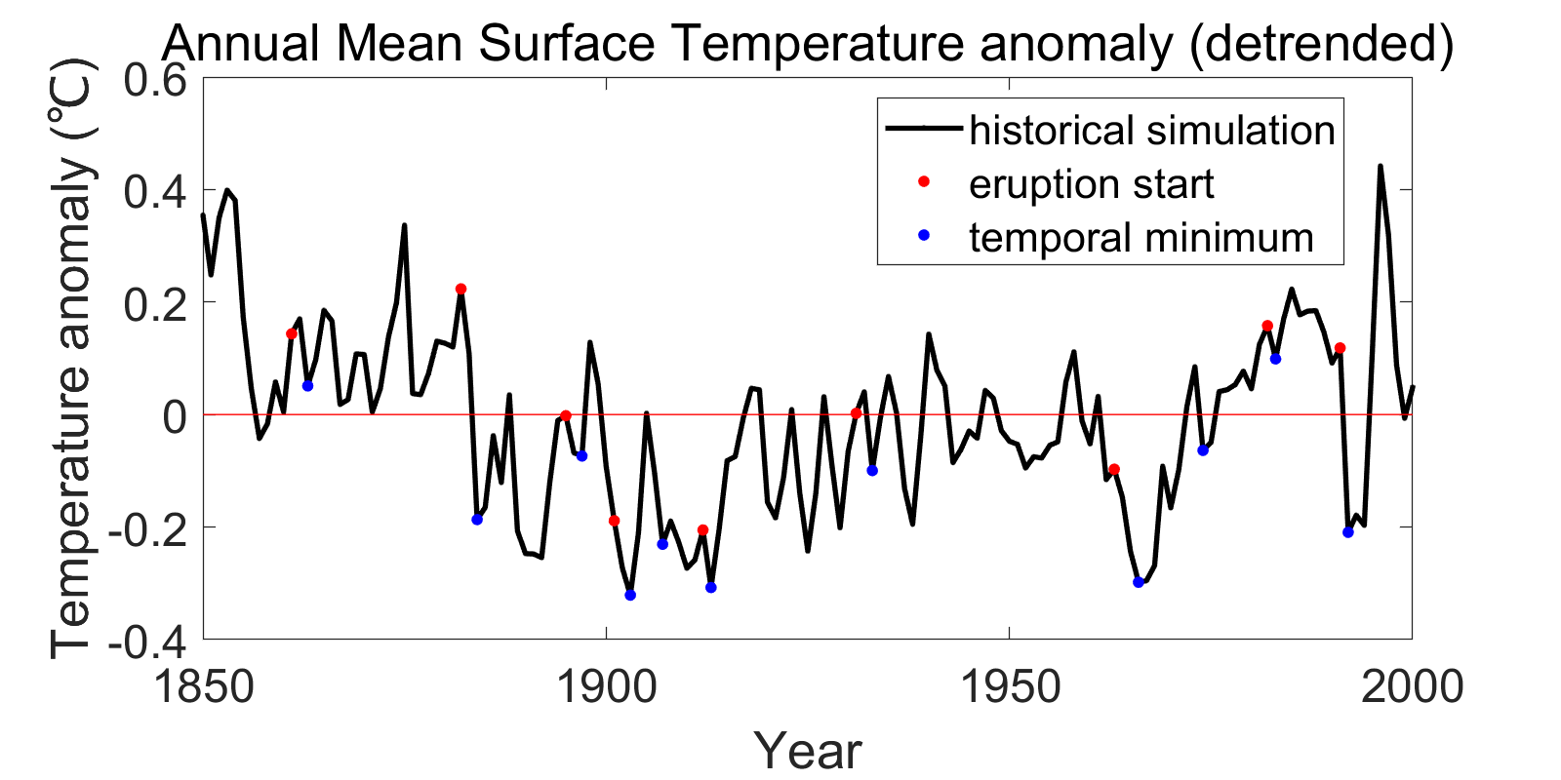

Effects of volcanic forcing on surface temperature in 0d-EBM with adjustment FROM one cloud layer
Kaiyan Yao, Xihui Jing, Mohammad Basir Uddin
Universität Hamburg Center for Earth System Research and Sustainability, Institute of Oceanography
run 0D-EBM without forcing,
get the equilibrium temperature
Previous group showed effects of volcanic forcing on surface temperature without considering cloud effects. The temperature change is much smaller compared to the findings in literatures.
Being motivated from here we want to see the adjustment from cloud layer in 0D-EBM.
loop over different value of emissivity
consider two cases: with clouds VS without clouds
Volcanic forcing has a cooling effect on surface temperature. The strength of this effect can be modified by adding cloud term in the model.
start from equilibrium temperature,
run 0D-EBM with forcing
1. decreasing emissivity ε
more severe decrease of temperature
same amount of time for a fully recovery of temperature
a slower recover rate at the beginning stage
Fig. 1. Surface temperature anomaly due to 11 modelled eruptions in 1850-2000. 0D-EBM starts from equilibrium, with cloud term.
Fig. 4. Decrease of temperature after eruptions in 1850-2000, comparison between historical simulation in MPI-ESM and 0D-EBM (cloud term included).
2. with clouds vs. no clouds
a slightly more severe decrease of temperature ~ O(10^-3)
Limitation
Only consider one cloud layer
Neglect the atmospheric response and seasonal variability
Effect of volcano highly depends on aerosol
model: Effects of volcanic forcing are modeled in 0-d EBM through changes in solar constant with respect to time.
assumptions:
albedo = 0.3
emissivity = [0.41,0.51,0.61]
c = 0.2 at 10 km; lapse rate = -6 K/km
Fig. 2. Difference of surface temperature anomaly between with cloud term and without cloud term.
3. historical simulation from MPI-ESM model
temperature decreases and reaches a trough after the eruptions except in 1907 and in 1974
E-mail address:
kaiyan.yao@studium.uni-hamburg.de
xihui.jing@studium.uni-hamburg.de
mohammad.basir.uddin@studium.uni-hamburg.de
Fig. 3. Annual mean surface temperature anomaly ( detrended)

