Slide 1
Capstone Project

Slide 2
Agenda
Introduction
Capstone Project Overview
Scope and Objective
Capstone Project solution design & solution implementation
Diagrams ( Architecture / Use Case /Class Diagrams / Sequence ) & Screen shots
Technology Stack
Best Practices followed during solution implementation
Challenges faced during solution design & solution implementation
Learnings & Experiences
Future Scope

Slide 3
Introduction A capstone project demonstrating a modern Digital Bank Customer Portal. Built with a secure, scalable, and user-friendly architecture. Focuses on real-world digital banking use cases.
Capstone Project Overview
Portal allows customer registration, login, account management, and transactions. Implements microservices with PostgreSQL backend and React frontend. Ensures convenience for customers and efficiency for bank operations.
Scope and Objective
Scope includes authentication, accounts, transactions, and loans. Objective is to provide a secure and maintainable banking portal. Lays the foundation for future advanced features.

Slide 4
Solution Design & Implementation
Designed with ER, architecture, class, and sequence diagrams. Implemented with modular backend, PostgreSQL schema, and React UI. Screenshots illustrate the portal’s functionality and flow.
Technology Stack
Backend: Node.js, Prisma ORM, PostgreSQL. Frontend: React with reusable components. Tools: JWT, REST APIs, GitHub version control.
Best Practices
Followed modular design and clean folder structure. Applied input validation, password hashing, and secure coding. Maintained GitHub commits and schema normalization.

Slide 5
Challenges Faced
Designing a normalized yet practical database schema. Making a proper friendly UI that can be easily understood by people of all ages. Integrating backend APIs with frontend components.
Learnings & Experiences
Hands-on experience with designing UI/UX and react. Improved collaboration and problem-solving as a team. Gained exposure to real-world digital banking workflows.
Future Scope
Add fund transfers, chatbot support, and cloud deployment. Integrate analytics and notifications. Expand to a full-featured, future-ready banking solution.

Slide 6
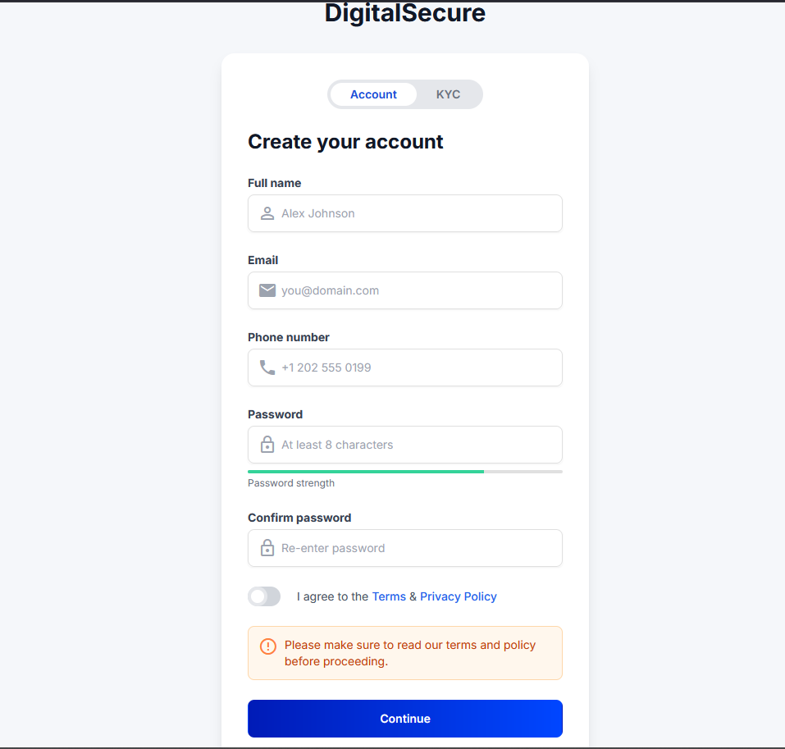

Slide 7
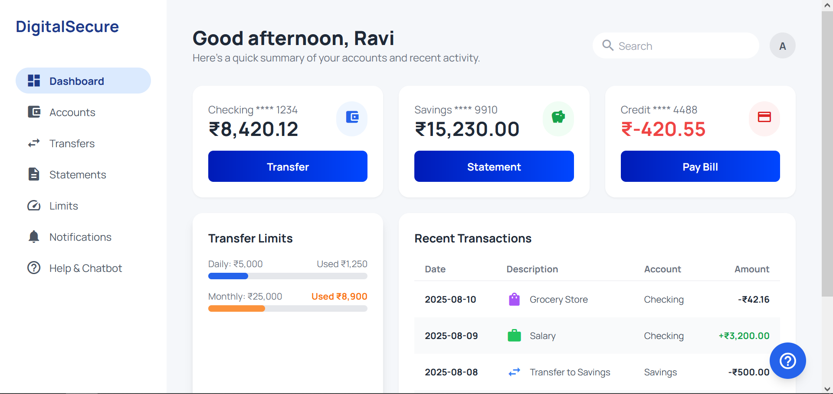

Slide 8
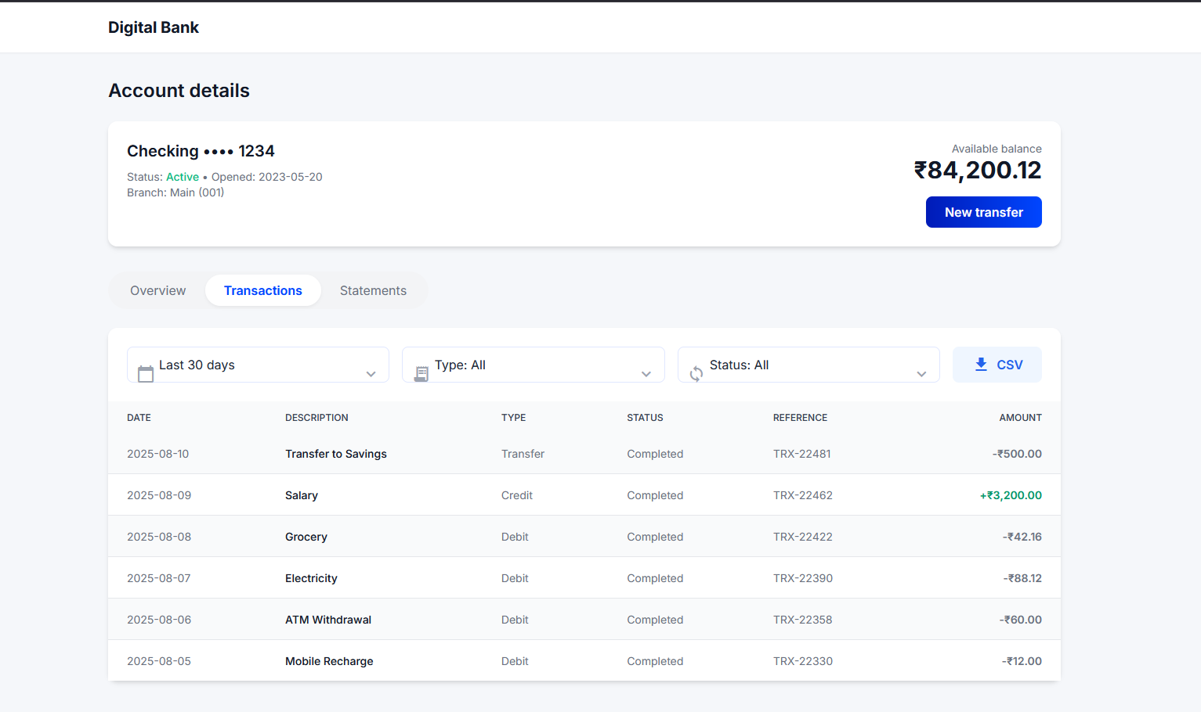

Slide 9
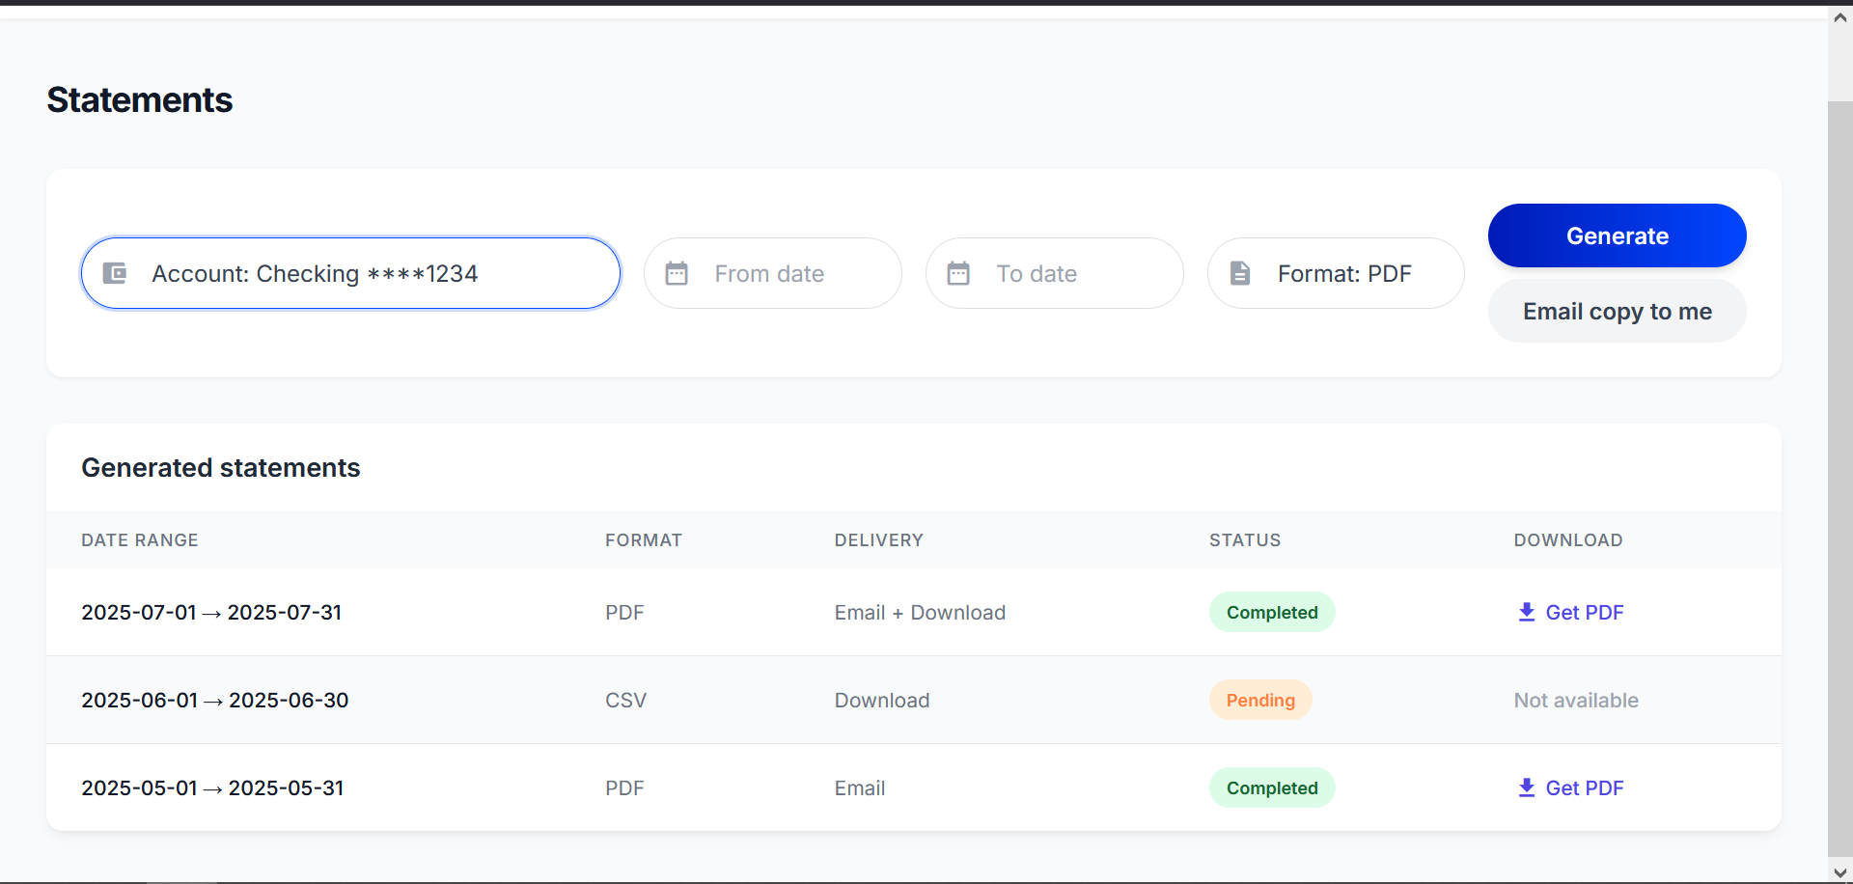

Slide 10
Thank You

