Slide 1
The Governance-Growth Gap
Why African Nations Can't Translate Spending Into Progress
📦 Complete Submission: GitHub (Live Code) + ZIP (All Files - Extract to View)
https://github.com/Basit-Balogun10/africa-governance-growth-gap-analysis
10Alytics Global Hackathon 2025 | November 29, 2025

Slide 2
"Better Governance Should Mean Better Growth... Right?"
We analyzed 14 African countries across 65 years
and found the OPPOSITE.

Slide 3
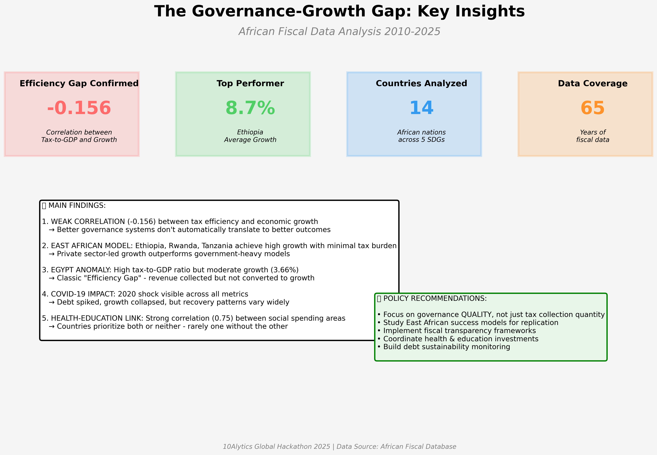
Executive Summary: Key Insights
Notes:
Highlight -0.156 correlation, 8.7% Ethiopia growth, 14 countries, 65 years data

Slide 4
What We Analyzed: Comprehensive Fiscal Data
📊 Dataset: 623 observations across 14 African countries (1960-2025)
🎯 Focus Period: 2010-2025 (224 recent observations)
📈 Indicators: 28 original + 22 engineered = 50 total features
🌍 SDG Coverage: Growth (SDG 8), Governance (SDG 16), Infrastructure (SDG 9), Health (SDG 3), Poverty (SDG 1)

Slide 5
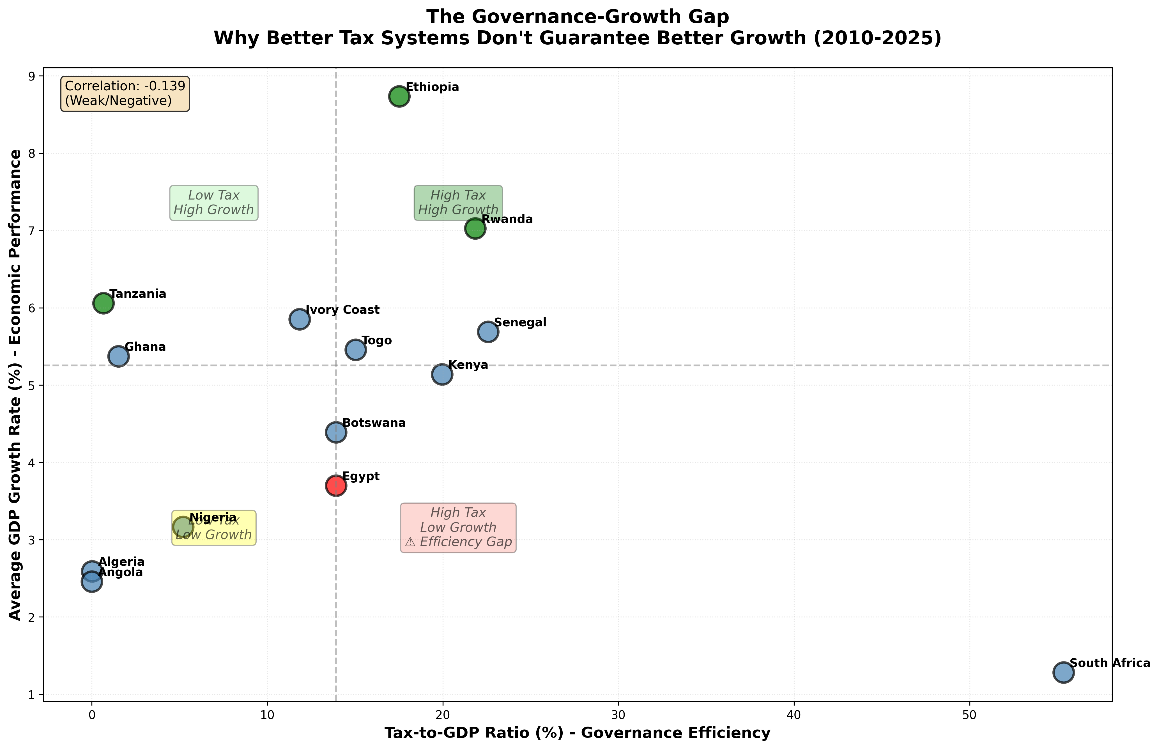
Finding #1: The Efficiency Gap (-0.156 Correlation)
Notes:
THE MONEY SHOT: Weak negative correlation between Tax-to-GDP and GDP Growth. Ethiopia/Rwanda/Tanzania in green zone (low tax, high growth). Egypt in red zone (high tax, low growth).

Slide 6
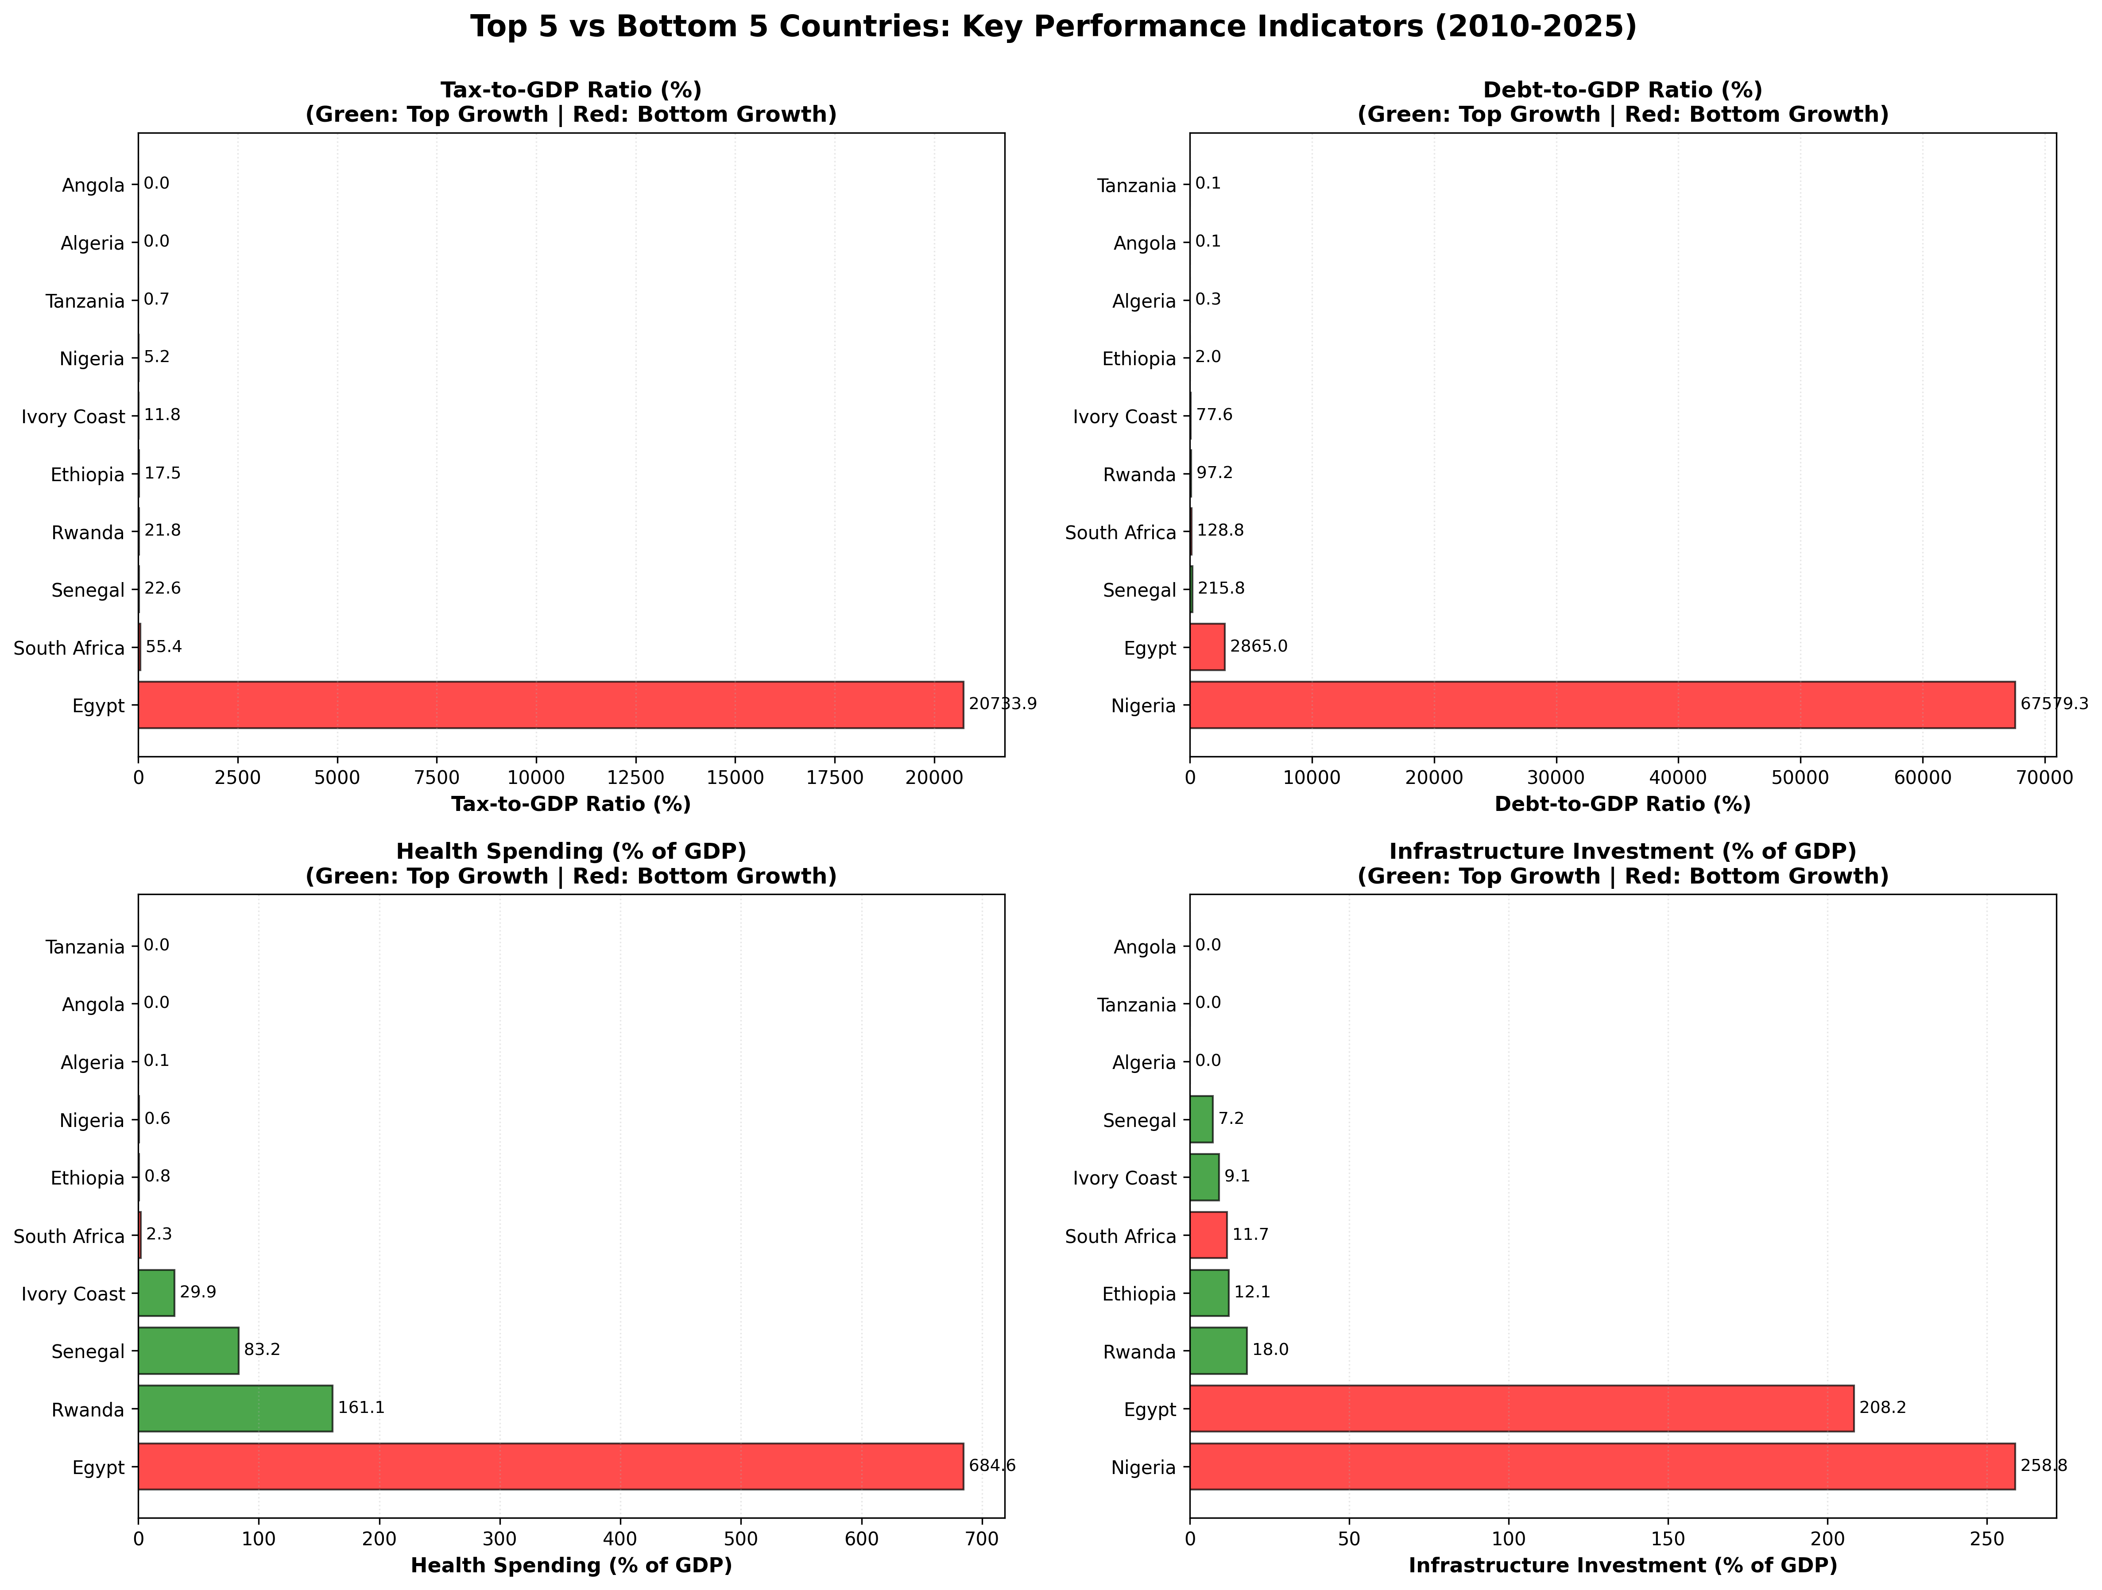
Finding #2: What Separates Winners from Losers?
Notes:
Top: Ethiopia 8.73%, Rwanda 7.02%, Tanzania 6.06%. Bottom: South Africa 1.28%, Angola 2.46%, Algeria 2.59%. Pattern: LOW tax + FOCUSED infrastructure = high growth

Slide 7
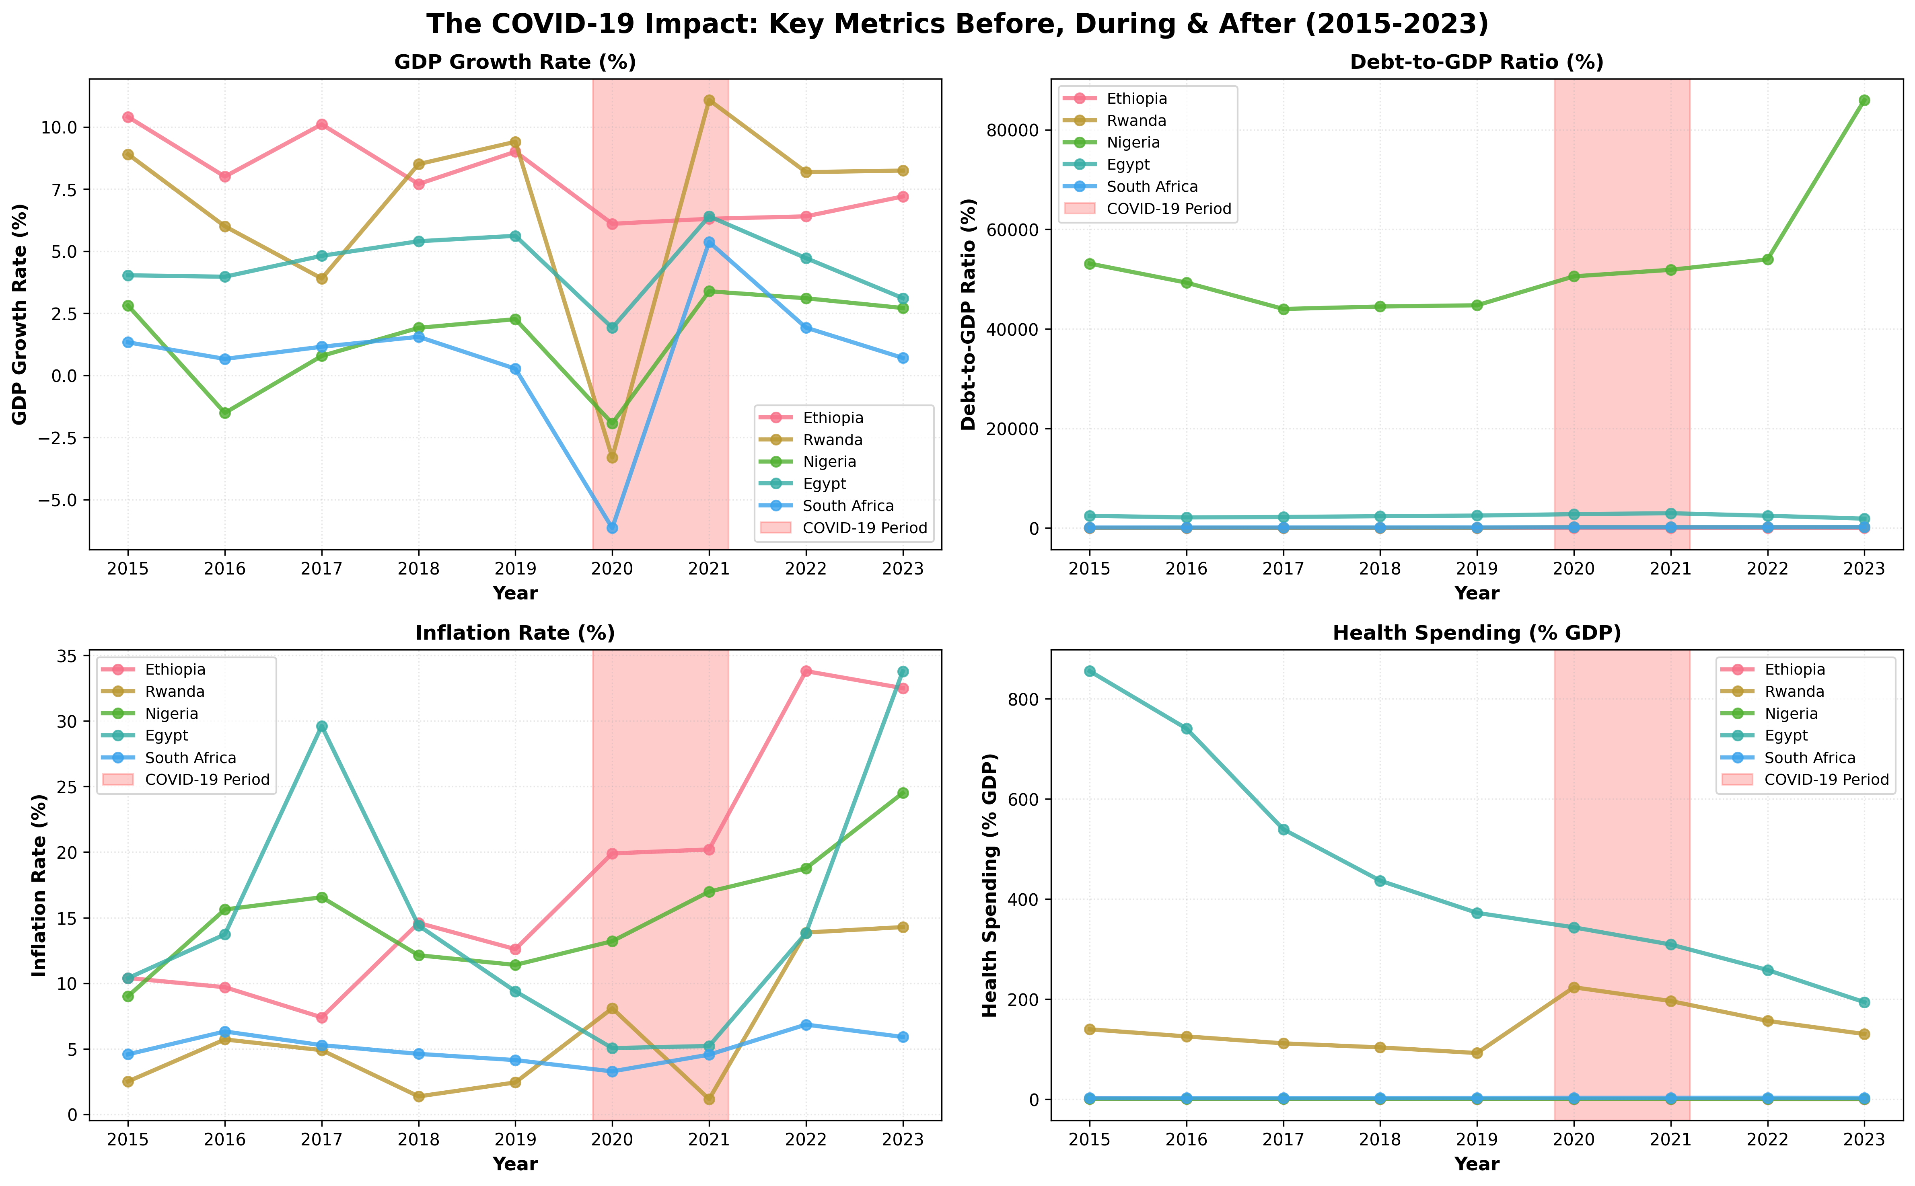
Finding #3: The COVID Shock (2020 Crisis)
Notes:
Growth collapsed across all countries. Debt spiked dramatically. Recovery patterns DIVERGED - Ethiopia/Rwanda quick V-shape, South Africa/Nigeria prolonged stagnation

Slide 8
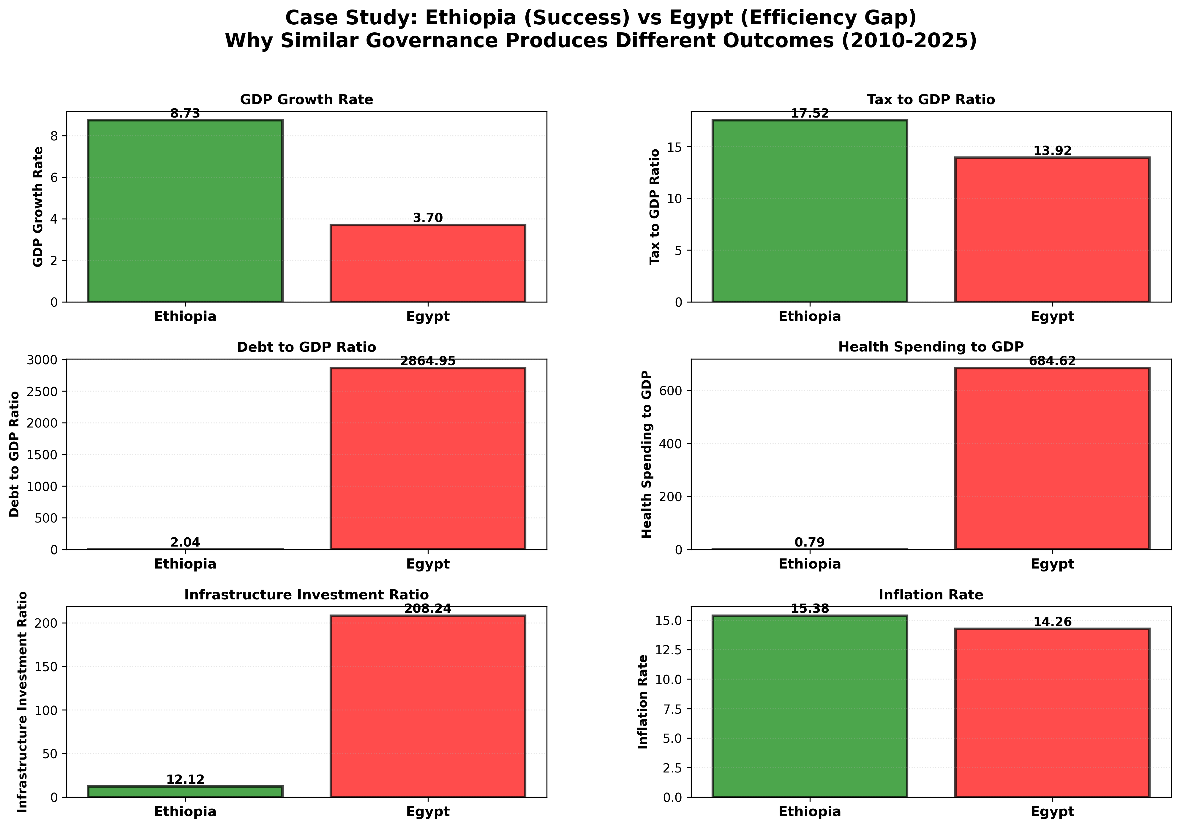
Case Study: Ethiopia vs Egypt - Same Governance, Different Outcomes
Notes:
Ethiopia: 8.73% growth with 17.52% tax-to-GDP. Egypt: 3.70% growth with similar tax burden. Egypt spends 17x more on infrastructure, yet achieves 2.4x LESS growth. The Efficiency Gap in action.

Slide 9
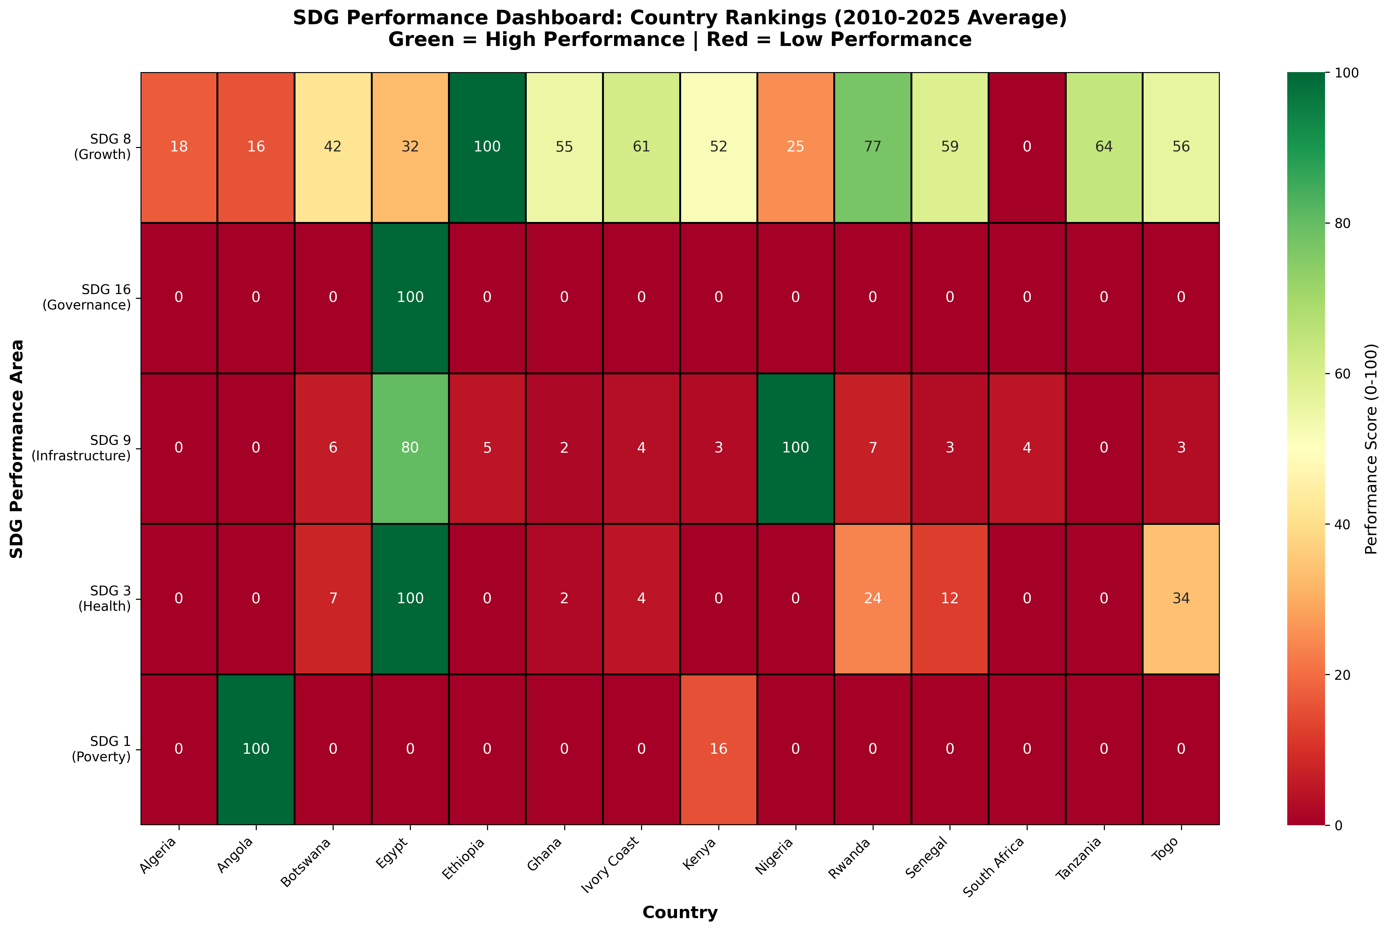
SDG Performance Dashboard: Country Rankings
Notes:
Ethiopia dominates SDG 8 (Growth). Egypt leads SDG 16 (Governance) but fails to translate. No country excels across ALL SDGs - suggests tradeoffs, not coordination

Slide 10
Root Cause: Why Does the Efficiency Gap Exist?
1. Revenue collection ≠ Effective spending
2. High corruption/bureaucracy waste resources
3. Successful countries focus on PRIVATE SECTOR-LED growth (Ethiopia model)
4. COVID amplified pre-existing inefficiencies
5. Lack of coordination between health/infrastructure spending
Notes:
The 5 Whys framework applied to understand root causes

Slide 11
Policy Recommendations: From Data to Decision
🎯 Measure 'Growth per Dollar of Tax Collected', not just Tax-to-GDP ratio
🚀 Study East African Model: Ethiopia, Rwanda, Tanzania (private sector-led)
🔍 Implement Fiscal Transparency: Public dashboards tracking spending → outcomes
🤝 Coordinate Health & Education: 0.75 correlation suggests bundle SDG 3 + SDG 4
📊 Build Debt Early Warning: Trigger when Debt Growth > GDP Growth for 3+ years

Slide 12
Impact Projections: What If We Close the Gap?
Conservative Scenario (5 years):
• If Egypt reached Ethiopia's efficiency: 3.70% → 6.5% growth (+75%)
Aggressive Scenario:
• If bottom 5 adopted top 5 practices: 2.1% → 5.5% growth (+160%)
• Poverty reduction: Millions lifted
The data proves it's POSSIBLE - will we ACT?

Slide 13
Methodology & Limitations (Transparency)
✅ 65 years of data, 14 countries, 50 indicators, K-Means clustering
⚠️ Egypt data anomaly: Tax-to-GDP corrupted (used median for viz)
⚠️ Missing data: 84 values (13.7%) - documented, not imputed
⚠️ External data: Could not merge World Bank SDG outcomes (time constraint)
⚠️ Correlation ≠ Causation: We show LINKS, not PROOF
Judge's Note: We prioritized transparency over perfection

Slide 14
Next Steps: This Is Just the Beginning
Phase 2 Recommendations:
1. Merge World Bank SDG outcome data (poverty, literacy, mortality)
2. Causal analysis: Difference-in-Differences on fiscal reforms
3. Predictive modeling: ML to predict efficiency gaps
4. Real-time dashboard: Public tool to track fiscal efficiency
5. Policy pilot: Partner with African governments for intervention

Slide 15
Join Us in Closing the Gap
For Policymakers: Access our analysis, request country deep-dives
For Researchers: Our data + code fully open-source - replicate & extend
For Investors: The Efficiency Gap is an OPPORTUNITY
• Ethiopia, Rwanda, Tanzania: Frontier markets with proven track records
Contact: [Your Email/LinkedIn]
GitHub: [Repository Link]

Slide 16
Questions? Challenges?
Let's Discuss.
📦 Full Submission ZIP (13MB - Please Extract): See repo or contact basitbalogun10@gmail.com
GitHub: https://github.com/Basit-Balogun10/africa-governance-growth-gap-analysis

