Slide 1
weather_dashboard
File created on: 7/31/2023 11:36:23 PM

Slide 2
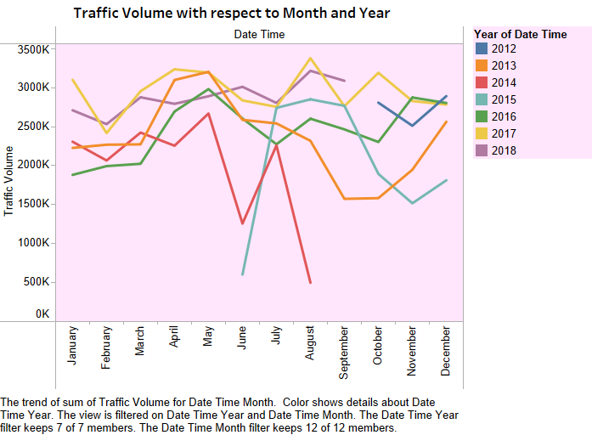

Slide 3
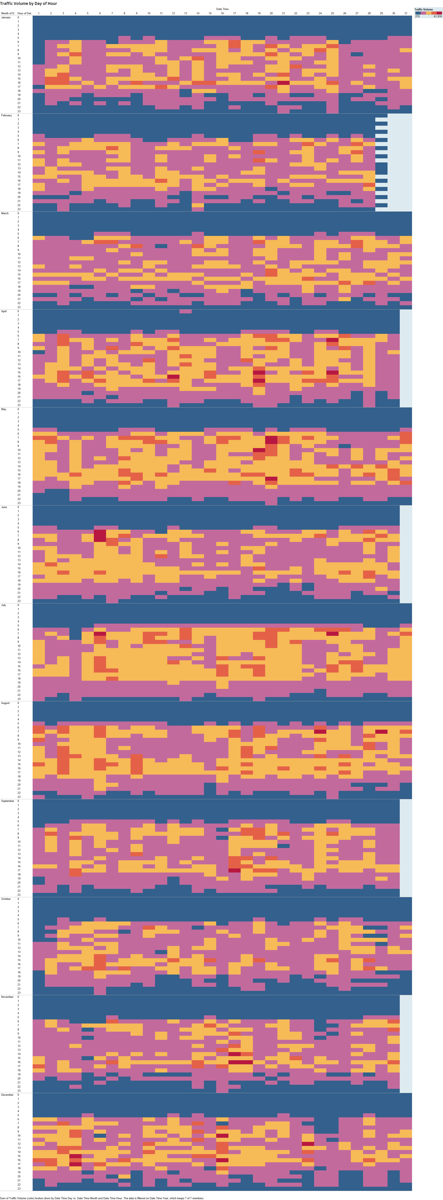

Slide 4
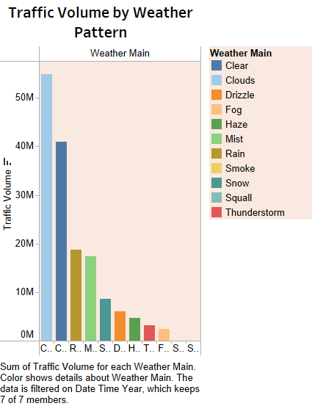

Slide 5
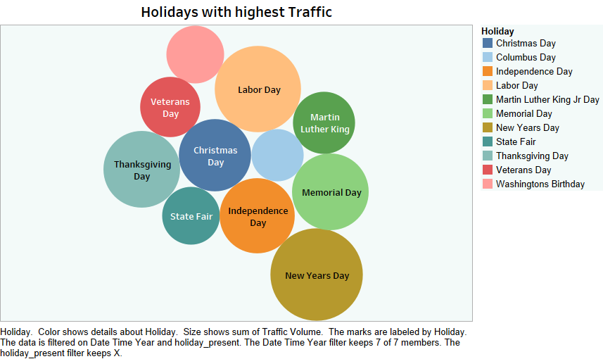

Slide 6
