Slide 1
Gender Bias in Natural Language Processing Across Human Languages.
Matthews, A., Grasso, I., Mahoney, C., Chen, Y., Wali, E., Middleton, T., Njie, M., & Matthews, J. (2021).
Group 1
Name: Basit Hussain
ID: 21141064
ST: Ehsanur Rahman Rhythm
RA: Md Humaion Kabir Mehedi

Slide 2
Introduction
Natural Language Processing (NLP) is a rapidly growing field with many practical applications
A team including speakers of 9 languages - Chinese, Spanish, English, Arabic, German, French, Farsi, Urdu and wolof.
The authors of this study collected data from various NLP applications and evaluated the results using a gender bias metric.

Slide 3
Data collection and Methodology
Gender bias was quantified using the Word Embedding Association Test (WEAT) and the Singular Value Decomposition (SVD) method.
The authors refer to Bolukbasi et al.'s work and their own previous work on gender bias in English and emphasize the importance of extending this analysis to other languages.
A list of gender-defining words and a set of gender-balanced professions were used to identify the gender of the individuals mentioned in the articles.
The paper uses Wikipedia articles as the corpus for each language.

Slide 4
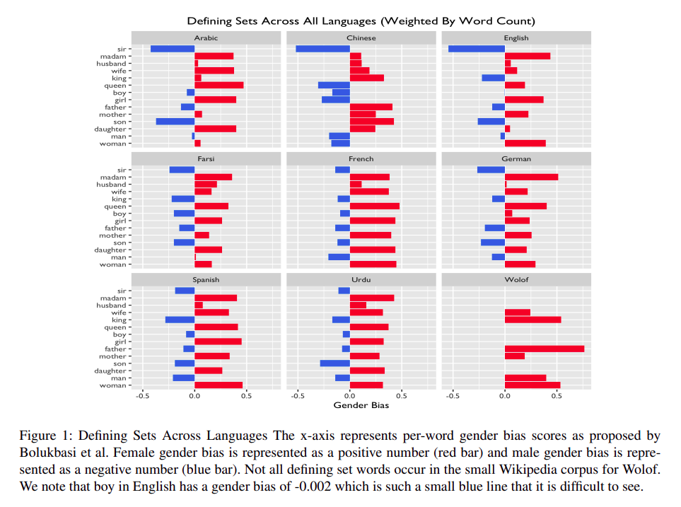
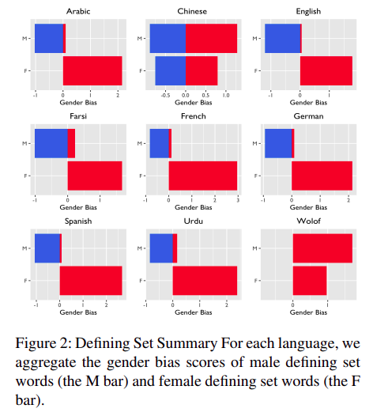
Results and Analysis

Slide 5
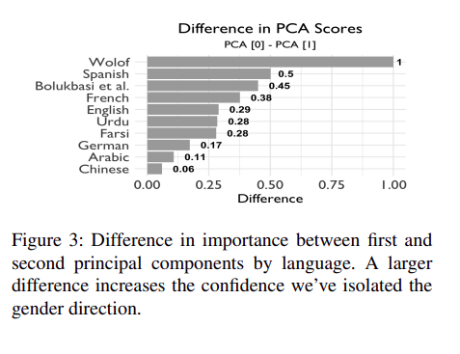
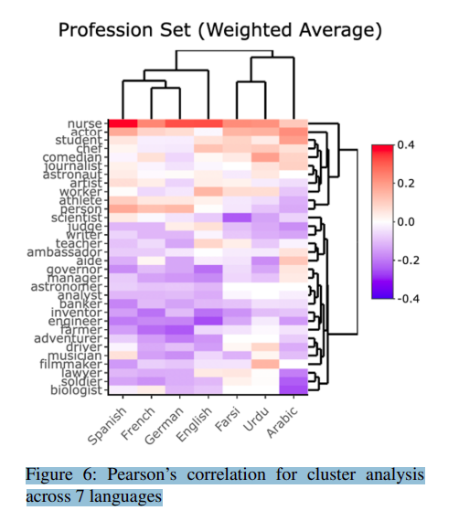
Results and Analysis

Slide 6
Conclusion
The paper concludes that gender bias is a pervasive problem in NLP models across multiple languages.
However, by quantifying and comparing gender bias across languages, we can begin to track and improve it.
The paper emphasizes the need for more useful tools and resources in order to overcome the barriers to building NLP tools with less gender bias.

Slide 7
Future work
Exploring the effects of gender bias in NLP models on downstream applications
investigating potential solutions for mitigating gender bias in NLP models

Slide 8
Reference
Matthews, A., Grasso, I., Mahoney, C., Chen, Y., Wali, E., Middleton, T., Njie, M., & Matthews, J. (2021). Gender bias in natural language processing across human languages. Proceedings of the First Workshop on Trustworthy Natural Language Processing. https://doi.org/10.18653/v1/2021.trustnlp-1.6

