Slide 1
INVESTOR PITCH / 2026
Hotel PMS
A manager-first operating system for
independent hotels in Pakistan
Hunza / Skardu / Naran / Swat / Gilgit
Concept / MVP Architecture / Roadmap

Slide 2




THE PROBLEM
Hotels run on paper, WhatsApp, and prayer.
Paper registers
WhatsApp chaos
Manual OTA re-entry
No owner visibility
Bookings, guest data, and payments tracked in handwritten ledgers. No backup, no search, no audit trail.
Reservations arrive across DMs and groups. Lost messages, overbookings, and disputes are routine.
Booking.com and Agoda reservations get re-typed into spreadsheets. Data silos. Inventory mismatches.
Owners get ad-hoc voice notes from managers. No consolidated view of revenue, cash, or occupancy.
The real competition isn't enterprise software — it's a WhatsApp group.
Hotel PMS / Investor Concept
2 / 14

Slide 3



EXISTING SOLUTIONS
The market has no good answer.
Foreign Cloud PMS
Local Desktop Software
Spreadsheets + WhatsApp
Cloudbeds, Mews, Oracle OPERA
Aging Windows-only tools
The actual status quo
USD pricing unsustainable here
Single-machine installs
No transaction integrity
No Urdu, no Roman Urdu input
No OTA integration
No audit trail
Zero JazzCash / Easypaisa support
No mobile access
Messages lost daily
No FBR e-invoicing integration
Frequently pirated and resold
Overbookings are weekly
Built for 100+ room properties
Developers have moved on
No reporting whatsoever
Hotel PMS / Investor Concept
3 / 14

Slide 4



THE OPPORTUNITY
A tourism economy without a software backbone.
20–30%
Why now
Hundreds of small hotels
YoY growth in northern Pakistan tourism
are opening monthly across Hunza, Skardu, Naran, Swat, and Gilgit.
20–80
Pakistani tourism is structurally underserved.
No PMS vendor has built specifically for this geography, language, and payment landscape.
Room range of our target customer
First-mover wins this market.
3–5 yr
Local distribution, regulatory integration, and trust take years to build — once we hold them, displacement is hard.
Window before well-funded entrants arrive
Hotel PMS / Investor Concept
4 / 14

Slide 5



OUR SOLUTION
A cloud-based PMS that replaces the notebook and the WhatsApp group with one trusted workspace.
Manager-first
Pakistan-native
Cloud, mobile-ready
Built for the people who run the hotel every day — not for guests, not for chains.
Urdu input, JazzCash, FBR e-invoicing, and WhatsApp are first-class, not afterthoughts.
Works on a laptop at the front desk and a Rs 15,000 Android in housekeeping.
Hotel PMS / Investor Concept
5 / 14

Slide 6
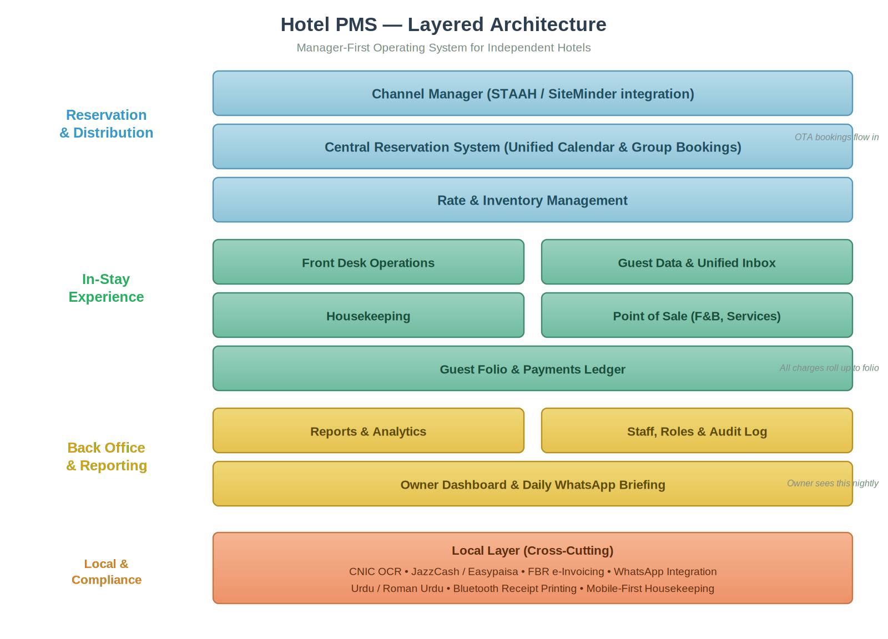
ARCHITECTURE
Three layers, plus a local compliance fabric.
RESERVATION
Distribution
Channel manager, unified calendar, rate and inventory.
IN-STAY
Experience
Front desk, unified inbox, housekeeping, POS, folio.
BACK OFFICE
Reporting
Analytics, audit log, owner dashboard, daily WhatsApp briefing.
LOCAL
Compliance fabric
CNIC OCR, JazzCash, FBR, WhatsApp, Urdu, thermal print.
Hotel PMS / Investor Concept
6 / 14

Slide 7
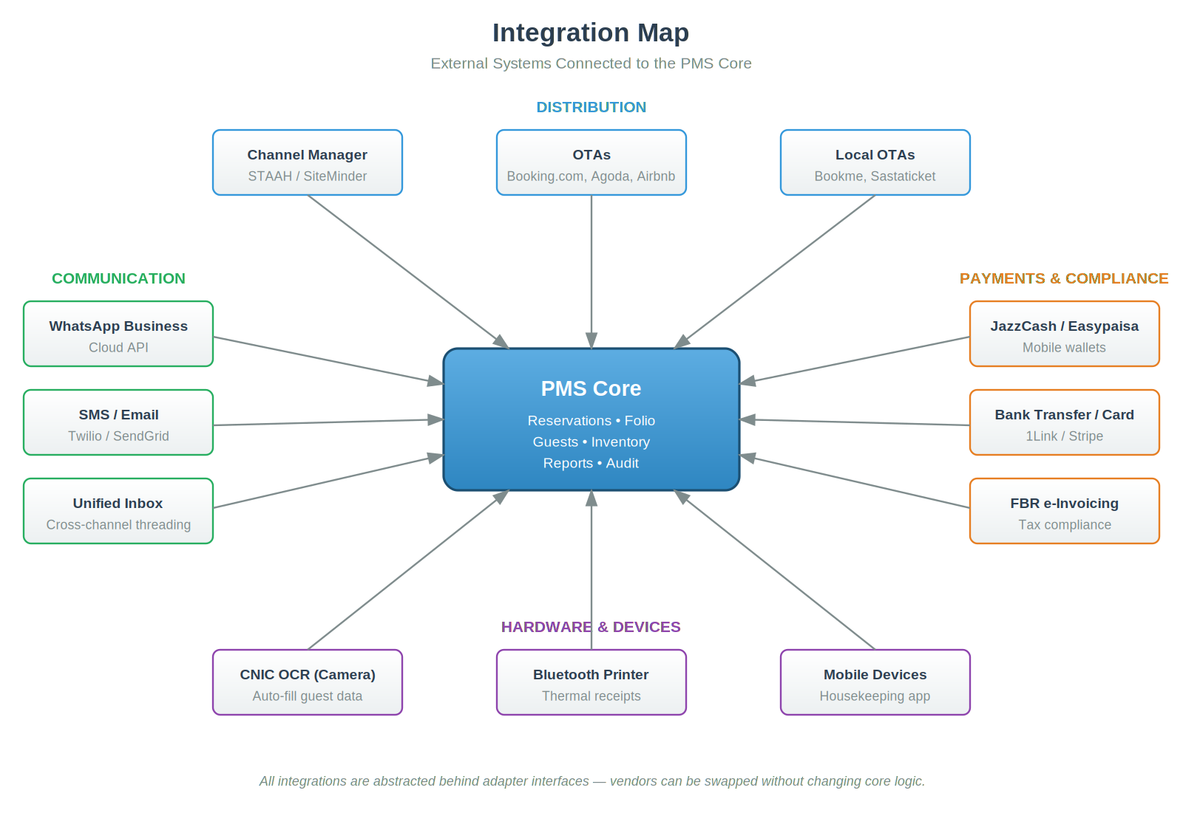
INTEGRATIONS
PMS core, best-of-breed integrations.
Build vs buy
We don't build the channel manager. We integrate STAAH or SiteMinder as middleware and focus engineering on what's unique to this market.
Adapter pattern
Every external system sits behind an adapter interface. Vendors can be swapped — STAAH today, direct Booking.com tomorrow — without touching core logic.
Hotel PMS / Investor Concept
7 / 14

Slide 8








MVP / 8 WEEKS
Ship the smallest product a manager will trust.
Reservation calendar
CNIC OCR check-in
Guest folio
Point of sale
Drag-and-drop room grid
Phone camera, auto-fill guest data
Line-item charges, payments ledger
F&B and services to folio
Unified inbox
Owner briefing
Reports
Audit & roles
WhatsApp threaded by guest
Nightly WhatsApp summary
Daily status, monthly revenue
Role-based access, full audit log
8-WEEK BUILD
W1–2
W3–4
W5–6
W7–8
Calendar, room grid, data model
Check-in/out, folio, POS
WhatsApp, inbox, owner briefing
Audit, roles, pilot deployment
Hotel PMS / Investor Concept
8 / 14

Slide 9

KILLER FEATURE
The owner's nightly WhatsApp briefing.
Why this feature wins.
Hotel Assistant
today 11:00 PM
1
The owner is the buyer.
Good evening, Sahib.
Daily summary — 16 May
Occupancy: 84% (32 / 38)
Revenue: Rs 218,400
Cash drawer: OK (no variance)
Tomorrow:
8 arrivals · 5 departures
1 group booking (Karachi, 6 rooms)
Flagged:
Room 204 dirty 6 hrs — chase HK
Booking #4521 advance overdue
Often based in Islamabad or Karachi, not on site. This message is what they see every night before sleep.
2
Manager can't sabotage it.
Fully automated. Managers who skim cash or under-report cannot quietly disable transparency.
3
Sells itself through WhatsApp.
Owners forward it to other owners in their group chats. The product spreads through the buyer's natural channel.
4
Builds a daily habit.
Every accurate nightly message reinforces trust. The subscription renews itself.
Hotel PMS / Investor Concept
9 / 14

Slide 10




BUSINESS MODEL
Subscription wedge, ecosystem expansion.
PHASE 1 · SUBSCRIPTION
PHASE 2 & 3 · EXPANSION
Primary revenue: SaaS
Where the margin lives
Monthly per-property subscription, priced in PKR and tiered by room count. Annual billing offered at a discount to smooth seasonality.
Payment processing take-rate
0.5–1% on transactions processed through JazzCash, Easypaisa, and bank rails.
Starter
Up to 20 rooms
Travel agent marketplace
3–5% transaction fee on inventory booked through the agent portal.
Growth
21 – 50 rooms
Tourism data products
Professional
51 – 80 rooms
Anonymized occupancy and demand data sold to tourism boards and ecosystem partners.
Embedded financial services
Plus: setup & onboarding fees, channel manager reselling margin, WhatsApp Business API reselling.
Referral revenue from microfinance partners offering working capital to hotels.
Hotel PMS / Investor Concept
10 / 14

Slide 11




DEFENSIBILITY
Features are copyable. The moat is not.
Local distribution
Travel agent network
Boots-on-ground onboarding in Hunza, Skardu, and Naran. Foreign players won't send a PM to Karimabad. This is the single biggest moat.
Two-sided platform where Karachi and Lahore agents book inventory directly. Once 200 agents are on the platform, hotels cannot leave.
Regulatory integration
Data network effects
FBR e-invoicing certification, KP and GB Tourism Department approvals, provincial revenue authority compliance. Years to replicate.
Cross-property guest blacklist, demand forecasting from regional booking data, anonymized benchmarks. Sticky as the network grows.
What is NOT the moat: features, design, price. All copyable within 6 months.
Hotel PMS / Investor Concept
11 / 14

Slide 12
GO-TO-MARKET
Pilot in Hunza. Scale across the north. Expand.
MONTHS 1–3
MONTHS 4–9
MONTHS 10–18
Pilot
Early growth
Scale
3–5 design-partner hotels
20–30 paying properties
100+ properties
Hunza and Skardu first
→
Expand to Naran, Swat, Gilgit
→
Expand to Murree, Hyderabad, Bahawalpur
Free access in exchange for weekly feedback
Hire in-region CS lead
Full travel agent marketplace
Founder personally drives, sets up, trains staff
Launch travel agent portal beta
Tourism board partnerships
Weekly product iteration
FBR certification, payment integration
Evaluate AJK, Balochistan
Hotel PMS / Investor Concept
12 / 14

Slide 13
ROADMAP
From PMS to tourism operating system.
PHASE 1 · 8 WEEKS
PHASE 2 · M 3–9
PHASE 3 · M 9–15
PHASE 4 · M 12–24
MVP
Operational depth
Revenue optimization
Ecosystem & platform
Reservations & calendar
Housekeeping mobile app
Dynamic pricing
Agent marketplace
Folio & POS
Maintenance tickets
Direct OTA integrations
Tourism data products
WhatsApp inbox
Group bookings
Upsell engine
Financial services
Owner briefing
Police reporting
Multi-property
AI assistant
Long-term vision: the operating system of Pakistan's tourism economy.
Hotel PMS / Investor Concept
13 / 14

Slide 14
THE WINDOW IS OPEN
An unserved market.
A solo competitor: paper.
A 3–5 year window.
Most PMS startups die from feature sprawl before they learn what users need. We ship a small, sharp 8-week MVP into real hotels in northern Pakistan, then iterate from real usage — not imagined requirements.
Let's build it.
Hotel PMS / Investor Concept
14 / 14

