Slide 1

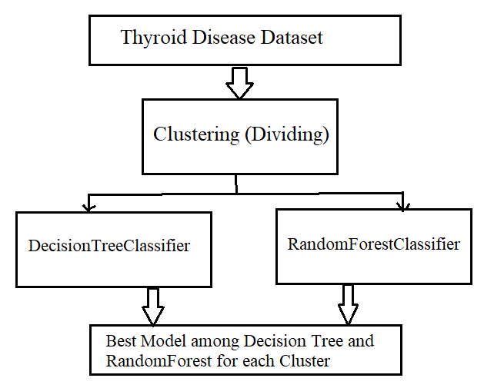
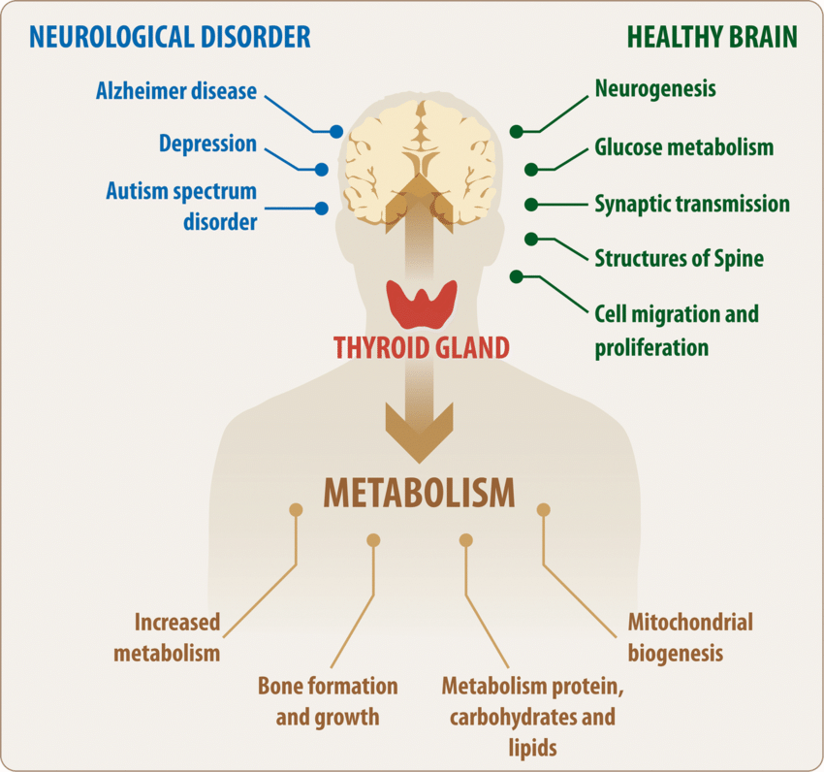
Thyroid Disease Prediction
Image Credit : https://link.springer.com/article/10.1007/s12035-018-1270-y
By Abdul Basith, MS IS, Spring 2023

Slide 2


