Slide 1


Understand Azure NetApp Files and Astra Trident
NetApp: a data management company that provide storage related solutions
Azure NetApp Files
fully managed file service provided by Microsoft in partnership with NetApp
allows Microsoft to offer a high-performance file storage solution
well suited for workloads that demand random access
Advantages
Performance
High throughput
Low latency
Flexible scaling
Optimized for workloads
High-availability
Automatic failover
Self-healing
Multi-protocol access
Data replication
Availability Zones and high-availability SLA
Data protection
Snapshot option
Integrated backup
Restore options
Security

Slide 2
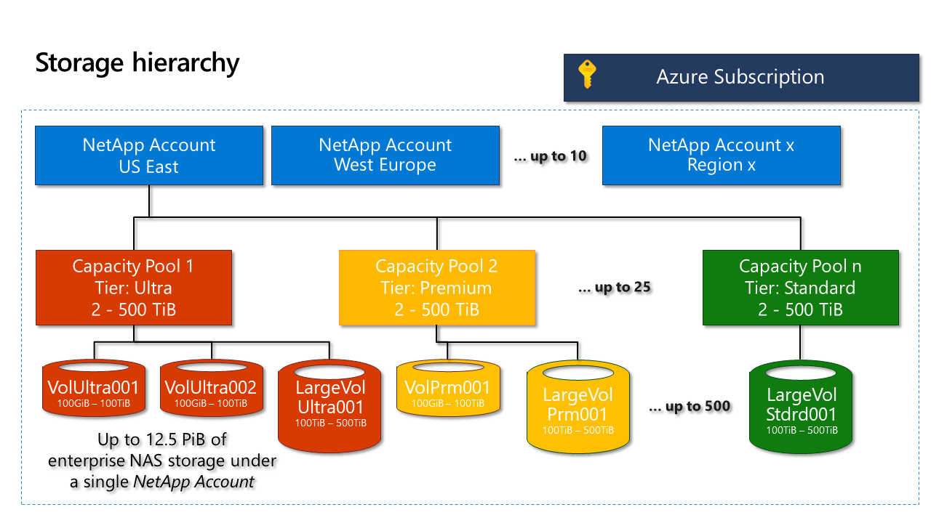
Understand Azure NetApp Files and Astra Trident
Azure NetApp Account
Logical container for Azure NetApp Files service
Azure NetApp Capacity Pool
Used to hold the volumes
SNET (with NetApp delegation)
AKS specifics:
Volume provisioning ways:
Static
Dynamic (on-demand)
Astra Trident (storage orchestrator
Source: https://learn.microsoft.com/en-us/azure/azure-netapp-files/azure-netapp-files-understand-storage-hierarchy
developed by NetApp)
App registration linked within Kubernetes secret
TridentBackendConfig (allows managing TridentBackend via kubectl)
StorageClass with the csi.trident.netapp.io provisioner -> Create PVC -> Mount in within pods

