Slide 1
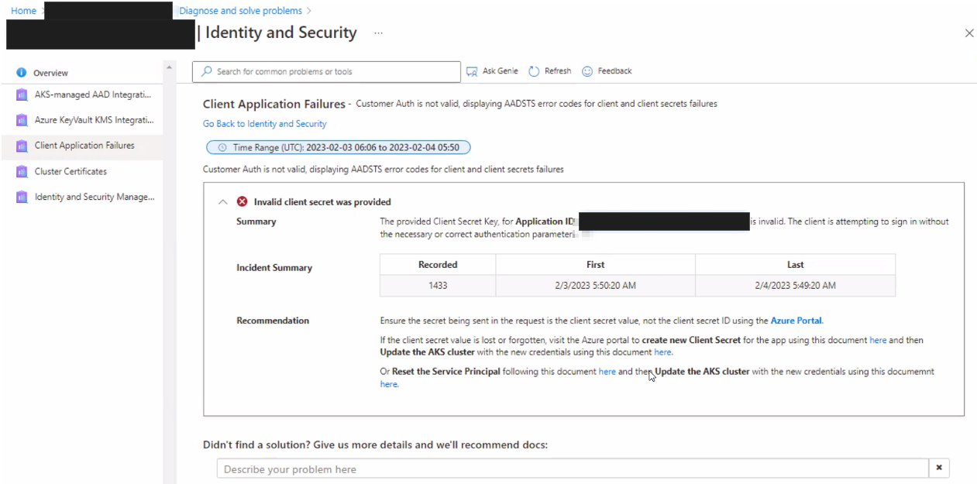
What to check to prevent an upgrade failure?
Service principal credential expiry
IP addresses available
Quota
PodDisruptionBudgets (PDBs)
A way to ensure high availability and reliability of applications running on a cluster
Allowed Disruptions should NOT be 0
Firewall/NSG/others blocking the cluster from downloading required resources
Azure Policy blocking operations

