Slide 1


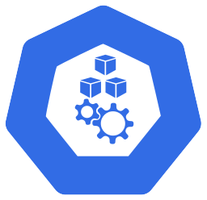

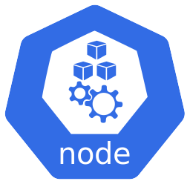
Exploring the AKS cluster – Azure infrastructure side
Virtual Machine Scale Set (VMSS)
Group of similar and load balanced VMs that are easily scalable
An AKS VMSS is like a normal VMSS with a few custom extensions, and is manageable using the AKS node pool
Each VMSS is controlled by an AKS node pool, which represents a group of nodes of the same configuration
AKS nodes run on Azure VMs, which are even VMSS instances or VMs part of Virtual Machine Availability Set (VMAS). VMSS is the most used and preferred in AKS due to their flexibility and easier management
AKS node names are in base32 and VMSS instances names are in base10
AKS node pool
VMSS
VMSS Instance 0
VMSS Instance 1
VMSS Instance 2
AKS node 0
AKS node 1
AKS node 2

