Slide 1
New Application
Add VCS Provider
Authorization
Create one in Azure Devops services
Save the AppID and ClientSecret for next step
Provide the Application details of Step-1
In TFC, Add Azure Devops as provider
Step-2 will route to Azure Devops services for authorization
Once approved, Azure Repos will sync with TFC.

Slide 2
Azure Repo
In Azure Devops, create a project and Create Repos with name “terraform-azurerm-<modulename>” to create modules.
Upload or create terraform files and add tags e.g. ‘v0.0.1’
TFC Modules
Connect the VCS provider
Select the module repos
TFC Workspace
Connect the VCS provider
Select the main repo to create resources and run Plan and Apply stages.
Azure Resources
Create Repo to call the modules (main).
Add sentinel policies in Organization settings
Choose the Version/Tags and publish

Slide 3
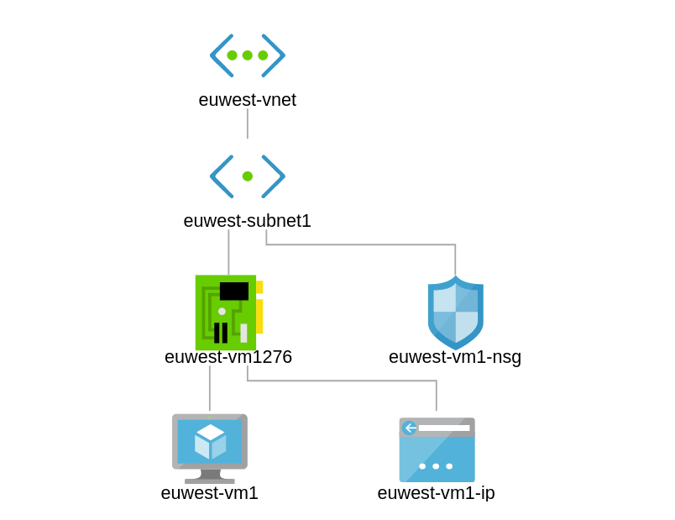

Slide 4
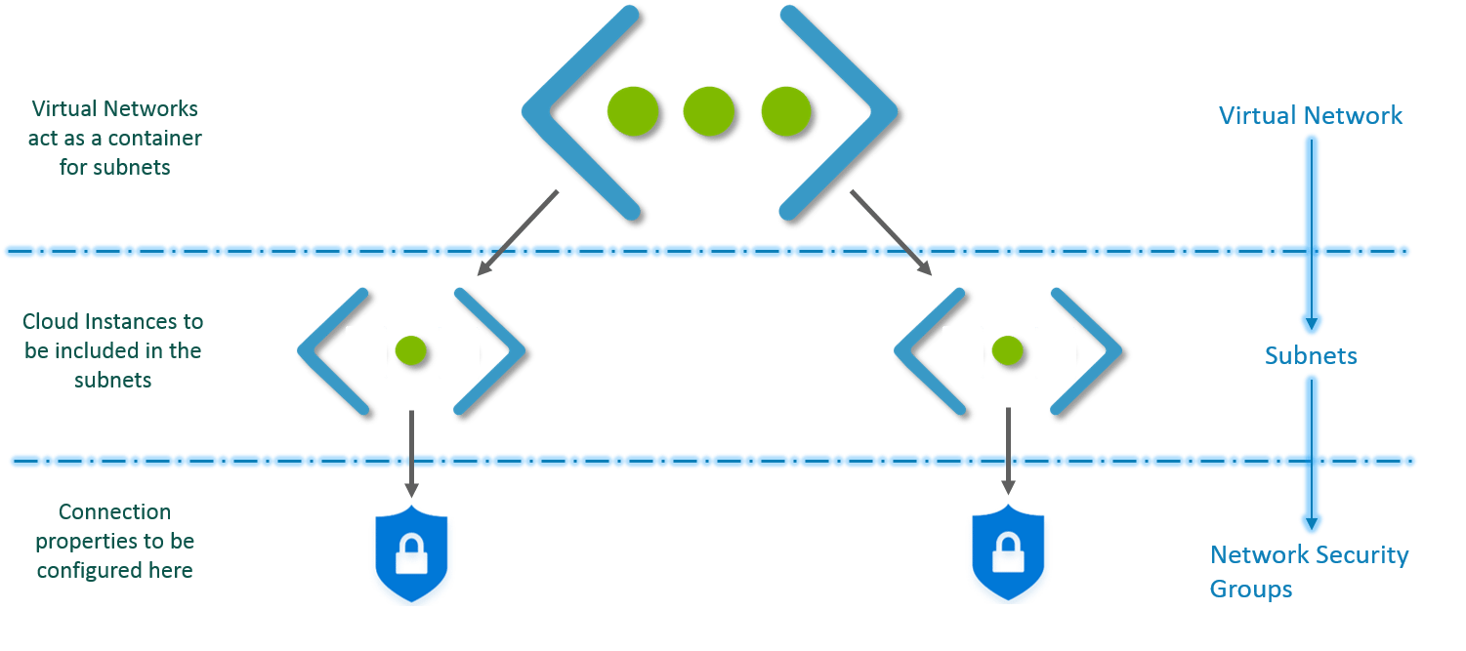

Slide 5
Agenda
Azure Terraform Module Review
Introduction : Terraform
Architecture : Teraform Core Plugins,Providers.
Simple workflow : Init,Plan+Apply,Destroy
Demo: Customize module created and available for deploy IaaS,PaaS and services.

Slide 6
Terraform Overview
A provider declarative tool that based on Infrastructure as Code paradigm.
Uses own syntax –HCL (HashiCorp Configuration Language).
Written in Golang
Helps to evolve your infrastructure, safely and predictably.
Terraform is a multipurpose composition tool.
Composes multipurpose composition tool:
Open & Enterprises sources.
Backend by HashiCorp company and HashiCorp Tao (Guide/Principles/Design)

Slide 7
Terraform Workflow
init
validate
plan
apply
destroy
1
2
3
4
5
terraform init
terraform validate
terraform plan
terraform apply
terraform destroy

Slide 8
Terraform Workflow
init
validate
plan
apply
destroy
1
2
3
4
5
Used to Initialize a working directory containing terraform config files
This is the first command that should be run after writing a new Terraform configuration
Downloads Providers
Validates the terraform configurations files in that respective directory to ensure they are syntactically valid and internally consistent.
Creates an execution plan
Terraform performs a refresh and determines what actions are necessary to achieve the desired state specified in configuration files
Used to apply the changes required to reach the desired state of the configuration.
By default, apply scans the current directory for the configuration and applies the changes appropriately.
Used to destroy the Terraform-managed infrastructure
This will ask for confirmation before destroying.

Slide 9

Publish Private Module Registry in Terraform Cloud
Check-in Private Module
Files
Azure Repo
Developer
Integrate it in
TF Cloud Modules
Terraform
Cloud

Slide 10
Terraform VCS Integration
Terraform Cloud is more powerful when you integrate it with your version control system (VCS) provider (Azure Repo, GitHub, Bitbucket, Gitlab).
Terraform Cloud can automatically initiate Terraform runs
Check-in TF Files
Azure Repo
Developer
Terraform Cloud makes code review easier by automatically predicting how pull requests will affect infrastructure.
Triggers Terraform
Runs
Publishing new versions of a private Terraform module is as easy as pushing a tag to the module's repository.
Terraform
Cloud

Slide 11
Terraform Private Module Registry
Terraform Cloud's private module registry helps you share Terraform modules across your organization.
It includes support for module versioning, a searchable and filterable list of available modules, and a configuration designer to help you build new workspaces faster.
Check-in Private Module
Files
Azure Repo
Developer
Integrate it in
TF Cloud Modules
By design, the private module registry works much like the public Terraform Registry. If you're already used the public registry, Terraform Cloud's registry will feel familiar.
Terraform
Cloud

Slide 12
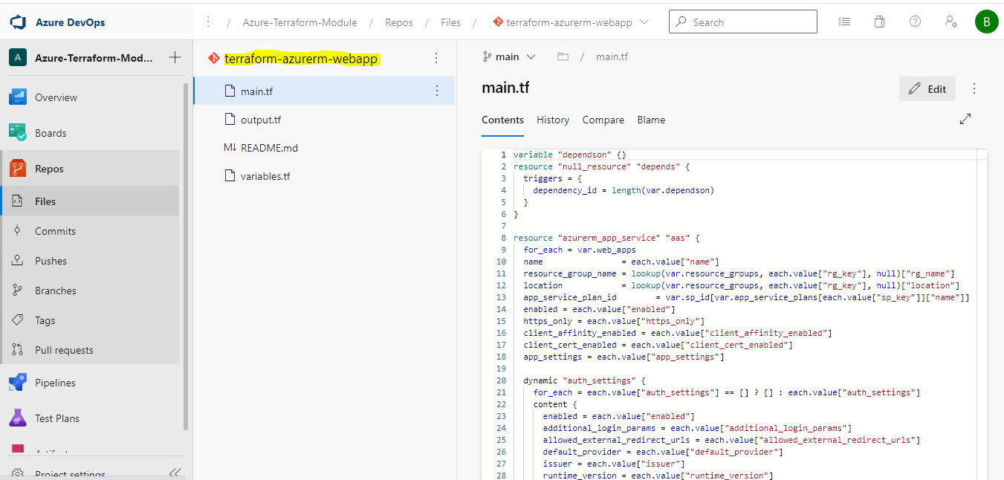

Slide 13
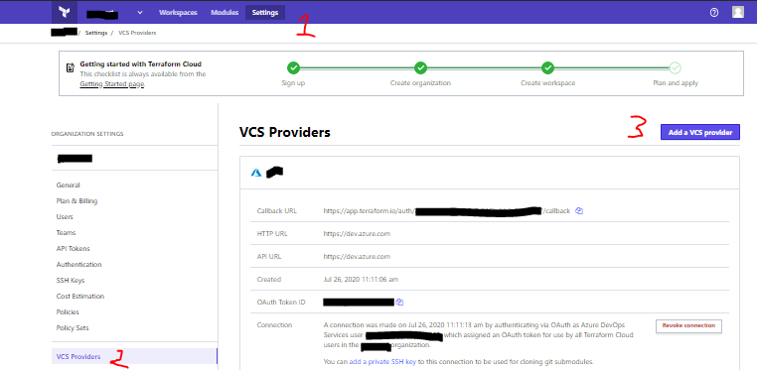
Terraform Cloud - VCS Workflow

Slide 17
What is Sentinel ?
Sentinel is an embedded policy-as-code framework integrated with the HashiCorp Enterprise products.
It enables fine-grained, logic-based policy decisions, and can be extended to use information from external sources.

Slide 18
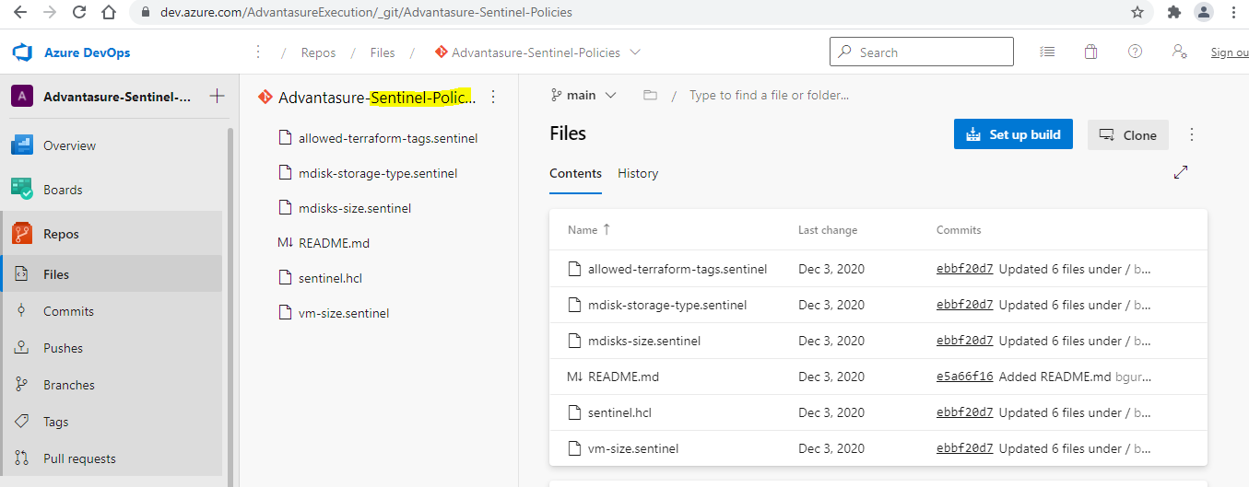
The Following Sentinel Policies Created and Ready to Use

Slide 19
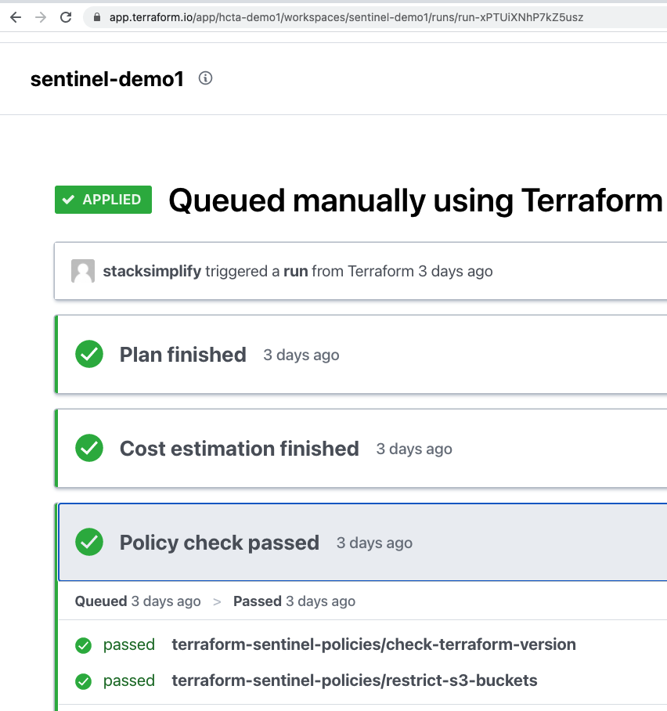
Sentinel Policies TFE
Sentinel Policies

Slide 20
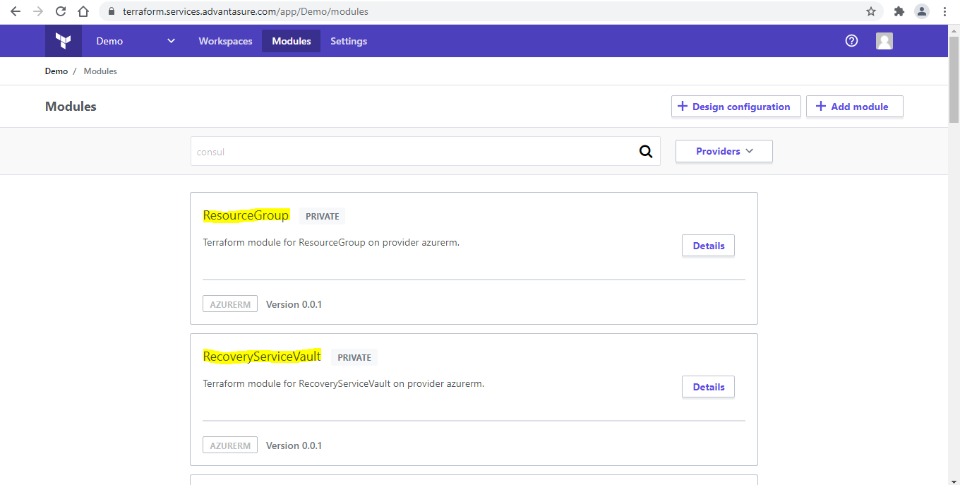

Slide 21
