Slide 1
New Application
Add VCS Provider
Authorization
Create one in Azure Devops services
Save the AppID and ClientSecret for next step
Provide the Application details of Step-1
In TFC, Add Azure Devops as provider
Step-2 will route to Azure Devops services for authorization
Once approved, Azure Repos will sync with TFC.

Slide 2
Azure Repo
In Azure Devops, create a project and Create Repos with name “terraform-azurerm-<modulename>” to create modules.
Upload or create terraform files and add tags e.g. ‘v0.0.1’
TFC Modules
Connect the VCS provider
Select the module repos
TFC Workspace
Connect the VCS provider
Select the main repo to create resources and run Plan and Apply stages.
Azure Resources
Create Repo to call the modules (main).
Add sentinel policies in Organization settings
Choose the Version/Tags and publish

Slide 3
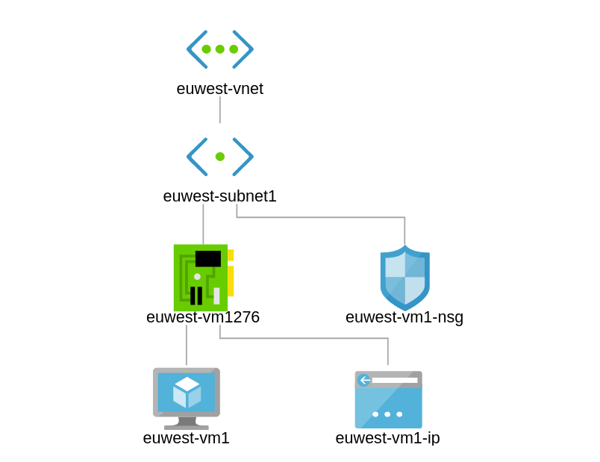

Slide 4
