Slide 1
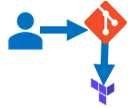
AGENDA
TFE Overview
Terraform Workflow
VCS Configuration
Modules and Sentinel Policy
Azure Resources

Slide 2
TERRAFORM OVERVIEW
A provider declarative tool that based on Infrastructure as Code paradigm.
Uses own syntax –HCL (HashiCorp Configuration Language).
Written in Golang
Helps to evolve your infrastructure, safely and predictably.
Terraform is a multipurpose composition tool.
Composes multipurpose composition tool:
Open & Enterprises sources.
Backend by HashiCorp company and HashiCorp Tao (Guide/Principles/Design)

Slide 3
TERRAFORM WORKFLOW
init
validate
plan
apply
destroy
1
2
3
4
5
Used to Initialize a working directory containing terraform config files
This is the first command that should be run after writing a new Terraform configuration
Downloads Providers
Validates the terraform configurations files in that respective directory to ensure they are syntactically valid and internally consistent.
Creates an execution plan
Terraform performs a refresh and determines what actions are necessary to achieve the desired state specified in configuration files
Used to apply the changes required to reach the desired state of the configuration.
By default, apply scans the current directory for the configuration and applies the changes appropriately.
Used to destroy the Terraform-managed infrastructure
This will ask for confirmation before destroying.

Slide 4
VCS CONFIGURATION
New Application
Add VCS Provider
Authorization
Create one in Azure Devops services
Save the AppID and ClientSecret for next step
Provide the Application details of Step-1
In TFC, Add Azure Devops as provider
Step-2 will route to Azure Devops services for authorization
Once approved, Azure Repos will sync with TFC.

Slide 5
MODULES
AZURE REPO
In Azure Devops, create a project and Create Repos with name “terraform-azurerm-<modulename>” to create modules.
Upload or create terraform files and add tags e.g. ‘v0.0.1’
TFE MODULES
Connect the VCS provider
Select the module repos
TFE WORKSPACE
Connect the VCS provider
Select the main repo to create resources and run Plan and Apply stages.
AZURE RESOURCES
Create Repo to call the modules (main).
Add sentinel policies in Organization settings
Choose the Version/Tags and publish
To publish module or manage VCS connection you must be member of “Owners” group.
Notes:
Terraform Cloud makes code review easier by automatically predicting how pull requests will affect infrastructure.
Publishing new versions of a private Terraform module is as easy as pushing a tag to the module's repository.
Terraform Cloud is more powerful when you integrate it with your version control system (VCS) provider (Azure Repo, GitHub, Bitbucket, Gitlab).
Terraform includes support for module versioning, a searchable and filterable list of available modules, and a configuration designer to help you build new workspaces faster.
By design, the private module registry works much like the public Terraform Registry. If you're already used the public registry, Terraform Cloud's registry will feel familiar.

Slide 6
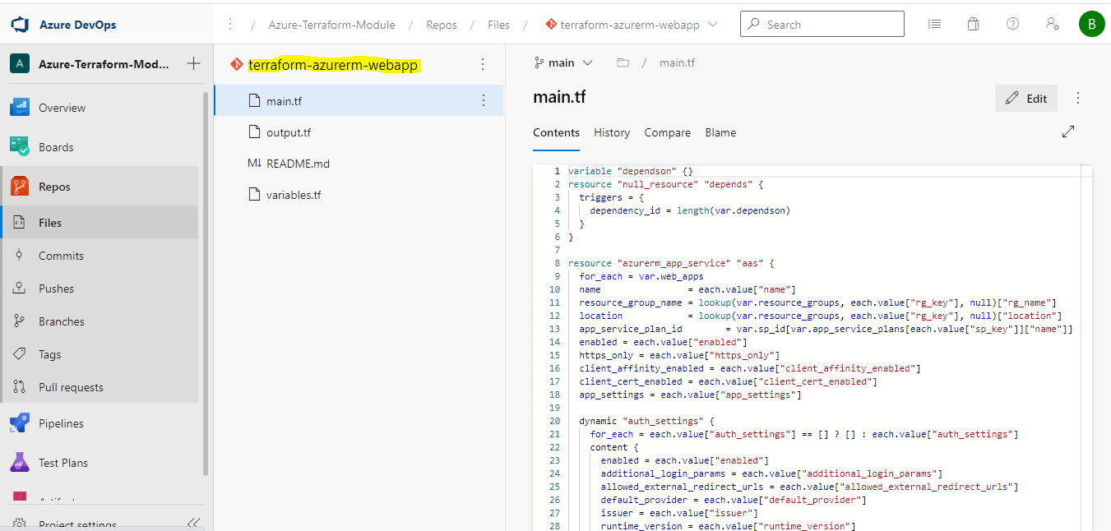
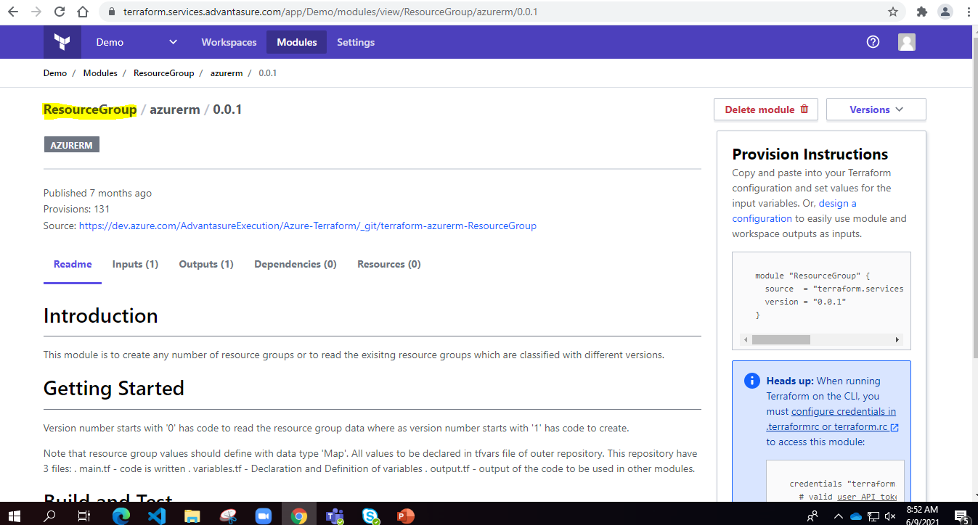
Azure Repo
TFE Module

Slide 7
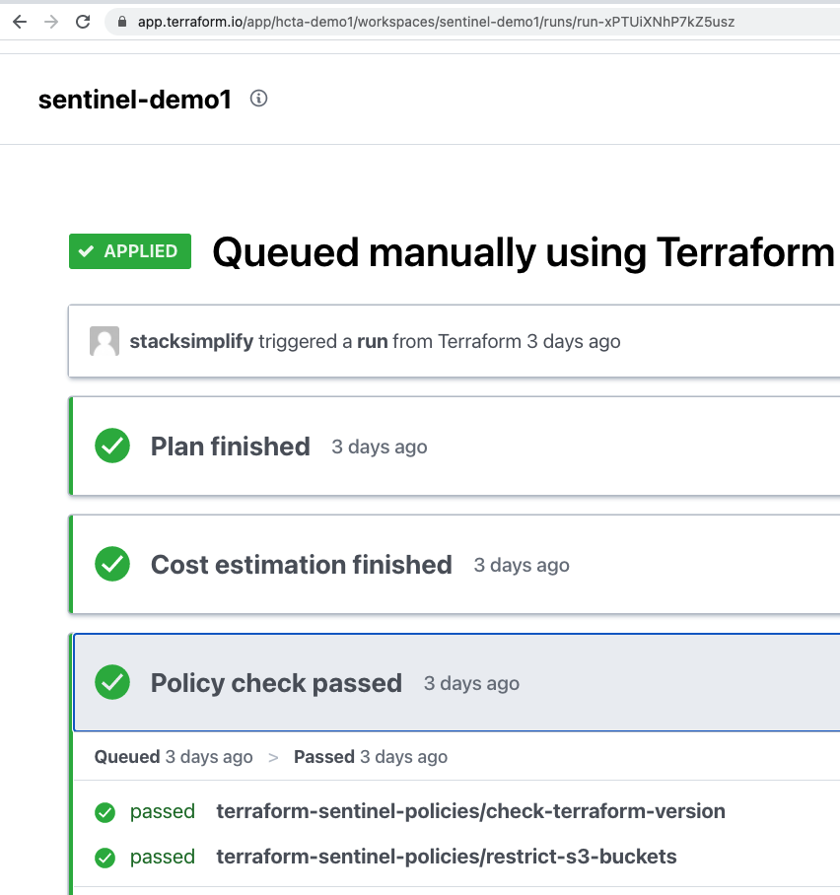
SENTINEL POLICIES
Sentinel is an embedded policy-as-code framework integrated with the HashiCorp Enterprise products.
It enables fine-grained, logic-based policy decisions, and can be extended to use information from external sources.
Policies are created in the followiing Azure Repository : “AdvantasureExecution\Advantasure-Sentinel Policies” which are configured to workspace using VCS connection

Slide 8
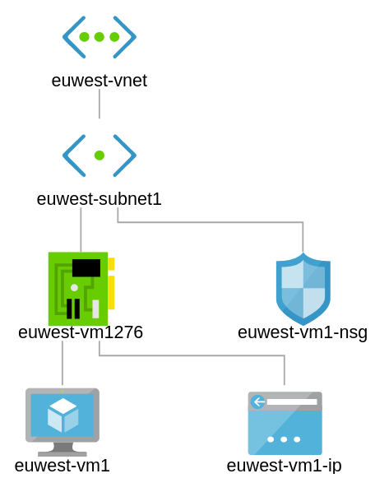
V0.0.1
V1.0.0
Tags
RG
NIC
KV
LB
MDisk
FIHR
WebApp
AS
SS
Storage
FncApp
RSV
Monitoring
LA
RSV
Policy
Monitoring
Policy
LA

Slide 9
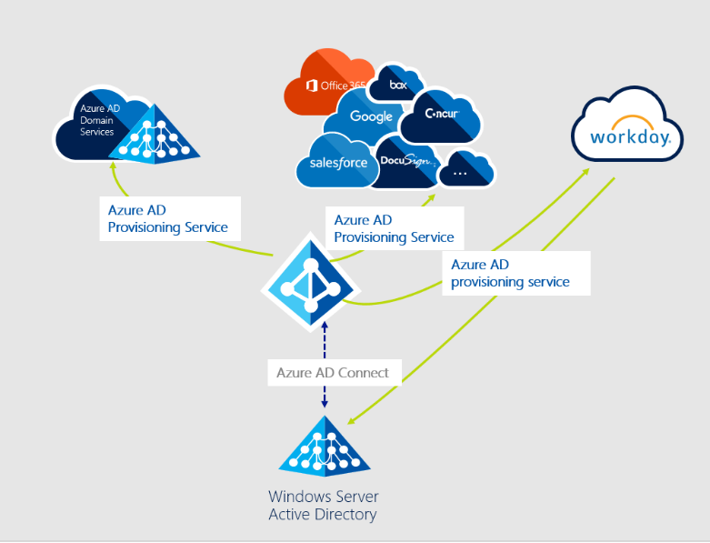
IaaS
PaaS
SaaS

