Slide 1
Employee Data Analysis using Excel
STUDENT NAME: Bhavadharini.V
REGISTER NO: 122201999
NAAN MUDHALVAN ID: asunm1353122201999
DEPARTMENT: B.Com (Corporate Secretaryship)
COLLEGE: Anna Adarsh College for Women

Slide 2
PROJECT TITLE
Employee Performance Analysis using Excel

Slide 3


AGENDA
Problem Statement
Project Overview
End Users
Our Solution and Proposition
Dataset Description
Modelling Approach
Results and Discussion
Conclusion
3/21/2024 Annual Review

Slide 4

PROBLEM STATEMENT
Analyzing employee data sets is crucial for several reasons:
Improving Employee Experience
Enhancing Productivity
Informed Decision-Making
Identifying Trends and Patterns
Ensuring Fairness and Compliance
Strategic Planning

Slide 5

PROJECT OVERVIEW
Objective:
The primary objective of this project is to systematically analyze employee performance across the organization, identify key factors affecting performance, and develop strategies to improve overall productivity, engagement, and job satisfaction.
Employee performance analysis is crucial for several reasons:
Feedback and improvement
Goal setting
Career development
Increased productivity
Alignment with organisational goals
Employee retention

Slide 6

WHO ARE THE END USERS?
Employee performance analysis is valuable tool for various stakeholders within an organization. Here are some of the key end users:
Human resource department
Managers and team leaders
Executives and senior management
Employees
Training and development teams
Data analysts

Slide 7
OUR SOLUTION AND ITS VALUE PROPOSITION
SOLUTION FOR EMPLOYEE PERFORMANCE ANALYSIS:
Data collection and integration
Performance metrics
Advanced analytics
Personalised insights
Continuous feedback and improvement
VALUE PROPOSITION:
Enhanced productivity
Employee engagement and retention
Data-driven decisions
Improved organizational performance
Scalability and flexibility

Slide 8
Dataset Description
Employee ID: Unique identifier for each employee in the organization. Described in numbers
First name: First name of the employee in text
Last name: Last name of the employee in text
Business unit: The specific business unit or department to which the employee belongs, in text.
Employee status: The current employment status of the employee i.e. active, on leave, terminated.
Employee type: The type of employment the employee has full-time, part-time, contract.
Gender code: A code representing the gender of the employee, M for male, F for female, N for non-binary.
Performance score: A score indicating the employee’s performance level i.e. excellent, satisfactory, needs improvement.
Current employee rating: The current rating or evaluation of the employee’s overall performance.

Slide 9

THE "WOW" IN OUR SOLUTION
Formula used for finding the performance level of employees
=IFS(Z8>=5,"VERY HIGH",Z8>=4,"HIGH",Z8>=3,"MED",true,”LOW”)
3/21/2024 Annual Review
9

Slide 10
MODELLING
Count of FirstName | Performance catagory
BusinessUnit | High | low | medium | Very high | Grand Total
BPC | 16 | 34 | 85 | 15 | 150
CCDR | 18 | 47 | 65 | 15 | 145
EW | 21 | 41 | 78 | 14 | 154
MSC | 17 | 39 | 92 | 9 | 157
NEL | 21 | 41 | 77 | 15 | 154
PL | 29 | 33 | 69 | 12 | 143
PYZ | 26 | 41 | 75 | 15 | 157
SVG | 26 | 43 | 82 | 16 | 167
TNS | 21 | 45 | 71 | 13 | 150
WBL | 25 | 34 | 84 | 13 | 156
Grand Total | 220 | 398 | 778 | 137 | 1533
10

Slide 11
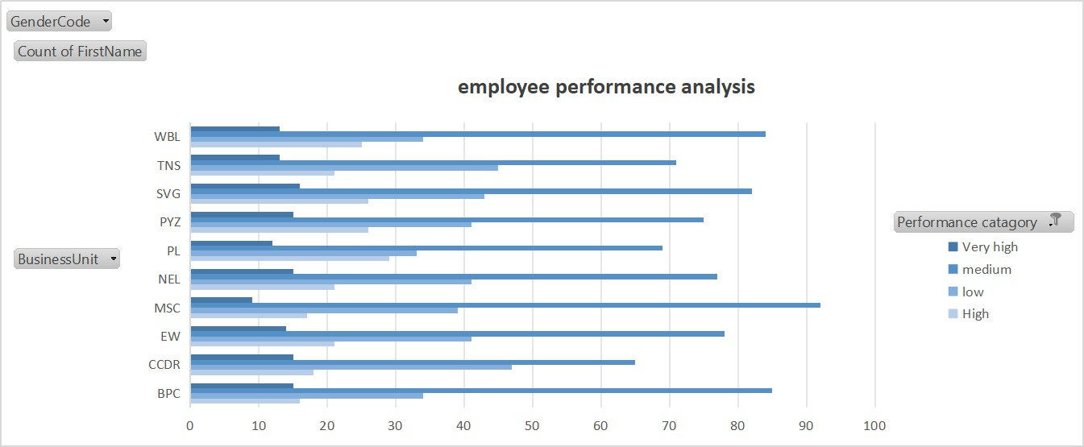
RESULTS
BAR GRAPH
11

Slide 12
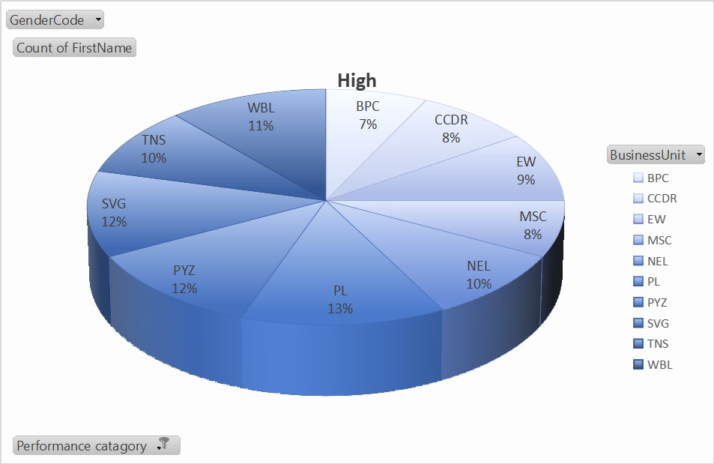
PIE CHART

Slide 13
conclusion
In any organization, the main task is people handling because the main task is to manage people who are the main assets of the organization as they are the person to fulfil the ultimate goal of the company.
There is a saying that “when you are an employee, success definition for you to grow yourself but at the time when you become a leader the definition of success is to grow others. And that is where employee performance analysis plays a huge role”.

