Slide 1
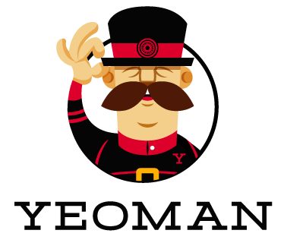
Basir Navab
April 2017

Slide 2
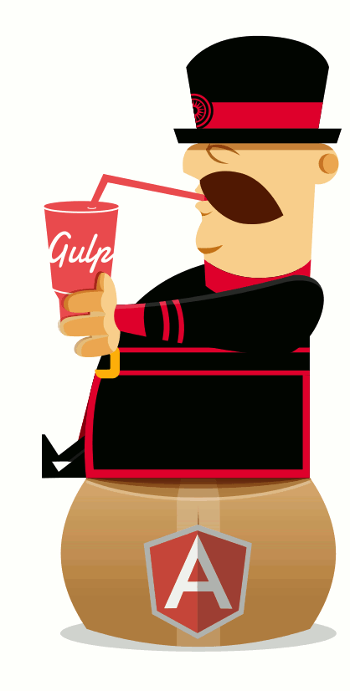
Outline
What is YEOMAN?
Main Functionalities
Product line
Similar tools
How can you work with YEOMAN? (Demo for AngularJs webapp)
Questions
YEOMAN | 2 / 10
Notes:
product line (any other tools offered by this program)

Slide 3

What is YEOMAN?
Yeoman is an client-side development stack, consisting of tools to help developers quickly build beautiful web applications
Simply, Yeoman creates a basic project structure with vendor libraries included.
Yeoman runs as command-line interface written for Node.js.
YEOMAN | 3 / 10
Notes:
One of the best and awesome tools that comes to front end development in a long time
it takes care of providing everything needed to get started without any of the normal headaches associated with a manual setup.

Slide 4
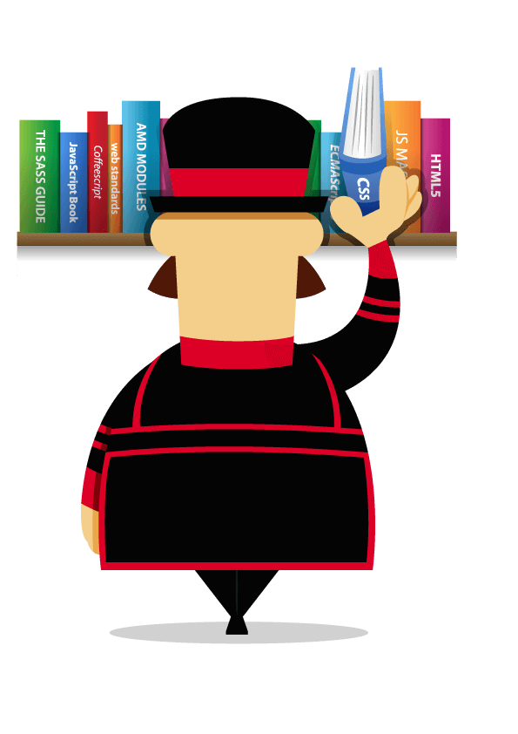
What is YEOMAN?
It can be run in any platforms such as
Mac OS X, Linux and Windows
Yeoman was released at Google I/O in 2012.
Yeoman is an open source tool.
YEOMAN | 4 / 10
Notes:
Google I/O (simply I/O) is an annual developer conference

Slide 5
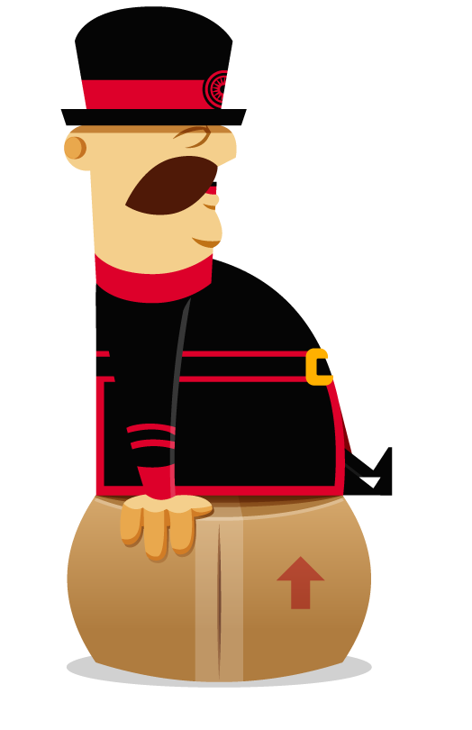
Main Functionalities
Yeoman provide several functionalities in to just one place:
Generating a starter template
Managing dependencies
running unit tests
providing a local development server
optimizing production code for
deployment
YEOMAN | 5 / 10

Slide 6
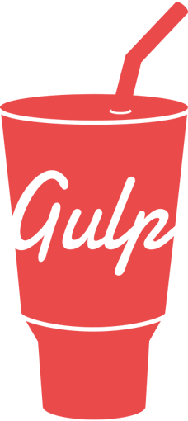


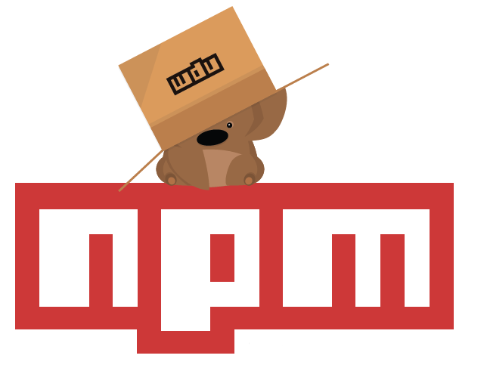

Product line
The Yeoman workflow include three types of other tools for enhancing your satisfaction and productivity during building a web app
The scaffolding tool (YO)
The package manager (like npm and Bower).
The build tools (Gulp, Grunt)
Create a new Webapp
Handle Dependencies
Preview, test, build
YEOMAN | 6 / 10
Notes:
yo scaffolds out a new application, writing your build configuration (e.g Gulpfile) and pulling in relevant build tasks and package manager dependencies (e.g npm) that you might need for your build.
The Build System is used to build, preview and test your project. Gulp and Grunt are two popular options.
The Package Manager is used for dependency management, so that you no longer have to manually download and manage your scripts. npm and Bower are two popular options.

Slide 7

Similar tools
Brunch
Brunch is an assembler for HTML5 applications.
Simply, Brunch is useful to create frameworks, libraries, programming, stylesheet & templating languages and backend technology
Pros
Brunch is an Open Source tool.
Brunch is compatible with Mac OS X, Windows and Linux.
Cons
Speed seems to be slower (Specially than Yeoman).
Scaffolding is much more complicated (Specially than Yeoman).
YEOMAN | 7 / 10
Notes:
In their website Brunch - ultra-fast HTML5 build tool

Slide 8
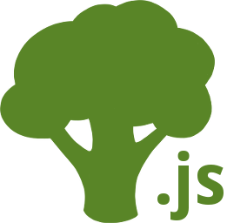
Similar tools
Broccoli
Broccoli is a browser compilation library, a build tool for JavaScript applications that launch in the browser.
Pros
Broccoli is an Open Source tool.
Broccoli is compatible with Mac OS X, Windows
and Linux.
Broccoli supports Node.JS and npm.
Cons
Windows not fully supported.
Small community.
Speed seems to be slower (Specially than Yeoman).
YEOMAN | 8 / 10

Slide 9

How can you work with YEOMAN? (Demo)
YEOMAN | 9 / 10
Notes:
You need to have installed on your device before
node.js
npm
Git
--------------
We are going to install Yo, bower and grunt

Slide 10


Questions?
navab@usc.edu
bit.ly/basir_navab
YEOMAN | 10 / 10

