Slide 1
Artificial Intelligence
Basma ElSaify
Microsoft

Slide 2
Artificial Intelligence
Rule Based System
Expert System
Machine Learning

Slide 3
Machine Learning
Supervised Learning
Unsupervised Learning
Reinforcement Learning

Slide 4
Machine Learning
Arthur Samuel's definition from 1959:
Field of study that gives computers the ability to learn without being explicitly programmed.
Tom Mitchell’s definition from 1998:
A computer program is said to learn from experience E with respect to some task T and some performance measure P, if its performance on T, as measured by P, improves with experience E.
E (+) => T => P (+)
Experience [data], Task, Performance [Accuracy]

Slide 5
Supervised vs Unsupervised
Supervised learning: historical labeled data
Unsupervised learning: non-labeled data
Classification vs Clustering

Slide 6
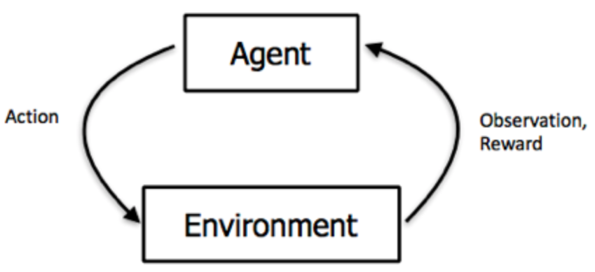
Reinforcement Learning
Q-Learning
SARSA
DQN
DDPG

Slide 7
Data Science Process
Domain Knowledge
Data Collection
Data Quality
Feature Engineering
Data Preprocessing
ML Model
Validation
Tuning
Benchmarking
Deploy

Slide 8
Deep Learning
Deep Learning is a method of statistical learning that extracts features or attributes from raw data. Deep Learning does this by utilizing neural networks with many hidden layers, big data, and powerful computational resources.

Slide 9
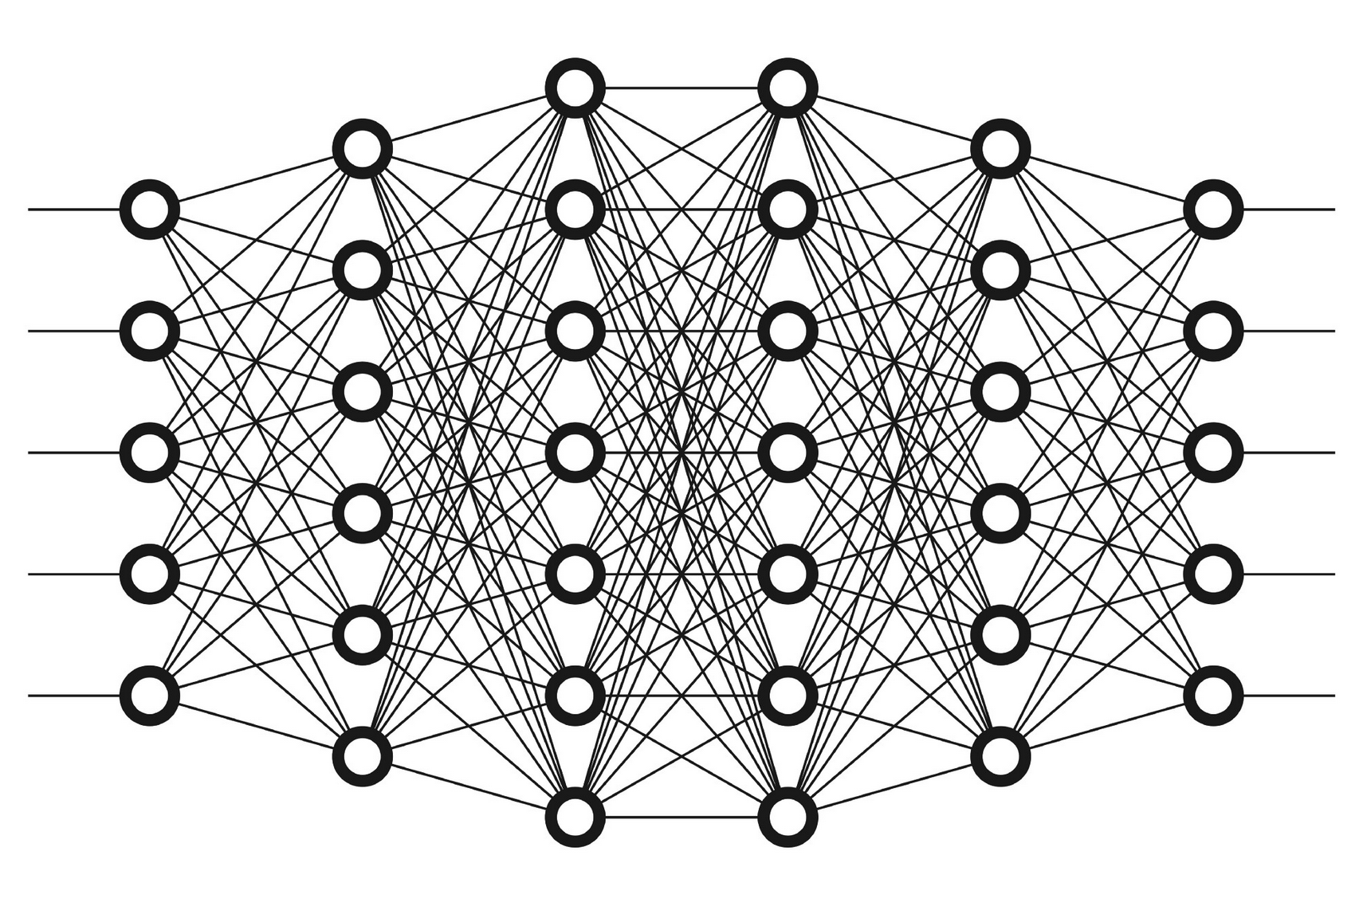
Deep Neural Network

Slide 10
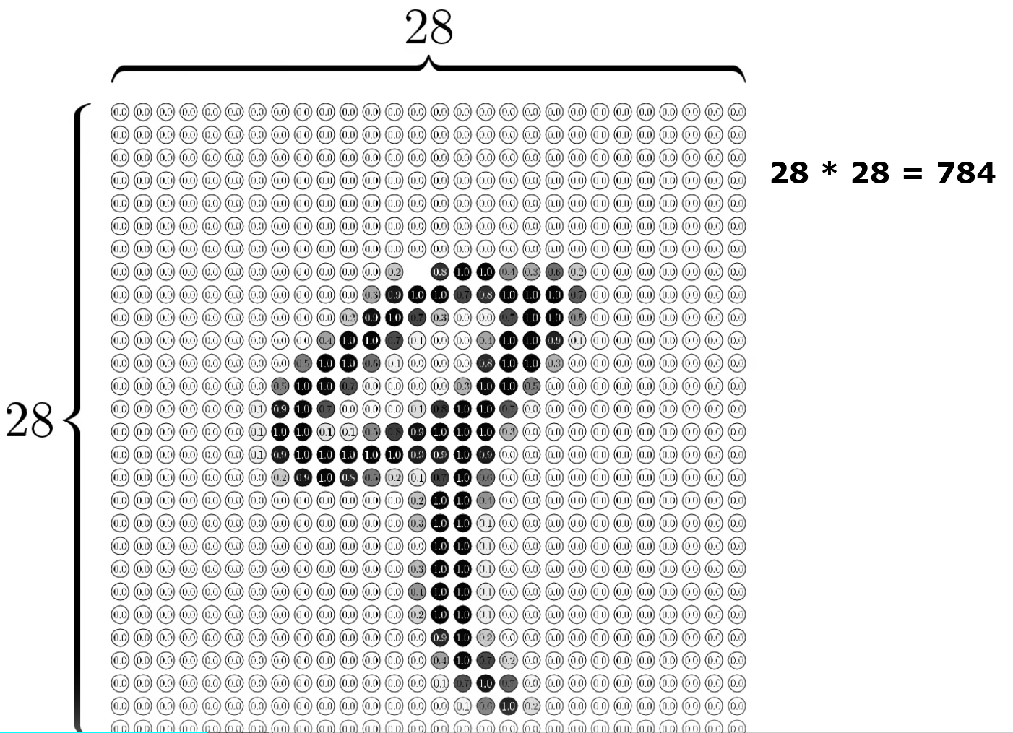
MNIST

Slide 11
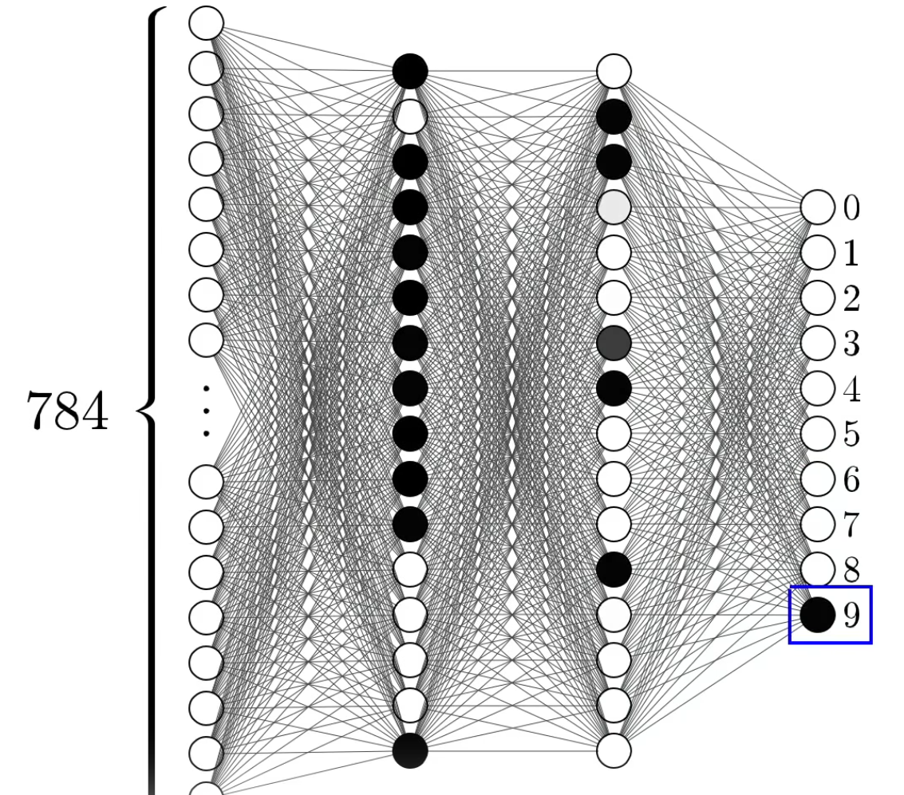
MNIST

Slide 12
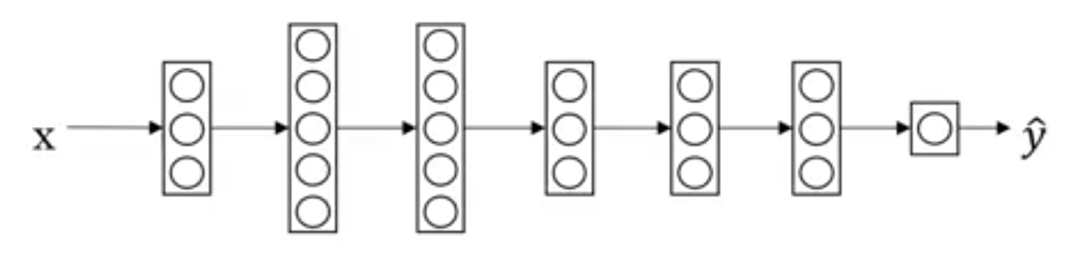
Transfer Learning
Object
Image Recognition
Images

Slide 13
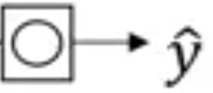
Transfer Learning
X
Object
Image Recognition
Images
1,000,000
radiology diagnosis
(x, y)
(Radiology Images, Diagnosis)
100

Slide 14
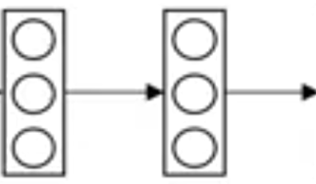
Transfer Learning
X
Object
Image Recognition
Images
1,000,000
radiology diagnosis
(x, y)
(Radiology Images, Diagnosis)
100

Slide 15
Transfer Learning
X
Object
Image Recognition
Images
1,000,000
Pre-Training
radiology diagnosis
(x, y)
(Radiology Images, Diagnosis)
100
Fine Tuning

Slide 16
Transfer Learning
X
Transcript
Speech Recognition
Audio
10,000h
Wake word/Trigger word
Detection
1h

Slide 17

When to use transfer learning
Transfer from a case with lots of data to relatively less data.
Low level features could be helpful.

Slide 18
Thank you

Slide 19
References
https://www.youtube.com/watch?v=yofjFQddwHE

