Slide 1
Transfer Learning
Basma ElSaify

Slide 2
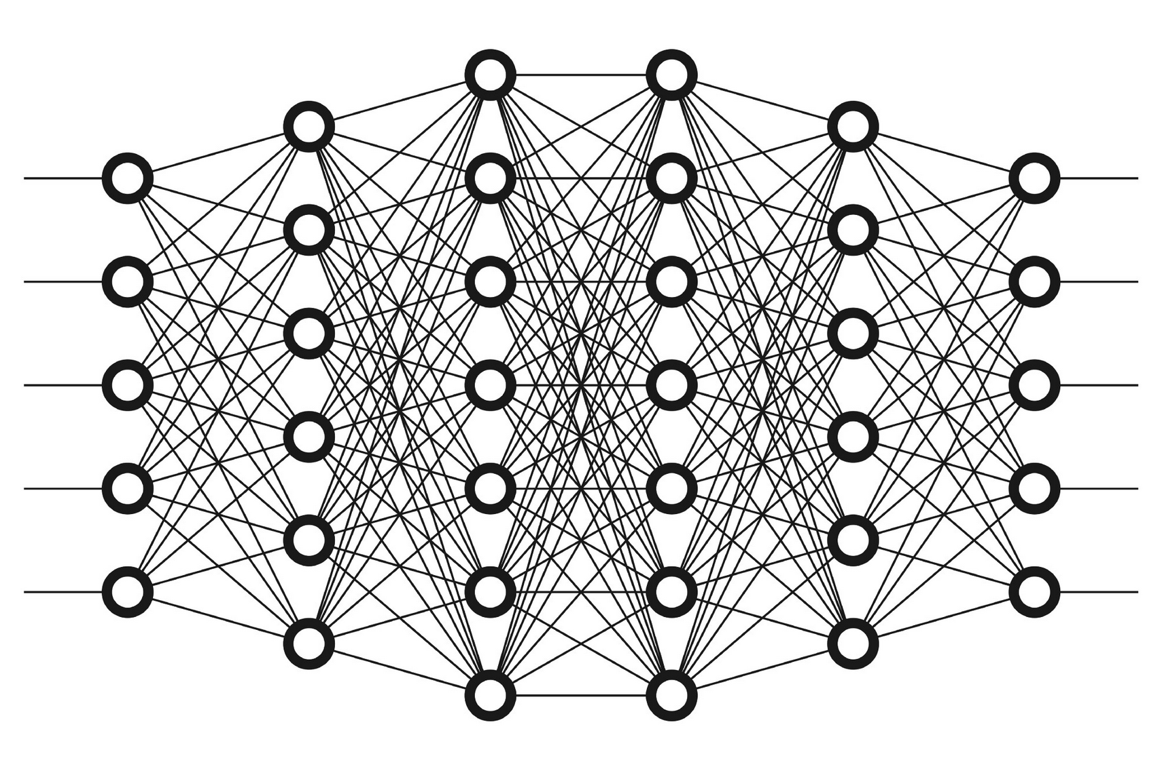
Deep Neural Network

Slide 3
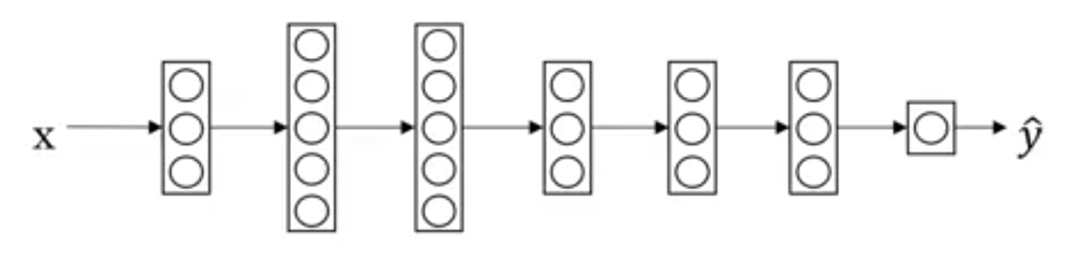
Transfer Learning
Object
Image Recognition
Images

Slide 4
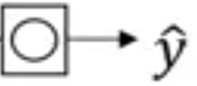
Transfer Learning
X
Object
Image Recognition
Images
1,000,000
radiology diagnosis
(x, y)
(Radiology Images, Diagnosis)
100

Slide 5
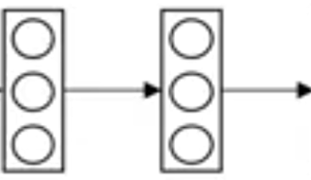
Transfer Learning
X
Object
Image Recognition
Images
1,000,000
radiology diagnosis
(x, y)
(Radiology Images, Diagnosis)
100

Slide 6
Transfer Learning
X
Object
Image Recognition
Images
1,000,000
Pre-Training
radiology diagnosis
(x, y)
(Radiology Images, Diagnosis)
100
Fine Tuning

Slide 7
Transfer Learning
X
Transcript
Speech Recognition
Audio
10,000h
Wake word/Trigger word
Detection
1h

Slide 8

When to use transfer learning
Transfer from a case with lots of data to relatively less data.
Low level features could be helpful.

Slide 10
References
https://www.youtube.com/watch?v=yofjFQddwHE

