Slide 1


Data Mining and Machine learning project presentation Depression hunter year 2022/2023
By:
BASMA MOHAMED AHMED GABER ADAWY

Slide 2


Project overview
Depression is a mood disorder that causes a persistent feeling of sadness and loss of interest. it affects how you feel, think and behave.
Many of people end their life because of depression, so this may help them to discover their illness and save their life.
Depression hunter API allows the user to check whether he is depressed or no from text.
Project link https://github.com/BasmaAdawy/DepressionHunter

Slide 3
tools
Python 3
Jupyter notebook & spyder IDE
FASTAPI
Machine learning libraries

Slide 4


dataset

Slide 5
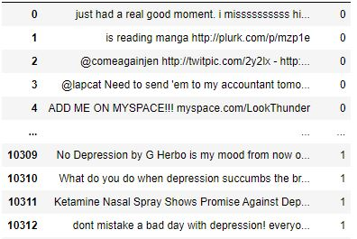
The data is in the format of csv files it contains the text and the class label (1 for depressed, 0 for not depressed. collected through web scrapping Subreddits and tweets.
The data is only in English language.
Source:
https://www.kaggle.com/datasets/infamouscoder/depression-reddit-cleaned --> 7731 rows
https://drive.google.com/file/d/1S1MFdyANyGyLOvsbFdhcSt1RZ8DJXlRS/view?usp=sharing --> 10314 rows
Finally: Data1 + Data2 = 18000 rows
Data sample

Slide 6
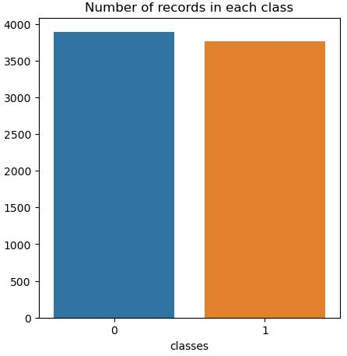
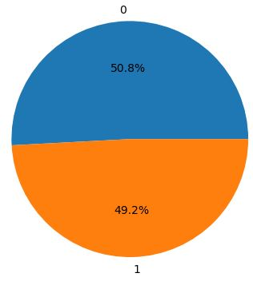
Dataset1 visualization

Slide 7
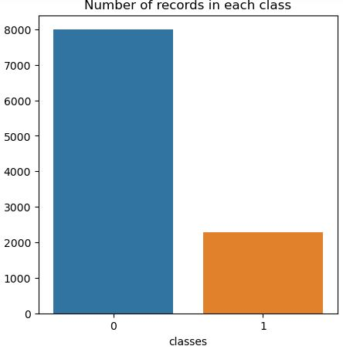
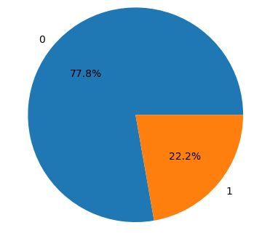
Dataset2 visualization

Slide 8

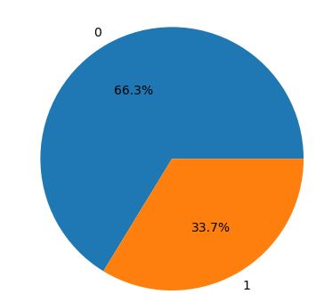
Total data

Slide 9
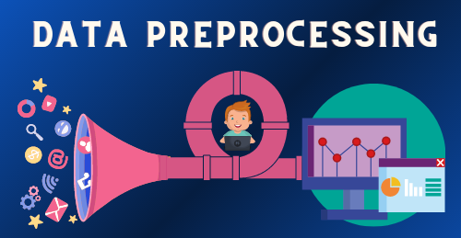

Slide 10
Data cleaning
Drop duplicates
Check null values
Drop unwanted columns
Rename columns
Converting text to lower case remove links and hashtags
Removing numbers and other numeric values
Removing punctuations
Removing stop words
Remove extra white spaces
Lemmatizing

Slide 11
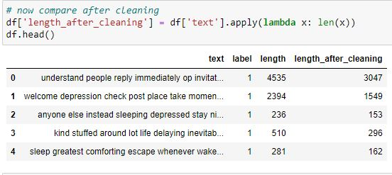
After Data cleaning

Slide 12
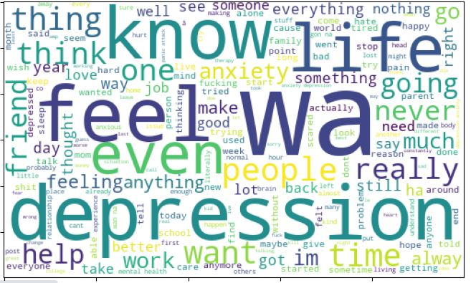
Data visualization after cleaning using wordcloud
Label = 1 (Depressed )

Slide 13
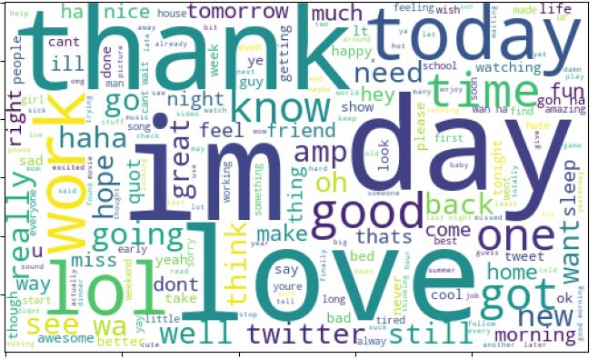
Data visualization after cleaning using wordcloud
Label = 0 (Not depressed )

Slide 14
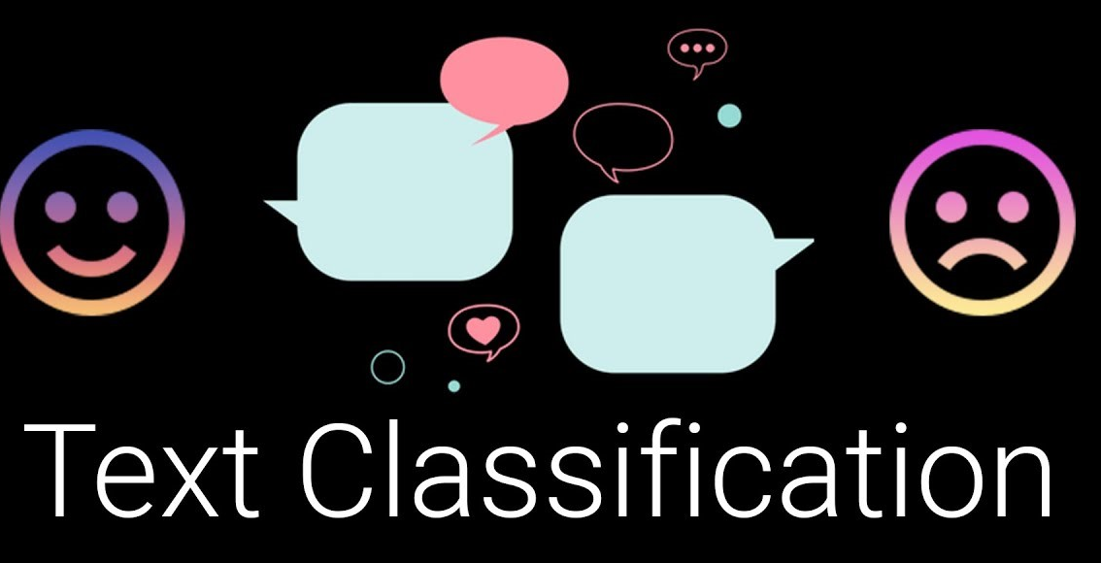

Slide 15

Splitting the data into train and test
percentage split (70% of the initial dataset has been used to generate the training set, while the other 30% has been used as test set).

Slide 16
Data vectorization
It converts the raw text into a format the NLP model can understand and use. Vectorization will create a numerical representation of the text strings called a sparse matrix or word vectors. The model works with numbers and not raw text.
CountVectorizer simply counts the number of times a word appears in a document (using a bag-of-words approach).
TF-IDF Vectorizer takes into account not only how many times a word appears in a document but also how important that word is to the whole corpus.

Slide 17
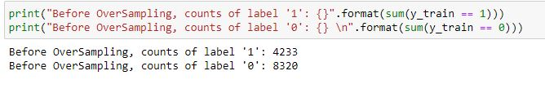
checking imbalance in the data

Slide 18

Data balancing
We solved this problem by using SMOTE (synthetic minority oversampling technique) is one of the most commonly used oversampling methods to solve the imbalance problem. It aims to balance class distribution by randomly increasing minority class examples by replicating them.

Slide 19
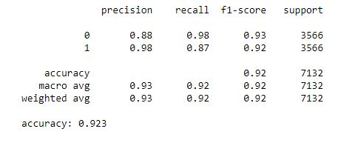
Classification models
SVC, or Support Vector Classifier, is a supervised machine learning algorithm typically used for classification tasks. SVC works by mapping data points to a high-dimensional space and then finding the optimal hyperplane that divides the data into two classes

Slide 20
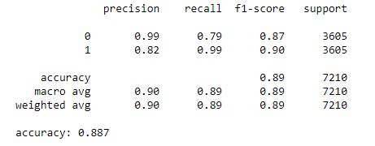
Classification models
The multinomial naïve Bayes is widely used for assigning documents to classes based on the statistical analysis of their contents. It provides an alternative to the "heavy" AI-based semantic analysis and drastically simplifies textual data classification.

Slide 21
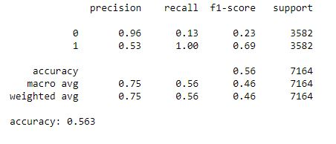
Classification models
KNN (k-nearest neighbors algorithm) is a supervised classification algorithm that classifies new data points based on the nearest data points. On the other hand, K-means clustering is an unsupervised clustering algorithm that groups data into a K number of clusters

Slide 22
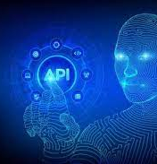
Depression hunter

Slide 23
Aim of our api
This is the final step to build an Api trained on machine learning classification algorithms to predict from the text if the user suffering from depression or not.
We built this API using FastAPI which is a modern, fast (high-performance), web framework for building APIs with Python 3.7+ based on standard Python type hints.
And Spyder which is an open-source cross-platform integrated development environment for scientific programming in the Python language.

Slide 24
How it works?
THE USER ENTERS A TEXT IN THE POST SECTION AND PRESS ON EXECUTE BUTTON AND WAITS FOR THE RESULT.
The result will tell him if he needs to see a therapist or no.

Slide 25
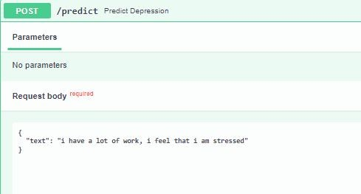
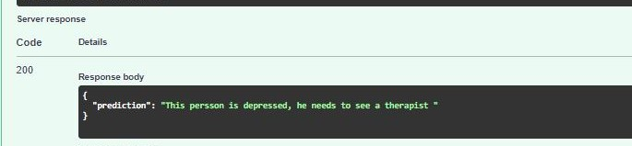
Example 1

Slide 26
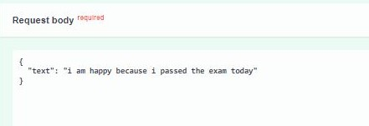
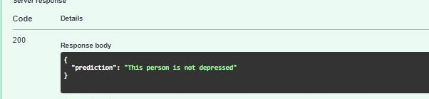
Example 2

Slide 27

Thank You!

