Slide 1
Credit Score Classification & Analysis
CMP4011 Big Data and Cloud Computing
Prepared By:
Ahmed Hosny
Ahmed Sabry
Basma Elhoseny
Zeinab Moawad
Under Supervision of:
Dr. Lydia Wahid
Eng. Omar Samir

Slide 2
1. Data Set
Main: https://www.kaggle.com/datasets/parisrohan/credit-score-classification
25 useful features
100 K Row
ID | Monthly_Inhand_Salary | Num_Credit_Inquiries | Payment_Behaviour
Customer_ID | Num_Bank_Accounts | Credit_Mix | Monthly_Balance
Month | Num_Credit_Card | Outstanding_Debt | Credit_Score
Name | Interest_Rate | Credit_Utilization_Ratio
Age | Num_of_Loan | Credit_History_Age
SSN | Type_of_Loan | Payment_of_Min_Amount
Occupation | Delay_from_due_date | Total_EMI_per_month
Annual_Income | Num_of_Delayed_Payment | Amount_invested_monthly

Slide 3
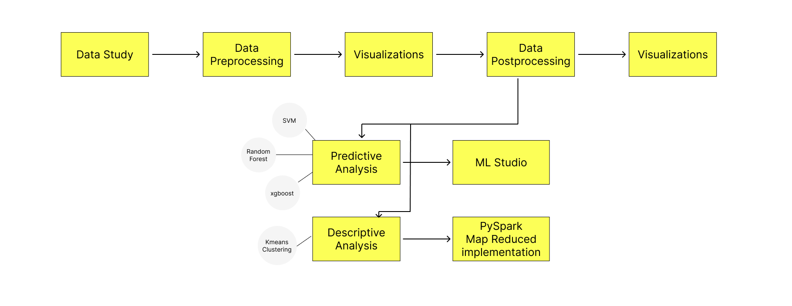
2. Project Pipeline

Slide 4
3. Data Processing
Preprocessing:
1. Drop unimportant features such as (Customer ID – SSN – Name ..)
2. Correct and Cleaning of some values like age containing 29_
3. Handling Missing Values based on series of 8 (Local [Per Customer])
4. Convert Categorial Data to One hot encoder or Label encoded [According to the model used]
5. Normalization (Kmeans) and Standardization
Postprocessing:
1. Further Cleaning for the data observed from visualizations 😉 (Global [Not per customer])
2. Remove Outliers using normal distribution of the feature [mean ± 3*std]
3. Split the type of loan column into 9(unique) columns

Slide 5
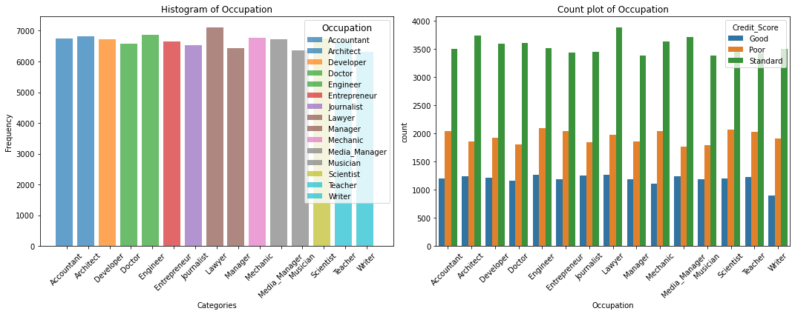

4. EDA (Data Visualization)
Same Distribution of credit Score across different occupation groups
➡ occupation isn’t an effective feature No need to consider occupation in the model.

Slide 6
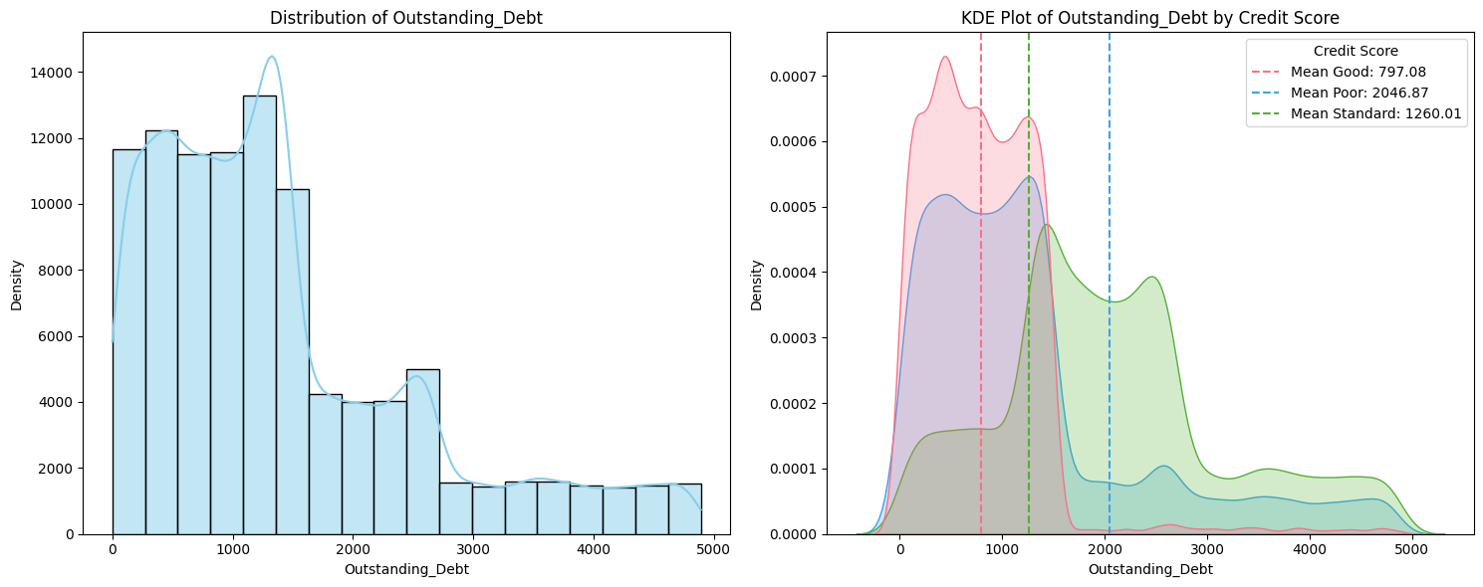
4. EDA (Data Visualization)
At outstanding debts more than 1800 the customer probability to be of good credit score is very small
Notes:
Draw the Kernel Density Estimate (KDE) plot of a continuous feature in the dataset

Slide 7
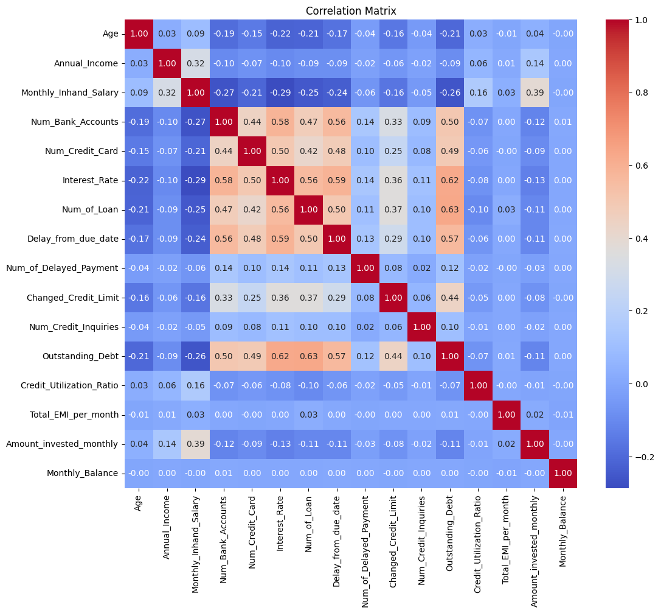
4. EDA (Data Visualization)
The num_of_bank_accounts, num_of_credit_cards , interest_rate and delay_from_due_date are the most features correlated with each other than other features.

Slide 8
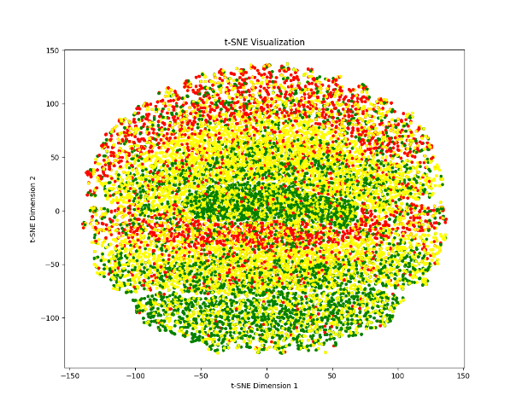
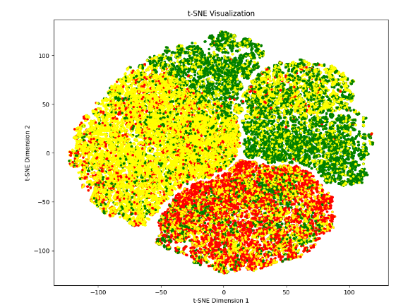

4. EDA (Data Visualization)
T-SNE on the 3 clusters of the data (good-standard-poor)
With Most of Features
Dropping features of importance < 0.04
Overlapping Clusters !!

Slide 9
5.Insights (Technical)
We Got insights as insights below each distribution for the features [Refer to the Report]
No Correlation between Continuous Features [Insight from the correlation Matrix of between all features] ➔ No need for PCA Reduction :D

Slide 10
5. Insights (Business)
Occupation & Age aren’t and effective features [insight from EDA histogram]
Num of banks accounts & credit cards are correlated together [Insight from EDA & Features correlation matrix]
The customers of good credit score are mostly the ones with high delay from due date this might be due to the types of their payments which is thought to be high [Insight from EDA]
The most important feature in the credit score decision is the outstanding debt, giving loan to a customer who has a many outstanding loans is risky 😃 [insight from important feature diagram of random forest]
The Bank should know the following important features that affect the credit score classification.

Slide 11
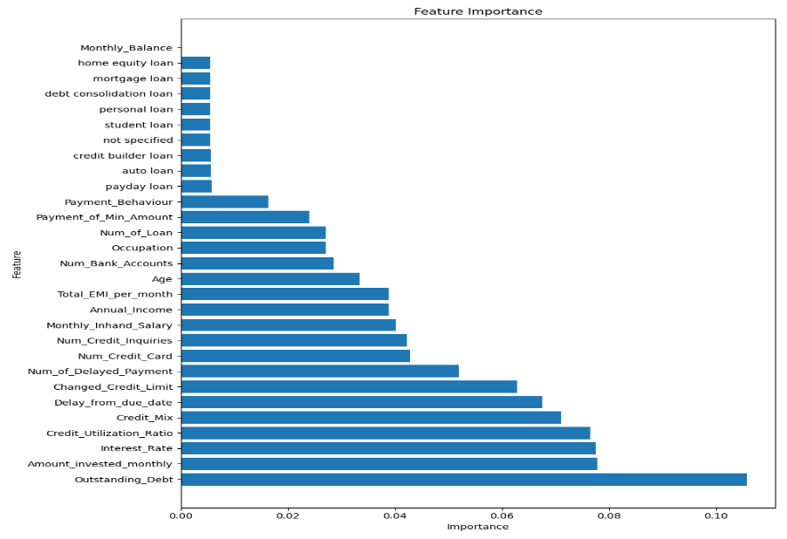
5. Insights (Business)

Slide 12
6. Predictive Analysis
Metric | SVM | Random Forest | XgBoost
Train
Accuracy | 0.787 | 1.0 | 1.0
Recall | 0.758 0.777 0.802 | 1.0 1.0 1.0 | 1.0 1.0 1.0
Precision | 0.679 0.797 0.823 | 1.0 1.0 1.0 | 1.0 1.0 1.0
F1-score | 0.716 0.789 0.812 | 1.0 1.0 1.0 | 1.0 1.0 1.0
Test
Accuracy | 0.7546 | 0.804 | 0.791
Recall | 0.710 0.743 0.777 | 0.758 0.835 0.802 | 0.738 0.803 0.803
Precision | 0.641 0.772 0.790 | 0.775 0.786 0.825 | 0.767 0.783 0.803
F1-score | 0.674 0.757 0.783 | 0.766 0.810 0.813 | 0.752 0.793 0.803

Slide 13
6. Predictive Analysis
Feature Importance Graph Obtained From Random Forest

Slide 14
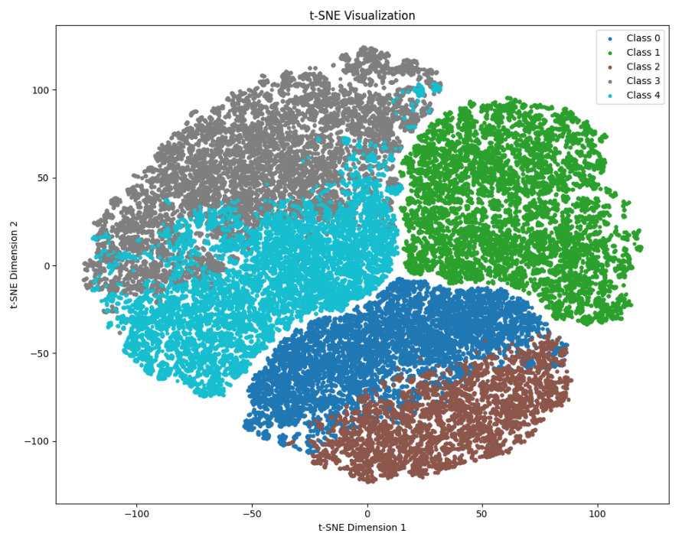
7. Descriptive Analysis (Kmeans)
T-SNE on the 5 clusters

Slide 15
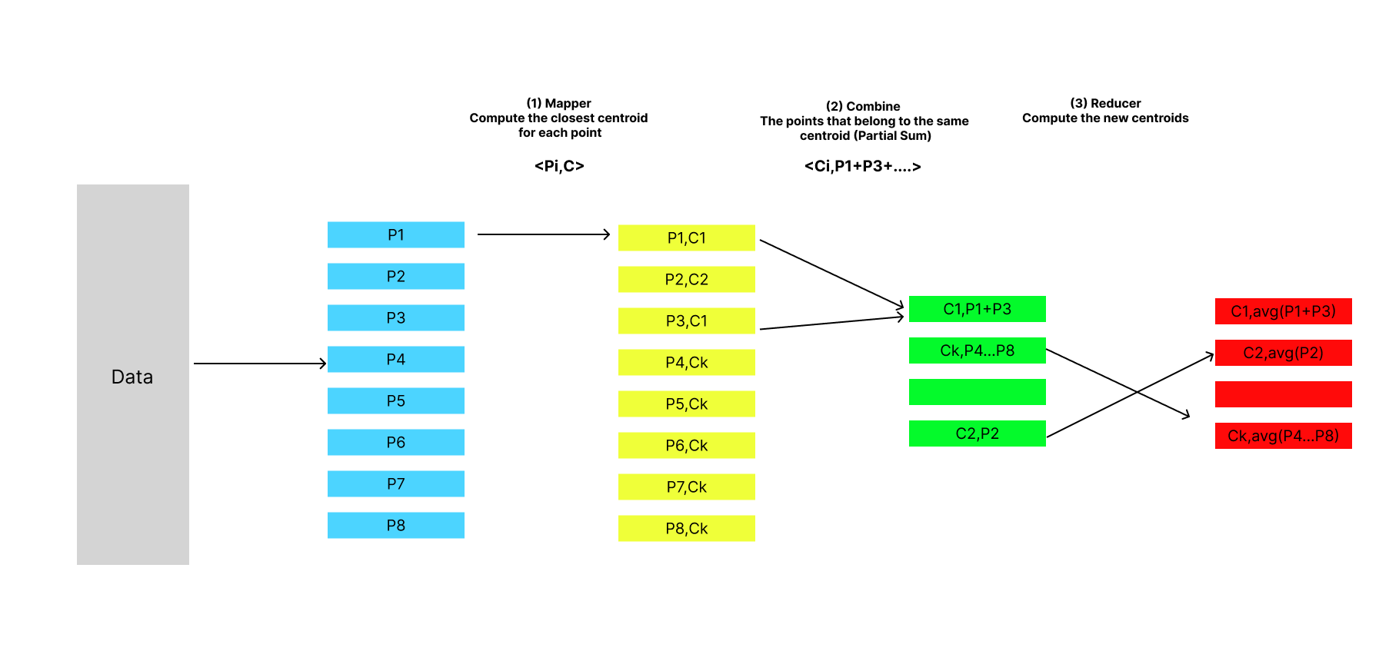
8. Kmeans Map-Reduce
POC | Sklearn | Pyspark Map-Reduce From Scratch
Silhouette Score | 0.252 | 0.25276
Training Time | 0.6300568580627441 | 124.21908068656921
Notes:
(Cases of all features used we got 0.09 🙂)

Slide 16

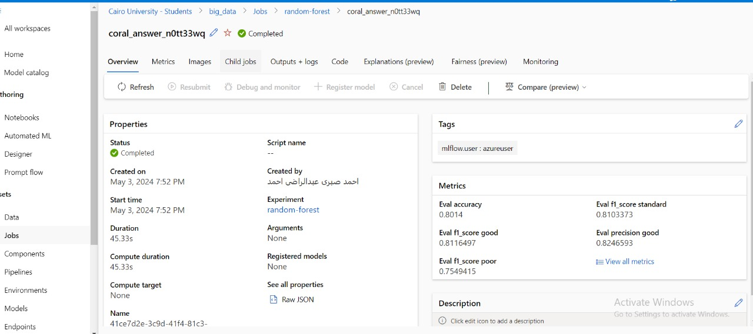
9. Random Forest on ML Studio
Notes:
(Cases of all features used we got 0.09 🙂)

Slide 17

10 .Unsuccessful Trials
Using All features (excluding identifiers like SSN, Name ,..) in the models training
Too long time to train
Curse of dimensionality (overfitting)
Clear in Clustering using all features vs using ones with most importance

Slide 18

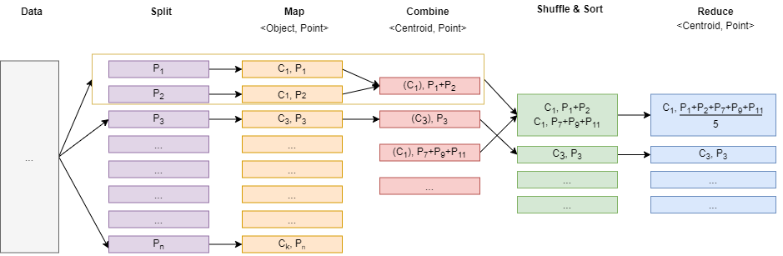
11. Future Work
Trying other Models (KNN, Decision Tree)
Apply Map Reduce on Multi Machine

Slide 19

Thank You
Any Questions ?

