Slide 1
Creidt Score Classification & Analysis
CMP4011 Big Data and Cloud Computing
Prepared By:
Ahmed Hosny
Ahmed Sabry
Basma Elhoseny
Zeinab Moawad
Under Supervision of:
Dr. Lydia Wahid
Eng. Omar Samir

Slide 3
1. Data Set
Main: https://www.kaggle.com/datasets/parisrohan/credit-score-classification
Main: https://www.kaggle.com/datasets/parisrohan/credit-score-classification
Main: https://www.kaggle.com/datasets/parisrohan/credit-score-classification

Slide 4
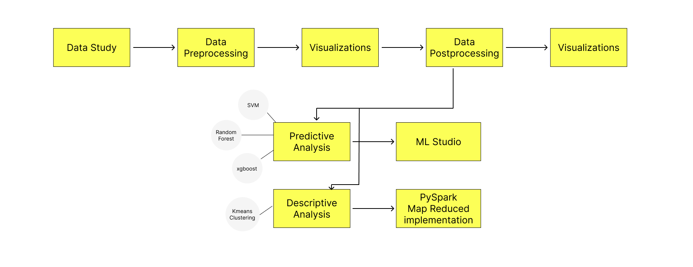
1. Project Pipeline

Slide 5
2. Data Processing
Preprocessing:
1. Drop unimportant features such as (Customer ID – SSN – Name ..)
2. Correct and Cleaning of some values like age containing 29_
3. Handling Missing Values based on series of 8 (Local [Per Customer])
4. Convert Categorial Data to One hot encoder or Label encoded [According to the model used]
5. Normalization (Kmeans) and Standardization (Predictive Models)
Postprocessing:
1. Further Cleaning for the data observed from visualizations 😉 (Global [Not per customer])
2. Remove Outliers using normal distribution of the feature [mean ± 3*std]
3. Split the type of loan column into 9(unique) columns

Slide 6
2. EDA (Data Visualization)

Slide 7
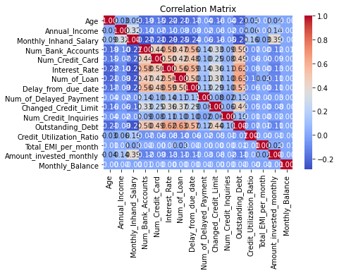
2. EDA (Data Visualization)

Slide 8
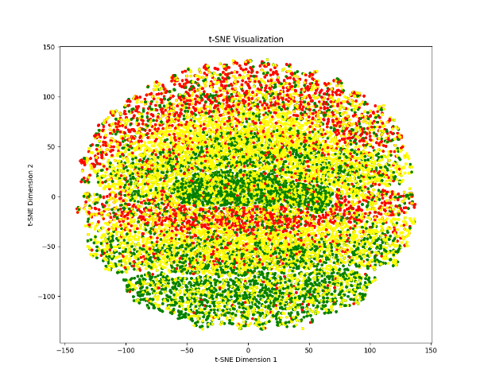
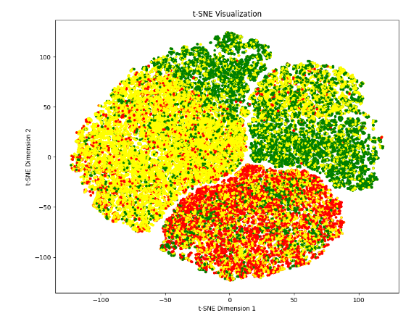

2. EDA (Data Visualization)
T-SNE on the 3 clusters of the data (good-standard-poor)
Dropping features of importance < 0.04
With Most of Features
Overlapping Clusters !!

Slide 9
2. Technical Insights

Slide 10
2. Business Insights

Slide 11
Predictive Analysis

Slide 12
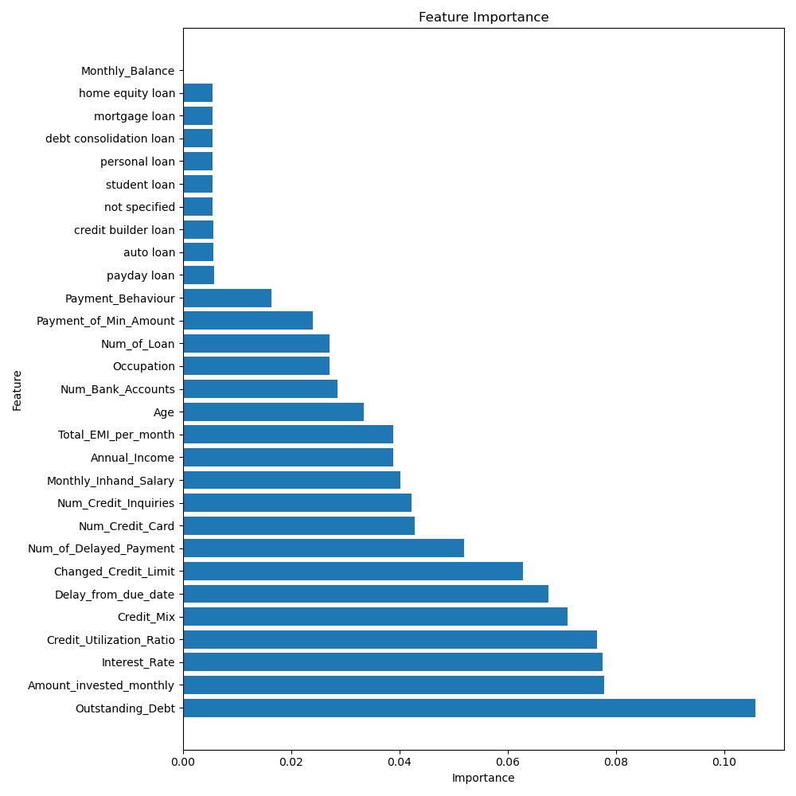
Predictive Analysis
Feature Importance Graph Obtained From Random Forest

Slide 13
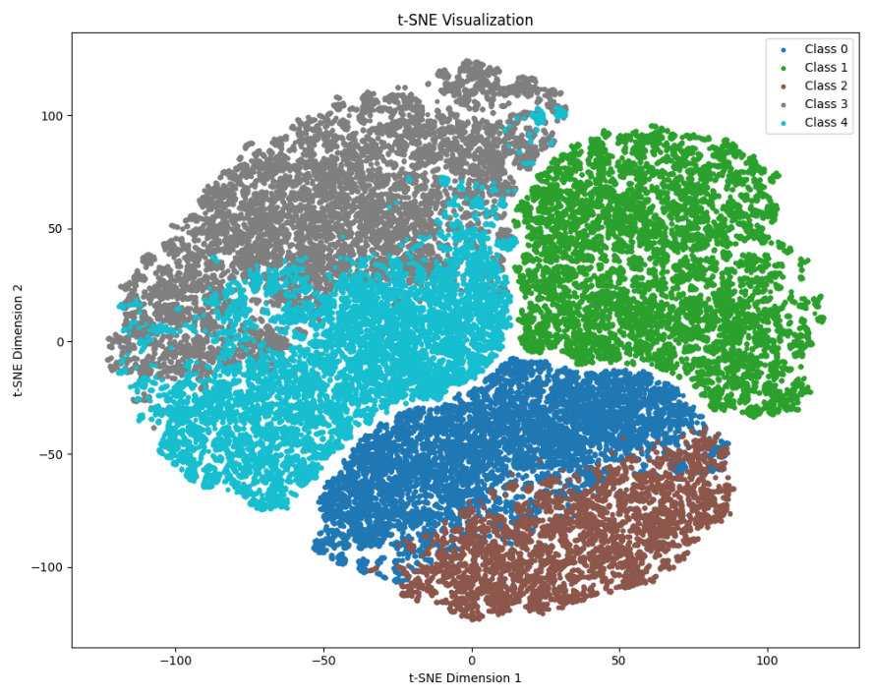
Descriptive Analysis (Kmeans)
T-SNE on the 5 clusters

Slide 14
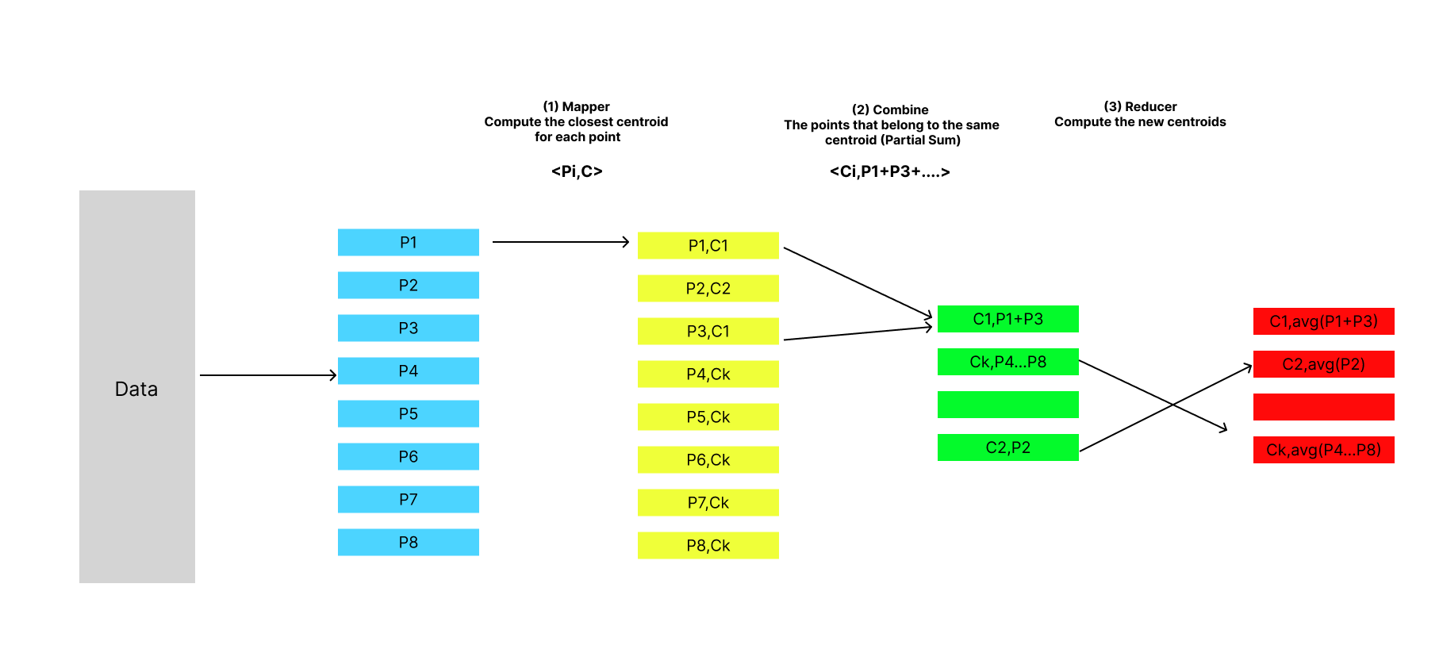
Kmeans Map-Reduce
POC | Sklearn | Pyspark Map-Reduce From Scratch
Silhouette Score | 0.252 | 0.25276
Training Time | 0.6300568580627441 | 124.21908068656921
Notes:
(Cases of all features used we got 0.09 🙂)

Slide 15
Random Forest on ML Studio
Notes:
(Cases of all features used we got 0.09 🙂)

Slide 20
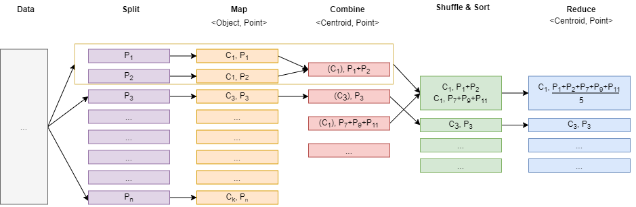

Slide 21

Thank You
Any Questions ?

