Slide 1

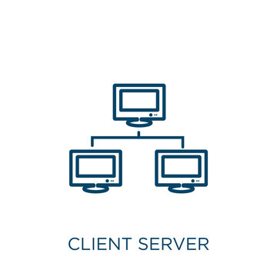
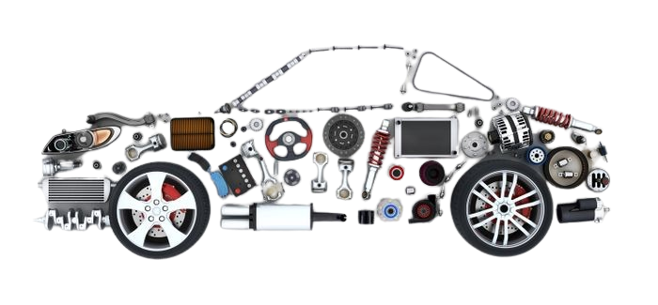
SPECjEnterprise
2010
Java Client/Server
Presented by: Basma Elhoseny
Supervised by: Dr. Samir Shaheen

Slide 2


Organization
Standard Performance Evaluation Corporation
Develops stanarized benchmarks to evaluate performance of computer systems
Allowing consistent and comparable performance measurmesnts across different systems
Notes:
SPEC is an organization that develops standardized benchmarks to evaluate the performance of computer systems.
This standardization allows for consistent and comparable performance measurements across different systems

Slide 3


Benchmark
SPECjEnterprise2010
Java Enterprise Edition (Java EE) benchmark
Java EE: Extension Java Standard Edition (SE) to include features such as distributed computing and enterprise-level components.
Meant to measure a Java EE based enterprise system
Notes:
SPECjEnterprise2010 is a Java Enterprise Edition (Java EE ) benchmark what is JEE?
Extension Java Standard Edition (SE) to include features such as distributed computing and enterprise-level components.
SPECjEnterprise2010 meant to measure a Java EE based enterprise system what is enterprise system?
A large-scale software application or suite of applications that supports the critical processes of an organization,
such as data storage, retrieval, and processing.
These systems are designed to handle complex business logic and are often distributed across multiple servers to meet the scalability and reliability requirements of large enterprise

Slide 4

Benchmark
Java EE based enterprise system
(Java EE) + enterprise system = a Java EE based enterprise system
Hardware System
Enterprise software stack based of Java EE 5
Database System
Virtual Machine
Operating System
Network
Notes:
A Java EE based enterprise system typically constitutes hardware systems, enterprise software stack based on the Java EE 5 specification, database systems, Java Virtual Machine, operating system and the network.

Slide 5


Benchmark
SPECjEnterprise2010
A full-system benchmark
Characterize performance for the complete application stack
Evaluates the entire system including all components and layers beyond the Java EE server
It is an end-to-end benchmark that evaluates the entire process or workflow of an application from the UI to the backend services
Notes:
SPECjEnterprise2010 is a full-system benchmark. It assesses(evaluates) the entire system including all components and layers beyond the Java EE server to characterize performance for the complete application stack

Slide 6
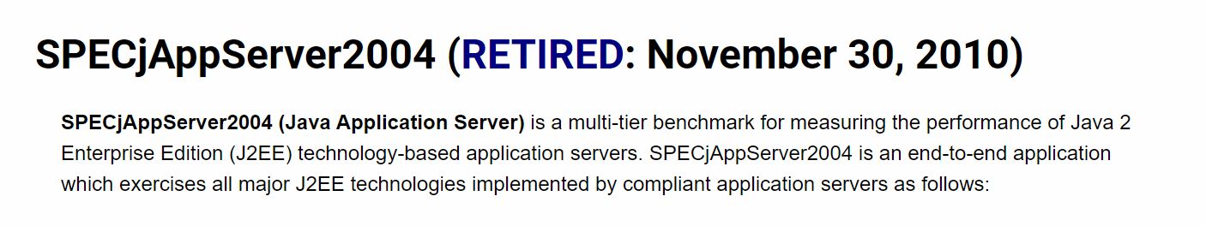
Other Benchmarks
SPECjAppServer2004 enjoyed a long life
Outpaced by new releases of the Java EE standards levels.
Compatible with Enterprise Edition (J2EE) 1.3
SPECjAppServer2010 ➔ Java EE 5.0
SPECjvm2008 is a client JVM benchmark.
SPECjbb2005 is a server JVM benchmark.
SPECjEnterprise2010 is a Java EE application server benchmark.
Notes:
Q2: You released SPECjEnterprise2010 predecessors five years ago. Why is SPEC releasing this new version?
A2: The previous benchmark SPECjAppServer2004 enjoyed a long life but has been outpaced by new releases of the Java EE standards levels. SPECjEnterprise2010 is an enhanced version of the benchmark that includes a modified workload and more Java EE 5.0 standard capabilities.
SPECjAppServer2004 is designed to be compatible with Java 2 Platform, Enterprise Edition (J2EE) 1.3. Java 2 Platform, Enterprise Edition 1.3 is an older version of the JEE specification
Q6: Does this benchmark make SPECjvm2008 or SPECjbb2005 obsolete?
A6: No. SPECjvm2008 is a client JVM benchmark. SPECjbb2005 is a server JVM benchmark. SPECjEnterprise2010 is a Java EE application server benchmark.

Slide 7
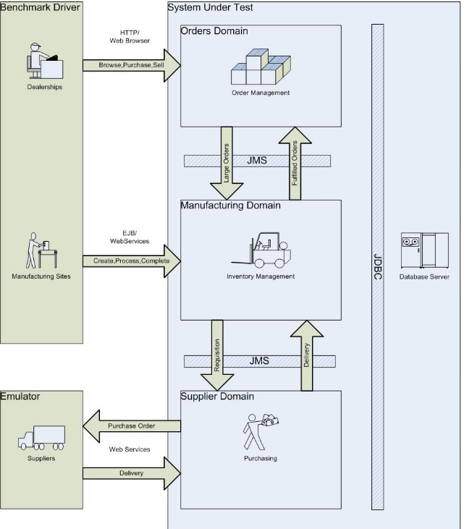
Application Under Test
The workload is modeled after an automobile manufacturer
Main customers are automobile dealers (a Web based UI)
Models :
Orders Domain Model
Manufacturing Domain Model
Supplier Domain Model
Data Base Model
SPECjEnterprise2010 EjOPS Enterprise jAppServer Operations Per Second
= Dealer Transactions/sec + Work orders/sec
Notes:
Model == Component in our system
Customer(orders) Domain ➔web-based UI so that customers can keep track of their accounts, manage their shopping cart and buy automobiles.
Orders above a certain size result in special large orders, So that they are requested directly from the manufacturer.
How to call the other Compoenet ??!
JMS ➔Java Message Service .It is a Java-based messaging API between distributed systems or components.
2. Manufacturing Domain ➔ It Models the production activity across different manufacturing plants in different locations
There are two types of production lines, the planned lines and Large-Order lines
3.Supplier Domain ➔ It Models the interactions with suppliers. It Decides which Supplier to be chosen based on the parts in the order, the lead time specified by the supplier and the price determined by the supplier
Metric???
Work order ➔ (Manufacturing)

Slide 8
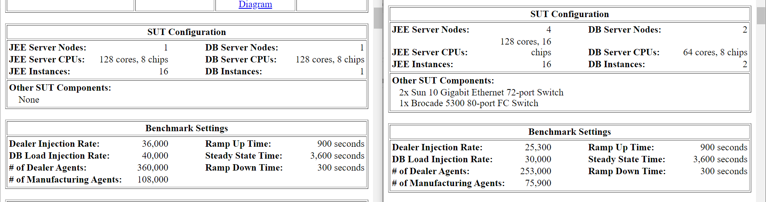
Systems
Oracle WebLogic Server Standard Edition Release 10.3.5 on SPARC T4-4
Vs
Oracle WebLogic Server Standard Edition Release 12.1.1 on Oracle SPARC T5-8
Oracle SPARC T4-4
Oracle SPARC T5-
Notes:
Oracle SPARC T5-8: It is a specific hardware system manufactured by Oracle. It includes processors, memory, storage, and other components integrated into a single server unit
Oracle SPARC T4-4: Another specific hardware system by Oracle belonging to the SPARC T4 series. It has a different architecture and capabilities compared to the SPARC T5-8
JEE Server Node: It is the logical instance of the Java EE application server. It's where the Java EE applications are deployed and run.
DB Server Node: : It is the logical instance of a database server. It's where the database management system (DBMS) runs and manages the data

Slide 9
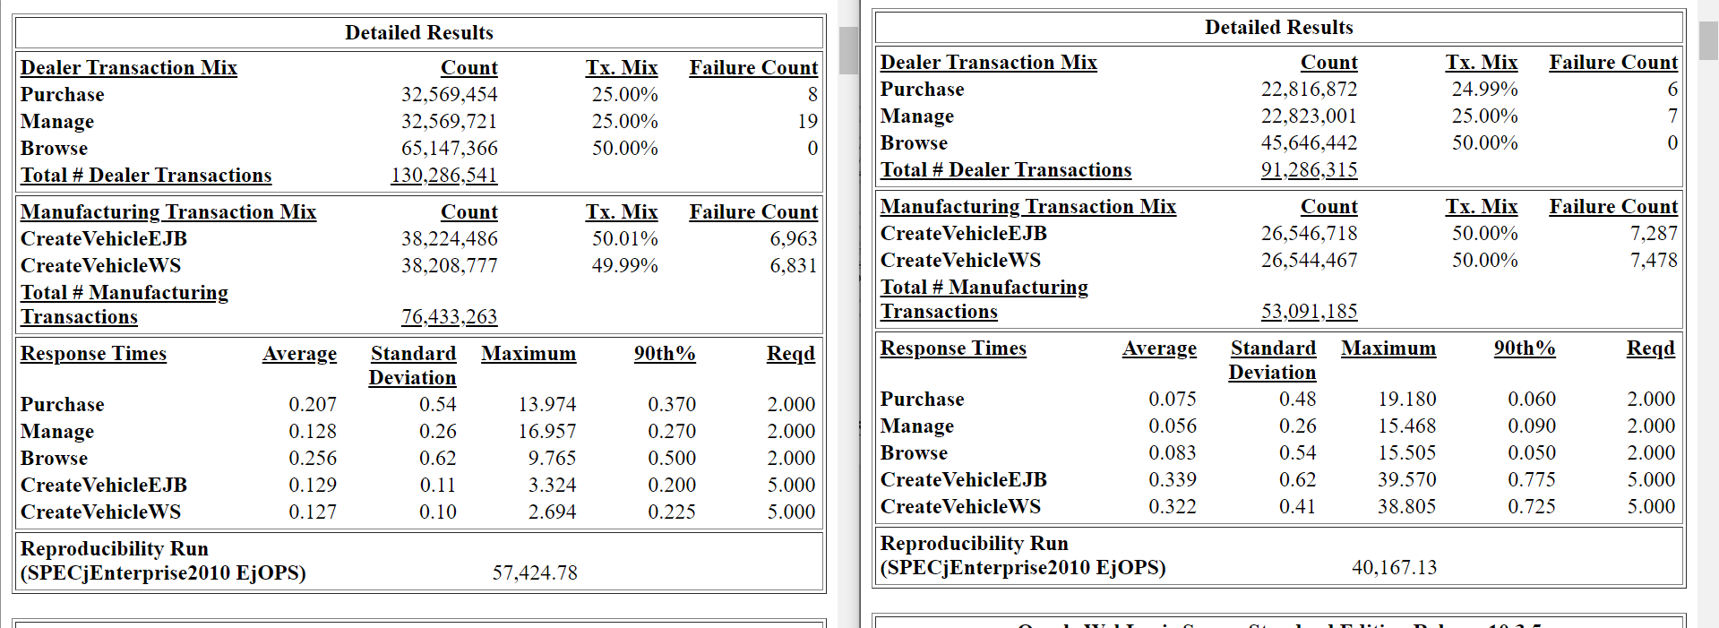
Results
Oracle SPARC T4-4
Oracle SPARC T5-8
NOT Correct to compare between them because different workload is applied
Response time ➔ time for an individual transaction (operation) to complete.
EjOPS ➔ measures the overall throughput of a system
The no of operations per sec
Higher EjOPS value indicates better overall throughput or the ability to handle a larger workload.
Notes:
Now we will compare but this isn’t right just we want to understand the difference
T4 lower average response → compared to the T5 why??
This depends on several factors
Hardware differences where SPARC T4-4 has a different processor architecture compared to SPARC T5-8 .
Although T4 has faster response time but T5 has better EjOPS

Slide 10

Thank You

