Slide 1



FRAUD
DETECTION
Microsoft Machine Learning Engineer
DEPI | 2024

Slide 2
TEAM MEMBERS
Basmala Ahmed
Mai Kamel
Tasneem Salama
Mai Mohammed
Mentored by: Eng Eslam Elreedy
Group Code: CAI1_AIS5_S8E
Traning Company: AST
DEPI | 2024
1

Slide 3
ABOUT TEAM
All team members contribute to all tasks.
1- Data Searching and Collection
2- Data Preparation, Cleaning, and Preprocessing
3- Statistical Analysis and Data Visualization
4- Model Architecture Design
5- Applying NLP Techniques to Text Datasets
6- GAN Implementation for Data Generation
7- Model Deployment and Monitoring
8- Testing Models in Real-World Applications
9- Report and Presentation
DEPI | 2024
1

Slide 4
ABSTRACT
Combines credit card transactions with email content for enhanced fraud detection.
Generates realistic synthetic data using Generative Adversarial Networks.
Second Problem
Uses various models to classify fraudulent activities.
Provides a real-time, user-friendly platform for quick fraud predictions.
DEPI | 2024
2

Slide 5
AGENDA
Problem
Data Visualization
About code
Dataset overview
NLP
Deployment
Data Cleaning
Model Selection
Conclusion
GANs
DEPI | 2024
3

Slide 6
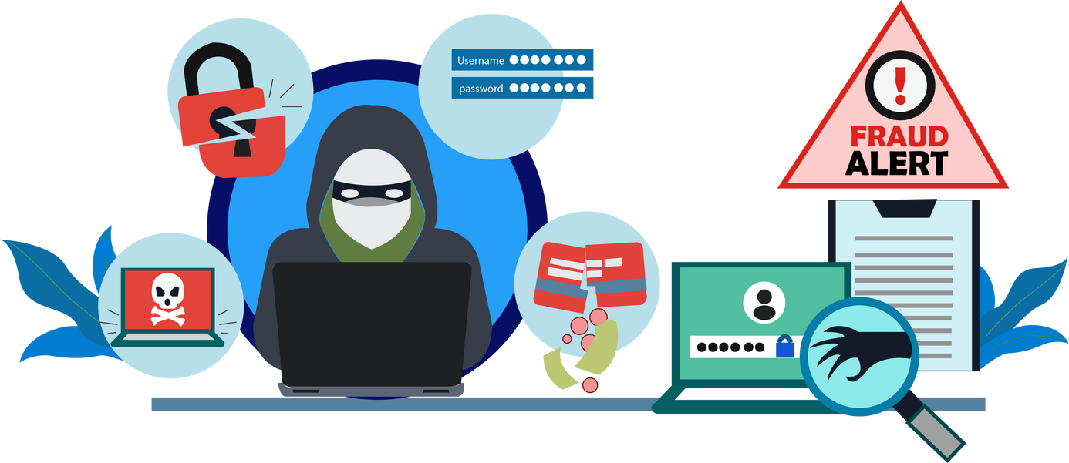
what is fraud detection?
Set of activities undertaken to prevent money or property from being obtained through false pretenses.
DEPI | 2024
4

Slide 7
PROBLEM
The rising complexity and frequency of fraudulent activities in financial transactions demand robust fraud detection mechanisms.
First Problem
Second Problem
Need for robust fraud detection mechanisms.
enhance accuracy and combat fraudulent activities in modern finance.
DEPI | 2024
5

Slide 8
DATASET EXPLAIN
This project involves working with two primary datasets
1
One containing detailed credit card information such as transaction timestamps, amounts, and merchant specifics
2
The other revolves around email content. Natural Language Processing (NLP) techniques are applied to extract meaningful features from the email dataset
DEPI | 2024
6

Slide 9

DATA CLEANING
Clean and preprocess credit card transaction and email
datasets separately.
Exploratory Data Analysis (EDA), Matplotlib and Seaborn guides model selection
Apply NLP techniques to extract features from email content.
DEPI | 2024
7

Slide 10

PREPROCESSING
1. Exploring the DataFrame
2. Checking for Duplicates and Missing Values
3. Examining Categorical Features
4. Preprocessing Numerical Data
5. Data Cleaning
6. Label Encoding
DEPI | 2024
8

Slide 11
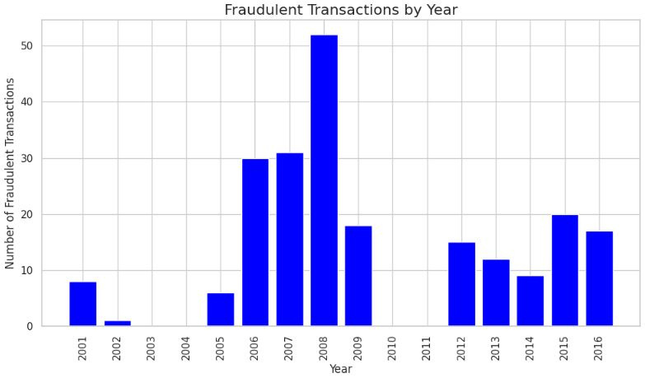
DATA VISUALIZATION
Understand Data Patterns and Relationships
Communicate Insights Effectively
Identify Fraudulent Activities
DEPI | 2024
9

Slide 12
NLP
1.Convert text to lowercase.
2.Remove digits and punctuation
3.Remove stopwords
(common words like "and", "the").
4.Tokenization
Breaking down the email into smaller chunks (tokens)..
5.TF-IDF Vectorization
Converting textual data into numerical form for the machine learning model to process.
DEPI | 2024
10

Slide 13




MODEL SELECTION
Logistic
regression
Decision
Tree
Random forest
XGBoost
79%
96%
98%
98%
DEPI | 2024
11

Slide 14
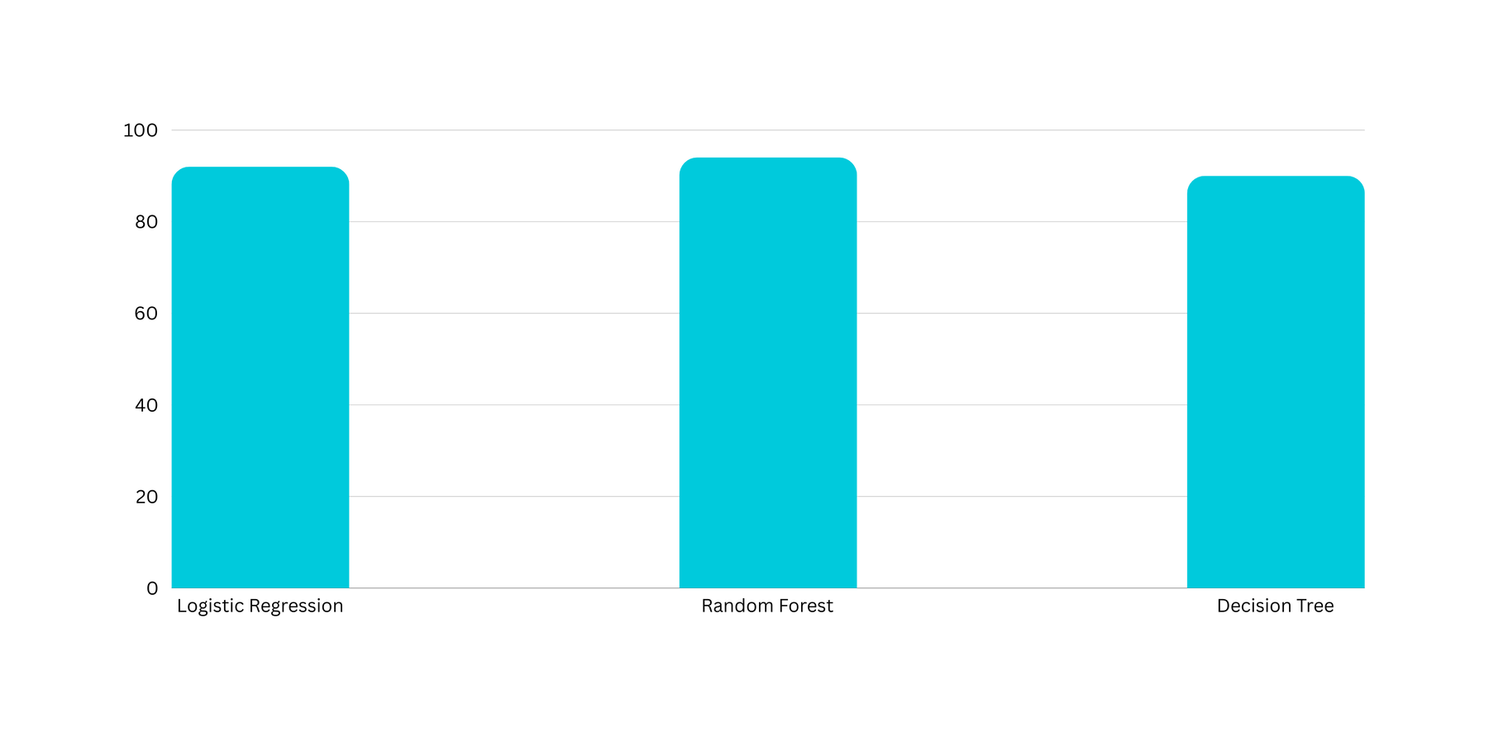
TEXT MODELS
DEPI | 2024
12

Slide 15
GANS
Generator
To validate and test our model effectively, we can implement Generative Adversarial Networks (GANs) to generate synthetic financial transaction data.
GANs consist of two neural networks: Generator and Discriminator.
Creates synthetic data that closely mimics real financial transactions, aiming to generate realistic fake data points.
Discriminator
Distinguishes between real and generated data, acting as a gatekeeper to identify whether data is genuine or synthetic.
DEPI | 2024
13

Slide 16
KEY STAGES IN TRAINING A TEXT GENERATION MODEL
Tokenize the input text, map words to indices, and apply padding for uniform sequence length.
Optimize model performance by tuning key hyperparameters such as learning rate and batch size.
Alternate training between the Generator and Discriminator to enhance text generation quality.
Generate text sequences and convert the resulting indices back into readable text.
DEPI | 2024
14

Slide 17
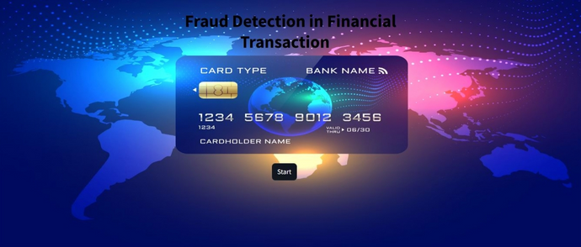
DEPLOYMENT
The fraud detection model was enhanced with credit card transaction data and email content analysis, seamlessly deployed for real-time predictions.
The user-friendly Streamlit interface ensured effective integration of advanced technologies, enhancing security measures. This streamlined process facilitated efficient fraud detection and demonstrated system scalability.
15
DEPI | 2024

Slide 18
ABOUT CODE
New data
GANs
This data about credit card information
This about GANs Algorithms and
synthetic data
Email Text
Deployment
This data about email text and apply on it NLP Algorithm
Building deployment using streamlit
16
DEPI | 2024

Slide 19
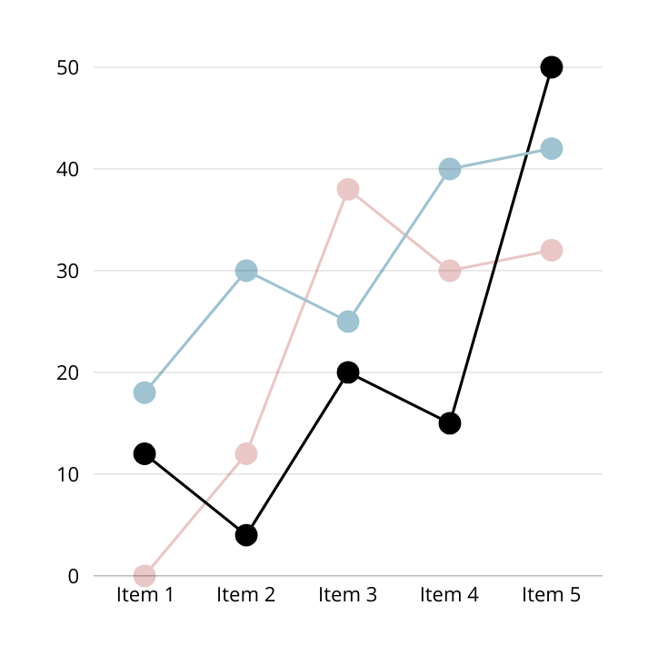
﻿RESULT
The results indicated improved fraud detection accuracy and efficiency through the integration of multiple datasets, NLP, GANs, and machine learning models. The deployed system using Streamlit facilitated user interaction and real-time predictions. achieved an outstanding accuracy rate of 98%
DEPI | 2024
17

Slide 20

CONCLUSION
In the project, the user's information, including credit card details and email content, was utilized to enhance fraud detection mechanisms.
The project showcased the efficacy of merging user data from credit card transactions and email interactions to strengthen fraud detection capabilities.
DEPI| 2024
18

Slide 21
THANK YOU
Any Questions?
DEPI| 2024

