Slide 1

UK TRAIN RIDES

Slide 2
TEAM PROJECT
1-Basmala Tharwat
2-Judy Ibrahim
3-Alaa Hosny

Slide 3
Project Objective
Our project aims to analyze train journey data across the UK to uncover key insights related to passenger behavior, ticketing trends, journey performance, and customer service issues such as delays and refund requests. The analysis aims to support data-driven improvements in rail service efficiency, pricing strategies, and overall customer satisfaction.

Slide 4
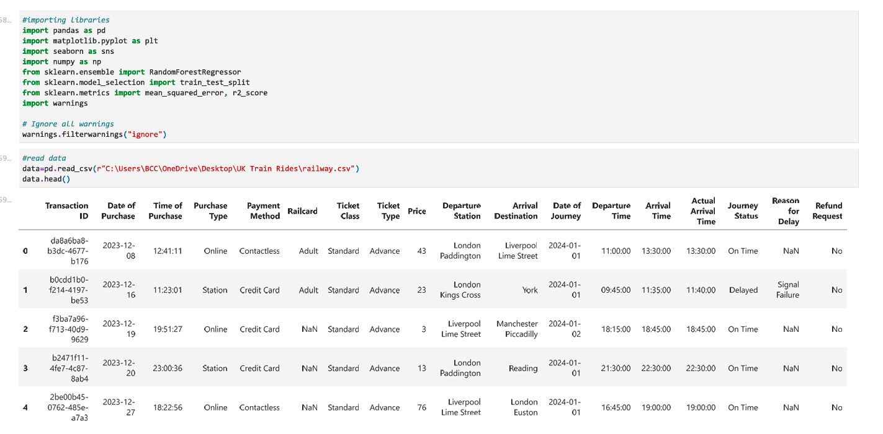
Dataset Features:
Transaction Details: ID, Purchase Date & Time, Payment Method, Purchase Type
Ticket Info: Class, Type, Price, Railcard.
Journey Data: Departure/Arrival Stations, Date of Journey, Departure /Arrival Time, Journey Status,
Customer Service: Delay Reasons, Refund Requests

Slide 5
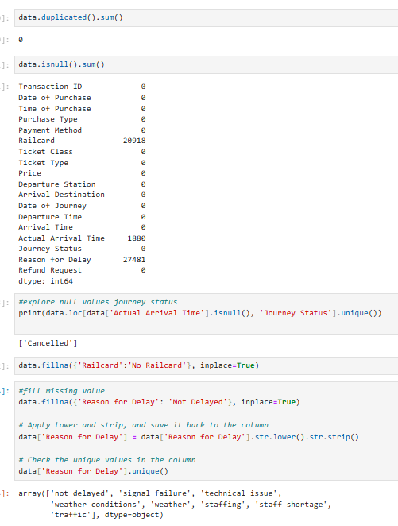
Data Preprocessing
Duplicate Records Check:
No duplicate records found
Missing Values Check:
Railcard :20,918 >Not having Railcard
Actual Arrival Time:1,880 >Trip is Cancelled
Reason for Delay:27,481> Not Delayed

Slide 6
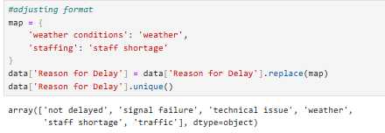
Data Preprocessing
Handling Missing Values:
Fill Railcard with No Railcard
Fill Reason for Delay with not delayed
Adjust Values of Reason for Delay for consistency.

Slide 7
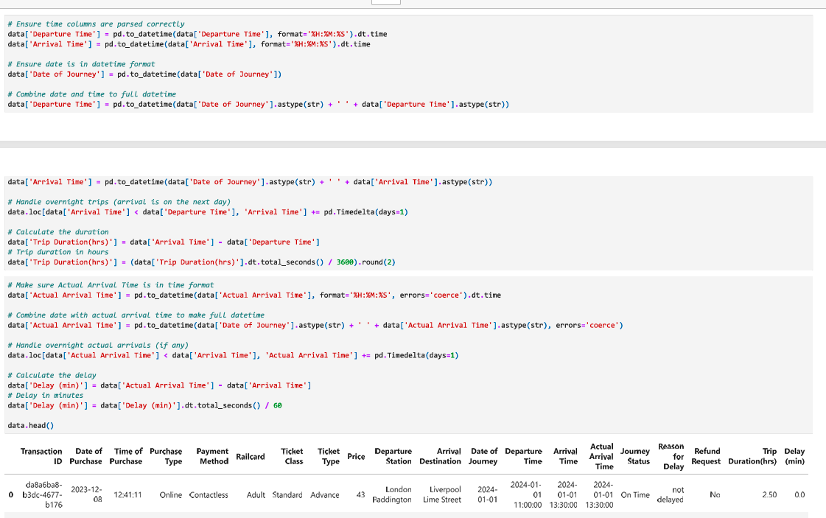
Time Parsing & Feature Engineering
Time Parsing:
Converted Departure Time ,Arrival Time and Actual Arrival time to time format.
Converted Date of Journey to datetime format.

Slide 8
Time Parsing & Feature Engineering
Feature Engineering:
Calculated Trip Duration (hrs) as difference between arrival time and departure time.
Calculated Delay (min) as difference between actual and scheduled arrival times
Filling Actual Arrival time missing with Cancelled
Filling Delay(min) with -1 indicating Cancelled trips

Slide 9
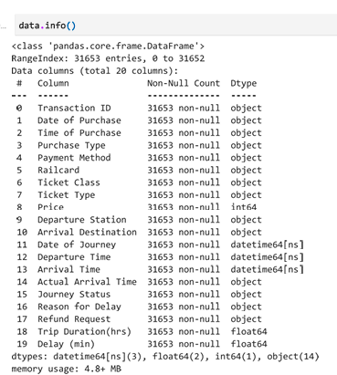
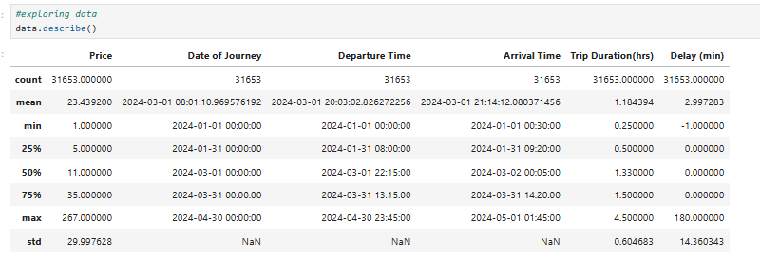
Statistical Information
Statistical Values
Data Types

Slide 10
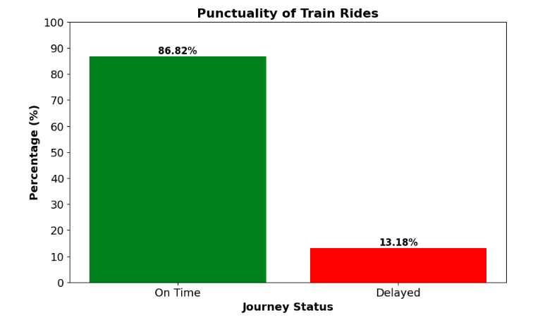
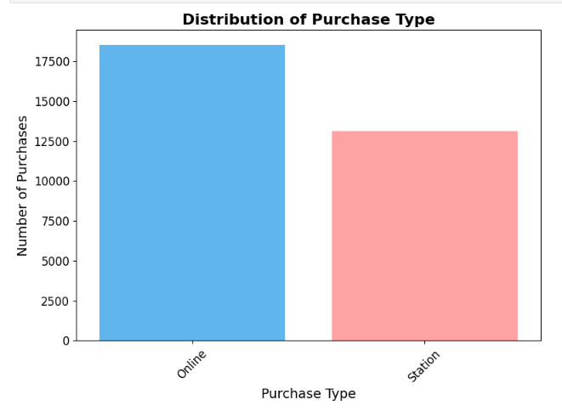
UK Train Analysis
UK Train Analysis
How punctual is the UK train?
Distribution of Purchase Type

Slide 11
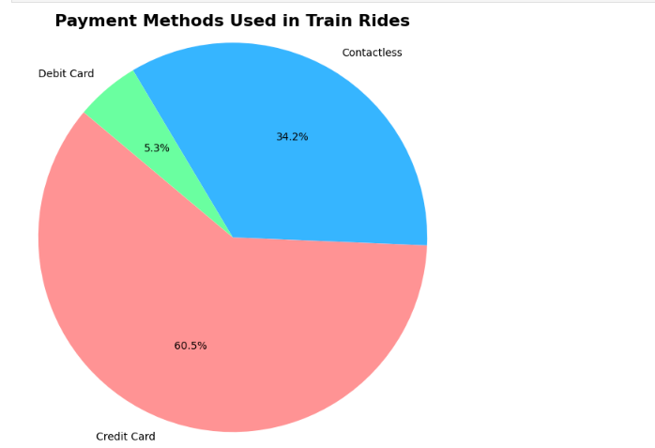
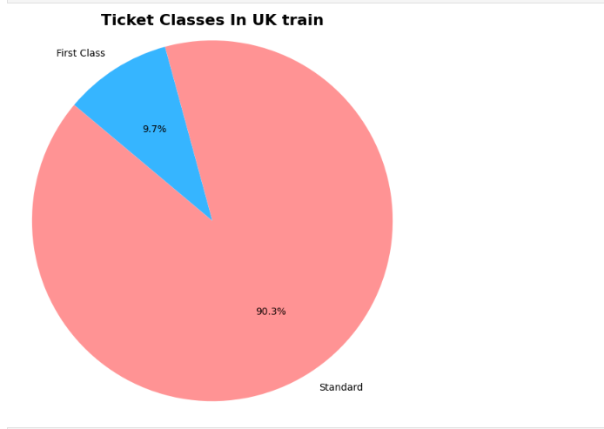
UK Train Analysis
UK Train Analysis
The different paying methods
The different classes in the train

Slide 12
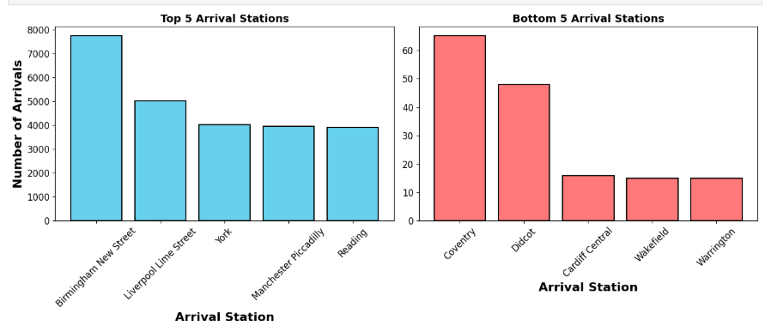
UK Train Analysis
The highest_traffic arrival destinations vs lowest_traffic

Slide 13
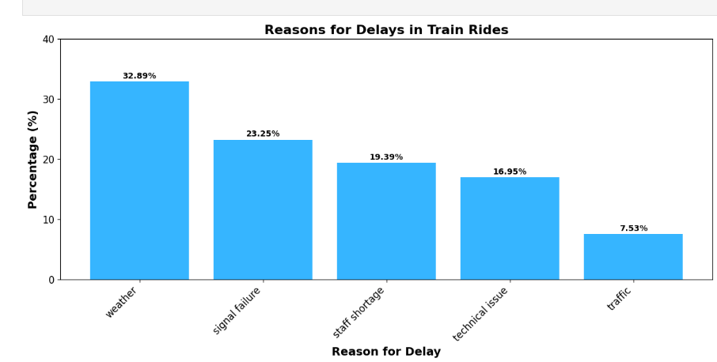
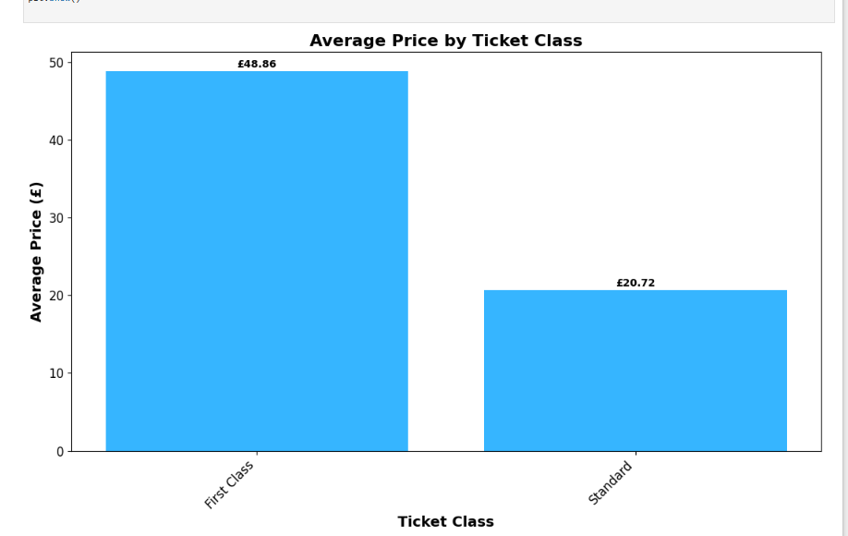
UK Train Analysis
Delay time by Reason for Delay
Average price in the First class vs standard

Slide 14
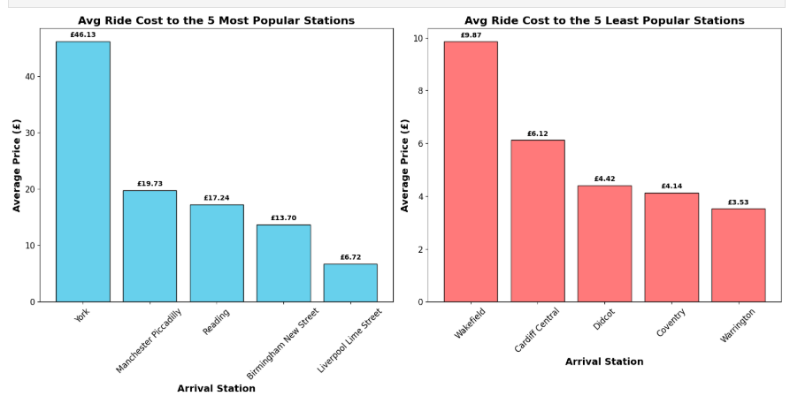
UK Train Analysis
Average price for the highest_traffic arrival destinations vs for the lowest_traffic

Slide 15
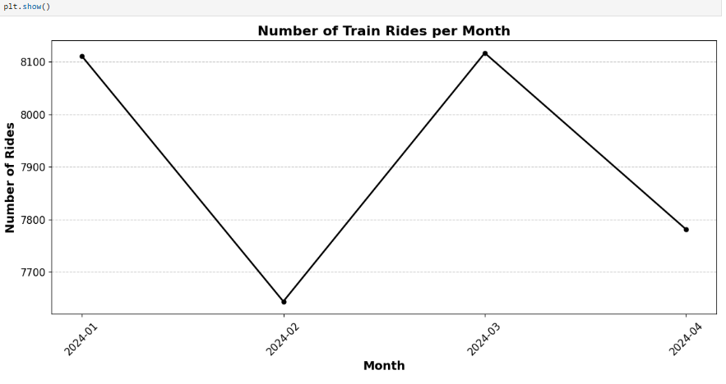
UK Train Analysis
Traffic trend over the months

Slide 16
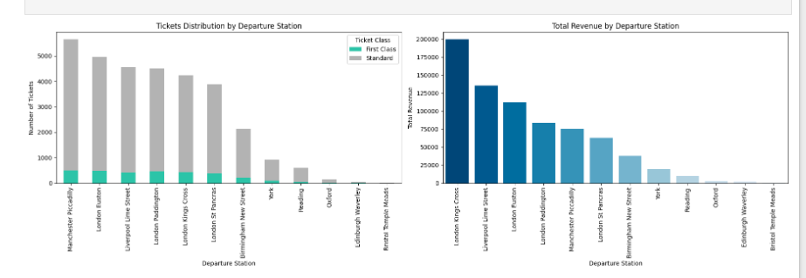
UK Train Analysis
How does ticket class vary across departure stations, and which stations contribute highest revenue?

Slide 17
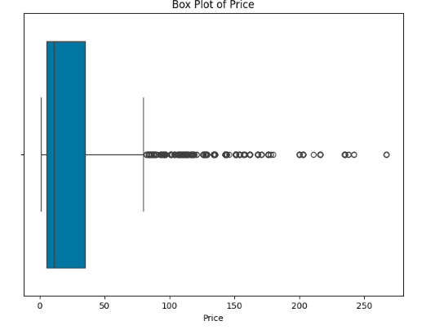
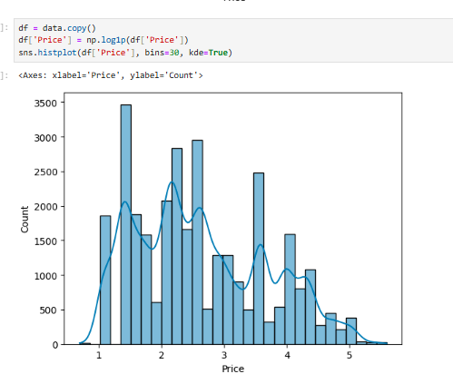
UK Train Analysis
Price Distribution
Log Transformation:
Applied to reduce effect of outlier on models

Slide 18
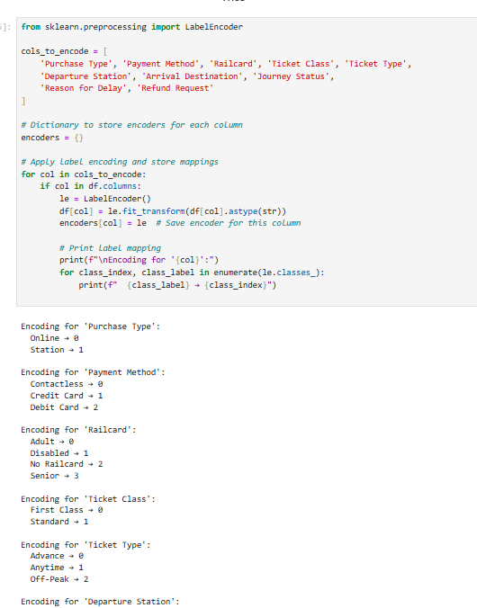
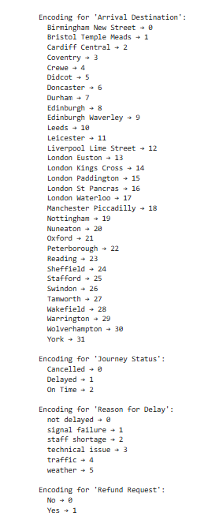
Feature Encoding
Label Encoding
Applied Label Encoding to convert categorical columns into numeric format
Columns encoded:
Purchase Type, Payment Method, Railcard, Ticket Class, Ticket Type, Departure station, Arrival destination, Journey Status, Reason for delay, Refund request

Slide 19
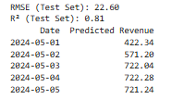
Forecasting
Revenue Forecasting with Random Forest
1.Model Preparation
Defined features X and target y as Revenue
Used train-test split (last 20% as test set)
Chose RandomForestRegressor with tuned hyperparameters:
2.Model Evaluation: RMSE,R2 Score
3.Future Forecasting (May–Oct 2024)
Generated synthetic features for future dates
Predicted revenue for each future day using trained model
Aggregated into monthly revenue forecasts

Slide 20
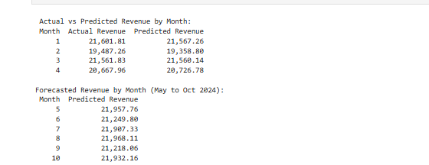
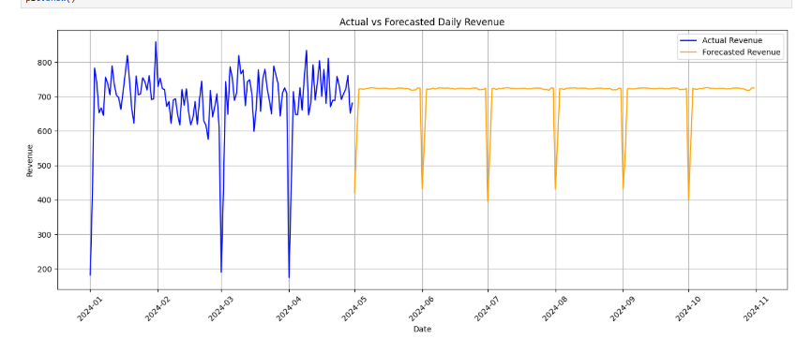
Revenue Forecasting Outcome
Actual vs Predicted Values
Actual vs Predicted Graph

Slide 21
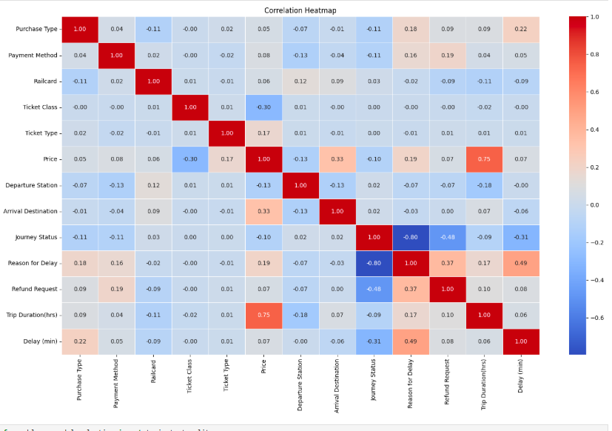
Correlation Matrix

Slide 22
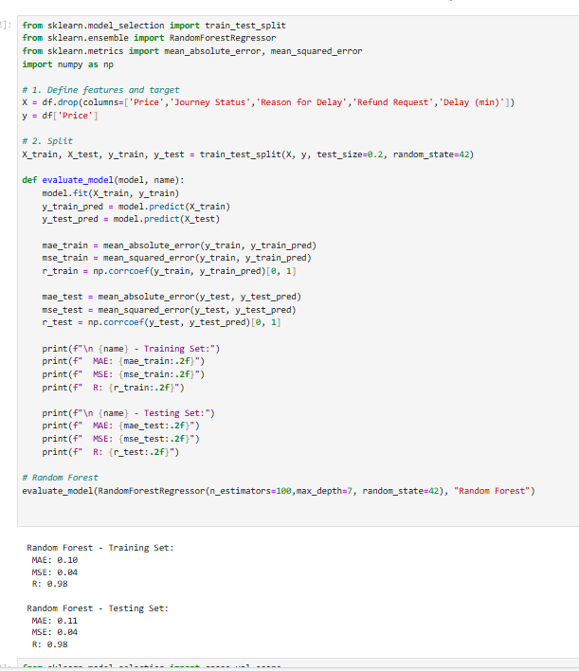
Prediction
Price Prediction with Random Forest
1.Features Used
Target Variable: Price
Excluded Columns: Journey Status, Reason for Delay, Refund Request, Delay(min)
Used train-test split (last 20% as test set)
Chose RandomForestRegressor with tuned hyperparameters:
2.Model Evaluation:
MSE,R2 Score for both training &test set

Slide 23
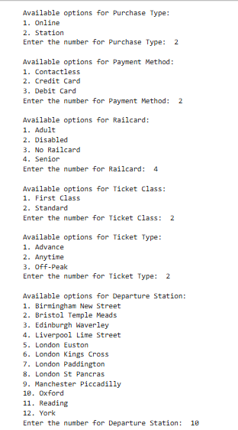
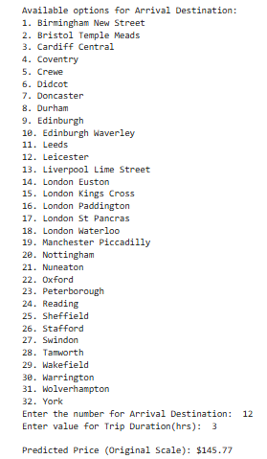
Price Prediction User Interaction

Slide 24
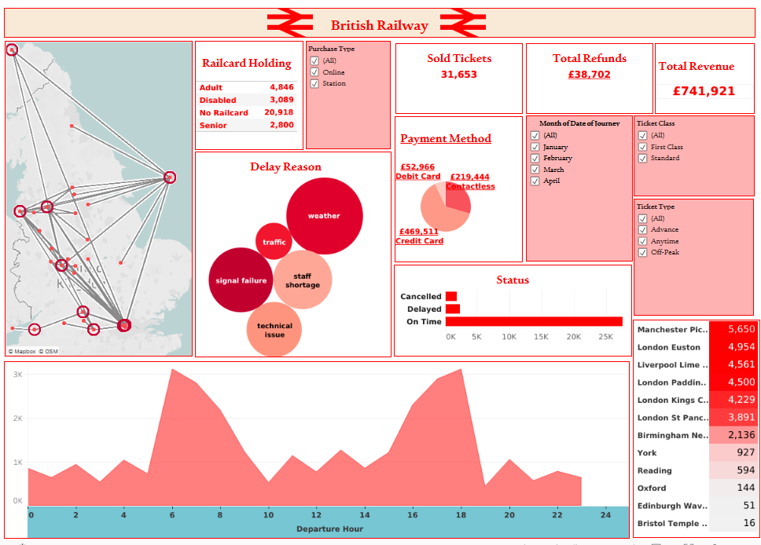
Tableau Dashboard

Slide 25

Key Insights
Price Correlates with Travel Factors
Future Revenue Forecasts Indicate Growth Opportunities
Leading Cause of Train Delays
Majority of delays in the dataset are linked to adverse weather conditions .
These delays often cause increasing refund requests and reducing customer satisfaction
Ticket price is influenced by ticket type, class, Arrival destination and trip duration
Projections (May–Oct 2024) show promising revenue trends if operational consistency is maintained.
Peak Departure Hours:
Punctuality of UK Train Rides
Payment Methods Used
Traffic tends to be most congested around 6:8 AM and then again from 5:7 PM onward.
The most common payment method is Credit Card, used by 60% of passengers.
Other Methods: Contactless by 34% ,Debit Crad by 5%
Around 87% of train rides arrive on time, while 13% experience delays.

Slide 26
Thank You

