Slide 1
AI-ML Basmalah Algahmi

Slide 2

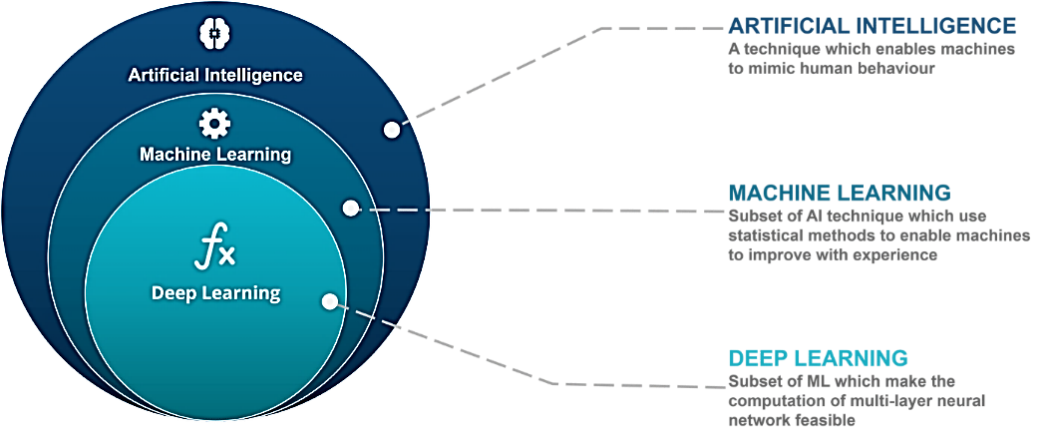
What is ML

Slide 3
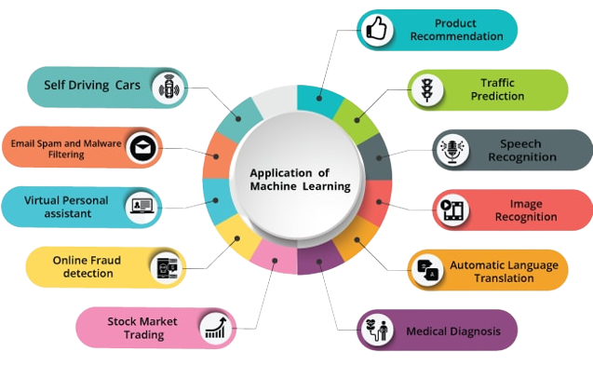
ML application in Real World

Slide 4
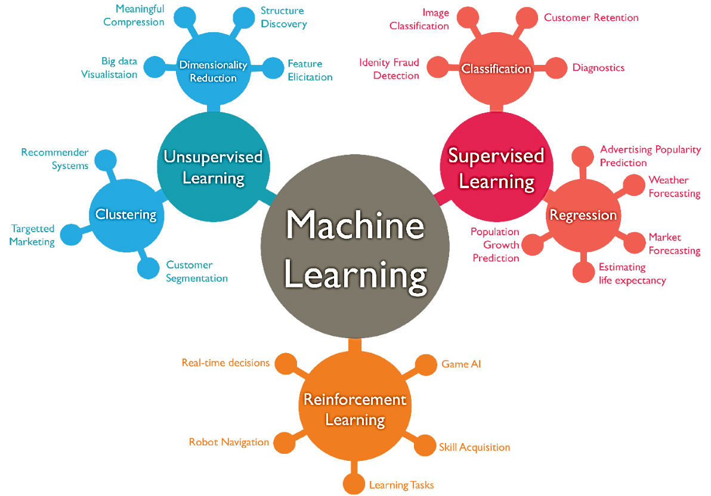
Types of ML

Slide 5
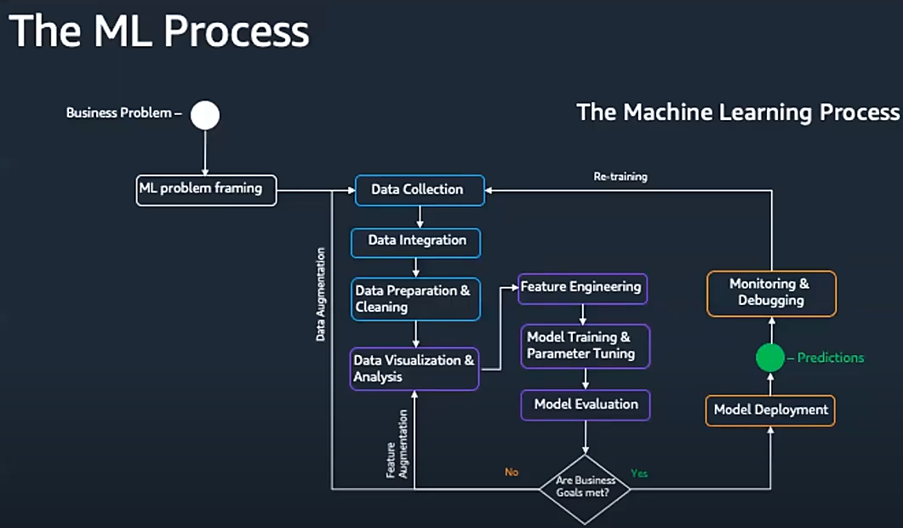
ML process

Slide 6
Slide Title
Product A
Product B
Feature 1
Feature 2
Feature 3
Feature 1
Feature 2
Feature 3

Slide 7
