Slide 1
Min/max
Kristoffer Snopestad Søderkvist
Kristoffer Eriksen Beck

Slide 2

Agenda
Problem statement
Sequential Programming
Parallel Programming
Performance Evaluations
Conclusions

Slide 3
Problem statement

Slide 4
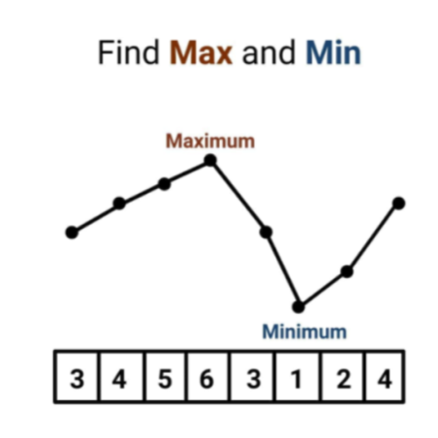
Min/Max
Our problem statement is "project 6". We had to make a program that finds the smallest and the highest value, in our case we decided to give the data through a txt file.

Slide 5
Sequential programming

Slide 6
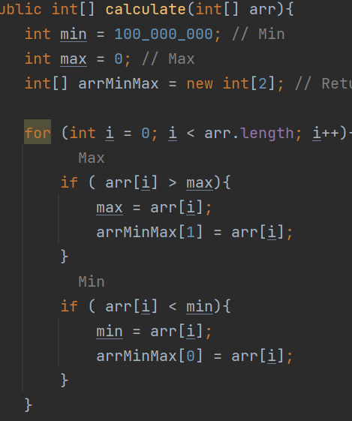
Our solution
Integer array
For loop

Slide 7
Parallel Programming

Slide 8
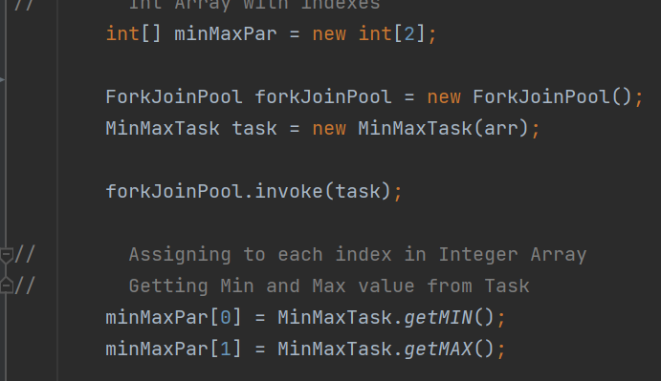
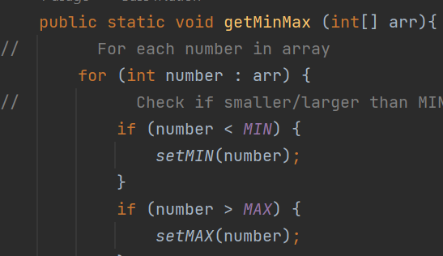
Introduction
Solution

Slide 9
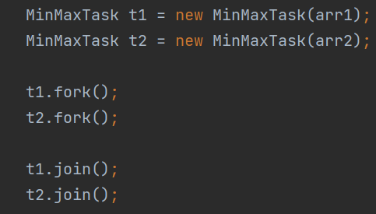
ForkJoin
Recursive Action
Fork()
Join()
Tried Recursive Task

Slide 10
Performance Evaluations
Speedup and Efficiency

Slide 11
Min/Max performance
Total values | Sequential ms | Parallel ms | Speedup | Efficiency %
1000 | 1 | 16 | 16 | 200
10 000 | 1 | 17 | 17 | 212.5
100 000 | 2 | 15 | 7.5 | 93.8
1 000 000 | 7 | 33 | 4.71 | 58.9
10 000 000 | 10 | 153 | 12.75 | 159.4
100 000 000 | 58 | 2082 | 35.9 | 448.7

Slide 12
Threshold

Slide 13
Conclusions

Slide 14
Conclusions
Efficiency
Serial is superior
Simplicity

Slide 15




Thank you
GitHub

